Slide 1
Title：The Finite-Volume Method for Elastic Waves
Zhang Shuoning
Date：2021.12.27

Slide 2
Theoretical basis for 1D and 2D elastic waves

Slide 3





Source-free version of the coupled first-order elastic wave equation can be written as follow:
In matrix-vector notation, we can get:
contains the parameters
for A is diagnalizable,A can be expressed with the definitions

Slide 4


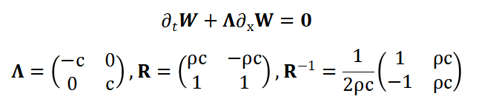



Applying the definitions to the equation we can get,
In specific case, A has real eigenvalues,
for eigenvectors we obtain,

Slide 5


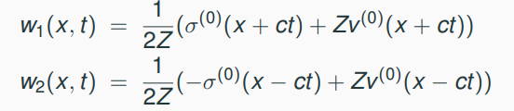
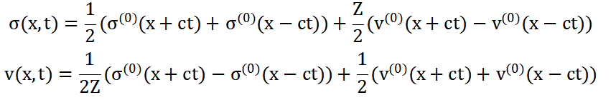

the wave equation in the rotated eigensystem can be stated as
the simple general solution:
in compact form this solution can be expressed as

Slide 6








Therefore, we can decompose the discontinuity jump into these eigenvectors,
decompose the solution into positive(right-propagating) and negative(left-propagating) eigenvalues
Then we can derive matrices A as follows,

Slide 7





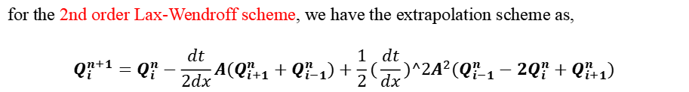
For an upwind finite-volume scheme,we have,
relate this formulation to the basic flux concept

Slide 8




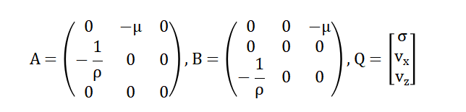
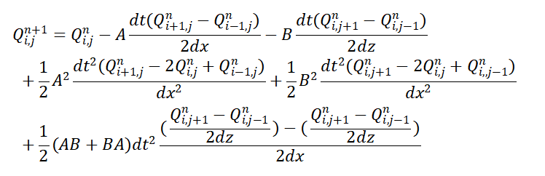
For 2D case, similarly, we have equations as follows,
in matrix form, we have,
where,
extrapolation scheme:

Slide 9
programming process and result analysis

Slide 10
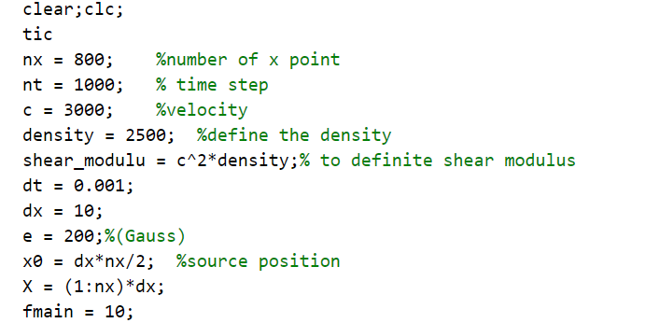
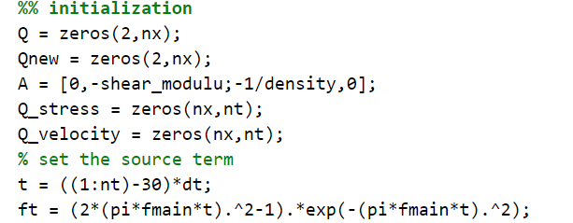
1D case(using Lax-Wendroff scheme)

Slide 11
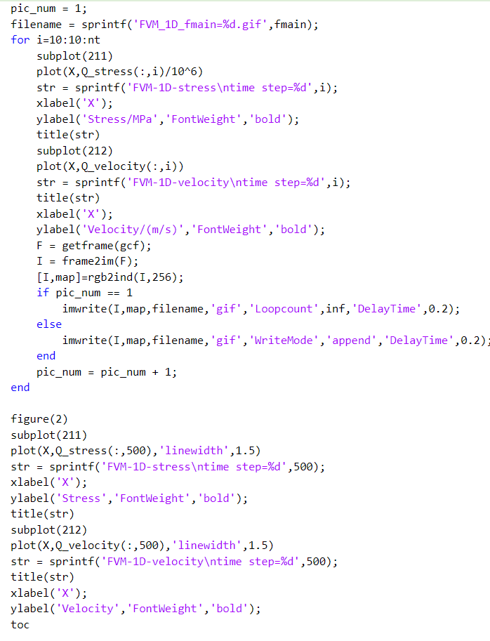
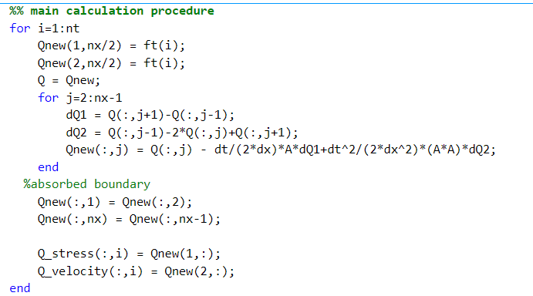
1D case(using Lax-Wendroff scheme)

Slide 12
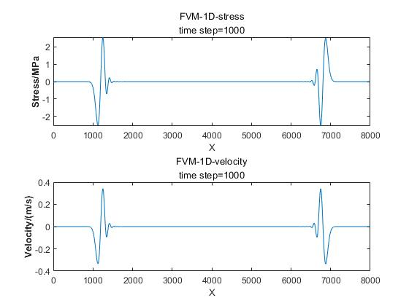
Lax-Wendroff scheme result(time step =1000):
Law-Wendroff scheme is a second-order scheme, better than up-wind scheme, and is more stable.

Slide 13
Lax-Wendroff scheme result in 2D:

Slide 14
Conclusions：
In FVM, though this method is less used in forward problems of elastic waves, there is still something to be learned.
Compared with the two different calculation schemes, Lax-Wendroff is better, for both complexibility and accuracy.
Have trouble in FVM in 2D elastic waves, not clear about its basic theory and specific cases.

Slide 15
Thanks!

