Slide 1
CANSSI NCSC Ferry Delays
Team: TH
Team Members: Xiaotong (Tania) Zhang and Shuoyang (Hedy) Shi

Slide 2
Introduction
This national case study competition is about creating a better customer experience for BC Ferries around Vancouver harbours with sailing analysis and delay prediction.
Our task is predicting whether or not each sailing described in the testing dataset was delayed.
In the methods section, we will perform the data cleaning step, and model selection using LASSO, XGBoost, Random Forest and other machine learning methods.
In the results section, we will describe the best model as well as choosing the best model for predicting.
In the conclusions section, we will conclude our whole project.
In the insights section, we will talk about our insights, interesting results, and our ideas for future.

Slide 3
Methods
Data The data of sailings, traffic, weather in Vancouver and weather in Victoria are gathered from https://www.kaggle.com/c/canssi-ncsc-ferry-delays/data.
The sailing dataset consists of 61,880 sailings (Aug 2016 to Mar 2018).
“train.csv” including 80% of the sailings (49,504 sailings, Aug 2016 to Nov 2017) with covariates such as “Day”, “Scheduled.Departure” and so on
“test.csv” including 20% of the sailings (12,376 sailings, Nov 2017 to Mar 2018) with covariates such as “Day”, “Scheduled.Departure” and so on
“traffic.csv” “Traffic.Ordinal” variable includes an integer with range 1 to 5 indicating the amount of traffic on the Lion's Gate Bridge
“vancouver.csv” describing weather in Vancouver with covariates such as “Temperature.in.Celsius”, “Dew.Point.Temperature.in.Celsius” and so on
“victoria.csv” describing weather in Victoria with covariates such as “Temperature.in.Celsius”, “Dew.Point.Temperature.in.Celsius” and so on

Slide 4
Methods
Data Cleaning The data need to be cleaned and reorganized first to produce a good result.
Find key variables and then convert characters to categorical data
Dealing with missing values
Search missing values “Trip.Duration” from BC Ferry official website
For each element in “train.csv” add columns like “last_time_traffic”, “next_time_traffic”, “van_temperature_last”, “van_temperature_next” and so on. So that, we can fill in the missing value with “last” or “next”
Use “na.approx” to estimate the missing value
Switch columns order of “test.csv” to get the same order of columns of “train.csv”

Slide 5
Methods
Model Selection We tried three different models which are LASSO, Random Forest and XGBoost.
Cross-validation: Divide the linked dataset into two groups (training set and test set). The training set would be used to build a model, and the test set would be made the delay prediction. Then, we can get the approximate accuracy without wasting our submission chances.

Slide 6
Methods
Model Selection
LASSO (least absolute shrinkage and selection operator) is a regression analysis method that performs both variable selection and regularization in order to enhance the prediction accuracy and interpretability of the statistical model it produces.
cv_lasso <- cv.glmnet(train_train_x,as.numeric(train_train_y), nfolds = 1000, standardize = FALSE, type.measure = "mse")
Random Forest consists of a large number of individual decision trees that operate as an ensemble. Each individual tree in the random forest spits out a class prediction and the class with the most votes becomes our model’s prediction.
rf<-randomForest(train_x_matrix,as.numeric(train_y))

Slide 7
Methods
Model Selection
XGBoost is an optimized distributed gradient boosting library designed to be highly efficient, flexible and portable.
It implements machine learning algorithms under the Gradient Boosting framework. XGBoost provides a parallel tree boosting (also known as GBDT, GBM) that solve many data science problems in a fast and accurate way.
A design goal was to make the best use of available resources to train the model. Some key algorithm implementation features include:
Sparse Aware implementation with automatic handling of missing data values.
Block Structure to support the parallelization of tree construction.
Continued Training so that you can further boost an already fitted model on new data.

Slide 8
Methods
XGBoost
xgb.fit <-
xgboost(data=as.matrix(train_train_x),
label = as.matrix(train_train_y),
eta = 0.08,
max_depth = 10,
nround = 100,
subsample = 0.8,
colsample_bytree = 0.5,
seed = 1,
eval_metric = "error",
objective = "binary:logistic",
nthread = 5,
lambda = 0.2,
verbose = 0)
Model Selection
We tried to change the values of “max_depth”, “nround”, “lambda” and get several different accuracy rates.
Because the variables in XGBoost must be numeric. We applied One Hot Encoding to convert categorical variables to numeric variables.
We should also avoid overfitting when using “max_depth”. If “max_depth” is too large, it would be more likely to be overfitted.

Slide 9
Methods
Model Selection
To begin with, we linked all the variables from external files to the “train.csv” as well as “test.csv” for further selection.
Furthermore, we added some extra variables which are created based on two standards. For example, we add the “last_time_traffic”, “next_time_traffic” into “train.csv”. “last_time_traffic” is the “Traffic.Ordinal” of the nearest time which is before the “Scheduled.Departure”. “next_time_traffic” is the “Traffic.Ordinal” of the nearest time which is after the “Scheduled.Departure”.
Hence, we did the variable selection and variable shrinkage.

Slide 10
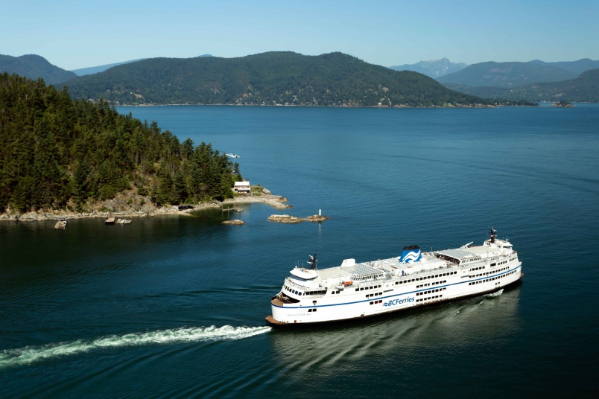
Methods
Model Selection
As mentioned before, we operated cross validation first within “train.csv” by dividing it into train set and test set. The best performed models were trained using different packages, producing high accuracy rates of predictions. The predictions of the results are all numeric.
By using “confusionMatrix”, we can get the Sensitivity, Specificity, Prevalence, Balanced Accuracy and so on.
We also tried to calculate the accuracy simply by averaging the predicted results which are equal to the actual result.
The model with highest accuracy rate will be selected for applying into “test.csv”.

Slide 11
Results
XGBoost and Random Forest produced similar accuracy rates, with Random Forest having a slightly higher accuracy.
Model Ensemble: It is a method uses multiple learning algorithms to obtain better predictive performance than could be obtained from any of the constituent learning algorithms alone. Hence, after applying different models we used some good results from them to build a new dataset. After doing cross validation, we trained model and chose the most precise result to get a new model. Then we applied the new model to “test.csv”.
Average the prediction results from several well-performed models to get a new prediction.
Perform Random Forest with several great prediction results to train new model for prediction.

Slide 12
Results
By using Model Ensemble, we got the highest Accuracy which is 0.72368 on public leaderboard.
However, our score of prediction on private leaderboard dropped to 0.70050.
- Overfitting!

Slide 13

Conclusion
In order to create a better customer experience for BC Ferries around Vancouver harbours, we did ailing analysis and delay prediction. First, we did data cleaning. Second, we did variable selection. Then, we applied three models to predict ferry delays. In addition, we found predictions by using Random Forest have more higher accuracy rates. At the end, we used Model Ensemble which has the highest accuracy 0.70050.

Slide 14
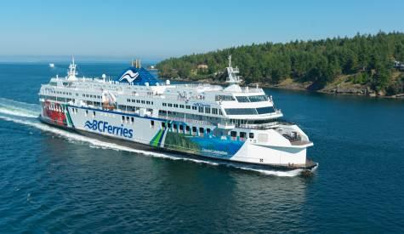
Insights
After deleting several variables about date such as (“Day”, “Month”, “Day.of.Month”, “Year”) in “train.csv”, the accuracy improved a lot.
Parallel Processing was used to speed up the code running time.
Because of the accuracy of predicting test set being about 0.70050, the model built by the Model Ensemble method for predicting does not show strong evidence to be accurate enough. We may access some new models which have higher accuracy rates in our future study.
Avoid overfitting.

