Slide 1


The 22nd Colloquium for Information Systems Security Education (CISSE 2018), June 11, 2018. New Orleans, LA
ReScuE: A Cloud-based System for Cybersecurity Education and Training
Liu Anyi, Dong Han, and Huirong Fu
Department of Computer Science & Engineering
Oakland University

Slide 2
Acknowledgement
This work is partially supported by the National Science Foundation under awards Grants No. DGE-1723707, DGE-1623713, CNS-1460897, and the Michigan Space Grant Consortium. Any opinions, findings, and conclusions or recommendations expressed in this material are those of the authors and do not necessarily reflect the views of the National Science Foundation and MSGC.

Slide 3
Outline
Problem Statement
System Design and Key Components
Hands-on Lab Design
Survey & Findings
Future work
Conclusion

Slide 4
The Problem Statement
With the proliferation of virtualization, Software-Defined Network (SDN) and Network Function Virtualization (NFV), educators start to emphasize on building the highly scalable, low cost, and easy to maintain computing environment for various educational purposes.
The environment for cybersecurity hands-on practice needs some unique features:
Isolation
Access control
Intrusion detection, and prevention
Forensics

Slide 5

Why ReScuE?
So many existing and sponsored projects:
SEED (http://www.cis.syr.edu/~wedu/seed/labs.html)
DeterLab (https://www.isi.deterlab.net/index.php)
Geni (http://www.geni.net/)
V-NetLab (http://www.seclab.cs.sunysb.edu/vnetlab/)
V-Lab (https://eits.uga.edu/support/vlab/)
EduRange (https://edurange.org)
OCCP (https://opencyberchallenge.net/)
ISERink (http://www.iserink.org/)
Platoon (https://www.mengjunxie.org/cyberdefense/)
……

Slide 6



Bridge the Gap
The cybersecurity education requires a smooth communication between the instructors and students.
However……

Slide 7

ReSecE: What Is It?
ReSecE is a cloud-based networked virtual environment dedicated for cybersecurity education.
It leverages the state-of-the-art technologies of SDN and NFV and elaborates the solutions to tackle the technical challenges of cybersecurity education.
It consists of the following components:
A CloudLab-enabled platform
A web-application front-end
A set of hands-on labs

Slide 8
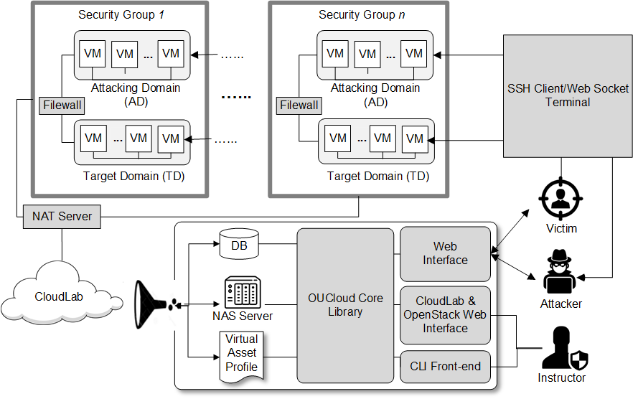
The Big Picture

Slide 9
Key Functionalities
We focus on building a library and an unified interface to make it easier to be used by the instructors and students.
Three categories of functionalities:
Infrastructure Management → Managing the virtual network
Virtual Environment Management → Building the virtual artifacts
User Management → Managing user/students
Language and dependency
Python
OpenStack Python API¹
1. Openstack Python API: https://docs.openstack.org/python-cinderclient/latest/

Slide 10

The Profile of a Virtual Environment
ReScuE wants to make the entire networked virtual environment easy to set up, easy to maintain, and highly scalable for pervasive adoption.
The instructor should only focus on the design a virtual environment without knowing the physical machine beneath it.
Unfortunately, cloud user always faces a situation that the time quota for the slices/projects expire and are needed to be renewed!
Forget to renew will cause the data loss!

Slide 11
A Sample Profile
We define the profile of a virtual environment as a collection of information (the virtual artifacts and their attributes) that is necessary to construct a virtual environment.
Virtual Artifacts | XML Elements | XML Attributes
Networks | <Networks> | <Network_ID>, <Network_Name>, <Network_Admin_State_UP>, <Subnet_ID>, <Subnet_Name>, <Subnet_CIDR>, <Subnet_IP_Version>, <Subnet_GateWay>
Network Interfaces | <Interfaces> | <Interface_ID>, <Network_ID>, <Interface_Admin_state_UP>, <Connected_Device_ID>, <InterfaceSubnet_ID>, <IP>
Routers | <Routers> | <Router_ID>, <Router_Admin_State>, <Zone>, <Interface_ID>, <Floating_IP>
Virtual Machines | <Images> | <Image_Name>, <Container_Format>, <Disk_Format>
 | <Flavors> | <Flavor_Name>, <VCPU>, <Disk>, <RAM>
 | <Instances> | <Instance_ID>, <Name>, <Status>, <Flavor>, <Image>, <Interface_ID>, <IP>

Slide 12

Break the Performance Bottleneck
CloudLab provides the powerful physical machines and is capable of balancing the workload. However, we experienced a significant delay when the virtual environment is large.
To improve the performance, we define two kinds of parallelisms:
intra-network and
inter-network

Slide 13
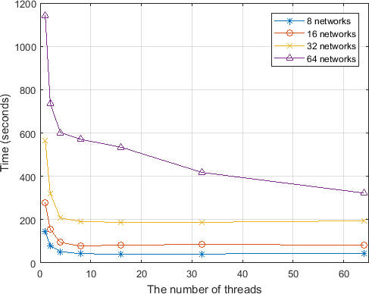
The Measurement of the Speed-up
By paralleling the virtual artifact construction, we can achieve nearly X3 speed-up.

Slide 14
Developed Hands-on Labs
We have developed the following hands-on labs.
Labs | Title
1 | Cloud-based malware construction and virtual machine introspection
2 | Fine-grained access control with Attribute-based Encryption (ABE)
3 | Processing encrypted data with Homomorphic Encryption (HE)
4 | The SQL injection attack for mobile devices

Slide 15
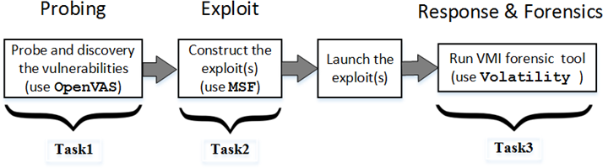
One Lab Example
In this lab, the student will learn how to use the off-the-shelf tool, including using the open-source tools to perform vulnerability discovery, exploit, and forensic investigation.
The tasks can be decoupled and work for different course modules.
The detailed learning objectives can be found in our paper.

Slide 16
After-lab Surveys
We have done pilot study with two groups of undergraduate groups (UGs) and collected their feedbacks through the surveys.
 | UG1 – Date: 07/13/2017 | UG2 – Date: 03/10/2018
Gender | Male: (9) Female: (1) | Male: (7) Female: (1)
Ethnicity | White: (8) African American: (1) Hispanic: (1) | White: (3) Asia: (5)

Slide 17
Survey Design and Questions (I)
We use the similar evaluation criteria used by the SEED lab²
The efficiency of the lab and
The effectiveness of the labs in cybersecurity education
The efficiency of the lab:
The clarification/usefulness of the lab instruction and the supporting materials
The usability of the virtual environment
The amount of time that students spent in the lab
Whether the time spent is worthwhile
The overall satisfaction of the lab
2. W. Du and R. Wang. (2008). SEED: A Suite of Instructional Laboratories for Computer Security Education. ACM Journal on Education Resources in Computing. Vol. 8, Issue 1, pp. 3:1 - 3:24.

Slide 18
Survey Design and Questions (II)
The effectiveness of the labs in cybersecurity education:
The level of challenge presented by the lab exercise
The familiarity of knowledge and skills before/after the lab
The level of students’ interests in the lab exercises
Open questions:
Which part of this lab could be improved?
Which part of the virtual environment could be improved?

Slide 19
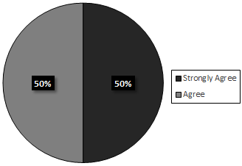
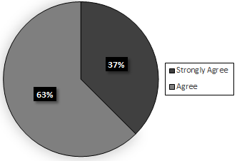
“The environment to access the VMs is easy to use.”
All students in both groups (UG1 and UG2) are either strongly agree or agree that the ReScuE is easy to use.
(A) The result of UG1. | (B) The result of UG2.

Slide 20
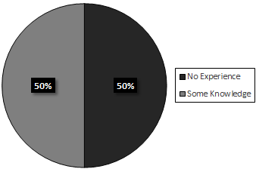
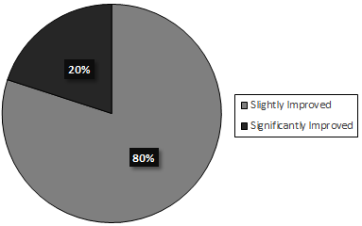
“The level of familiarity in the cybersecurity -related knowledge before/after the lab.” (UG1)
All the students in the UG1 responded that their level of familiarity increases slightly or significantly after taking the hands-on lab.
(A) The level of familiarity before the lab. | (B) The level of familiarity after the lab.
** https://brilliant.org/wiki/cuckoo-filter/

Slide 21
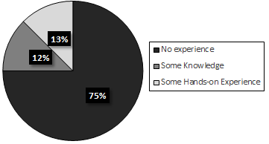
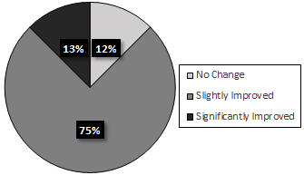
“The level of familiarity in the cybersecurity -related knowledge before/after the lab.” (UG2)
88% of the students in the UG2 answer that their level of familiarity increases slightly or significantly after taking the hands-on lab.
(A) The level of familiarity before the lab. | (B) The level of familiarity after the lab.
** https://brilliant.org/wiki/cuckoo-filter/

Slide 22
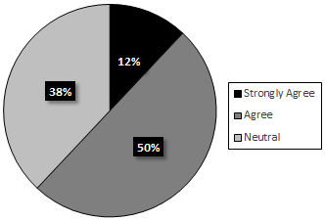
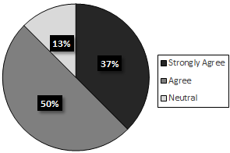
“I became more interested in cybersecurity after taking this lab.”
62% of the students in UG1 and 87% of the students in UG2 agree that the hands-on lab makes them become more interested in cybersecurity after taking this lab.
(A) The result of UG1. | (B) The result of UG2.

Slide 23
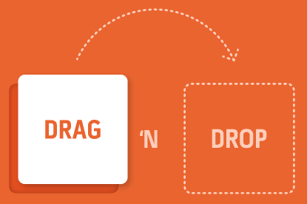
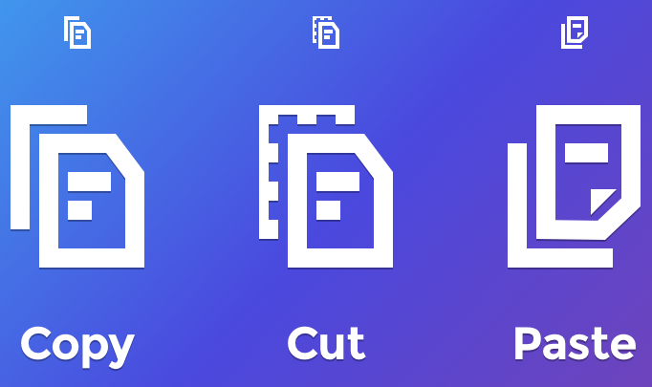
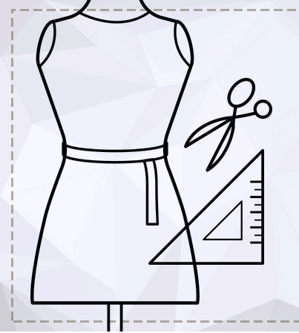

The On-going Work
A web interface makes life easier for instructor to build the cyber-specific lab environment.
An online repository for the templates.
Interoperability with the federated infrastructures.

Slide 24

@YouTube: Create Virtual Environment in ReScuE
Notes:
https://youtu.be/eFMSg3_CItU

Slide 25
@YouTube: Use ReScuE Web Application
Notes:
https://youtu.be/TZ_02uBtzYk

Slide 26

@YouTube: Backup a Profile in ReScuE
Notes:
https://youtu.be/pNcppD9o_zQ

Slide 27
Conclusion
ReScuE is a cloud-based networked virtual environment dedicated to cybersecurity education.
ReScuE leverages a free cloud infrastructure and solves some technical challenges in the infrastructure.
A collection of cybersecurity-related hands-on labs has been developed.
We have tested the ReScuE and the hands-on labs with our students. The assessment results show that ReScuE improves the students’ proficiency in the knowledge and skills, as well as increases their interests in cybersecurity.

Slide 28

Q/A
Any question and comments?

