Slide 1
Unit 3: Receive Filtering
EL-GY 6013: Digital communications
Prof. Sundeep rangan

Slide 2
This Unit
Channel coding
Symbol mapping
TX filter DAC
Upconversion
Info bits
Coded bits
IQ symbols
Analog baseband
RF
Passband
Channel
Sync
Channel decoding
Symbol demod
Equalization
RX filter and ADC
Down-conversion

Slide 3
Learning Objectives
Describe the steps in recovering symbols for a linearly modulated signal
Determine the matched filter response
Determine MF for known gain and delay in the channel
Compute the effective discrete-time channel given
Channel response, TX an RX filter
Time-domain or frequency-domain method
Determine if there is ISI
Compute the frequency response using digital RX filtering and downsampling
Determine specifications on the digital and analog filters

Slide 4
Outline
Receiver filtering and sampling
Perfect reconstruction with orthonormal modulation
General channels: Time-domain analysis
General channels: Frequency-domain analysis
PSD Analysis
Practical RX filter design
Channel sounding

Slide 5



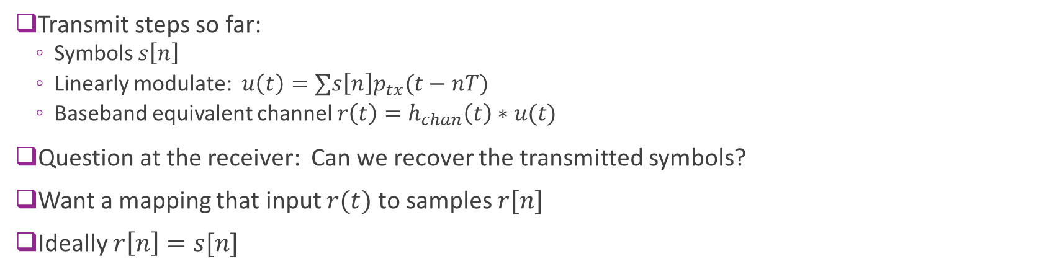



Receiver Problem
$$u_{δ}(t)$$
$$u(t)$$
$$r(t)$$
$$s[n]$$
$$r\left[n\right]=s[n]$$
TX symbols
Ideal D/A
TX filter
Channel
Receiver
Transmit steps so far:
Symbols $s\left[n\right]$
Linearly modulate: $u\left(t\right)=∑s\left[n\right]p_{tx}(t−nT)$
Baseband equivalent channel $r\left(t\right)=h_{chan}\left(t\right)∗u(t)$
Question at the receiver: Can we recover the transmitted symbols?
Want a mapping that input $r(t)$ to samples $r[n]$
Ideally $r\left[n\right]=s[n]$

Slide 6


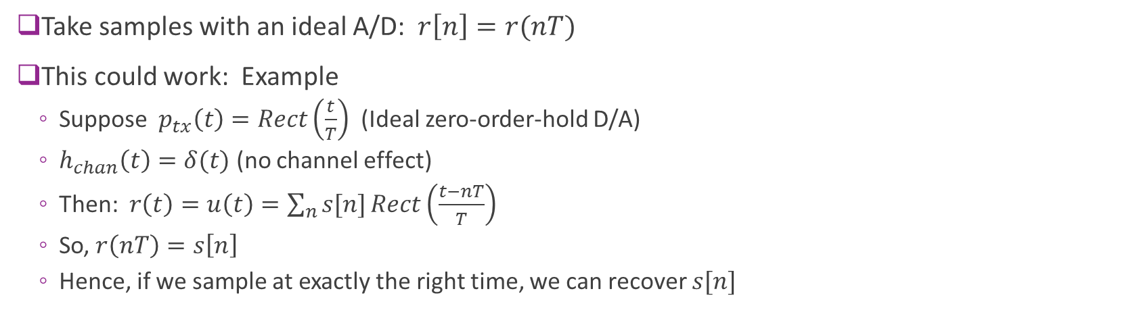



Simple Idea: Sampling
$$u_{δ}(t)$$
$$u(t)$$
$$r(t)$$
$$s[n]$$
$$r\left[n\right]=s[n]$$
TX symbols
Ideal D/A
TX filter
Channel
Ideal A/D
Take samples with an ideal A/D: $r\left[n\right]=r(nT)$
This could work: Example
Suppose $p_{tx}\left(t\right)=Rect\left(\frac{t}{T}\right)$ (Ideal zero-order-hold D/A)
$h_{chan}\left(t\right)=δ(t)$ (no channel effect)
Then: $r\left(t\right)=u\left(t\right)=\sum_{n}{s[n]}Rect\left(\frac{t−nT}{T}\right)$
So, $r\left(nT\right)=s\left[n\right]$
Hence, if we sample at exactly the right time, we can recover $s[n]$

Slide 7


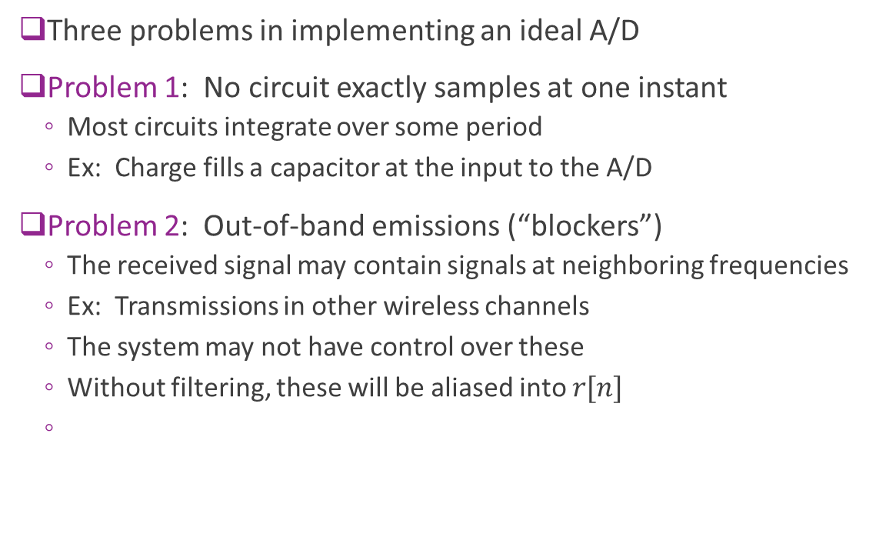



Problems with Ideal Sampling
Three problems in implementing an ideal A/D
Problem 1: No circuit exactly samples at one instant
Most circuits integrate over some period
Ex: Charge fills a capacitor at the input to the A/D
Problem 2: Out-of-band emissions (“blockers”)
The received signal may contain signals at neighboring frequencies
Ex: Transmissions in other wireless channels
The system may not have control over these
Without filtering, these will be aliased into $r[n]$
$$r(t)$$
$$r\left[n\right]$$
Ideal A/D
Desired
PSD of $r(t)$
Interferer
Frequency
$$−\frac{f_{s}}{2}$$
0
$$\frac{f_{s}}{2}$$

Slide 8
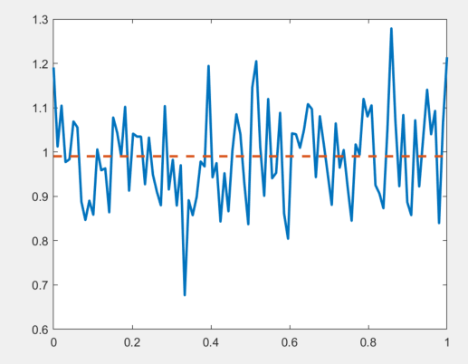
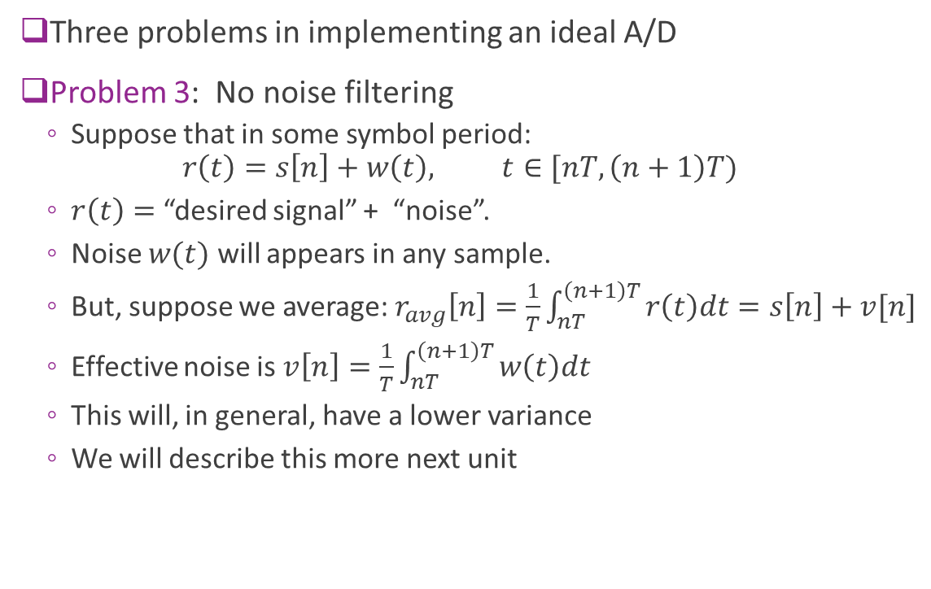
Problems with Ideal Sampling
Three problems in implementing an ideal A/D
Problem 3: No noise filtering
Suppose that in some symbol period: $r\left(t\right)=s\left[n\right]+w\left(t\right), t∈[nT,\left(n+1\right)T)$
$r\left(t\right)=$ “desired signal” + “noise”.
Noise $w(t)$ will appears in any sample.
But, suppose we average: $r_{avg}\left[n\right]=\frac{1}{T}\int_{nT}^{\left(n+1\right)T}{r\left(t\right)dt}=s\left[n\right]+v[n]$
Effective noise is $v\left[n\right]=\frac{1}{T}\int_{nT}^{\left(n+1\right)T}{w\left(t\right)dt}$
This will, in general, have a lower variance
We will describe this more next unit
$$r(t)$$
$$r\left[n\right]$$
Ideal A/D

Slide 9
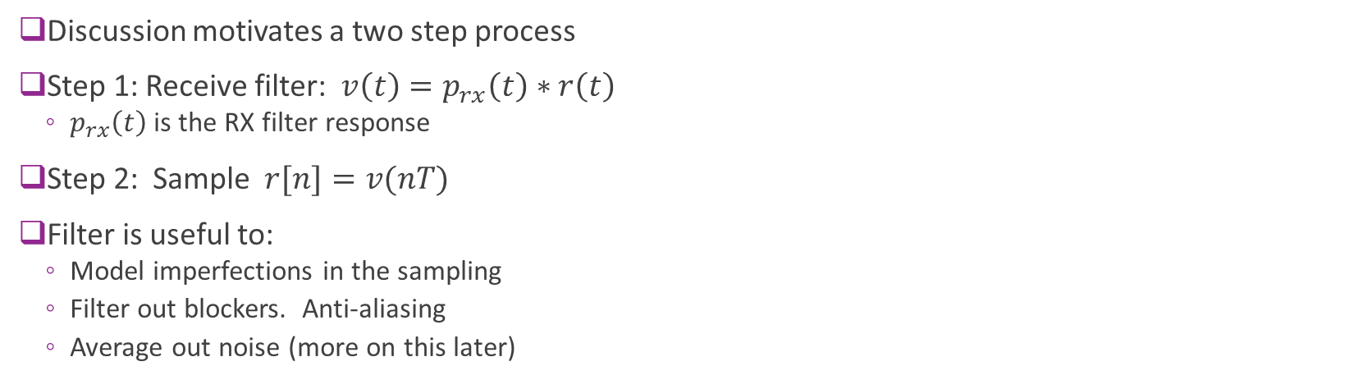



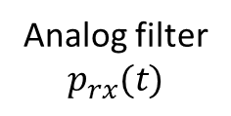
Two Step Receiver
$$v(t)$$
RX complex baseband
RX complex symbols
$$r(t)$$
$$r[n]$$
Analog filter $$p_{rx}(t)$$
ADC
Discussion motivates a two step process
Step 1: Receive filter: $v\left(t\right)=p_{rx}\left(t\right)∗r\left(t\right)$
$p_{rx}\left(t\right)$ is the RX filter response
Step 2: Sample $r[n]=v(nT)$
Filter is useful to:
Model imperfections in the sampling
Filter out blockers. Anti-aliasing
Average out noise (more on this later)

Slide 10
Outline
Receiver filtering and sampling
Perfect reconstruction with orthonormal modulation
General channels: Time-domain analysis
General channels: Frequency-domain analysis
PSD Analysis
Practical RX filter design
Channel sounding

Slide 11



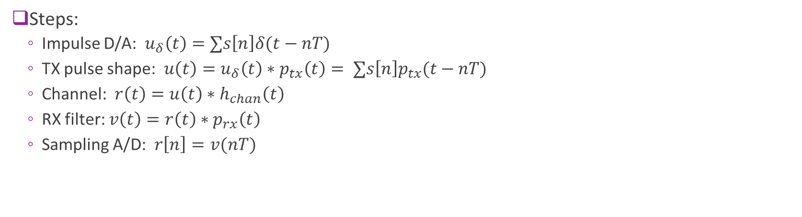






End-to-end TX and RX Chain so Far
$$u_{δ}(t)$$
$$u(t)$$
$$r(t)$$
$$v(t)$$
TX symbols
$$s[n]$$
$$r[n]$$
Ideal D/A
$$p_{tx}(t)$$
$$h_{chan}(t)$$
$$p_{rx}(t)$$
Ideal A/D
Steps:
Impulse D/A: $u_{δ}\left(t\right)=∑s\left[n\right]δ(t−nT)$
TX pulse shape: $u\left(t\right)=u_{δ}\left(t\right)∗p_{tx}\left(t\right)= ∑s\left[n\right]p_{tx}(t−nT)$
Channel: $r\left(t\right)=u\left(t\right)∗h_{chan}\left(t\right)$
RX filter: $v\left(t\right)=r\left(t\right)∗p_{rx}\left(t\right)$
Sampling A/D: $r\left[n\right]=v(nT)$

Slide 12
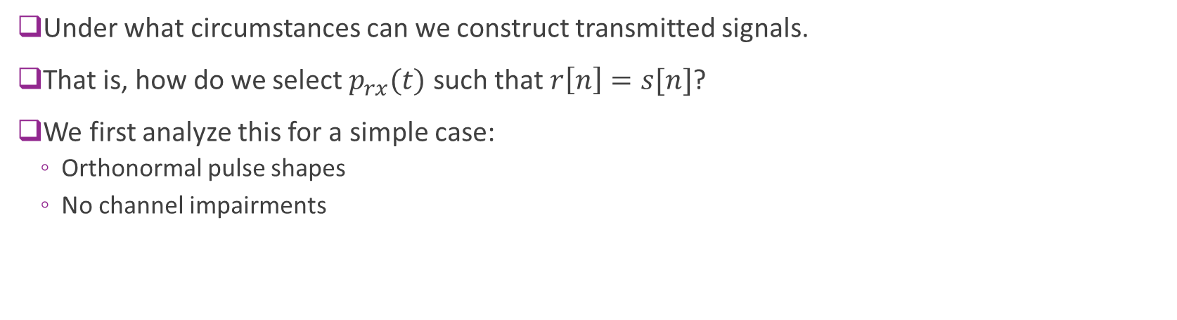
Basic Questions
$$u_{δ}(t)$$
$$u(t)$$
$$r(t)$$
$$v(t)$$
TX symbols
$$s[n]$$
$$r[n]$$
Ideal D/A
$$p_{tx}(t)$$
$$h_{chan}(t)$$
$$p_{rx}(t)$$
Ideal A/D
Under what circumstances can we construct transmitted signals.
That is, how do we select $p_{rx}(t)$ such that $r\left[n\right]=s[n]$?
We first analyze this for a simple case:
Orthonormal pulse shapes
No channel impairments

Slide 13
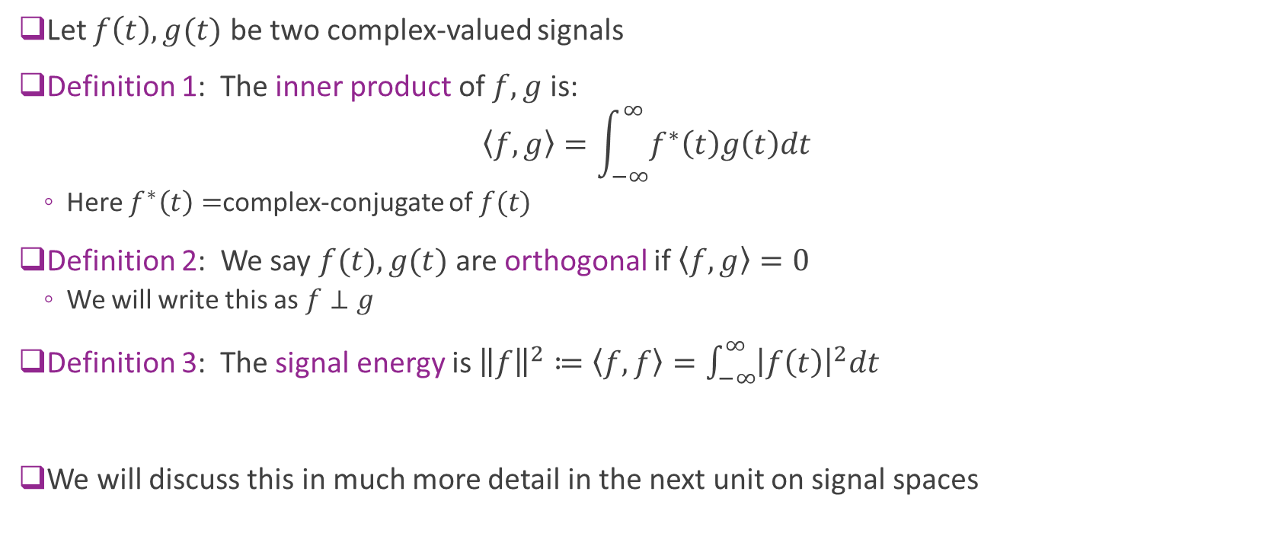
Inner Products and Orthonormal Signals
Let $f\left(t\right),g(t)$ be two complex-valued signals
Definition 1: The inner product of $f,g$ is:
$$\left\langle f,g\right\rangle =\int_{−∞}^{∞}{f^{∗}\left(t\right)g\left(t\right)dt}$$
Here $f^{∗}\left(t\right)=$complex-conjugate of $f(t)$
Definition 2: We say $f(t),g(t)$ are orthogonal if $\left\langle f,g\right\rangle =0$
We will write this as $f⊥g$
Definition 3: The signal energy is ${\left\|f\right\|}^{2}≔\left\langle f,f\right\rangle =\int_{−∞}^{∞}{{\left|f\left(t\right)\right|}^{2}dt}$
We will discuss this in much more detail in the next unit on signal spaces

Slide 14

Example Problem
Suppose $f\left(t\right)=aRect\left(\frac{t}{T}\right),g\left(t\right)=(b+ct)Rect\left(\frac{t}{T}\right)$
Complex $a,b,c$ with $a≠0$
Compute $\left\langle f,g\right\rangle$
When is $f⊥g$?
Solution:
$\left\langle f,g\right\rangle =\int_{−∞}^{∞}{f^{∗}\left(t\right)g\left(t\right)dt}=\int_{−T/2}^{T/2}{a^{∗}(b+ct)dt}=a^{∗}bT$
Therefore $f⊥g=0⟺\left\langle f,g\right\rangle =a^{∗}bT=0$.
Since $a,T≠0,$ $f⊥g=0⟺b=0$

Slide 15

Orthogonality in Frequency Domain
Sometimes it is more convenient to evaluate inner products in frequency domain
Parseval’s Theorem: Let $f\left(t\right),g(t)$ be any two signals. Then: $\left\langle f,g\right\rangle =∫f^{∗}\left(t\right)g\left(t\right)dt=∫F^{∗}\left(f\right)G\left(f\right)df$
This is useful whenever the Fourier transforms $F\left(f\right), G(f)$ are simple to work out.

Slide 16
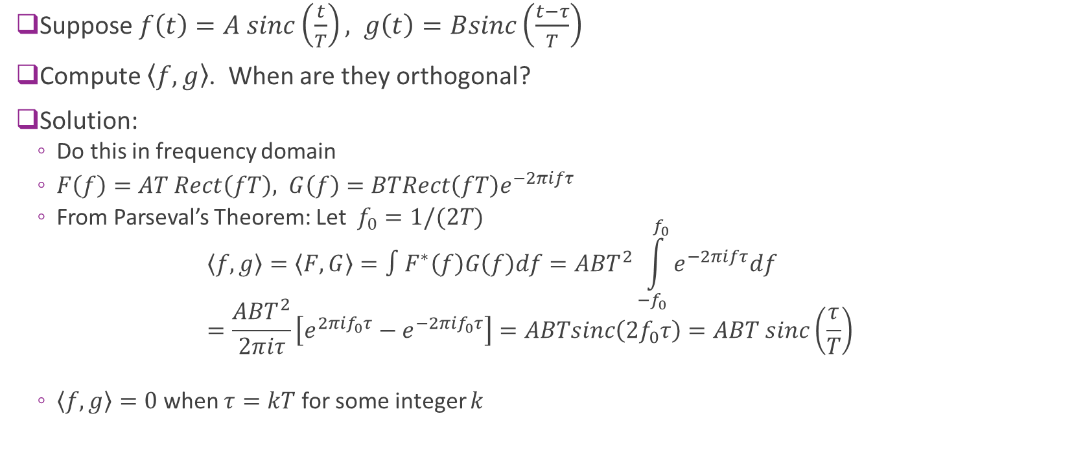
Example
Suppose $f\left(t\right)=A sinc\left(\frac{t}{T}\right), g\left(t\right)=Bsinc\left(\frac{t−τ}{T}\right)$
Compute $\left\langle f,g\right\rangle$. When are they orthogonal?
Solution:
Do this in frequency domain
$F\left(f\right)=AT Rect\left(fT\right), G\left(f\right)=BTRect\left(fT\right)e^{−2πifτ}$
From Parseval’s Theorem: Let $f_{0}=1/(2T)$ $\left\langle f,g\right\rangle =\left\langle F,G\right\rangle =∫F^{∗}\left(f\right)G\left(f\right)df=ABT^{2}\int_{−f_{0}}^{f_{0}}{e^{−2πifτ}df}$ $=\frac{ABT^{2}}{2πiτ}\left[e^{2πif_{0}τ}−e^{−2π{if}_{0}τ}\right]=ABTsinc\left({2f}_{0}τ\right)=ABT sinc\left(\frac{τ}{T}\right)$
$\left\langle f,g\right\rangle =0$ when $τ=kT$ for some integer $k$

Slide 17
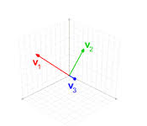
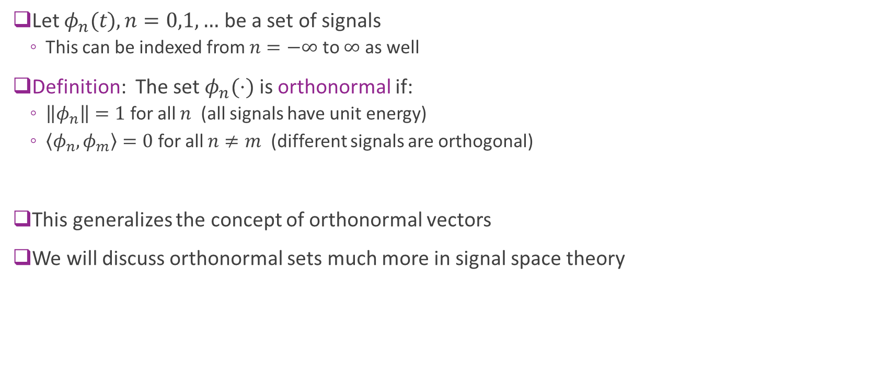
Orthonormal Signals
Let $φ_{n}(t),n=0,1,…$ be a set of signals
This can be indexed from $n=−∞$ to $∞$ as well
Definition: The set $φ_{n}(⋅)$ is orthonormal if:
$\left\|φ_{n}\right\|=1$ for all $n$ (all signals have unit energy)
$\left\langle φ_{n},φ_{m}\right\rangle =0$ for all $n≠m$ (different signals are orthogonal)
This generalizes the concept of orthonormal vectors
We will discuss orthonormal sets much more in signal space theory

Slide 18
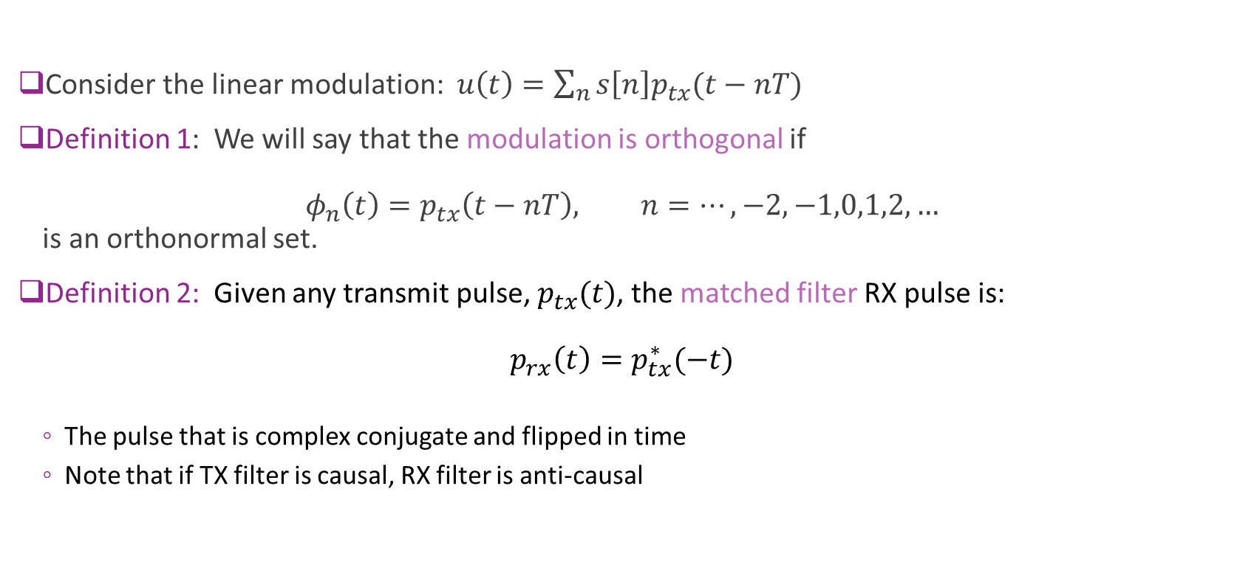
Orthonormal Pulses and Matched Filtering
Consider the linear modulation: $u\left(t\right)=\sum_{n}{s\left[n\right]p_{tx}(t−nT)}$
Definition 1: We will say that the modulation is orthogonal if $φ_{n}\left(t\right)=p_{tx}\left(t−nT\right), n=…,−2,−1,0,1,2,…$ is an orthonormal set.
Definition 2: Given any transmit pulse, $p_{tx}(t)$, the matched filter RX pulse is: $p_{rx}\left(t\right)=p_{tx}^{∗}(−t)$
The pulse that is complex conjugate and flipped in time
Note that if TX filter is causal, RX filter is anti-causal

Slide 19
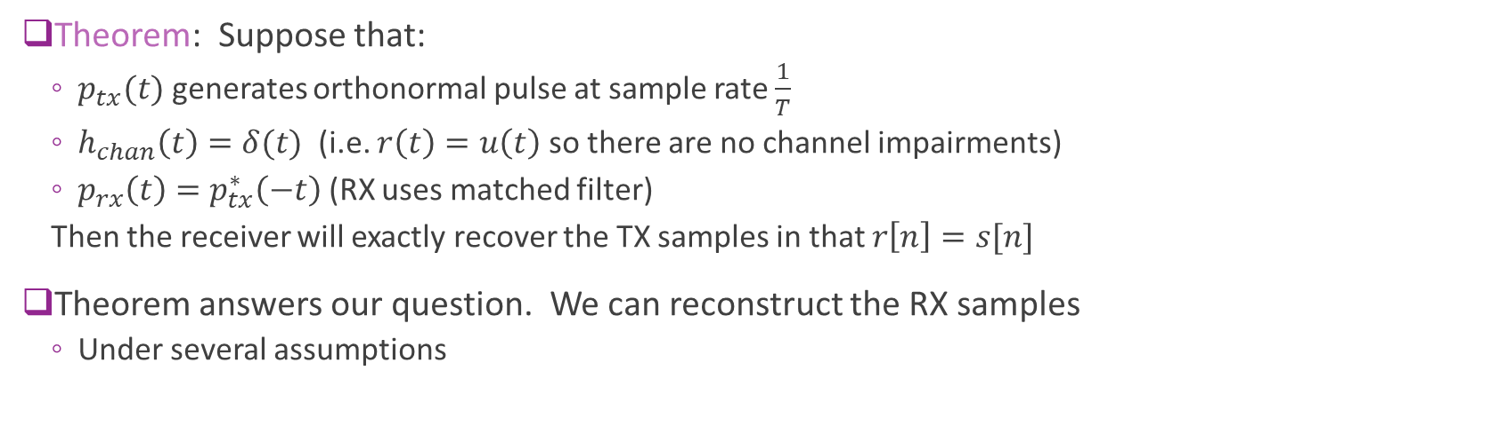
Reconstruction With Orthonormal Pulses
$$u_{δ}(t)$$
$$u(t)$$
$$r(t)$$
$$v(t)$$
TX symbols
$$s[n]$$
$$r[n]$$
Ideal D/A
$$p_{tx}(t)$$
$$h_{chan}(t)$$
$$p_{rx}(t)$$
Ideal A/D
Theorem: Suppose that:
$p_{tx}(t)$ generates orthonormal pulse at sample rate $\frac{1}{T}$
$h_{chan}\left(t\right)=δ(t)$ (i.e. $r\left(t\right)=u\left(t\right)$ so there are no channel impairments)
$p_{rx}\left(t\right)=p_{tx}^{∗}\left(−t\right)$ (RX uses matched filter)
Then the receiver will exactly recover the TX samples in that $r\left[n\right]=s[n]$
Theorem answers our question. We can reconstruct the RX samples
Under several assumptions

Slide 20
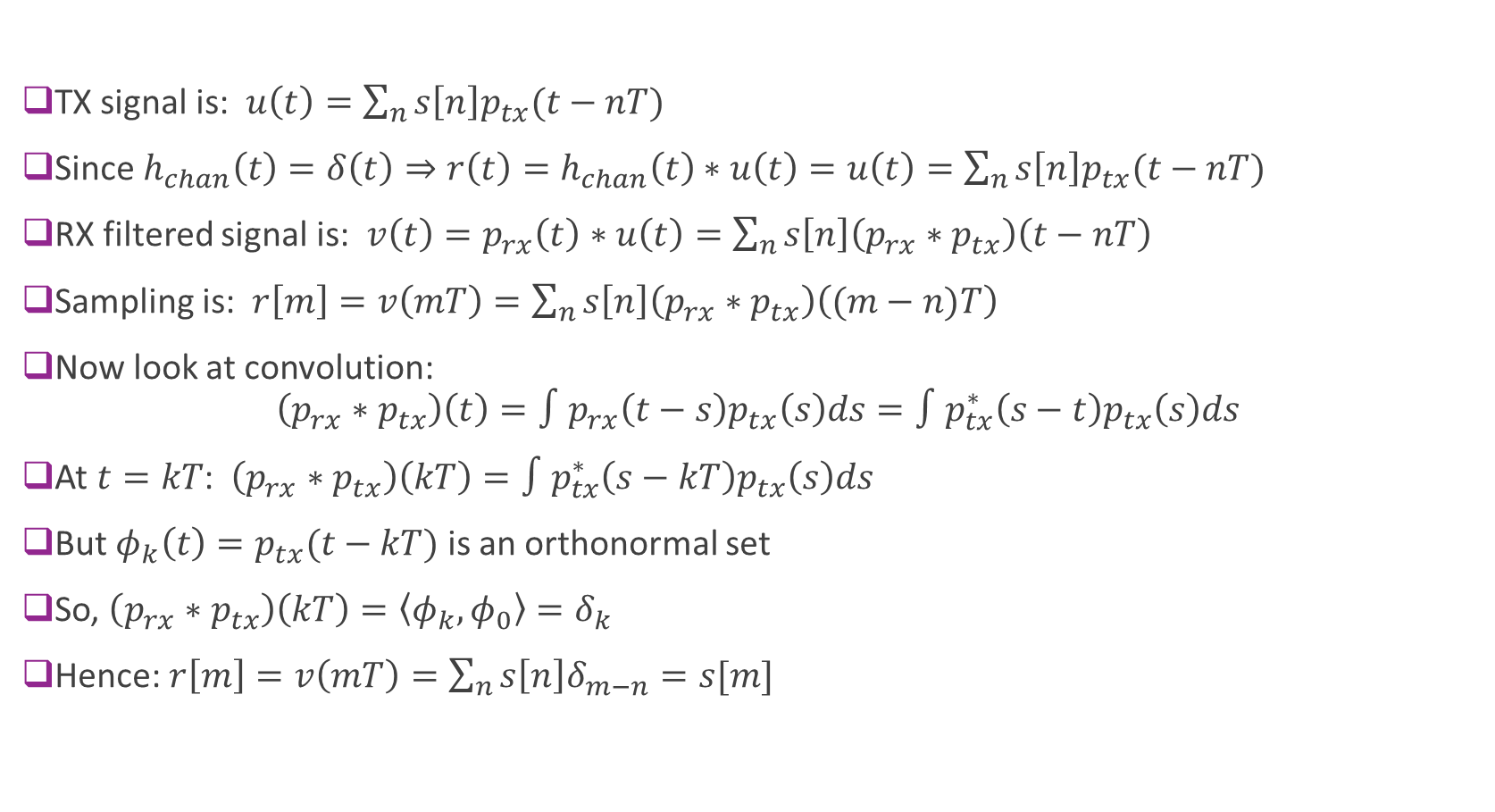
Proof of Reconstruction Theorem
TX signal is: $u\left(t\right)=\sum_{n}{s\left[n\right]p_{tx}(t−nT)}$
Since $h_{chan}\left(t\right)=δ\left(t\right)⇒r\left(t\right)=h_{chan}\left(t\right)∗u\left(t\right)=u\left(t\right)=\sum_{n}{s\left[n\right]p_{tx}(t−nT)}$
RX filtered signal is: $v\left(t\right)=p_{rx}\left(t\right)∗u\left(t\right)=\sum_{n}{s\left[n\right]\left(p_{rx}∗p_{tx}\right)\left(t−nT\right)}$
Sampling is: $r\left[m\right]=v\left(mT\right)=\sum_{n}{s\left[n\right]\left(p_{rx}∗p_{tx}\right)\left((m−n)T\right)}$
Now look at convolution: $\left(p_{rx}∗p_{tx}\right)\left(t\right)=∫p_{rx}\left(t−s\right)p_{tx}\left(s\right)ds=∫p_{tx}^{∗}\left(s−t\right)p_{tx}\left(s\right)ds$
At $t=kT$: $\left(p_{rx}∗p_{tx}\right)\left(kT\right)=∫p_{tx}^{∗}\left(s−kT\right)p_{tx}\left(s\right)ds$
But $φ_{k}\left(t\right)=p_{tx}(t−kT)$ is an orthonormal set
So, $\left(p_{rx}∗p_{tx}\right)\left(kT\right)=\left\langle φ_{k},φ_{0}\right\rangle =δ_{k}$
Hence: $r\left[m\right]=v\left(mT\right)=\sum_{n}{s\left[n\right]δ_{m−n}}=s[m]$

Slide 21
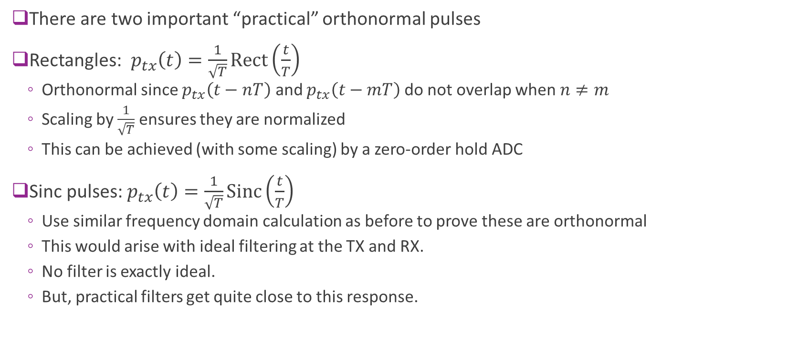
“Practical” Orthogonal Pulses
There are two important “practical” orthonormal pulses
Rectangles: $p_{tx}\left(t\right)=\frac{1}{\sqrt{T}}Rect\left(\frac{t}{T}\right)$
Orthonormal since $p_{tx}\left(t−nT\right)$ and $p_{tx}\left(t−mT\right)$ do not overlap when $n≠m$
Scaling by $\frac{1}{\sqrt{T}}$ ensures they are normalized
This can be achieved (with some scaling) by a zero-order hold ADC
Sinc pulses: $p_{tx}\left(t\right)=\frac{1}{\sqrt{T}}Sinc\left(\frac{t}{T}\right)$
Use similar frequency domain calculation as before to prove these are orthonormal
This would arise with ideal filtering at the TX and RX.
No filter is exactly ideal.
But, practical filters get quite close to this response.

Slide 22
Outline
Receiver filtering and sampling
Perfect reconstruction with orthonormal modulation
General channels: Time-domain analysis
General channels: Frequency-domain analysis
PSD Analysis
Practical RX filter design
Channel sounding

Slide 23
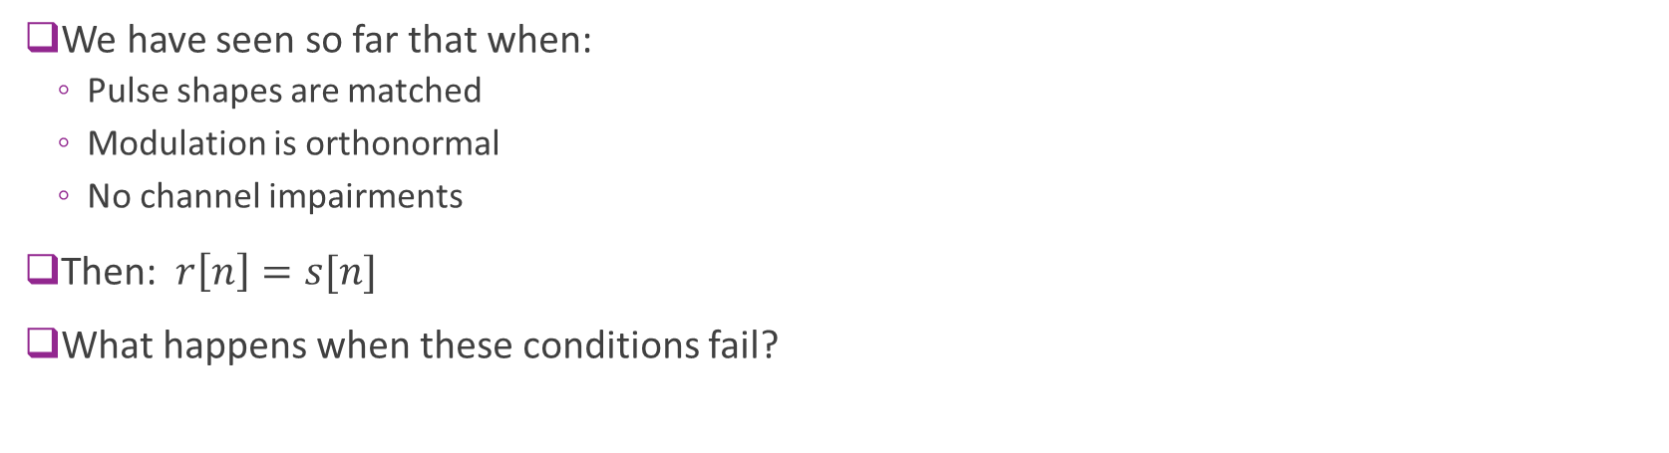
Modeling the End-to-End System
$$u_{δ}(t)$$
$$u(t)$$
$$r(t)$$
$$v(t)$$
TX symbols
$$s[n]$$
$$r[n]$$
Ideal D/A
$$p_{tx}(t)$$
$$h_{chan}(t)$$
$$p_{rx}(t)$$
Ideal A/D
We have seen so far that when:
Pulse shapes are matched
Modulation is orthonormal
No channel impairments
Then: $r\left[n\right]=s[n]$
What happens when these conditions fail?

Slide 24
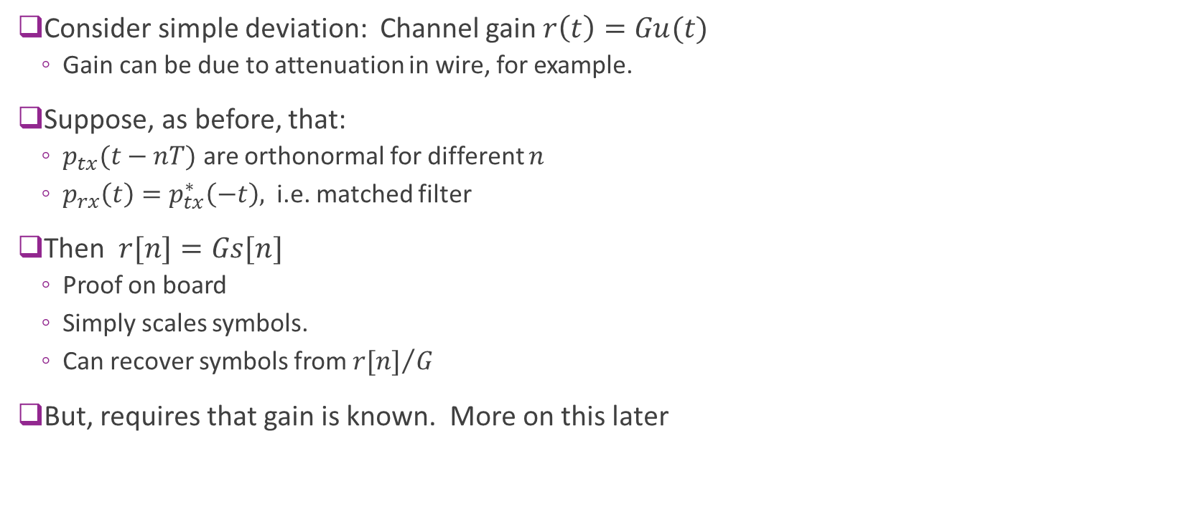


Channel Gain
Consider simple deviation: Channel gain $r\left(t\right)=Gu(t)$
Gain can be due to attenuation in wire, for example.
Suppose, as before, that:
$p_{tx}(t−nT)$ are orthonormal for different $n$
$p_{rx}\left(t\right)=p_{tx}^{∗}\left(−t\right),$ i.e. matched filter
Then $r[n]=Gs[n]$
Proof on board
Simply scales symbols.
Can recover symbols from ${r[n]}/G$
But, requires that gain is known. More on this later
$$u(t)$$
$$r\left(t\right)=Gu(t)$$
Channel gain

Slide 25
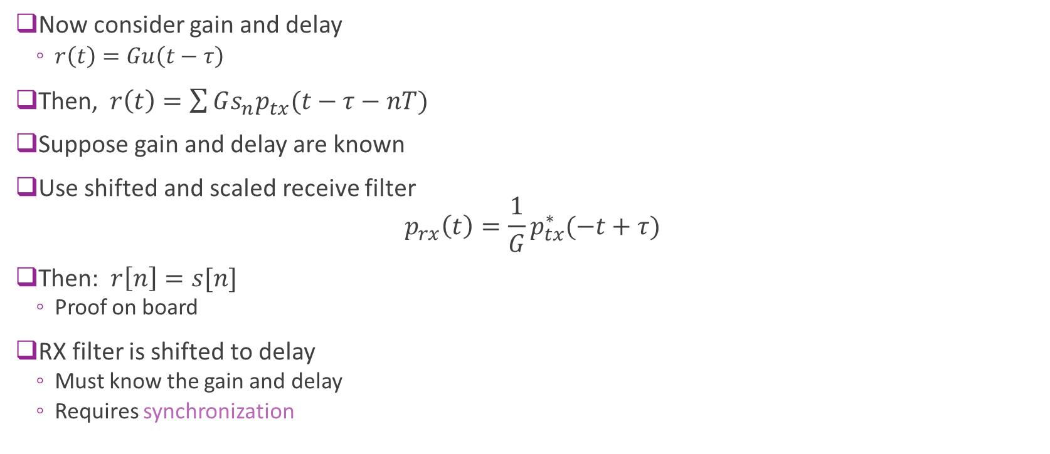

Channel Gain and With Known Delay
Now consider gain and delay
$r\left(t\right)=Gu\left(t−τ\right)$
Then, $r\left(t\right)=\sum{Gs_{n}p_{tx}(t−τ−nT)}$
Suppose gain and delay are known
Use shifted and scaled receive filter $p_{rx}\left(t\right)=\frac{1}{G}p_{tx}^{∗}(−t+τ)$
Then: $r\left[n\right]=s[n]$
Proof on board
RX filter is shifted to delay
Must know the gain and delay
Requires synchronization
$$u(t)$$
$$r\left(t\right)=Gu(t−τ)$$
Channel gain

Slide 26
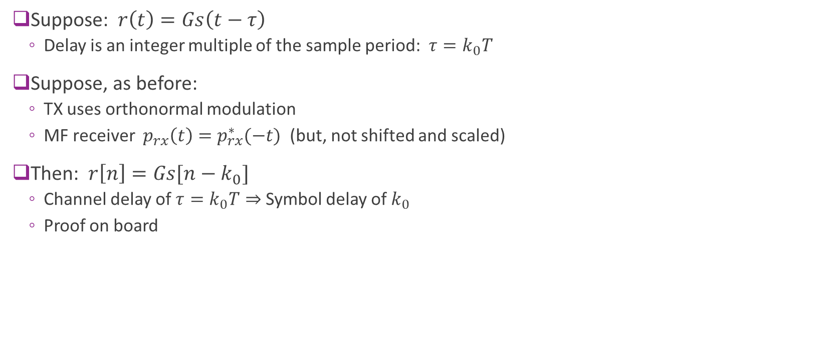
Integer Delays
Suppose: $r\left(t\right)=Gs\left(t−τ\right)$
Delay is an integer multiple of the sample period: $τ=k_{0}T$
Suppose, as before:
TX uses orthonormal modulation
MF receiver $p_{rx}\left(t\right)=p_{rx}^{∗}(−t)$ (but, not shifted and scaled)
Then: $r\left[n\right]=Gs[n−k_{0}]$
Channel delay of $τ=k_{0}T⇒$ Symbol delay of $k_{0}$
Proof on board

Slide 27









Integer Delays visualized
Suppose TX uses orthonormal modulation and RX uses matched filter
Suppose sample rate is $T=0.1 μs$ ($f=10$ Msym/s)
Baseband channel impulse response
Effective discrete-time channel
$$G$$
$$G$$
$$τ=0$$
$$k=0$$
$$G$$
$$G$$
$$τ=4 μs$$
$$k=40$$

Slide 28
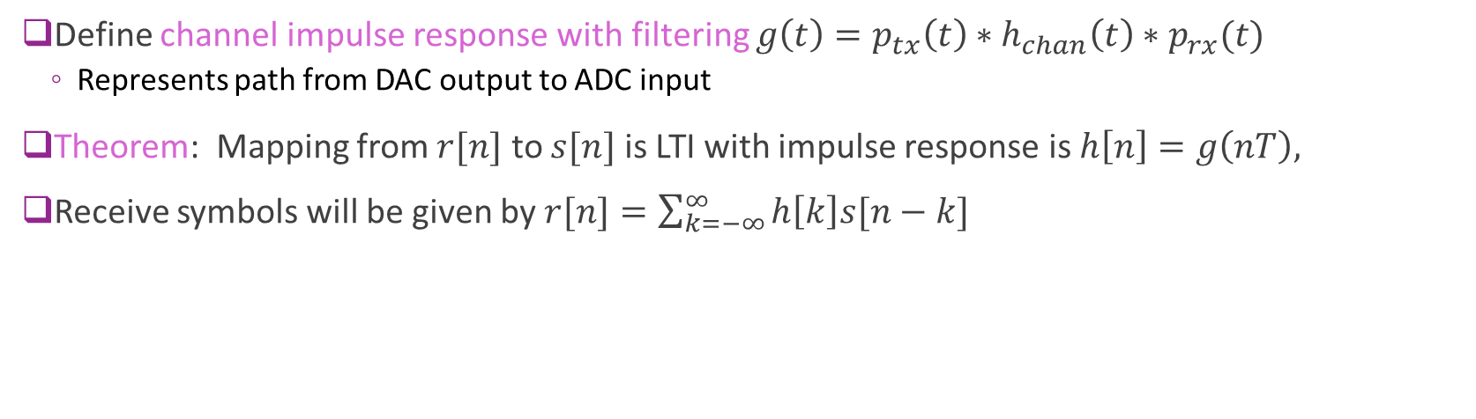
General case
$$u_{δ}(t)$$
$$u(t)$$
$$r(t)$$
$$v(t)$$
$$s[n]$$
$$r[n]$$
Ideal D/A
$$p_{tx}(t)$$
$$h_{chan}(t)$$
$$p_{rx}(t)$$
Ideal A/D
Define channel impulse response with filtering $g\left(t\right)=p_{tx}\left(t\right)∗h_{chan}\left(t\right)∗p_{rx}(t)$
Represents path from DAC output to ADC input
Theorem: Mapping from $r[n]$ to $s[n]$ is LTI with impulse response is $h\left[n\right]=g\left(nT\right),$
Receive symbols will be given by $r[n]=\sum_{k=−∞}^{∞}{h\left[k\right]s[n−k]}$

Slide 29
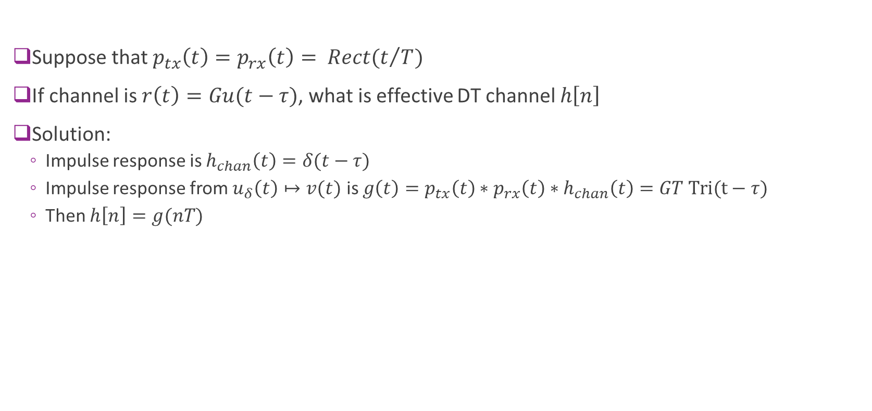
Example 1: Rectangular Pulse
Suppose that $p_{tx}\left(t\right)=p_{rx}\left(t\right)= Rect(t/T)$
If channel is $r\left(t\right)=Gu(t−τ)$, what is effective DT channel $h\left[n\right]$
Solution:
Impulse response is $h_{chan}\left(t\right)=δ(t−τ)$
Impulse response from $u_{δ}\left(t\right)↦v(t)$ is $g\left(t\right)=p_{tx}\left(t\right)∗p_{rx}\left(t\right)∗h_{chan}\left(t\right)=GT Tri(t−τ)$
Then $h\left[n\right]=g(nT)$

Slide 30
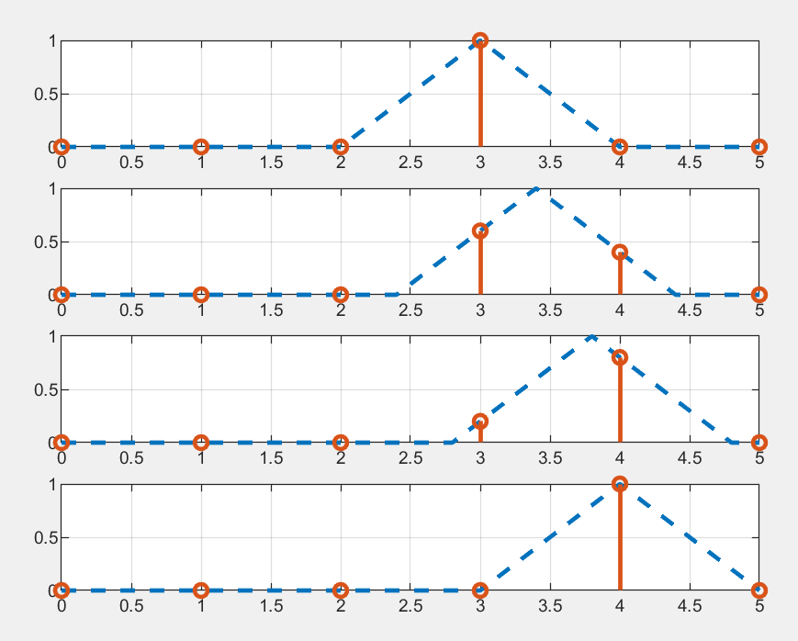

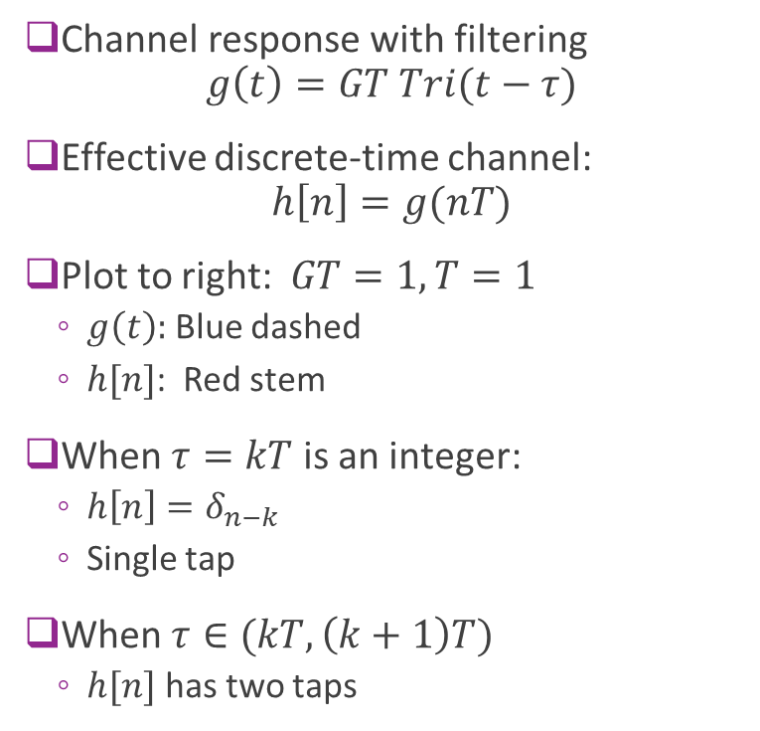



Example 2 Illustrated
Channel response with filtering $g\left(t\right)=GT Tri(t−τ)$
Effective discrete-time channel: $h\left[n\right]=g(nT)$
Plot to right: $GT=1, T=1$
$g\left(t\right):$ Blue dashed
$h[n]$: Red stem
When $τ=kT$ is an integer:
$h\left[n\right]=δ_{n−k}$
Single tap
When $τ∈(kT,\left(k+1\right)T)$
$h[n]$ has two taps
$$τ=3$$
$$τ=3.4$$
$$τ=3.8$$
$$τ=4$$

Slide 31
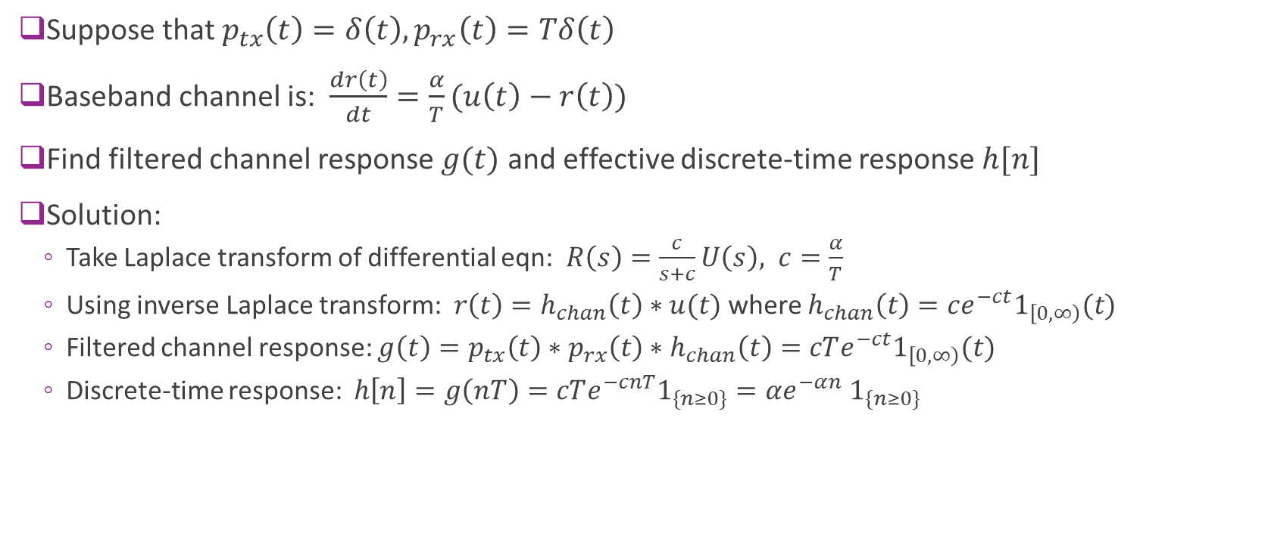
Example 2: Exponential
Suppose that $p_{tx}\left(t\right)=δ\left(t\right), p_{rx}\left(t\right)=Tδ\left(t\right)$
Baseband channel is: $\frac{dr\left(t\right)}{dt}=\frac{α}{T}(u\left(t\right)−r\left(t\right))$
Find filtered channel response $g(t)$ and effective discrete-time response $h[n]$
Solution:
Take Laplace transform of differential eqn: $R\left(s\right)=\frac{c}{s+c}U\left(s\right), c=\frac{α}{T}$
Using inverse Laplace transform: $r\left(t\right)=h_{chan}\left(t\right)∗u(t)$ where $h_{chan}\left(t\right)=ce^{−ct}1_{\left[0,∞\right)}(t)$
Filtered channel response: $g\left(t\right)=p_{tx}\left(t\right)∗p_{rx}\left(t\right)∗h_{chan}\left(t\right)=cTe^{−ct}1_{\left[0,∞\right)}(t)$
Discrete-time response: $h\left[n\right]=g\left(nT\right)=cTe^{−cnT}1_{\{n≥0\}}=αe^{−αn}$ $1_{\{n≥0\}}$

Slide 32
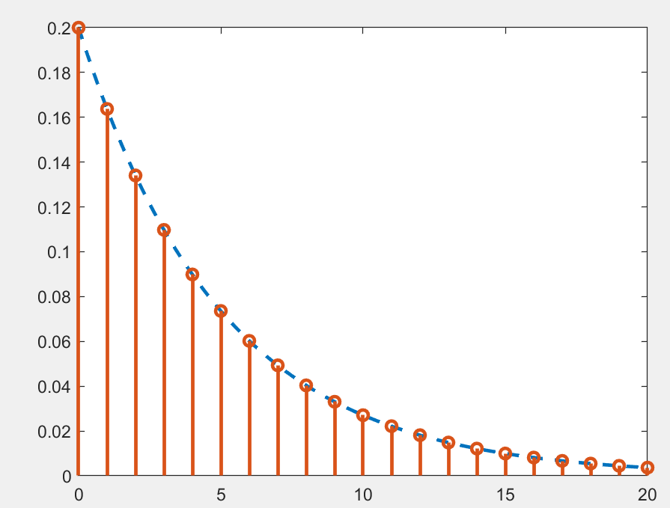

Example 2: Exponential Illustrated
Suppose that $p_{tx}\left(t\right)=δ\left(t\right), p_{rx}\left(t\right)=Tδ\left(t\right)$
Baseband channel is: $\frac{dr\left(t\right)}{dt}=\frac{α}{T}(u\left(t\right)−r\left(t\right))$
From previous slide:
Filtered channel response: $g\left(t\right)=cTe^{−ct}1_{\left[0,∞\right)}(t)$
Discrete-time response: $h\left[n\right]=g\left(nT\right)=αe^{−αn}$ $1_{\{n≥0\}}$

Slide 33
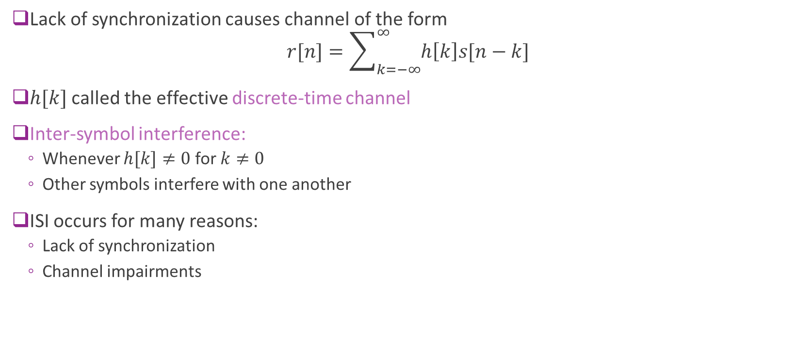
Effective Discrete-Time Channel
Lack of synchronization causes channel of the form $r[n]=\sum_{k=−∞}^{∞}{h\left[k\right]s[n−k]}$
$h[k]$ called the effective discrete-time channel
Inter-symbol interference:
Whenever $h[k]≠0$ for $k≠0$
Other symbols interfere with one another
ISI occurs for many reasons:
Lack of synchronization
Channel impairments

Slide 34
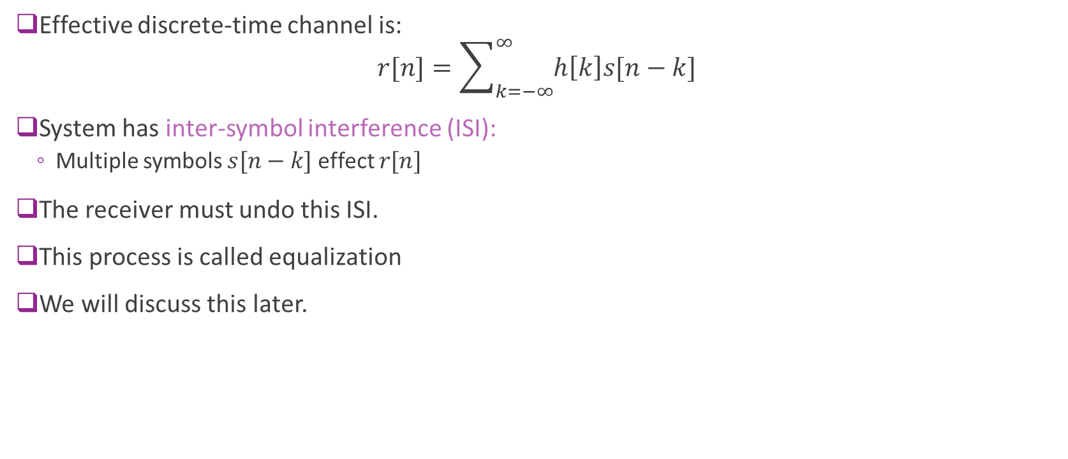
ISI and Equalization
Effective discrete-time channel is: $r[n]=\sum_{k=−∞}^{∞}{h\left[k\right]s[n−k]}$
System has inter-symbol interference (ISI):
Multiple symbols $s[n−k]$ effect $r[n]$
The receiver must undo this ISI.
This process is called equalization
We will discuss this later.

Slide 35
Outline
Receiver filtering and sampling
Perfect reconstruction with orthonormal modulation
General channels: Time-domain analysis
General channels: Frequency-domain analysis
PSD Analysis
Practical RX filter design
Channel sounding

Slide 36
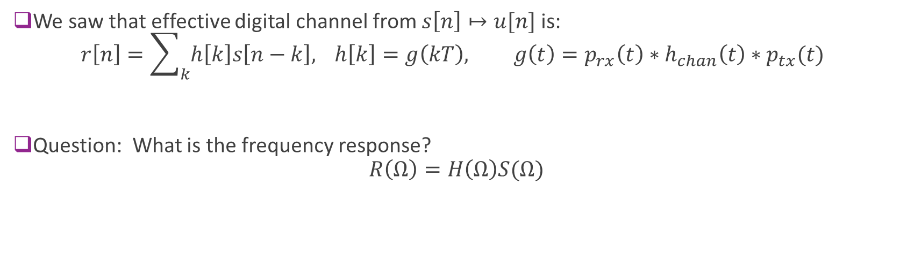
Digital Channel Frequency Response
$$u_{δ}(t)$$
$$u(t)$$
$$r(t)$$
$$v(t)$$
$$s[n]$$
$$r[n]$$
Ideal D/A
$$p_{tx}(t)$$
$$h_{chan}(t)$$
$$p_{rx}(t)$$
Ideal A/D
We saw that effective digital channel from $s\left[n\right]↦u[n]$ is: $r\left[n\right]=\sum_{k}{h\left[k\right]s\left[n−k\right],} h\left[k\right]=g\left(kT\right), g\left(t\right)=p_{rx}\left(t\right)∗h_{chan}\left(t\right)∗p_{tx}(t)$
Question: What is the frequency response? $R\left(Ω\right)=H\left(Ω\right)S(Ω)$

Slide 37
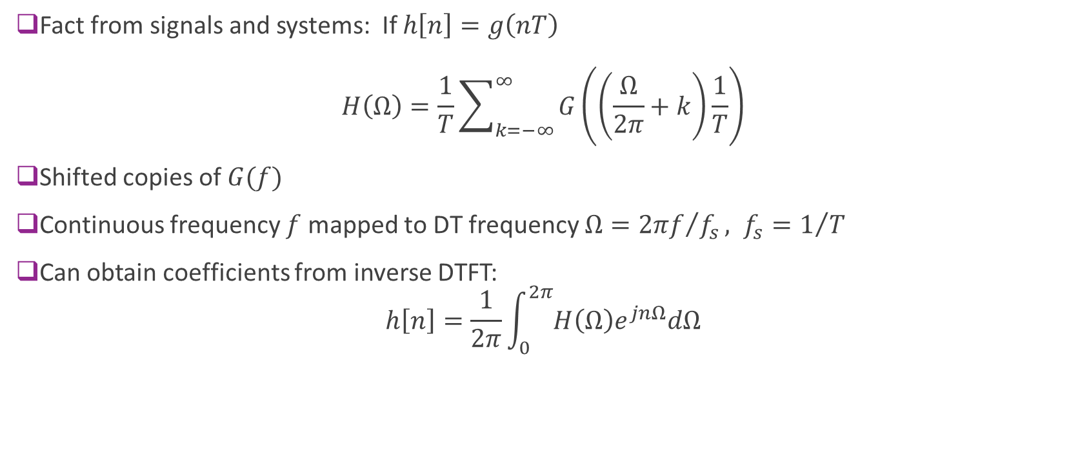
Frequency Response of DT Filter
Fact from signals and systems: If $h\left[n\right]=g\left(nT\right)$ $H\left(Ω\right)=\frac{1}{T}\sum_{k=−∞}^{∞}{G\left(\left(\frac{Ω}{2π}+k\right)\frac{1}{T}\right)}$
Shifted copies of $G(f)$
Continuous frequency $f$ mapped to DT frequency $Ω={2πf}/{f_{s}}, f_{s}=1/T$
Can obtain coefficients from inverse DTFT: $h\left[n\right]=\frac{1}{2π}\int_{0}^{2π}{H\left(Ω\right)e^{jnΩ}dΩ}$

Slide 38
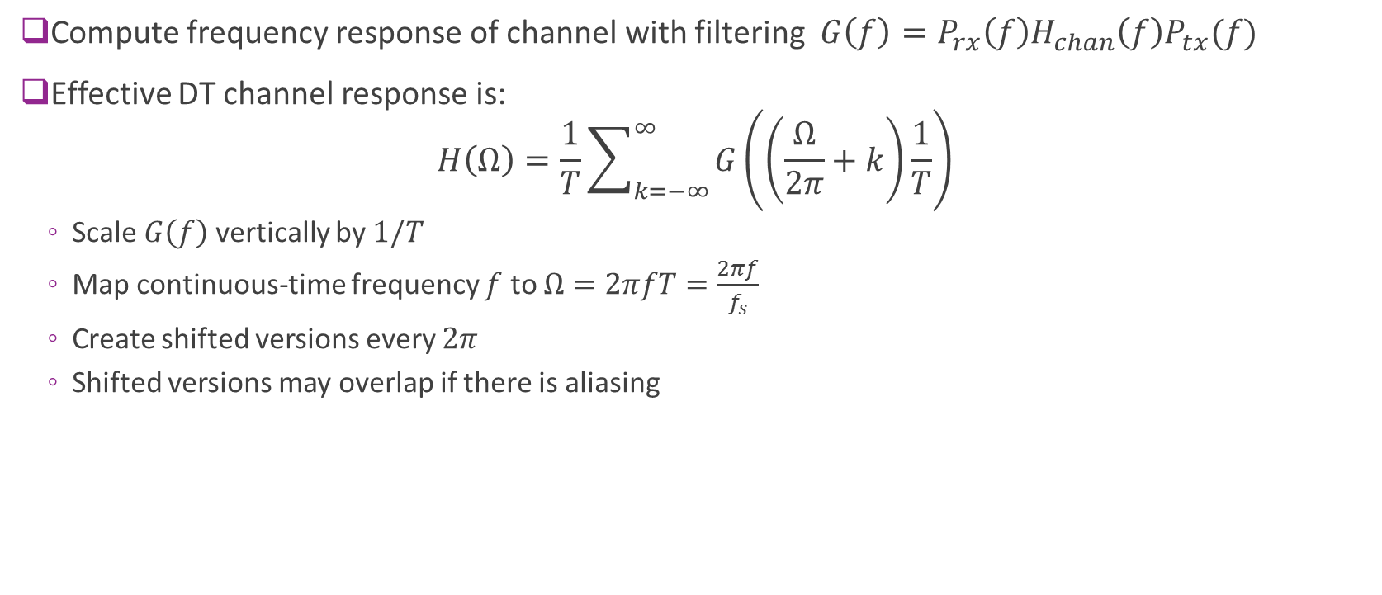
Computing Effective DT Frequency Response Summary
Compute frequency response of channel with filtering $G\left(f\right)=P_{rx}\left(f\right)H_{chan}\left(f\right)P_{tx}(f)$
Effective DT channel response is: $H\left(Ω\right)=\frac{1}{T}\sum_{k=−∞}^{∞}{G\left(\left(\frac{Ω}{2π}+k\right)\frac{1}{T}\right)}$
Scale $G\left(f\right)$ vertically by $1/T$
Map continuous-time frequency $f$ to $Ω=2πfT=\frac{2πf}{f_{s}}$
Create shifted versions every $2π$
Shifted versions may overlap if there is aliasing

Slide 39
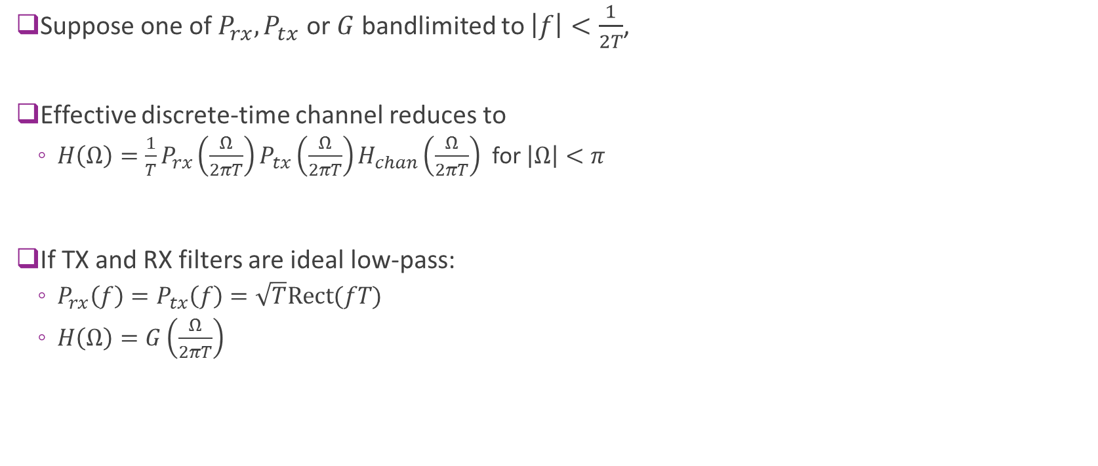
Bandlimited Channel
Suppose one of $P_{rx}, P_{tx}$ or $G$ bandlimited to $\left|f\right|<\frac{1}{2T}$,
Effective discrete-time channel reduces to
$H\left(Ω\right)=\frac{1}{T}P_{rx}\left(\frac{Ω}{2πT}\right)P_{tx}\left(\frac{Ω}{2πT}\right)H_{chan}\left(\frac{Ω}{2πT}\right)$ for $\left|Ω\right|<π$
If TX and RX filters are ideal low-pass:
$P_{rx}\left(f\right)=P_{tx}\left(f\right)=\sqrt{T}Rect(fT)$
$H\left(Ω\right)=G\left(\frac{Ω}{2πT}\right)$

Slide 40

Example: Sinc Pulses
Suppose that
$p_{rx}\left(t\right)=p_{tx}\left(t\right)=\frac{1}{\sqrt{T}}sinc\left(\frac{t}{T}\right)$
$H_{chan}\left(f\right)=1$ (no impairments)
Then,
$P_{rx}\left(f\right)=P_{tx}\left(f\right)=\sqrt{T}rect\left(fT\right)$
$H\left(Ω\right)=$1
Hence, $R\left(Ω\right)=S(Ω)$.
Recover symbols exactly. No ISI

Slide 41
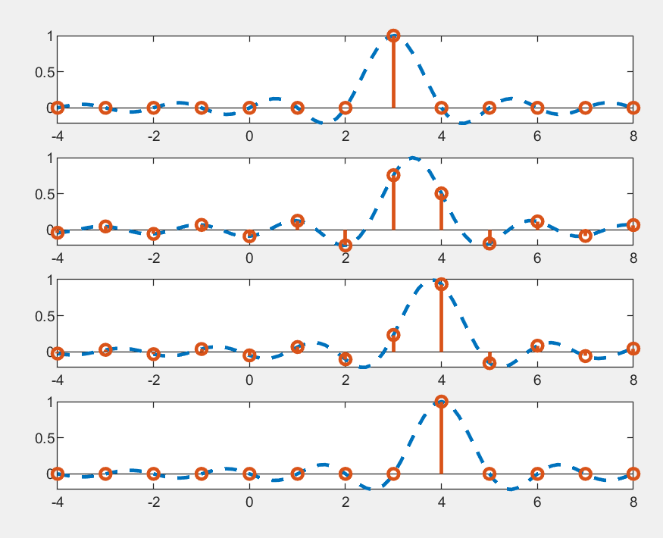





Example: Sinc Pulses with Delay
Suppose that $p_{rx}\left(t\right)=p_{tx}\left(t\right)=\frac{1}{\sqrt{T}}sinc\left(\frac{t}{T}\right)$
Channel has gain and delay: $r\left(t\right)=Gu\left(t−τ\right)$
$H_{chan}\left(f\right)=Ge^{−2πjfτ}$
Then,
$P_{rx}\left(f\right)=P_{tx}\left(f\right)=\sqrt{T}rect\left(fT\right)$
$H\left(Ω\right)=H_{chan}\left(\frac{Ω}{2πT}\right)=Ge^{−jΩτ/T}$
Similar calculation as before: $h\left[n\right]=sinc\left(\frac{τn}{T}\right)$
$$τ=3$$
$$τ=3.4$$
$$τ=3.8$$
$$τ=4$$

Slide 42

Flat Channels
Suppose that
$P_{rx}\left(f\right)=P_{tx}\left(f\right)=\sqrt{T}rect\left(fT\right)$
$G\left(f\right)≈G_{0}$ in $\left|f\right|<\frac{1}{2T}$
“Flat” over the channel.
Then, effective discrete-time channel is
$H\left(f\right)=G_{0}$
$r[n]=G_{0}s[n]$
No ISI
Conclusion: When channel is “flat” over band, equalization is not needed

Slide 43



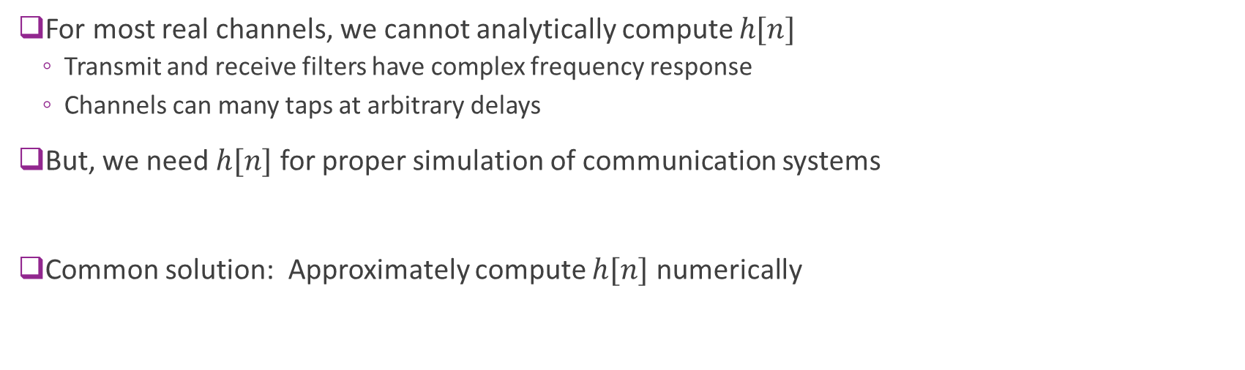






Numerically Computing the Channel
$$u_{δ}(t)$$
$$u(t)$$
$$r(t)$$
$$v(t)$$
$$s[n]$$
$$r[n]$$
Ideal D/A
$$p_{tx}(t)$$
$$h_{chan}(t)$$
$$p_{rx}(t)$$
Ideal A/D
For most real channels, we cannot analytically compute $h[n]$
Transmit and receive filters have complex frequency response
Channels can many taps at arbitrary delays
But, we need $h[n]$ for proper simulation of communication systems
Common solution: Approximately compute $h[n]$ numerically

Slide 44
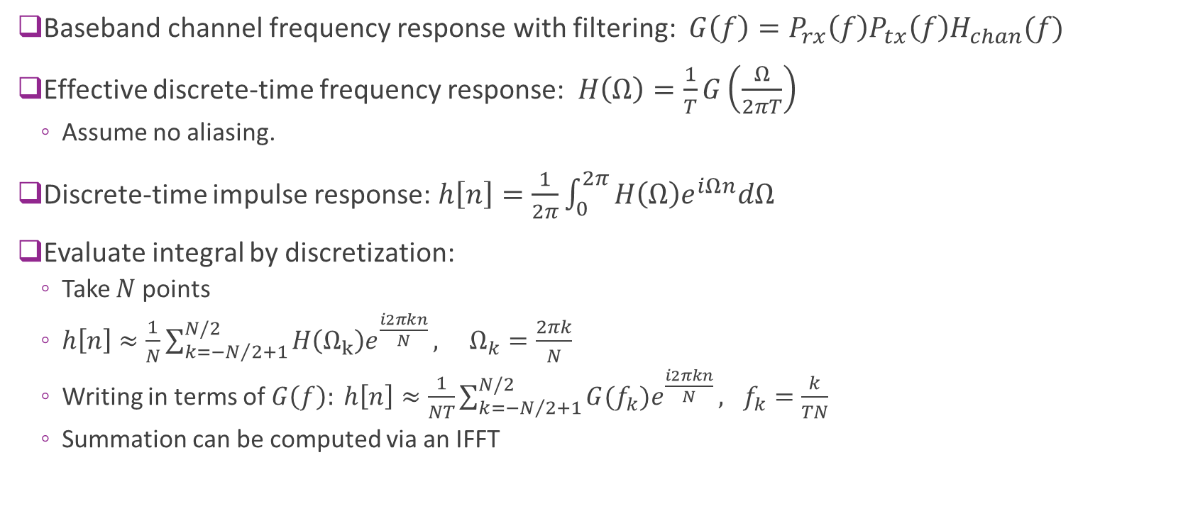
Numeric Computation via Discretization
Baseband channel frequency response with filtering: $G\left(f\right)=P_{rx}\left(f\right)P_{tx}\left(f\right)H_{chan}(f)$
Effective discrete-time frequency response: $H\left(Ω\right)=\frac{1}{T}G\left(\frac{Ω}{2πT}\right)$
Assume no aliasing.
Discrete-time impulse response: $h\left[n\right]=\frac{1}{2π}\int_{0}^{2π}{H\left(Ω\right)e^{iΩn}dΩ}$
Evaluate integral by discretization:
Take $N$ points
$h\left[n\right]≈\frac{1}{N}\sum_{k=−N/2+1}^{N/2}{H\left(Ω_{k}\right)e^{\frac{i2πkn}{N}}}, Ω_{k}=\frac{2πk}{N}$
Writing in terms of $G\left(f\right): h\left[n\right]≈\frac{1}{NT}\sum_{k=−N/2+1}^{N/2}{G(f_{k})e^{\frac{i2πkn}{N}}}, f_{k}=\frac{k}{TN}$
Summation can be computed via an IFFT

Slide 45
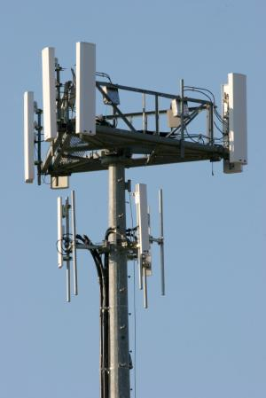
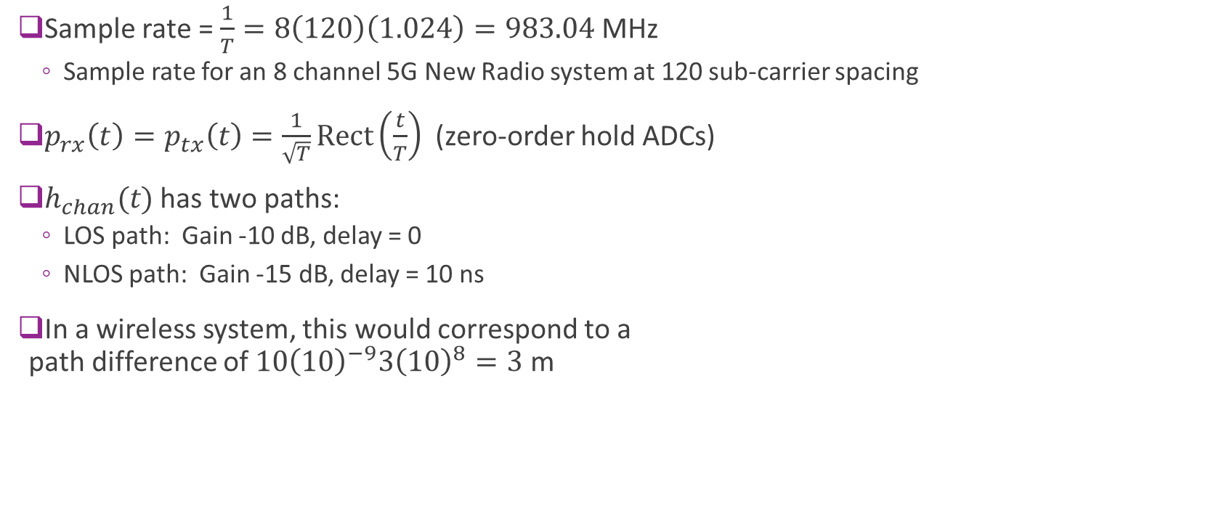


Example: Two Path Channel
Sample rate = $\frac{1}{T}=8\left(120\right)\left(1.024\right)=983.04$MHz
Sample rate for an 8 channel 5G New Radio system at 120 sub-carrier spacing
$p_{rx}\left(t\right)=p_{tx}\left(t\right)=\frac{1}{\sqrt{T}}Rect\left(\frac{t}{T}\right)$ (zero-order hold ADCs)
$h_{chan}(t)$ has two paths:
LOS path: Gain -10 dB, delay = 0
NLOS path: Gain -15 dB, delay = 10 ns
In a wireless system, this would correspond to a path difference of $10{\left(10\right)}^{−9}3{\left(10\right)}^{8}=3$ m
$$G_{2},τ_{2}$$
$$G_{1},τ_{1}$$

Slide 46
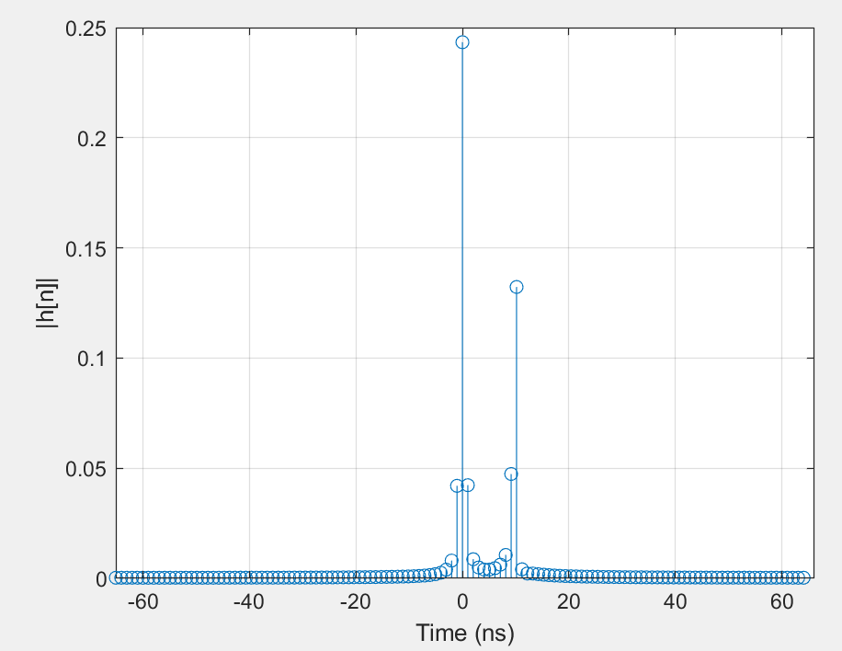
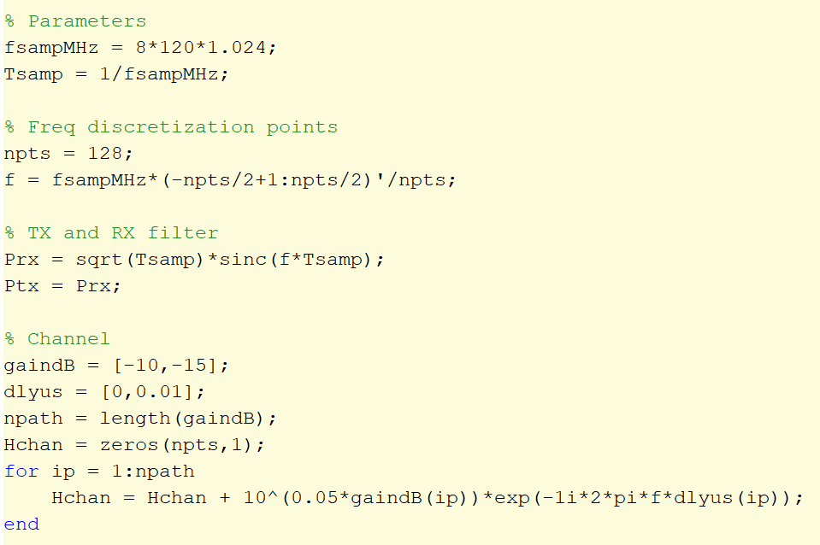
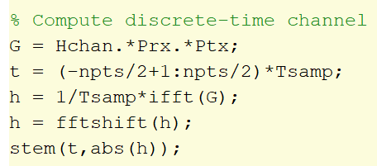
MATLAB Code

Slide 47
Outline
Receiver filtering and sampling
Perfect reconstruction with orthonormal modulation
General channels: Time-domain analysis
General channels: Frequency-domain analysis
PSD Analysis
Practical RX filter design
Channel sounding

Slide 48
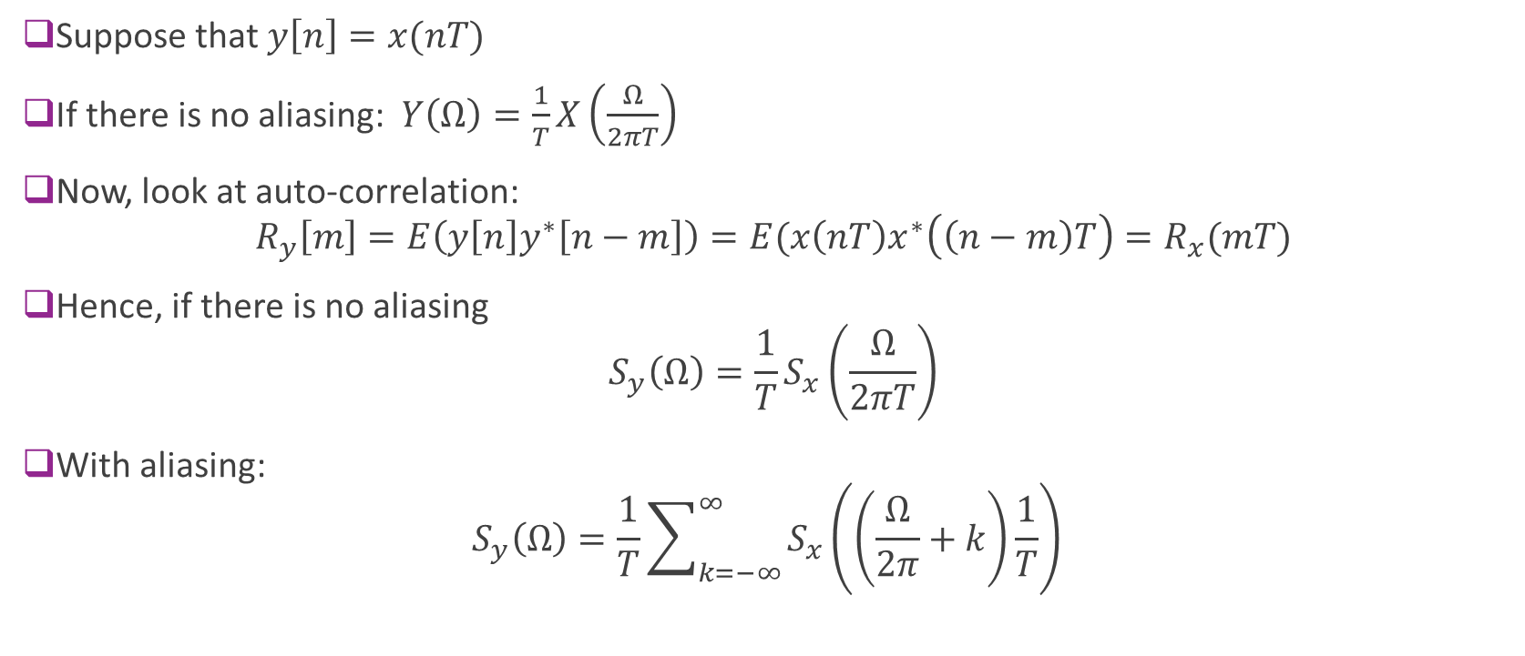
PSD of a Sampled Signal
Suppose that $y\left[n\right]=x(nT)$
If there is no aliasing: $Y\left(Ω\right)=\frac{1}{T}X\left(\frac{Ω}{2πT}\right)$
Now, look at auto-correlation: $R_{y}\left[m\right]=E\left(y\left[n\right]y^{∗}\left[n−m\right]\right)=E(x\left(nT\right)x^{∗}\left(\left(n−m\right)T\right)=R_{x}(mT)$
Hence, if there is no aliasing $S_{y}\left(Ω\right)=\frac{1}{T}S_{x}\left(\frac{Ω}{2πT}\right)$
With aliasing: $S_{y}\left(Ω\right)=\frac{1}{T}\sum_{k=−∞}^{∞}{S_{x}\left(\left(\frac{Ω}{2π}+k\right)\frac{1}{T}\right)}$

Slide 49

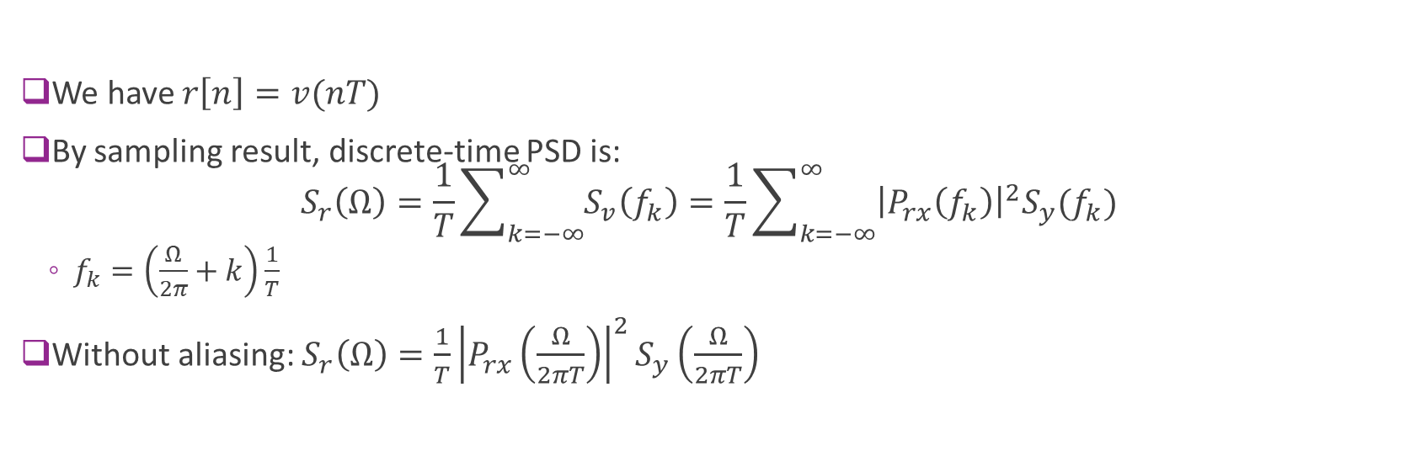

PSD of the Receiver
$$v(t)$$
RX complex baseband
RX complex symbols
$$y(t)$$
$$r[n]$$
$$p_{rx}(t)$$
ADC
We have $r\left[n\right]=v(nT)$
By sampling result, discrete-time PSD is: $S_{r}\left(Ω\right)=\frac{1}{T}\sum_{k=−∞}^{∞}{S_{v}\left(f_{k}\right)}=\frac{1}{T}\sum_{k=−∞}^{∞}{{\left|P_{rx}\left(f_{k}\right)\right|}^{2}S_{y}(f_{k})}$
$f_{k}=\left(\frac{Ω}{2π}+k\right)\frac{1}{T}$
Without aliasing: $S_{r}\left(Ω\right)=\frac{1}{T}{\left|P_{rx}\left(\frac{Ω}{2πT}\right)\right|}^{2}S_{y}\left(\frac{Ω}{2πT}\right)$

Slide 50
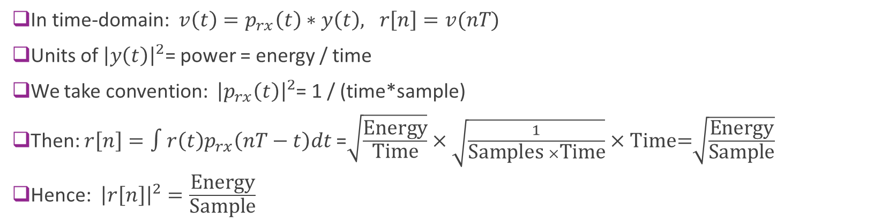
Units in RX Chain: Time Domain
$$v(t)$$
RX complex baseband
RX complex symbols
$$y(t)$$
$$r[n]$$
$$p_{rx}(t)$$
ADC
In time-domain: $v\left(t\right)=p_{rx}\left(t\right)∗y\left(t\right), r\left[n\right]=v(nT)$
Units of ${\left|y\left(t\right)\right|}^{2}$= power = energy / time
We take convention: ${\left|p_{rx}\left(t\right)\right|}^{2}$= 1 / (time*sample)
Then: $r\left[n\right]=∫r\left(t\right)p_{rx}\left(nT−t\right)dt$ =$\sqrt{\frac{\text{Energy}}{\text{Time}}}×\sqrt{\frac{1}{\text{Samples} ×\text{T}\text{ime}}}×\text{Time}\text{=}\sqrt{\frac{\text{Energy}}{\text{Sample}}}$
Hence: ${\left|r\left[n\right]\right|}^{2}=\frac{\text{Energy}}{\text{Sample}}$

Slide 51

Units in RX Chain: PSD
$$v(t)$$
RX complex baseband
RX complex symbols
$$y(t)$$
$$r[n]$$
$$p_{rx}(t)$$
ADC
$S_{r}\left(Ω\right)=\frac{1}{T}{\left|P_{rx}\left(\frac{Ω}{2πT}\right)\right|}^{2}S_{y}\left(\frac{Ω}{2πT}\right)$
Units of $S_{y}(f)$= power/Hz = energy
Units of ${\left|p_{rx}\left(t\right)\right|}^{2}=1/(samples×time)$
Units of ${\left|P_{rx}\left(f\right)\right|}^{2}=1/(samples×Hz)$
Units of $S_{r}\left(Ω\right)=\frac{1}{Time}×Energy×\frac{Time}{Sample}=\text{Energy}$ per radian

Slide 52














Sample problem (Solution on board)
Desired
Interference
Received PSD and filter as shown
Two components:
Desired signal
Nearby adjacent carrier signal
Assume they are uncorrelated
Hence powers add.
Draw discrete-time PSD $S_{r}(Ω)$
Sample rate = 80 Msamples / sec
Sample rate = 20 Msamples / sec
dBm/Hz
$$−60$$
PSD $S_{y}(f)$
[dBm/Hz]
$$−80$$
MHz
$$−8$$
$$8$$
$$15$$
$$20$$
Fillter gain
${\left|P_{rx}\left(f\right)\right|}^{2}$
[dB/samp/Hz]
$$20$$
$$−30$$
MHz
$$−10$$
$$10$$
$$12$$

Slide 53
Outline
Receiver filtering and sampling
Perfect reconstruction with orthonormal modulation
General channels: Time-domain analysis
General channels: Frequency-domain analysis
PSD Analysis
Practical RX filter design
Channel sounding

Slide 54

Problems with Analog Filtering
$$v(t)$$
RX complex baseband
RX complex symbols
$$r(t)$$
$$r[n]$$
Analog filter $$p_{rx}(t)$$
ADC
Up to now, we have considered two stage filtering
Filtering: $v\left(t\right)=p_{rx}\left(t\right)∗r\left(t\right)$
Sampling / ADC: $r\left[n\right]=v(nT)$
Problem: Filtering is performed in analog
Desire sharp filters to remove close adjacent carrier
Difficult to design sharp filters

Slide 55











Typical Digital Implementation of RX Filtering
$$y(t)$$
$$v_{1}(t)$$
$$v_{2}[k]$$
$$v_{3}[k]$$
$$r[n]$$
RX complex symbols,
Symbol rate = $f_{s}$
RX complex baseband
ADC
Analog filter $$h_{ana}(t)$$
Sample rate= $Mf_{s}$
Digital filter $$H_{dig}(Ω)$$
Decimate by $M$
Use combination of analog and digital filtering in four steps:
Step 1. Analog filtering $v_{1}\left(t\right)=h_{ana}\left(t\right)∗y(t)$
Step 2. Sample at $M$ times symbol rate: $v_{2}\left[k\right]=v_{1}({kT}/M)$
$M$ = oversampling ratio
Step 3. Digitally filter: $v_{3}\left[k\right]=h_{dig}\left[k\right]∗v_{2}[k]$
Step 4. Decimate: $r\left[n\right]=v_{3}[nM]$.
Takes one every $M$ samples

Slide 56

Frequency Domain Analysis
Step 1: $V_{1}\left(f\right)=H_{ana}\left(f\right)Y(f)$
Step 2: Sampling at $\frac{T}{M}$: $V_{2}\left(Ω\right)=\frac{M}{T}\sum_{k=−∞}^{∞}{V_{1}\left(\left(\frac{Ω}{2π}+k\right)\frac{M}{T}\right)}$
Step 3: Digital filtering: $V_{3}\left(Ω\right)=V_{2}\left(Ω\right)H_{dig}(Ω)$
Step 4: Decimate: $R\left(Ω\right)=\frac{1}{M}\sum_{m=0}^{M−1}{V_{3}\left(\frac{Ω+2πm}{M}\right)}$
Assuming no aliasing: Effective RX pulse shape is $P_{rx}\left(f\right)=H_{ana}\left(f\right)H_{dig}\left(\frac{2πf}{f_{s}M}\right)$

Slide 57

Frequency Domain Analysis: PSD
Step 1: $S_{1}\left(f\right)={\left|H_{ana}\left(f\right)\right|}^{2}S_{y}(f)$
Step 2: Sampling at $\frac{T}{M}$: $S_{2}\left(Ω\right)=\frac{M}{T}\sum_{k=−∞}^{∞}{S_{1}\left(\left(\frac{Ω}{2π}+k\right)\frac{M}{T}\right)}$
Step 3: Digital filtering: $S_{3}\left(Ω\right)=S_{2}\left(Ω\right){\left|H_{dig}\left(Ω\right)\right|}^{2}$
Step 4: Decimate: $R\left(Ω\right)=\frac{1}{M}\sum_{m=0}^{M−1}{S_{3}\left(\frac{Ω+2πm}{M}\right)}$
Assuming no aliasing: Effective RX pulse shape is $P_{rx}\left(f\right)=H_{ana}\left(f\right)H_{dig}\left(\frac{2πf}{f_{s}M}\right)$

Slide 58







Sample problem (Solution on board)
Received passband signal $S_{y}(f)$ as shown
Two components:
Desired signal
Nearby adjacent carrier signal
Draw the following:
Complex baseband $R(f)$ after mixing at $f_{c1}$
Response after analog filtering with cutoff $\left|f\right|≤20$ MHz
Sampling at 40 Ms/s
Digital filtering with $\left|Ω\right|≤π/2$
Downsampling by 2
Desired
Interference
$$c_{2}$$
$$c_{1}$$
$$W$$
$$W$$
$f_{c1}=2.3$ GHz
$W=12$MHz
$f_{c2}=2.5$ GHz
$W=12$MHz

Slide 59

Filter Design
Effective pulse shape: $P_{rx}\left(f\right)=H_{ana}\left(f\right)H_{dig}\left(\frac{2πf}{f_{s}M}\right)$
Want $P_{rx}\left(f\right)$ to be low-pass with cutoff $f=\frac{1}{T}$
Typical design for analog filter
$H_{ana}\left(f\right)$ passband up to $\frac{1}{2T}$, Stopband $\frac{2M−1}{2T}$
Removes images before sampling
Large transition region. Easy to design
Design spec for digital filter
Low pass with digital cut-off frequency $π/M$
Typically very sharp to remove close adjacent carrier

Slide 60

Summary of Sampling Relations
Operation | Time domain | Frequency-domain | PSD
Ideal DAC | $u\left(t\right)=\sum_{n}{s\left[n\right]p\left(t−nT\right)}$ | $U\left(f\right)=P(f)S\left(\frac{2πf}{f_{s}}\right)$ | $S_{u}\left(f\right)=\frac{1}{T}S_{s}(2πfT){\left|P\left(f\right)\right|}^{2}$
Digital upsampling | $s\left[n\right]=\left\{\begin{matrix}x[k] & n=kM \\ 0 & else\end{matrix}\right.$ | $S\left(Ω\right)=X\left(MΩ\right)$ | $S_{s}\left(Ω\right)=\frac{1}{M}S_{x}(MΩ)$
Ideal ADC | $r\left[n\right]=v(nT)$ | $R\left(Ω\right)=\frac{1}{T}\sum_{k=−∞}^{∞}{V\left(f_{k}\right)}$ $f_{k}=\left(\frac{Ω}{2π}+k\right)\frac{1}{T}$ | $S_{r}\left(Ω\right)=\frac{1}{T}\sum_{k=−∞}^{∞}{S_{v}\left(f_{k}\right)}$ $f_{k}=\left(\frac{Ω}{2π}+k\right)\frac{1}{T}$
Ideal ADC. No aliasing | $r\left[n\right]=v(nT)$ | $R\left(Ω\right)=\frac{1}{T}V\left(\frac{Ω}{2πT}\right)$ | $S_{r}\left(Ω\right)=\frac{1}{T}S_{v}\left(\frac{Ω}{2πT}\right)$
Digital decimation | $r\left[n\right]=x(nM)$ | $R\left(Ω\right)=\frac{1}{M}\sum_{m=0}^{M−1}{X\left(\frac{Ω+2πm}{M}\right)}$ | $S_{r}\left(Ω\right)=\frac{1}{M}\sum_{m=0}^{M−1}{S_{x}\left(\frac{Ω+2πm}{M}\right)}$
Digital decimation. No aliasing | $r\left[n\right]=x(nM)$ | $R\left(Ω\right)=\frac{1}{M}X\left(\frac{Ω}{M}\right)$ | $S_{r}\left(Ω\right)=\frac{1}{M}S_{x}\left(\frac{Ω}{M}\right)$

Slide 61

Summary of Units
Operation | Quantity | Time domain units | PSD units
TX symbols | $s[n]$ | ${\left|s\left[n\right]\right|}^{2}$: Energy per sample | $S_{S}\left(Ω\right):$Energy per sample per radian
TX modulation | $u\left(t\right)=∑p_{tx}\left(t−nT\right)s[n]$ | ${\left|p_{tx}\left(t\right)\right|}^{2}:$ Samples / sec | ${\left|P_{tx}\left(f\right)\right|}^{2}:$ Samp / Hz = Samp x sec
 |  | ${\left|u\left(t\right)\right|}^{2}:$ Energy / sec = power | $S_{u}(f)$: Power / Hz = Energy
RX signal | $y(t)$ | ${\left|y\left(t\right)\right|}^{2}$ : Energy / sec = power | $S_{y}(f)$: Power / Hz = Energy
RX filtered & sampled | $v\left(t\right)=p_{rx}\left(t\right)∗y(t)$ $r\left[n\right]=v(nT)$ | ${\left|p_{rx}\left(t\right)\right|}^{2}:$ 1/(samp x time) | ${\left|P_{rx}\left(f\right)\right|}^{2}:$ 1/(samp x Hz)=time/samp
 |  | ${\left|r\left[n\right]\right|}^{2}:$ Energy per sample | $S_{r}\left(Ω\right):$Energy per sample per radian

Slide 62
Outline
Receiver filtering and sampling
Perfect reconstruction with orthonormal modulation
General channels: Time-domain analysis
General channels: Frequency-domain analysis
PSD Analysis
Practical RX filter design
Channel sounding

Slide 63



Channel Sounder
Measure channel
Useful for:
Wireless propagation analysis
Measure multipath components, signal strengths, directions of arrival
But, also good for debugging any front-end
TX
RX
Channel impulse response
MmWave and sub-THz channel sounder by Rappaport lab
https://wireless.engineering.nyu.edu/mmwave-5g-and-6g-channel-sounder/

Slide 64

FFT-Based Channel Sounding
Effective discrete-time channel: $r\left[n\right]=h\left[n\right]∗s[n]$
Select period $N$
Repeatedly transmit $s\left[n\right]=\sum_{k=0}^{N−1}{S_{k}e^{2πikn/N}}=FFT(S_{k})$
Receiver will get: $r\left[n\right]=\sum_{k=0}^{N−1}{R_{k}e^{2πikn/N}}, R_{k}=S_{k}H\left(\frac{2πk}{N}\right)$
Recover $R_{k}=IFFT(r\left[n\right])$
Get channel response: $H\left(\frac{2πk}{N}\right)$ $=\frac{R_{k}}{S_{k}}=H_{chan}\left(\frac{k}{NT}\right)P_{tx}\left(\frac{k}{NT}\right)$ $P_{rx}\left(\frac{k}{NT}\right)$
Learn $P_{tx}\left(\frac{k}{NT}\right),P_{rx}\left(\frac{k}{NT}\right)$ from calibration
Estimate $H_{chan}\left(\frac{k}{NT}\right)$
Provides a discrete estimate of the channel.
More in the lab

