Slide 1
Course Admin
EL-GY 6013: Digital Communications
Prof. Sundeep rangan

Slide 2
People and Time
Professor: Sundeep Rangan, srangan@nyu.edu
2 MetroTech Center 9.104
Office Hours: Thursdays, 2-4pm
TA:
Sourjya Dutta, sdutta@nyu.edu
Office Hours: TBD
Ask for all questions regarding homeworks and labs
Location: JAB 673
Tuesdays, 12:30 to 3pm

Slide 3
Pre-requisites
EL6303 Graduate probability
This is essential
Chapters 1-7 and chapter 9 from Papoullis, Pillai
This class is offered this semester
Undergraduate signals & systems:
Fourier transforms, filters, sampling, bandwidth
We will review stochastic processes only very briefly.

Slide 4
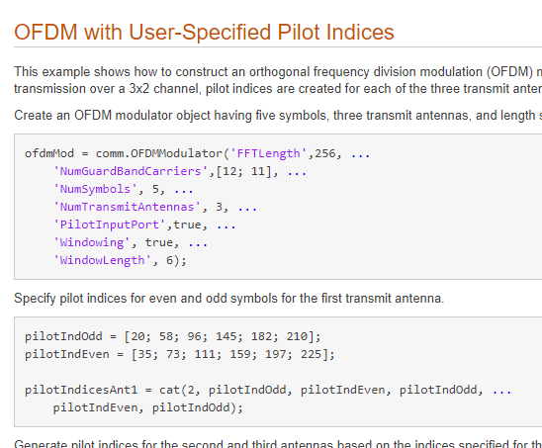
MATLAB
All labs will be in MATLAB
Download the latest MATLAB with Communications Toolbox
NYU students can get this for free:
https://www.mathworks.com/academia/tah-portal/new-york-university-618777.html
Make sure you get R2018B (Latest version)
Communications Toolbox
Very powerful set of tools for simulating communications systems
Building blocks for all common parts
Channels, modulators, demod, coding, decoding, …
Can integrate with Simulink
Can even export to HDL for synthesis

Slide 5
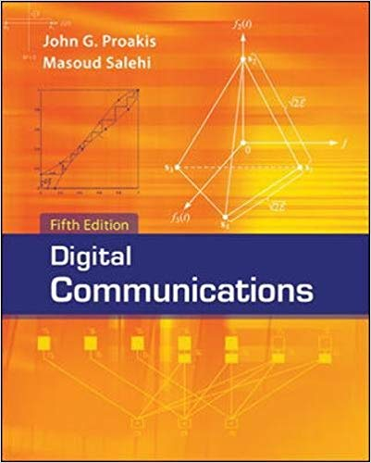
Text
Proakis, Salehi, “Digital Communications”
Fifth edition
Good points:
Very comprehensive. Widely-used
Lots of problems
But, extremely abstract
I will try to make it more concrete
It is OK if you have an older version
TA will post the questions when we use problems from the book

Slide 6
Class will Follow This Diagram
Channel coding
Symbol mapping
TX filter DAC
Upconversion
Info bits
Coded bits
IQ symbols
Analog baseband
RF
Passband
Channel
Sync
Channel decoding
Symbol demod
Equalization
RX filter and ADC
Down-conversion

Slide 7
Tentative Schedule
Lecture | Date | Topic | Text section
1 | 1/29/2019 | Introduction. Passband modulation | Proakis 2.1
2 | 2/5/2019 | Stochastic models for signals | Proakis 2,6, 2.7
3 | 2/12/2019 | TX and RX filtering | Proakis 3.4
4 | 2/19/2019 | Symbol mapping, signal space theory | Proakis 3.2, Proakis 2.2
5 | 2/26/2019 | Synchronization, match filtering and noise | Proakis 4.5, 5.1-5.3
6 | 3/5/2019 | Symbol demodulation | Proakis 4.1-4.3
7 | 3/12/2019 | Midterm review
8 | 3/19/2019 | Spring break, no class
9 | 3/26/2019 | Midterm
10 | 4/2/2019 | Equalization | Proakis 9.1,9.3
11 | 4/9/2019 | Linear codes | Proakis 7
12 | 4/16/2019 | Convolutional and turbo codes | Proakis 8
13 | 4/23/2019 | Information theory | Proakis 6
14 | 4/30/2019 | Final review
15 | 5/7/2019 | Final exam
Note: March 5 class will need to be moved or taught by a guest lecturer

Slide 8
Grading
Grading:
30% homework, labs and quizzes, 10% final project, 30% midterm, 30% final
Quizzes:
One problem asked at end of each class.
Based on previous lecture
Exams: Midterm and final are closed book, 2 cheat sheets.
No calculators
Optional project:
Can replace up to 20% of your grade

Slide 9
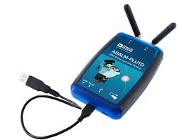
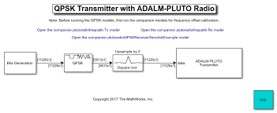
Final Project
You will simulate an end-to-end system of your choice
Example:
802.11ad, LTE, 5G, …
Your project should comprehensively test at least one component
Ex: equalization, effect of phase noise, …
Extra credit:
Go significantly beyond class
Some advanced topic
New research idea
Implementation in hardware
Can replace up to 20% of your grade
Bonus for hardware implementation
One idea: Use the ADAM Pluto board

Slide 10
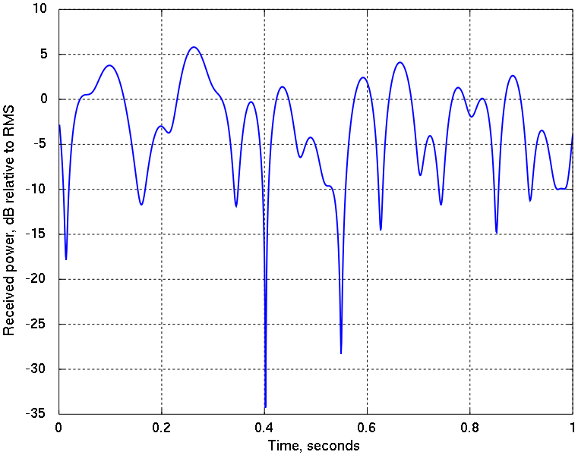
What is Digital Communications?
Transmission of digital data through a channel
Digital data
011000101…
Analog waveform
Digital data
011000101…
Transmitter
Channel
Receiver

Slide 11
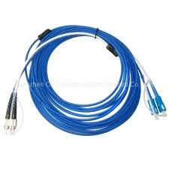
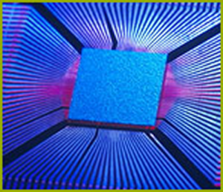
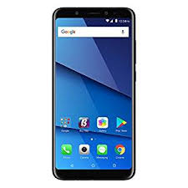
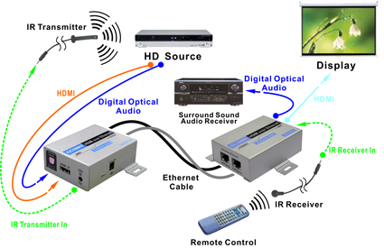
Digital Communications is Everywhere!
Many scales, data rates, channel media, ranges, …

Slide 12
What do Communications Theorists Do?
Try to make communication:
Reliable,
Fast,
Cheap, …
Basic tools in this class:
Look at point-to-point links.
Model transmission and reception as a statistical estimation problem.
Develop mathematical methods for good communication

Slide 13
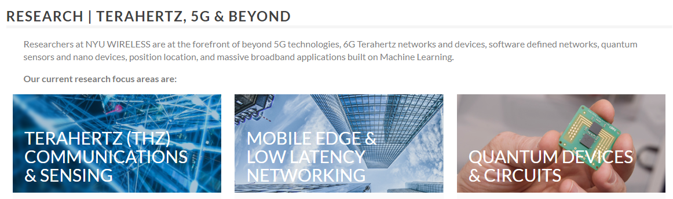
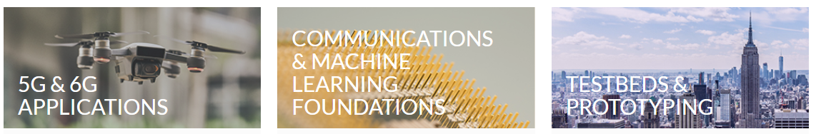
Research at NYU WIRELESS

Slide 14
Course Learning Objectives
Mathematically describe the components of a basic communication link
Mixing, filtering, symbol modulation, synchronization, equalization, channel coding, …
Simulate the system
Mathematical analyze the performance of the system
Model impairments in the channel and devices
Measure the performance such as bit error rate, power, …
Optimize the parameters of the design to maximize various performance metric
Account for constraints such as power, complexity, …

