Slide 1
U.S. Fishery Management Allocation and Harvest
Shuping Wang
4/22/2025

Slide 2
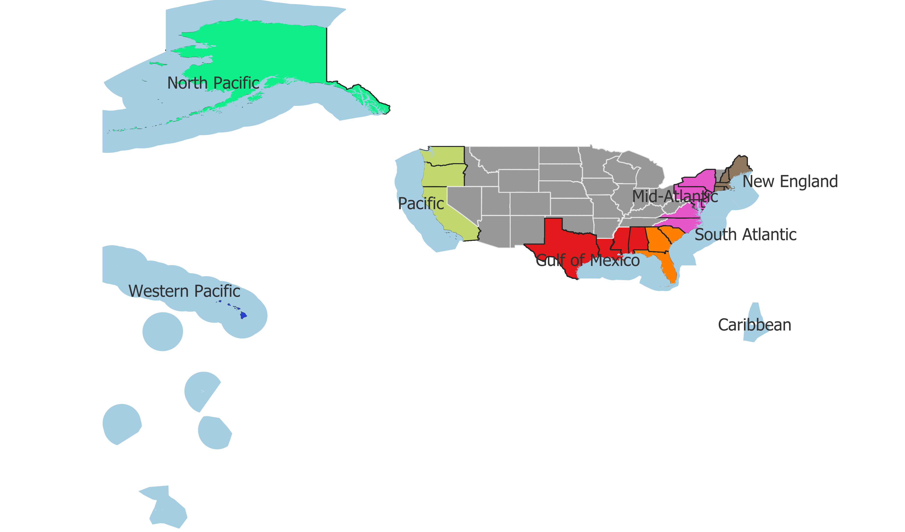

Research questions:
What are the trends of total landing value and paid licenses holders?
How is fishery economics in commercial sectors different across all councils and states?
How is fishery economics in recreational sectors different across all councils and states?

Slide 3
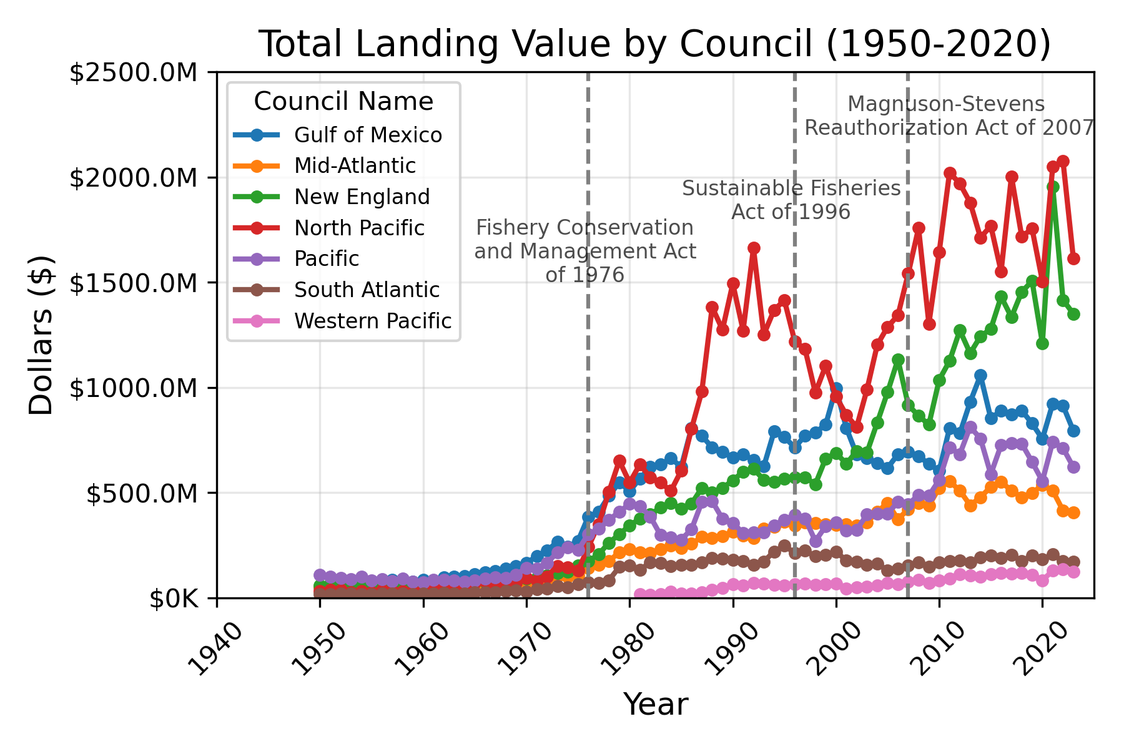

Slide 4
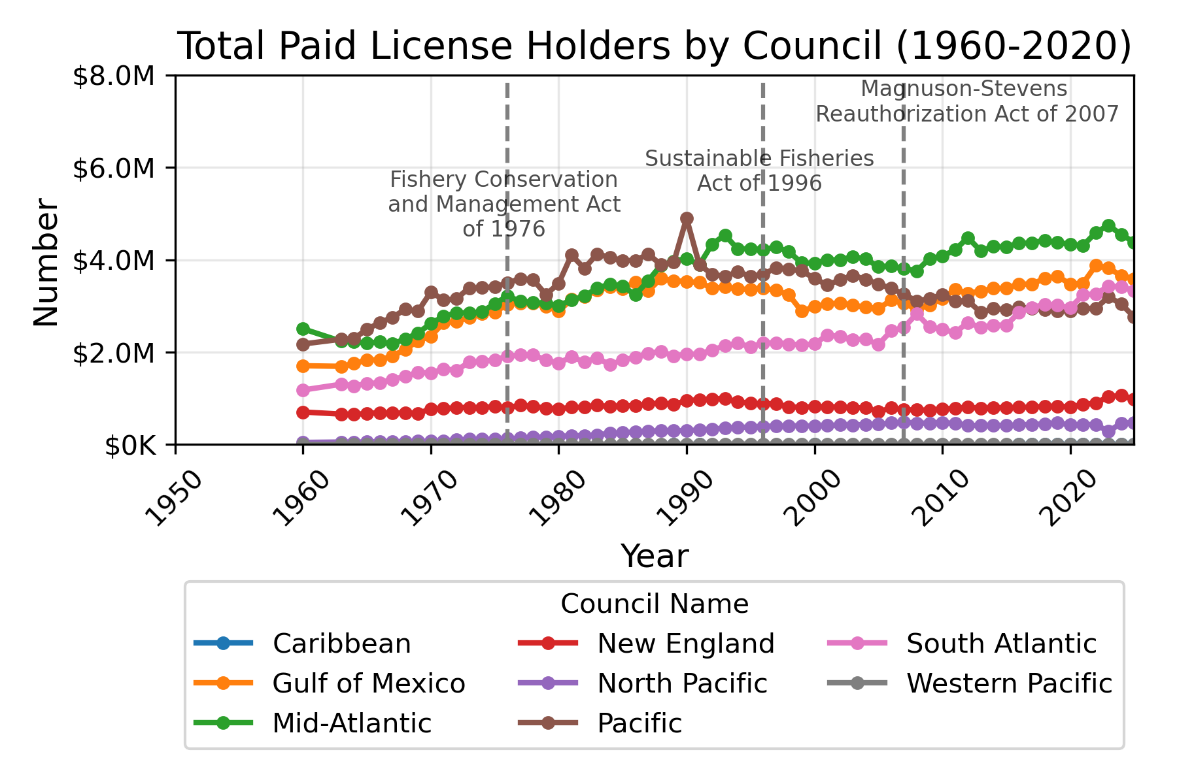

Slide 5
