Slide 1


SHORT - TERM PROJECT
Deploy-and-Configure-an-Amazon-Light-Sail-My-SQL-Database
Presented By:
Group-3: TEAM MEMBER OF 5,
FROM AWS AND REDHAT TRAINEE
Under the guidance of: Mr.SIVA SANKAR RAMADEV

Slide 2
EXECUTIVE SUMMARY
INTRODUCTION :
We completed our project during vacation from 06-10-2024 to 13-10-2024. During this period, We gained valuable experience and knowledge about our project (Deploy and Configure an Amazon LightSail MYSQL Database), learning how to utilize Amazon LightSail MYSQL Database of AWS effectively and efficiently. This experience included developing real-time projects and models.
Project Organization: Techwing is a leading organization promoting AWS & REDHAT in medical for technical research. It fosters innovation and excellence by creating a collaborative environment among researchers, practitioners, and students.

Slide 3
Summary of Activities: Techwing promotes interdisciplinary research and collaboration at the intersection of AWS & REDHAT course. Key activities include organizing conferences, symposia, and workshops, offering training programs, and providing funding and mentorship for research projects. The society also develops ethical guidelines and best practices for AWS &REDHAT applications.
Conclusion: The project provided a great experience in using ubuntu server and MYSQL database efficiently. This experience significantly enhanced my understanding and application of Amazon LightSail technologies.

Slide 4
MAIN TOPICS
1.Create database
2.CREATE INSTANCE
3.SELECT A PLATFORM (Linux/UNIX)
4.Select server (ubuntu-20.04 lts)

Slide 5
1.CREATE DATABASE
In this project,we done deploy a database on Amazon LightSail,this can be used by any LightSail instances or applications deployed in the same AWS Region. We build applications and system within LightSail without needing to use additional AWS services.
PROCESS:
Go to the Amazon LightSail console.
Select the Database tab.
Choose Create database. Choose Change AWS Region and Availability Zone and select the Region and Availability Zone where you want your database to reside.
Select your database. Currently LightSail supports MYSQL and PostgreSQL. Then select MySQL and use the latest version.
Choose Specify login credentials.

Slide 6
PROCESS:
Ten you can create a database user name such as dbmasteruser or you can leave it blank and you will see default credentials after the database is deployed.
By default, LightSail will create a strong password for your database instance,which will be shown in the console after the database is deployed.
Give your database name. When deploying a LightSail database, you are actually deploying both a database instance and a new database on the instance.
Enter DB-Instance-1.This is the name of the database instance,which you will see in the LightSail console under your database resources.
Choose Create database.it will take 10-15 minutes to deploy the database server. Until it is ready, the resource will be grayed out with a status of creating.

Slide 7
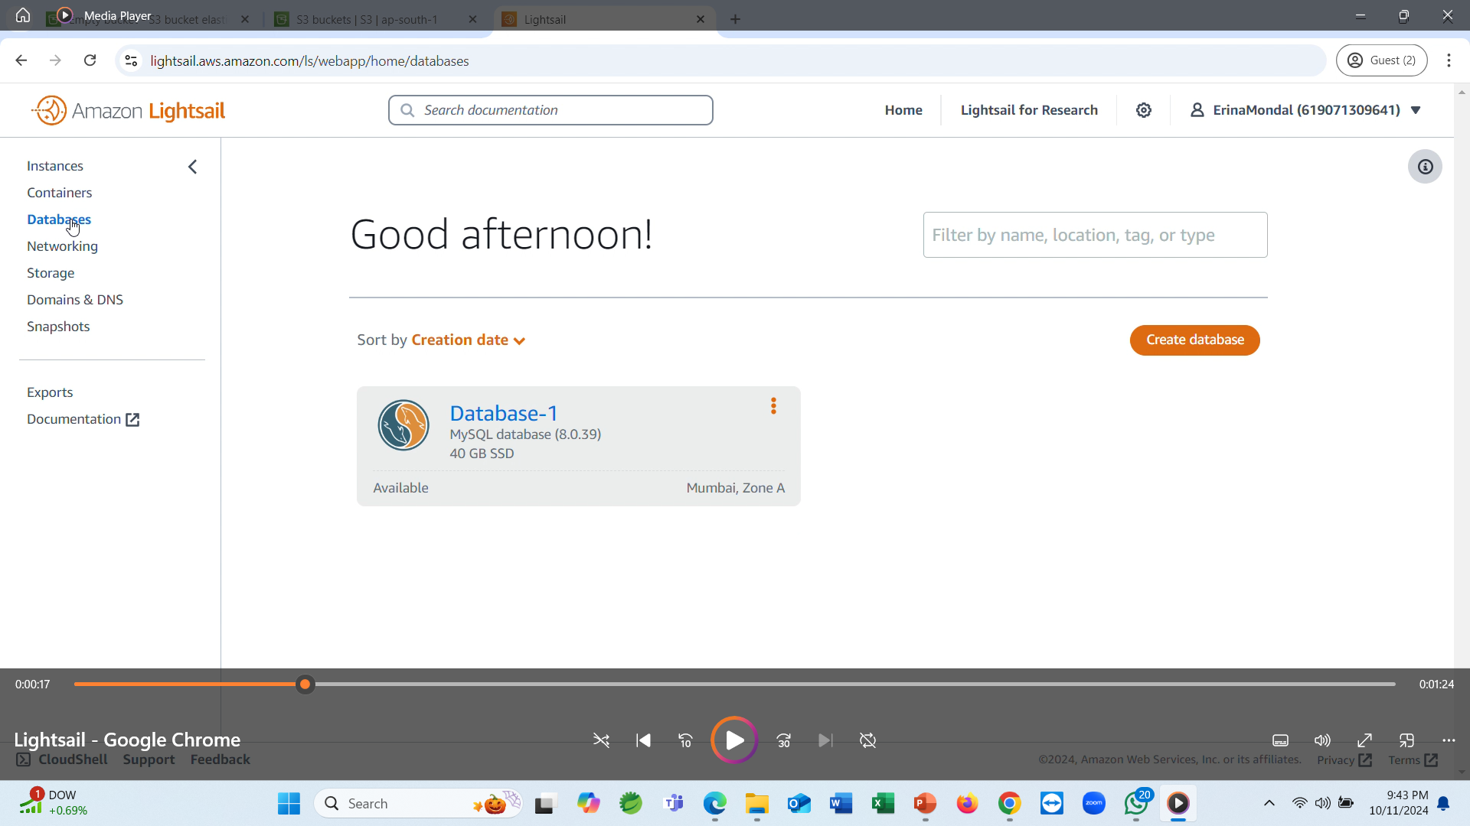
OUTPUT

Slide 8
2.CREATE INSTANCE
This allows you to build applications and systems within LightSail without needing to use additional to use additional AWS services.
Step-by-Step “Create Instance”
We will deploy a LightSail Ubuntu instance that we can use to remote into our database instance and perform some administrative tasks. Choose the LightSail icon or the Home button at the top of the LightSail console, which will take the instances page.
Choose a “Create instance”.
Then select the corresponding Region.Otherwise,choose OS Only Select a blueprint and select the latest Ubuntu blueprint.

Slide 9
Step-by-Step “Create Instance”
Choose Add launch script. This will run code at the end of deploying this instance. You will use the launce script to add the MySQL client, allowing you to remotely connect to your database instance and perform administrative tasks.
Select the $5/$3.50 USD per month instance plan. For large applications or websites, you can select the instance plan according to your requirements.
To identify your instance, enter Ubuntu-1,then choose Create instance.
Then showing the create instance in the page.

Slide 10
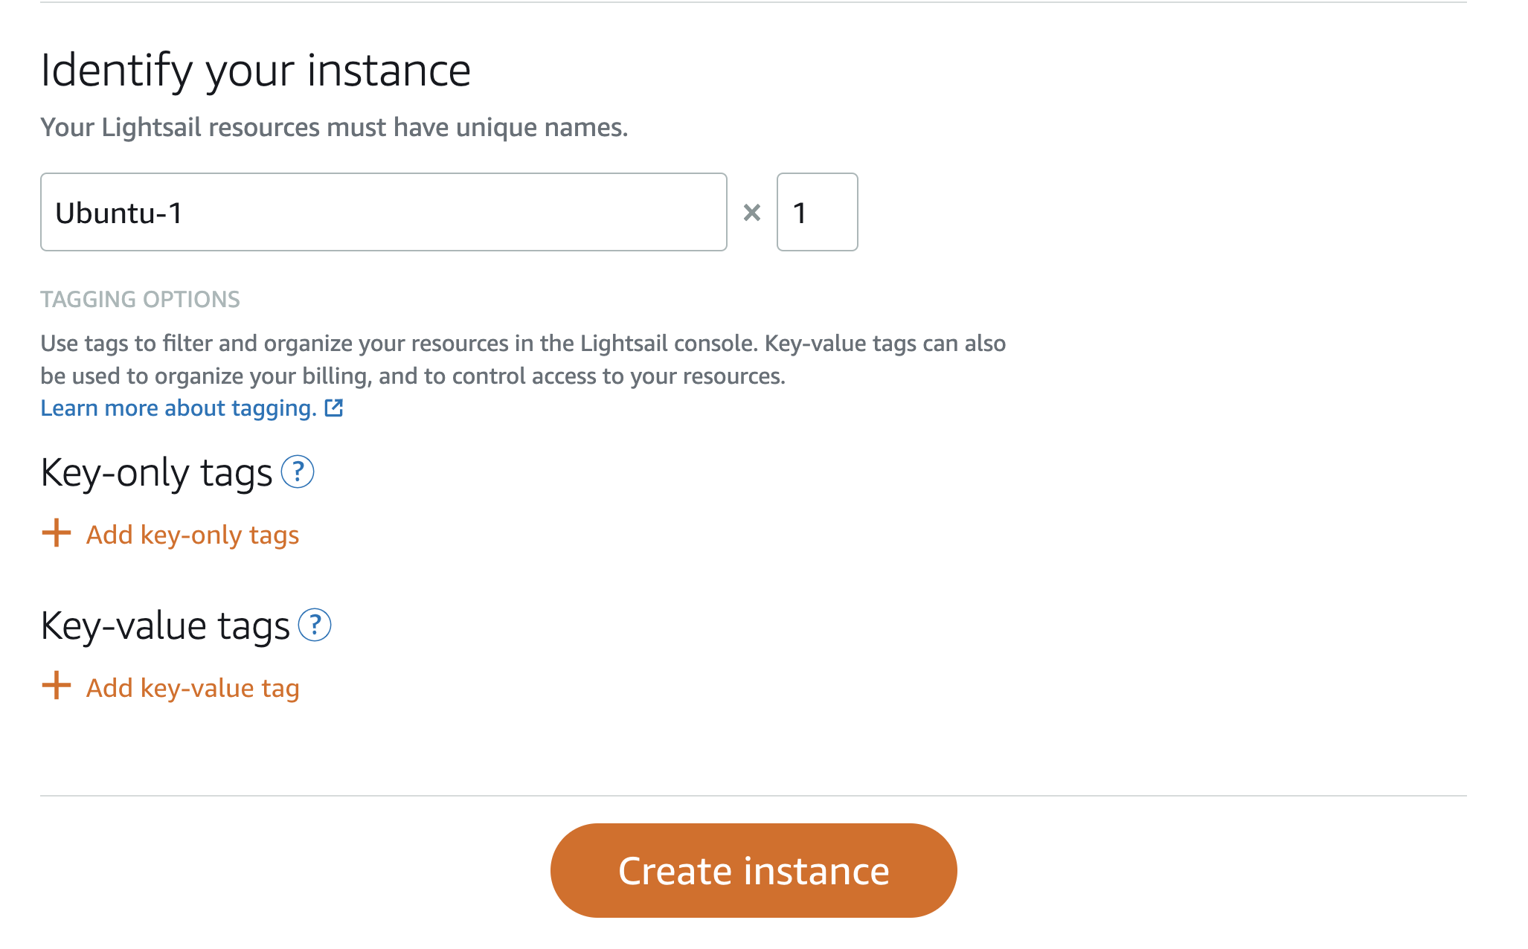
OUTPUT

Slide 11
HOW TO USE UBUNTU SERVER WITH MYSQL
After creating ubuntu-1 instance, then go to DB-Instance-1 see the resources, MySQL version, and Region, followed by the Endpoint and Port. The endpoint and port number are what you’ll use to connect an application to the database.
Then set up all the tab in DB-Instance-1 (like logs & history, Metrices, Networking, Snapshot & restore, Tags, Delete)
Copy the database endpoint to your clipboard, then navigate back to your Ubuntu-1 instance. Choose the remote terminal icon.

Slide 12
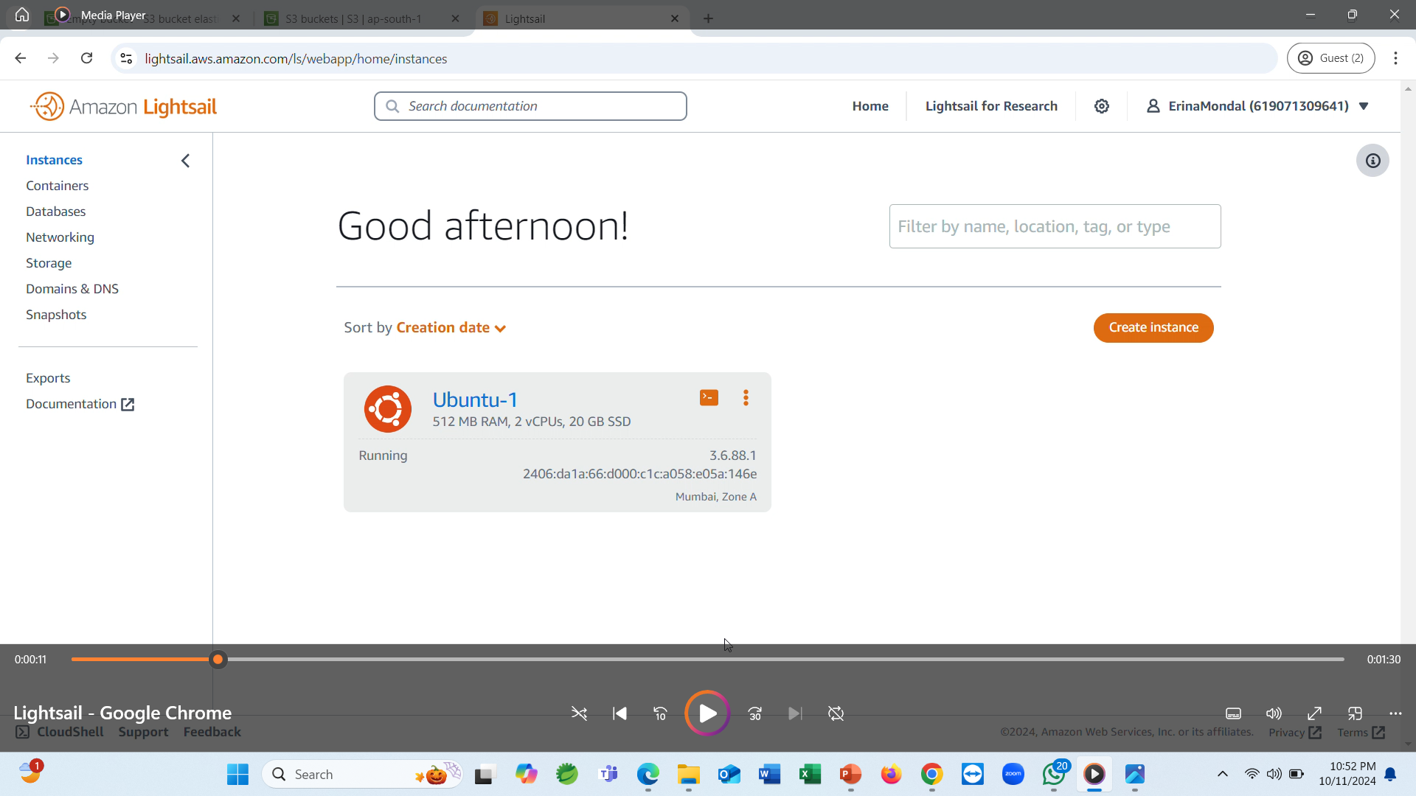
OUTPUT

Slide 13
HOW TO CONNECT MYSQL INSTANCE
A new SSH window will pop up and you can now connect from this instance into your database instance. Enter the following command and replace DATABASE_URL with the database endpoint you copied to your clipboard in the previous step.
Then you will see that you are connected to the MySQL instance.
Write a command (SHOW DATABASE),then run the command.
After you will see dbmain.
We created during database deployment, along with several others used by the LightSail database service. Object detection system.

Slide 14
After connect to the MySQL instance. Then create another database on the instance using the following command (CREATE DATABASE secondDB).
Then give your user dbmasteruser privileges on the new database by running the following command (GRANT ALL PRIVILEGES ON second.*to ’dbmasteruser).The above code grants your user all privileges on the secondDB database.
Finally, we can exit the remote SQL session by entering (exit).
Then showing the final output.

Slide 15
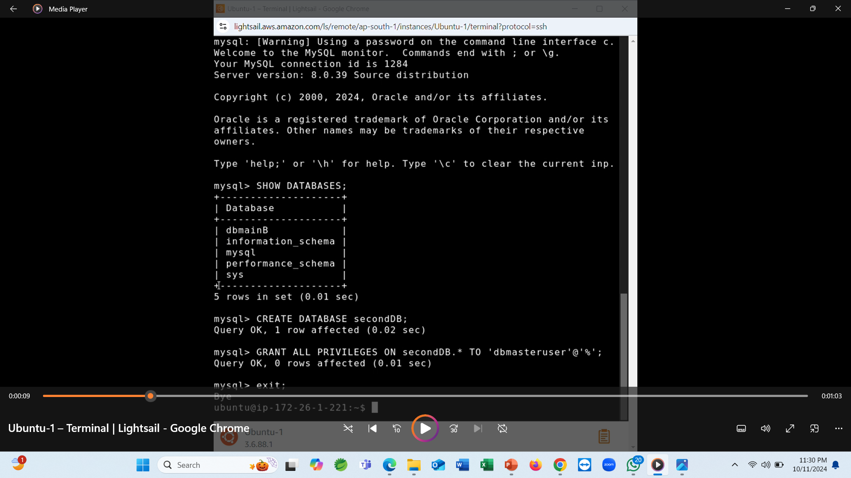
OUTPUT

Slide 16
THANK YOU

