Slide 1
Movie Recommender — Stage 1: Exploratory Data Analysis
MovieLens (small, latest) dataset • Generated from 01_exploration.ipynb

Slide 2
Dataset overview
100,836 ratings across 610 users and 9,724 movies
Average rating: 3.50 / 5.0
Median ratings per user: 70
Median ratings per movie: 3
Source files: movies.csv (movieId, title, genres), ratings.csv (userId, movieId, rating, timestamp)

Slide 3
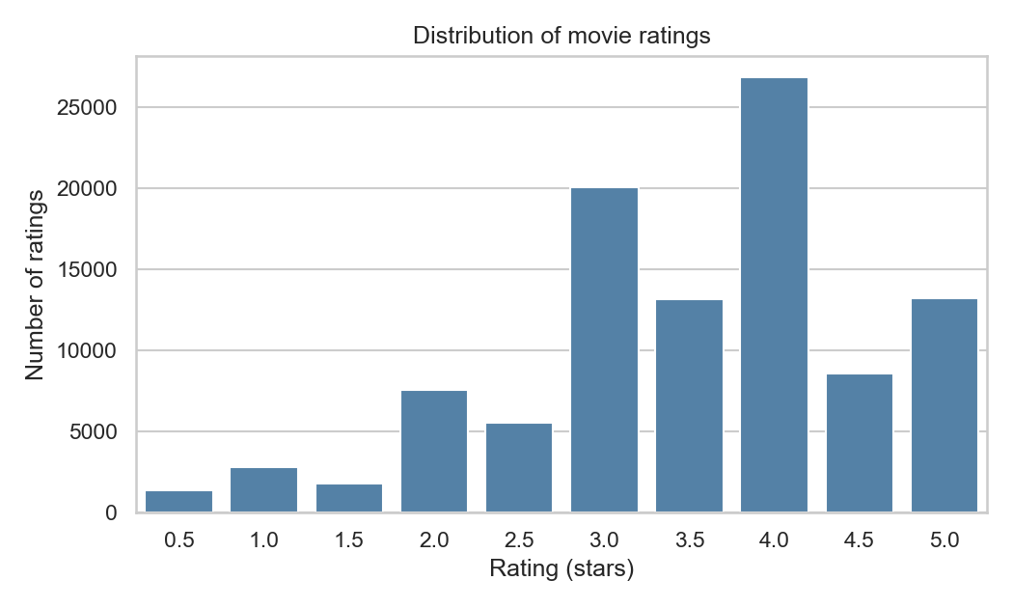
How are ratings distributed?
Ratings skew toward 3-4 stars (average = 3.50). People tend to rate things they chose to watch, so high scores dominate.

Slide 4
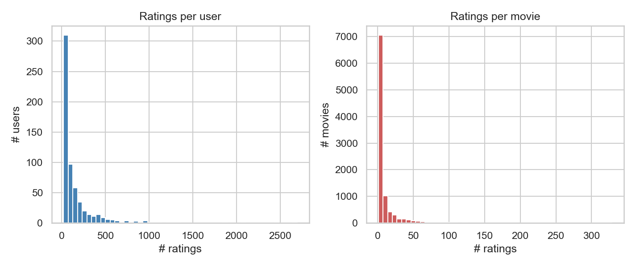
How active are users? How popular are movies?
Both distributions are long-tailed: median user rates 70 movies, median movie gets 3 ratings — a few power users/blockbusters dominate the rest.

Slide 5
Most-rated movies (popularity baseline candidates)
Title | # Ratings | Avg Rating
Forrest Gump (1994) | 329 | 4.16
Shawshank Redemption, The (1994) | 317 | 4.43
Pulp Fiction (1994) | 307 | 4.2
Silence of the Lambs, The (1991) | 279 | 4.16
Matrix, The (1999) | 278 | 4.19
Star Wars: Episode IV - A New Hope (1977) | 251 | 4.23
Jurassic Park (1993) | 238 | 3.75
Braveheart (1995) | 237 | 4.03
Terminator 2: Judgment Day (1991) | 224 | 3.97
Schindler's List (1993) | 220 | 4.22
The most-rated titles are the natural seed for Stage 2's popularity-based recommender.

Slide 6
How sparse is the data?
User x Movie grid: 610 x 9,724 = 5,931,640 possible cells
Actual ratings collected: 100,836
Density: 1.70% (cells filled)
Sparsity: 98.30% (cells empty)
This sparsity is why collaborative filtering needs to generalize from very few signals per user/movie.

Slide 7
What we learned & what's next
Ratings skew toward 3-4 stars — people mostly rate things they like
Users and movies both follow a long-tail distribution of activity/popularity
The data is extremely sparse (98.3%) — models must generalize from few signals
Next: build a popularity baseline (02_baseline.ipynb), then content-based and collaborative filtering (SVD)

