Slide 1
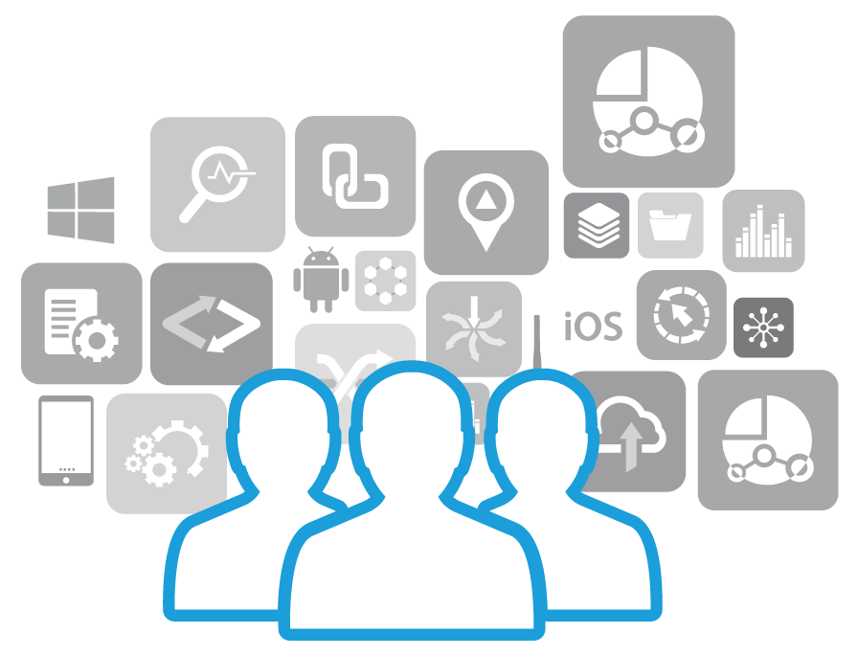
APPFORUM2014 Helping the developer community build next-generation, multi-platform apps.
SCHAUMBURG, ILLINOIS | SEPTEMBER 8-10

Slide 2
RhoConnect
Michael Toews/Alex Babichev | RHOCONNECT
Notes:
Before we start I feel that I should mention that we will be using mac OS commands for most of this session. It is not necessary that you use mac OS to use RhoConnect but there are some tools we will be using that are Mac OS only. Also, we highly recommend either Mac OS or Linux for RC development as the RC server is not supported for running on Windows machines.
Also, I ask that all questions be held until the specified points in our presentation. Please write down any questions you have and ask later on in the session.

Slide 3
Problem
Support mobile apps with highly-scalable data synchronization.
Implement non-trivial code for communicating and caching the data on the device.
Memory/performance constraints
Each mobile platform has its own development patterns & techniques
Scalability and redundancy issues
Inherent problem with enterprise solutions.
Notes:
You’re creating an Enterprise mobile app but, you have a few problems, most of which stem from synchronization. As any of us who have manually rolled out a synchronization engine out know, it can be the most time consuming and aggravating part of your development cycle. What you need is some middle-ware that has already done all the hard work for you; for this we have created RhoConnect.

Slide 4
Solution!
RhoConnect Sync Engine middleware.
Allows to isolate business logic in the single server-side container
Saves the developer from the need to code and support low-level data-syncing algorithms
Provides support for scalability and redundancy
Hides all platform-dependent details from the user
Follows modern development techniques and patterns (Sinatra-like interface, REST support, Model/Controller architecture, Node.js support, Redis) = makes learning curve time shorter + better user experience
Plugin system allows developers to write in their preferred language and environment and allows RhoConnect to handle syncing
Notes:
RhoConnect solves the problems of scalability, performance constraints on low-resource devices, as well as other inherent enterprise solutions issues. With RhoConnect, all your business logic is separated from your app logic in such a way that RC can be used with virtually any front-end, not solely RhoMobile apps. That combined with the modern development tools and paradigms makes the entire process of setting up and maintaining your synchronization service much more enjoyable. RhoConnect also offers plugins to other programming languages so you can code in the language that best allows RhoConnect to handle sync with your environment. How RhoConnect does all this is quite complicated but maybe a visual representation of the architecture will help.

Slide 5
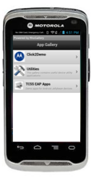


Architecture
RhoConnect
Core Engine - Sync, Request Brokers, Extensions)
REDIS
RhoConnect Plugins (MVC.NET, Java , Rails)
Application’s code (source adapters - controllers & models, implementing business logic)
Mobile App
Backend
Application
Notes:
Here you can see how the RhoConnect app interacts with your front- and back-end. As shown here in the graphic, RhoConnect’s core engine performs all the complex sync, request brokering, and other messy processes and all the RC developer needs to worry about is the part or RC that handles the CRUD operations concerning the back-end. Our documentation describes this in more detail but all the RC dev would need to do is provide the RC app with the means by which to communicate with and perform CRUD operations with the back-end, which includes having models and controllers for each object that will have sync enabled. Details of the sync process: 1) Object created on device or back-end, sync is triggered.
2) RC app receives sync request and processes the request using developer provided business logic.
3) RC app checks the data in the RC app’s associated Redis server for diffs.
4) Once RC has determined what is to be synced, the data is downloaded / uploaded to each location.
5) After the sync, RC issues statuses on the sync to the device and the back-end to notify of any errors or successes.
6) Sync concludes when objects on the device match the appropriate objects on the back-end.

Slide 6
DEMO

Slide 7
DEMO
Demo will consist of 3 separate exercises.
RhoConnect
Simple RhoConnect server application running on local machine
RhoConnect without plugins in cloud
Same RhoConnect server as #1, but running in cloud
RhoConnect with plugins
Vanilla RhoConnect server, with logic in rails plugin
Notes:
We have separated our demo into three distinct exercises, Local RC, RC with plugins, RC without plugins in the cloud.

Slide 8
LOCAL RHOCONNECT

Slide 9
RhoConnect-local
‘rhoconnect app rhoconnect-server’
Create rhoconnect app called “rhoconnect-server”
‘cd rhoconnect-server’
Change directory into the app’s dir.
‘rhoconnect source Product’
Create source adapter called ‘Product’
Edit Product model to include business logic
Model/Controller Rails-like code structure.
CRUD operations.
Notes:
To setup a local RC server, you’ll first need to create your app using the ‘rhoconnect app’ command, create a source adapter that will correspond to your model on your client app. For our purposes, we’re making a source adapter called ‘Product’. Then you define your business logic for CRUD operations.
We are going to just skip past the business logic and CRUD operations and go straight to the creation of the client app.

Slide 10
StoreManager - local
‘rhodes app store-manager’
Create rhodes client application called store-manager
‘cd store-manager’
Change into the app dir.
‘rhodes model product brand,name,price,quantity,sku’
Create rhodes model called ‘product’ with fields ‘brand’, ‘name’, ‘price’, ‘quantity’, ‘sku’
Edit rhoconfig.txt
Add/edit: syncserver = ‘http://<insert local ip>:9292’
Edit app/index.erb
Add/edit ‘<li><a href=‘Product’>Products</a></li>’ create Products list item
Notes:
If you attended the Rho bootcamp session, you should know this already but we’ll go over it quickly. First, create your app with the ‘rhodes app’ command and create the model that corresponds to your RC source adapter. Set your syncserver in your rhoconfig.txt. Add a link to your Product’s page in your app/index.erb and enable sync for that model in your model’s .rb file.

Slide 11
StoreManager – local (cont)
Edit app/Product/product.rb
Add/edit ‘enable :sync’ to enable syncing
‘rvm use 1.9.3’
Make sure to use ruby version 1.9.3
‘rake device:android:production_with_prebuild_binary’
Rake task to create .apk
‘adb install bin/target/android/store-manager.apk’
Install apk on target android device
Notes:
For this demo, we want to make sure that we are using ruby 1.9.3 because we know that it works with that config version. Run the rake task to create the app package, in the case of Android, an .apk file, and install the apk onto your device.
Here is one we setup earlier so you can see how it works.

Slide 12
RHOCONNECT LOCAL DEMO

Slide 13
Questions?

Slide 14
RHOCONNECT IN CLOUD

Slide 15
RhoConnect - Cloud
Create/login to account on RhoMobile.com
Create rhomobile rhoconnect application
Copy remote repository git url
Add remote to git
Commit to git
Push to remote repository
Build on RhoMobile.com
Deploy
Notes:
Creating either your RC app or your client app in the cloud both start in the same place, creating a rhomobile.com account. One caveat to building in the cloud is, you must signup for either a silver or gold level subscription. The free tier of subscription does not support remote builds.
Once you have signed up for your subscription on rhomobile.com, you’ll need to connect your local RhoConnect app directory to a remote github repo that will host your source code to be used in building your app.
After building, you’ll deploy your app somewhere, like Heroku or some other such service, and it will be ready to connect to.

Slide 16
StoreManager - Cloud
Add/edit rhoconfig.txt to include rhoconnect-server cloud location
syncserver = “<your-backend>”
Create/login to account on RhoMobile.com
Create RhoMobile RhoConnect app
Copy remote repository git url
Add remote to git
Commit to git
Push to remote repository
Build on rhomobile.com
Download to device
Notes:
Similarly to the previous steps, to create a client app in the cloud, you must create or login to your rhomobile.com account, link your local directory to the remote git repo, push your code, and tell it to build.
Once your app is built, you’ll need to download it to your device, and install it.

Slide 17
RHOCONNECT CLOUD DEMO

Slide 18
RhoConnect Plugin

Slide 19
RhoConnect and Rails Apps
‘rhoconnect app rhoconnect-vanilla’
Create purely vanilla rhoconnect application.
Optionally just start rhoconnect anonymous server.
‘rhoconnect start’
‘rails new rhostore-with-plugin’
Create a new rails app.
Edit Gemfile
Add/Edit ‘rhoconnect-rb’ to Include the RhoConnect plugin gem.
Add/Edit config/initializers/rhoconnect.rb
Add specific RhoConnect information.
Add/Edit app/models/product.rb
Add actions for ‘partition’ and ‘self.rhoconnect_query’.
Notes:
First we’ll need to create a vanilla RhoConnect app and a new rails app to work with. Once they are both created, we need to add the parts that will allow us to connect the two: add the ‘rhoconnect-rb gem into the Gemfile, setup RhoConnect as we usually would with the config, initializers etc., and edit our models to add actions to their rhoconnect_query method.

Slide 20
StoreManager
No changes!
Notes:
As far as our client app is concerned, nothing needs to be changed in order for it to work with RhoConnect w/ plugins.

Slide 21
RHOCONNECT WITH PLUGINS DEMO

Slide 22
THANK YOU

