Slide 1

CLASS 7 HISTORY · MEDIEVAL INDIA
Mobile and Settled Communities
How caste groups, tribal societies, traders and regional kingdoms shaped medieval India.

Slide 2
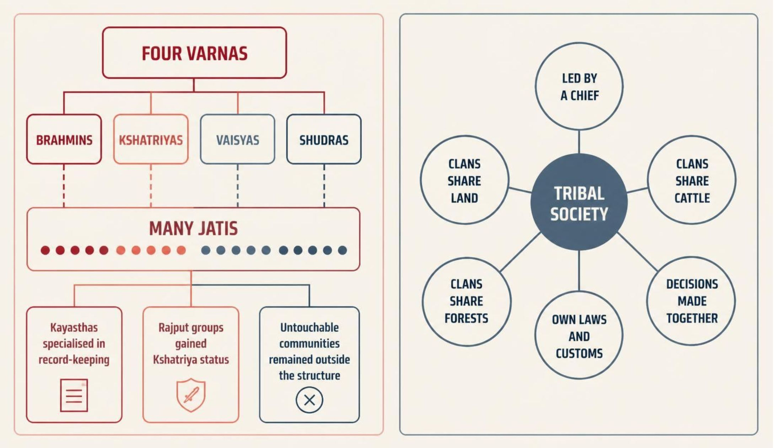
SOCIETY
Medieval society became more complex
New occupations, wealth and political power created many groups within and beyond the older varna structure.
Different communities followed different laws, customs and occupations.

Slide 3
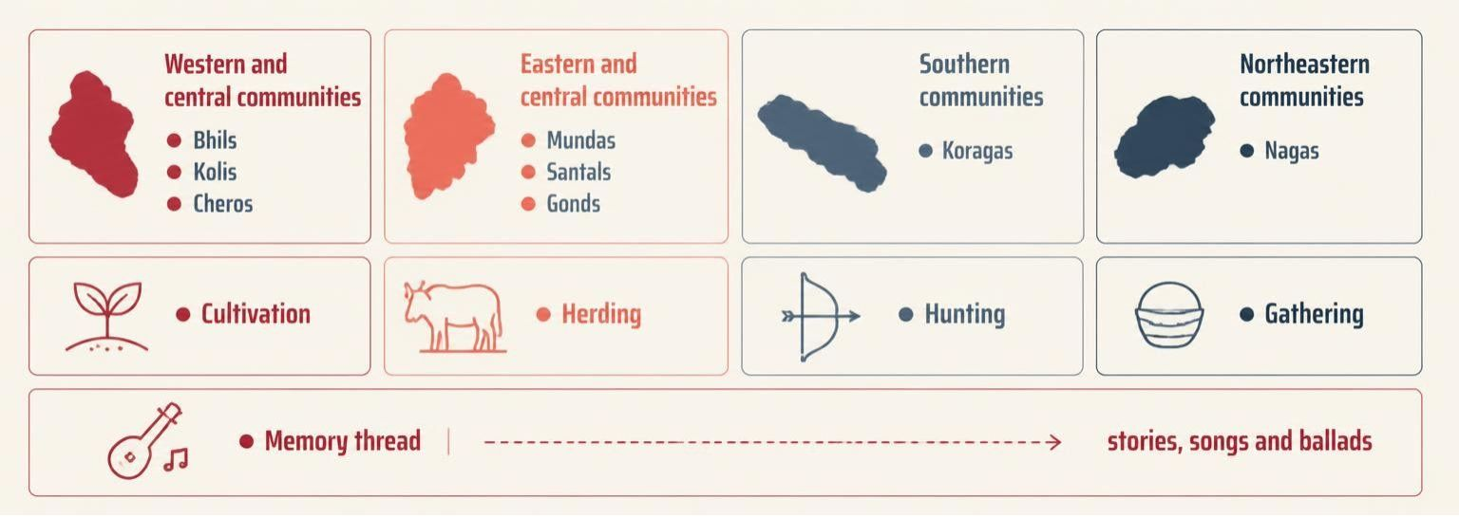
TRIBAL SOCIETIES
Tribes connected regions through work and memory
Across forests, hills, deserts and wastelands, communities cultivated, herded, hunted and gathered. Barter linked them with settled societies.
Stories, songs, ballads and ancestor traditions preserved history when written scripts were uncommon.

Slide 4
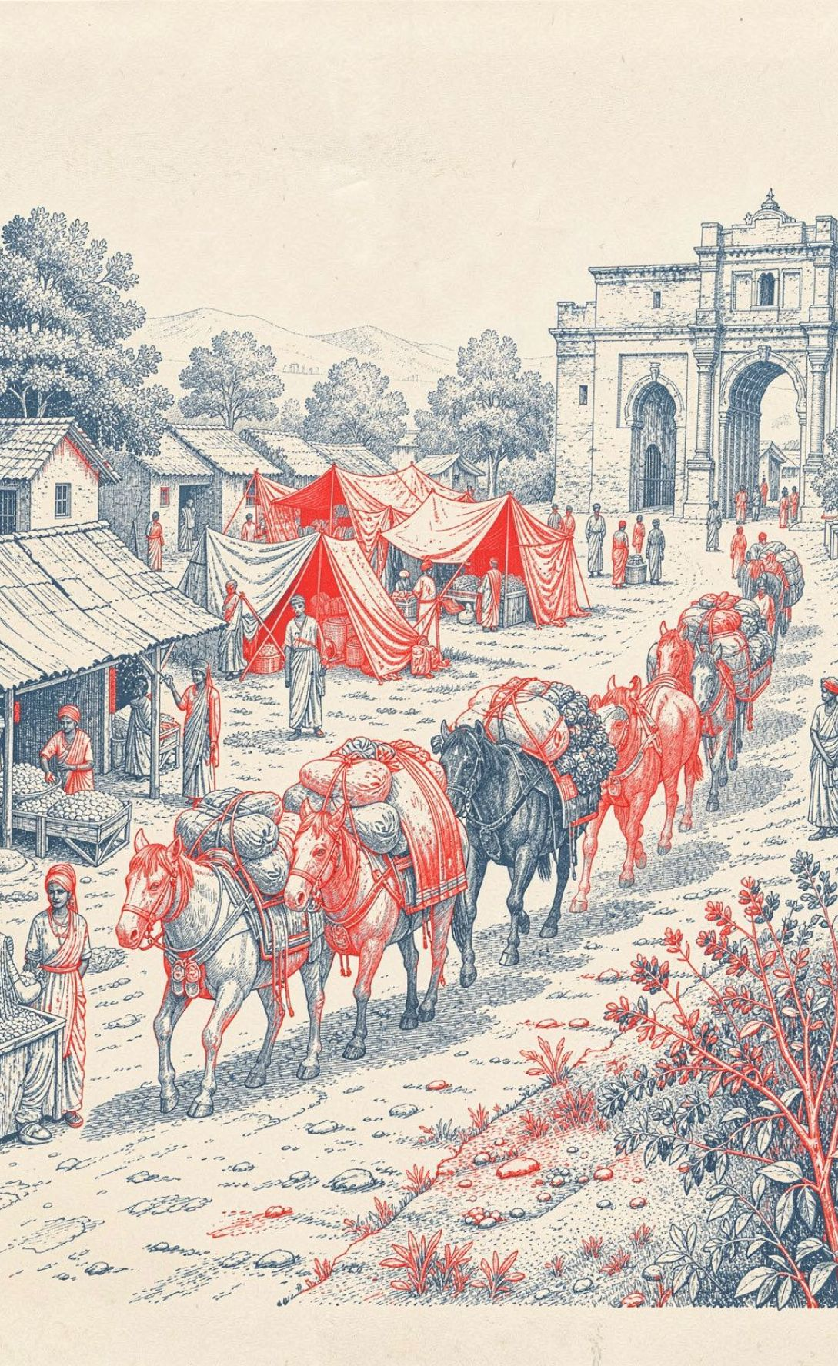
TRADE AND MOBILITY
Banjaras moved goods across medieval India
Pastoral nomads exchanged wool, butter and milk for grain, textiles and other goods. They bought food from peasants and carried it to urban markets in large caravans.
Their temporary camps were called tandas. A caravan could travel with 10,000 to 20,000 animals.
Village peddlers carried handmade goods from village to village, extending local trade.

Slide 5
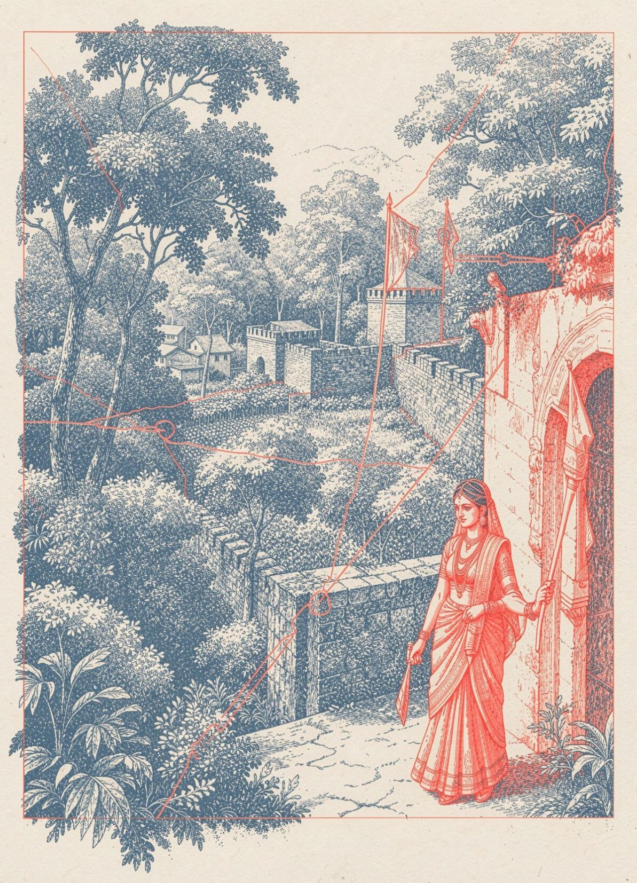
KINGDOMS
The Gonds built a powerful kingdom
In the fifteenth century, Gond tribes united in central India and Chhattisgarh to form Garha Katanga.
The kingdom was organised into territorial units. Each had a garh, or fortress, and several villages.
Rani Durgavati ruled for her son Bir Narayan, made the kingdom prosperous and defended it against neighbouring powers and the Mughals.
Her resistance became a lasting example of courage and leadership.

Slide 6
THE AHOMS
The Ahoms made the Brahmaputra valley their own
Migration and expansion
Working with local power
The Ahoms migrated into the Brahmaputra valley in the thirteenth century and later conquered the Chutiyas.
They built a powerful independent kingdom while working with local landlords called bhuyans.
Recording a shared past
Blending traditions
Royal chronicles called buranjis recorded rulers, administration and historical events.
Ahom rulers blended Hindu influences with traditional tribal deities, language and customs.

Slide 7
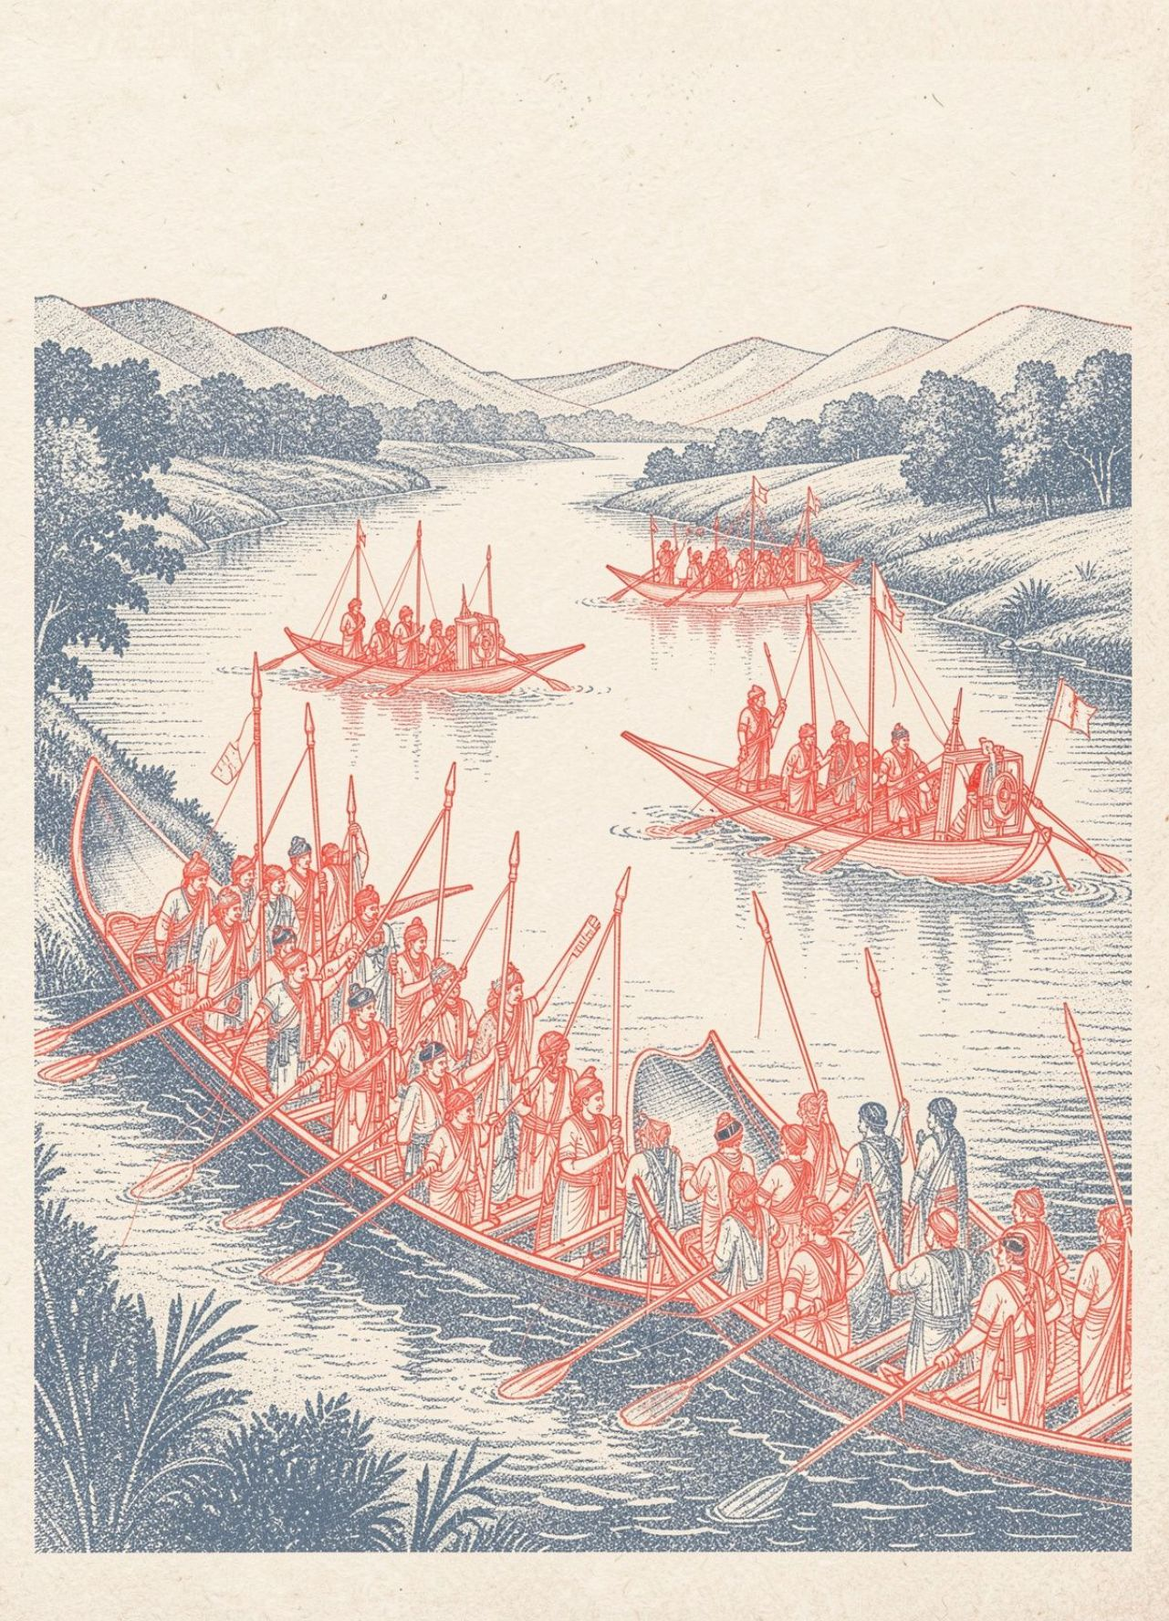
AHOM LEADERSHIP
Saraighat showed the strength of Ahom leadership
In 1662, Mughal forces captured the western Brahmaputra valley, while the Ahoms held the east.
Lachit Borphukan led the Ahom army to recover lost territory. In 1671, Ahom forces defeated the Mughals in a naval battle at Saraighat and drove them from the kingdom.
24 November is celebrated as Lachit Divas.

Slide 8
ADMINISTRATION
The paik system organised work, land and defence
Service was shared so the kingdom could defend itself while land stayed productive.
01
02
03
04
Paiks
One serves
Rotation
Khels
Most men aged 15 to 60 served as soldiers, road and dam builders, and reclaimers of rice land.
Four members formed a got. One person served while the others cared for his land.
The got rotated service, keeping work and defence moving together.
In the seventeenth century, paiks were organised into administrative divisions called khels.
Rang Ghar and Ahom traditions show how administration and culture developed together.

Slide 9
LOOKING BACK
Remember the story through a timeline
13th century
16th century
19th century
Ahoms migrate into the Brahmaputra valley.
Ahoms conquer the Chutiyas.
British rule ends the Ahom kingdom.
1
2
3
4
5
15th century
1662 · 1671
Gond tribes unite to form Garha Katanga.
Mughals capture the western valley; Ahoms win at Saraighat.

Slide 10
REVIEW
Key terms and final takeaway
TERM | MEANING
Varna · jati | Broad social division; smaller social group.
Clan · nomad | Related families; a person or community that moves.
Barter · ballad | Exchange without money; a story told in song.
Garh · tanda | Fortress; Banjara camp.
Buranji · paik · khel | Ahom chronicle; Ahom worker-soldier; paik division.
Big idea
Medieval India was shaped by interaction between settled communities, mobile groups, tribal societies and expanding kingdoms.
Discussion prompt
Which community changed medieval India's economy, politics or culture most strongly, and why?

Slide 11



