Slide 1
Couchbase Server in Production
Perry Krug
Sr. Solutions Architect
Notes:
In this session, we’re shifting gears from development to production. I’m going to talk about how to operate Couchbase in production – how to “care and feed” for the system to maintain application uptime and performance.
I will try to demo as much as time permits – as this is a lot about practice.
-This presentation will discuss the new features and production impact of 2.0, while most of this remains the same for 1.8 I will call out the specific differences as we come to them.

Slide 2
Agenda
Deploy
Architecture
Deployment Considerations/choices
Setup
Operate/Maintain
Automatic maintenance
Monitor
Scale
Upgrade
Backup/Restore
Failures
Notes:
Each on of these can determined the number of nodes
Data sets, work load, etc.

Slide 3
Deploy
Notes:
Before getting into the detailed recommendations and considerations for operating Couchbase across the application lifecycle, we’ll cover a few key concepts and describe the “high level” considerations for successfully operating Couchbase in production.

Slide 4



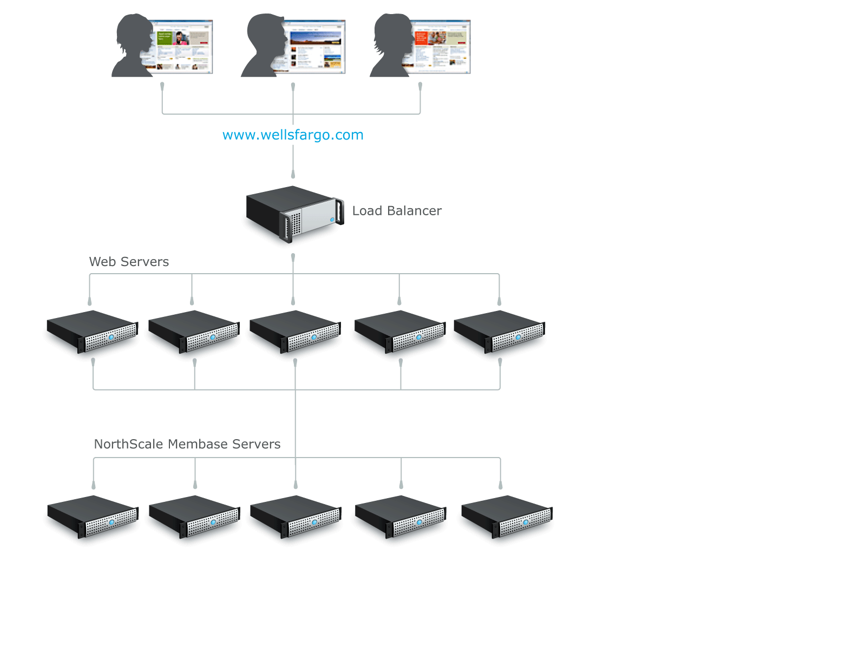






Typical Couchbase production environment
Application users
Load Balancer
Application Servers
Couchbase Servers
Notes:
The typical couchbase production environment. Many users of a web application, served by a load balanced tier of web/application servers, backed by a cluster of Couchbase Servers. Couchbase provides the real-time/transactional data store for the application data.

Slide 5
Couchbase deployment
Web Application
Web Application
Web Application
…
…
Couchbase
Client Library
Data ports
Couchbase Server
Couchbase Server
Couchbase Server
Couchbase Server
Replication Flow
Cluster Management
Notes:
When an application server or process starts up, it instantiates a Couchbase client object. This object takes a bit of configuration (language dependent) which includes one or more URL’s to the Couchbase Server cluster. That client object then makes a connection on port 8091 to one of the URL’s in its list and receives the topology of the cluster (called a vbucket map). Technically a client connects to one bucket within the cluster. Using this map, the client library then sends the data requests to the individual Couchbase Server nodes. In this way, every application server does the load balancing for us without the need for any routing or proxy process.
Let’s first start out by looking at the operations within each single node. Keep in mind again that each node is completely independent from one another when it comes to taking in and serving data. Every operation (with the exception of queries) is only between a single application server and a single Couchbase node. ALL operations are atomic and there is no blocking or locking done by the database itself. Application requests are responded to as quickly as possible which should mean sub-ms depending on your network unless a read is coming from disk and any failure (except timeouts) is designed to be sent as quickly as possible…”fail fast”.

Slide 6
Hardware
Designed for commodity hardware
Scale out, not up…more smaller nodes better than less larger ones
Tested and deployed in EC2
Physical hardware offers best performance and efficiency
Certain considerations with using VM’s:
RAM use inefficient / Disk IO usually not as fast
Local storage better than shared SAN
1 Couchbase VM per physical host
You will generally need more nodes
Don’t overcommit
“Rule-of-thumb” minimums:
3 or more nodes
4GB+ RAM
4+ CPU Cores
“best” local storage available
Notes:
Do not failover a healthy node!

Slide 7
Amazon/Cloud Considerations
Use a EIP/hostname instead of IP:
Easier connectivity (when using public hostname)
Easier restoration/better availability
RAID-10 EBS for better IO
XDCR:
Must use hostname when crossing regions
Utilize Amazon-provided VPN for security
You will need more nodes in general
Notes:
Talk about the Amazon “disaster” in December. Amazon told almost all our customers that almost all of their nodes would be restarted. We advised them to proactively rebalance in a whole cluster of new nodes and rebalance out the old ones, preventing any disruption when the restarts actually happened.

Slide 8
Amazon Specifically…
Disk Choice:
Ephemeral is okay
Single EBS not great, use LVM/RAID
SSD instances available
Put views/indexes on ephemeral, main data on EBS or both on SSD
Backups can use EBS snapshots (or cbbackup)
Deploy across AZ’s (“zone awareness” coming in 2.5)
Notes:
Talk about the Amazon “disaster” in December. Amazon told almost all our customers that almost all of their nodes would be restarted. We advised them to proactively rebalance in a whole cluster of new nodes and rebalance out the old ones, preventing any disruption when the restarts actually happened.

Slide 9
Setup: Server-side
Not many configuration parameters to worry about!
A few best practices to be aware of:
Use 3 or more nodes and turn on autofailover
Separate install, data and index paths across devices
Over-provision RAM and grow into it

Slide 10
Setup: Client-side
Use the latest client libraries
Only one client object, accessed by multiple threads
Easy to misuse in .NET and Java (use a singleton)
PHP/Ruby/Python/C have differing methods, same concept
Configure 2-3 URI’s for client object
Not all nodes necessary, 2-3 best practice for HA
Turn on logging – INFO by default
(Moxi only if necessary, and only client-side)

Slide 11
Operate/Maintain
Notes:
Before getting into the detailed recommendations and considerations for operating Couchbase across the application lifecycle, we’ll cover a few key concepts and describe the “high level” considerations for successfully operating Couchbase in production.

Slide 12
Automatic Management/Maintenance
Cache Management
Compaction
Index Updates
Occasionally tune the above
Notes:
So the monitoring goal is to help assess the cluster capacity usage which derive the decision of when to grow.

Slide 13
Cache Management
Couchbase automatically manages the caching layer
Low and High watermark set by default
Docs automatically “ejected” and re-cached
Monitoring cache miss ratio and resident item ratio is key
Keep working set below high watermark
Notes:
not unique to Couchbase…MySQL suffers as well for example

Slide 14
View/Index Updates
Views are kept up-to-date:
Every 5 seconds or every 5000 changes
Upon any stale=false or stale=update_after
Thresholds can be changed per-design document
Group views into design documents by their update frequency
Notes:
not unique to Couchbase…MySQL suffers as well for example

Slide 15
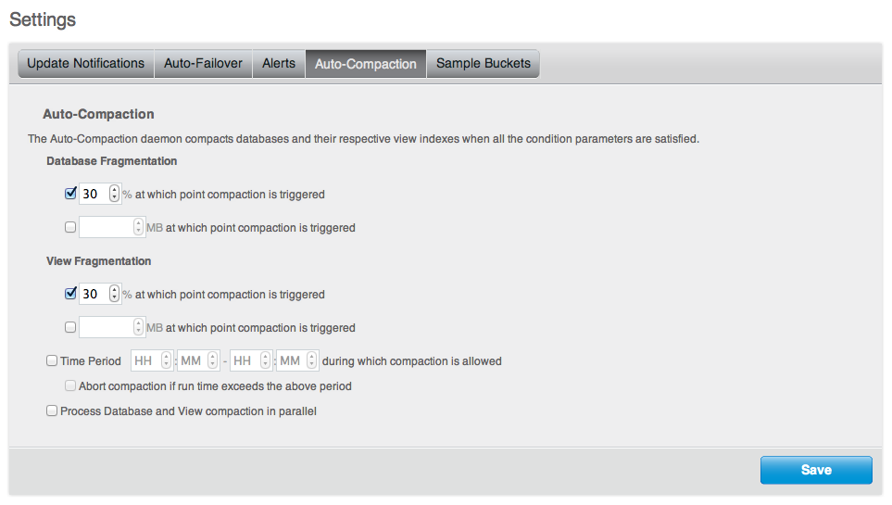
Disk compaction
Compaction happens automatically:
Settings for “threshold” of stale data
Settings for time of day
Split by data and index files
Per-bucket or global
Reduces size of on-disk files – data files AND index files
Temporarily increased disk I/O
and CPU, but no downtime!
Notes:
not unique to Couchbase…MySQL suffers as well for example

Slide 16
Disk compaction
Initial file layout:
Update some data:
After compaction:
Doc A
Doc B
Doc C
Doc A
Doc A
Doc B
Doc B
Doc C
Doc A’
Doc A’
Doc B’
Doc D
Doc A’’
Doc C
Doc B’
Doc D
Doc A’’
Notes:
not unique to Couchbase…MySQL suffers as well for example

Slide 17
Tuning Compaction
“Space versus time/IO tradeoff”
30% is default threshold, 60% found better for heavy writes…why?
Parallel compaction only if high CPU and disk IO available
Limit to off-hours if necessary
Notes:
not unique to Couchbase…MySQL suffers as well for example

Slide 18
Manual Management/Maintenance
Scaling
Upgrading/Scheduled maintenance
Dealing with Failures
Backup/Restore
Notes:
So the monitoring goal is to help assess the cluster capacity usage which derive the decision of when to grow.

Slide 19
Scaling
Couchbase Scales out Linearly:
Need more RAM? Add nodes…
Need more Disk IO or space? Add nodes…
Monitor sizing parameters and growth to know when to add more nodes
Couchbase also makes it easy to scale up by swapping larger nodes for smaller ones without any disruption
Notes:
So the monitoring goal is to help assess the cluster capacity usage which derive the decision of when to grow.

Slide 20
What to Monitor
Application
Ops/sec (breakdown of r/w/d/e(xpiration))
Latency at client
RAM
Cache miss ratio
Resident Item Ratio
Disk
Disk Write Queue (proxy for IO capacity)
Space (compaction and failed-compaction frequency)
XDCR/Indexing/Compaction progress

Slide 21
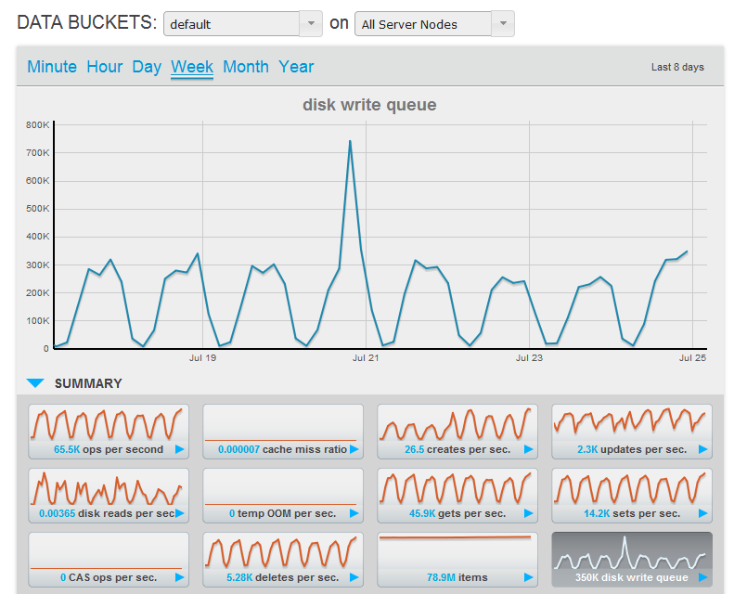
Notes:
An example of a weekly view of application on production, clearly see the oscillation on the disk write queue load.
About 13 node cluster at the time (grew since then),
With ops/sec that varies from 1k at the low time to 65K at peak, running on EC2.
We can easily see the traffic patterns on the disk write queue, and regardless the load, the application sees the same deterministic latency.

Slide 22
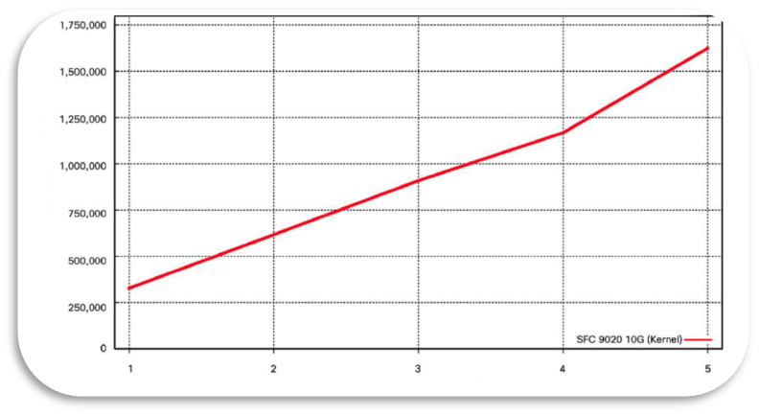
Couchbase + Cisco + Solarflare
High throughput with 1.4 GB/sec data transfer rate using 4 servers
Operations per second
Linear throughput scalability
Number of servers in cluster

Slide 23
Upgrade
Add nodes of new version, rebalance…
Remove nodes of old version, rebalance…
Done!
No disruption
General use for software upgrade, hardware refresh, planned maintenance
Clusters compatible with multiple versions
(1.8.1->2.x, 2.x->2.x.y)
Notes:
Talk about the Amazon “disaster” in December. Amazon told almost all our customers that almost all of their nodes would be restarted. We advised them to proactively rebalance in a whole cluster of new nodes and rebalance out the old ones, preventing any disruption when the restarts actually happened.

Slide 24
Planned Maintenance
Use remove+rebalance on “malfunctioning” node:
Protects data distribution and “safety”
Replicas recreated
Best to “swap” with new node to maintain capacity and move minimal amount of data
Notes:
Do not failover a healthy node!

Slide 25

Failures Happen!
Hardware
Network
Bugs
Notes:
Do not failover a healthy node!

Slide 26
Easy to Manage failures with Couchbase
Failover (automatic or manual):
Replica data and indexes promoted for immediate access
Replicas not recreated
Do NOT failover healthy node
Perform rebalance after returning cluster to full or greater capacity
Notes:
Do not failover a healthy node!

Slide 27
Fail Over Node
App Server 1
App Server 2
COUCHBASE Client Library
COUCHBASE Client Library
Cluster Map
Cluster Map
App servers accessing docs
Requests to Server 3 fail
Cluster detects server failed
Promotes replicas of docs to active
Updates cluster map
Requests for docs now go to appropriate server
Typically rebalance would follow
Server 1
Server 2
Server 3
Server 4
Server 5
Active
Active
Active
Active
Active
Doc 5
Doc
Doc 4
Doc
Doc 1
Doc
Doc 9
Doc
Doc 6
Doc
Doc 2
Doc
Doc 7
Doc
Doc 2
Doc
Doc 8
Doc
Doc
Doc 1
Doc 3
REPLICA
REPLICA
REPLICA
REPLICA
REPLICA
Doc 4
Doc
Doc 6
Doc
Doc 7
Doc
Doc 5
Doc
Doc 8
Doc
Doc 1
Doc
Doc 3
Doc
Doc 9
Doc
Doc 2
Doc
Couchbase Server Cluster
User Configured Replica Count = 1
Notes:
http://www.couchbase.com/docs/couchbase-manual-2.0/couchbase-admin-tasks-failover.html
Finally, let’s look at what happens when a node fails.
Imagine the application is reading and writing to server #3. (click) In reality, it is sending requests to all the servers, but let’s just focus on number 3.
If that nodes goes down, there have to be some requests that fail. Some will have already been sent on the wire, and others may be sent before the failure is detected. It’s important for your application to be prepared for some requests to fail, whether it’s a problem with Couchbase or not.
Once the failure is detected, the node can be failed over either automatically by the cluster or manually by the administrator pressing a button or a script triggering our REST API. Once this happens (click), the replica data elsewhere in the cluster is made active, (click) the client libraries are updated and (click) subsequent accesses are immediately directed at the other nodes. Notice that server 3 doesn’t fail all of its data over to just one other server which would disproportionately increase the load on that node, but all of the other nodes in the cluster take on some of that data and traffic.
Note also that the data on that node is not re-replicated. This would put undo load on an already degraded cluster and potentially lead to further failures.
The failed node can now be rebooted or replaced and rebalanced back into the cluster. It is our best practice to return the cluster to full capacity before rebalancing which will automatically recreate any missing replicas. There is no worry about that node bringing its potentially stale data back online, once failed over the node is not allowed to return to the cluster without a rebalance.

Slide 28
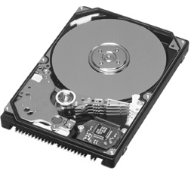

Backup
“cbbackup” used to backup node/bucket/cluster online:
cbbackup
Server
Server
Server
Data Files
network
network
network

Slide 29
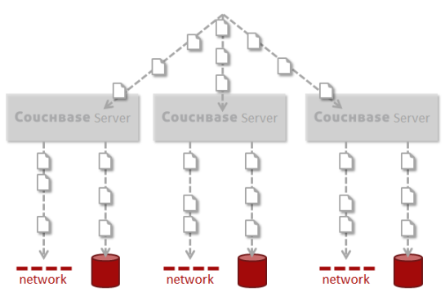
Restore
“cbrestore” used to restore data into live/different cluster
cbrestore
Data Files
Notes:
Worthwhile to say that during warmup, data is not available from node…
Unlike traditional RDBMS…
Can handle at application level with “move on”, “retry”, “log”, “blow up”…some data is unavailable, not all

Slide 30
Want more?
Lots of details and best practices in our documentation:
http://www.couchbase.com/docs/
Notes:
Do not failover a healthy node!

Slide 31
Thank you Couchbase NoSQL Document Database perry@couchbase.com @couchbase

