Slide 2
Document Your World
Robin Johnson
Developer Advocate

Slide 3

Robin Johnson
Developer Advocate at Couchbase
Polyglot Hacker (Primarily Ruby, Python, Go, and C)
NoSQL & REST API Enthusiast
@RBIN
robin@couchbase.com
Notes:
Lead of UK Development and proud to have been a key part of the team, Bootstrapped the worlds first, award winning Social Gambling website.

Slide 4
What to Expect:
JSON Basics
JSON Documents within Couchbase itself
Mind-set Changes between Relational and Non-Relational Modeling
Building an application around JSON
Document Structuring / Modeling our data effectively
Views and Indexes within Couchbase
An introduction to Map / Reduce
Notes:
All tied up by a real-life Use Case!

Slide 5

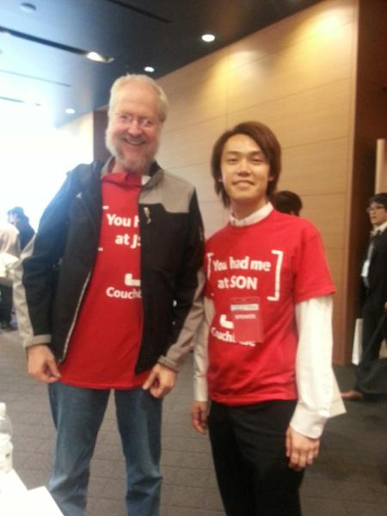
JSON Basics – what is JSON?
Java Script Object Notation
Created by Douglas Crockford
Text Based Format
Designed for Human-readable data interchange
Notes:
a text-based open standard designed for human-readable data interchange.

Slide 6
JSON Basics – Why JSON?
JSON has a lot of advantages:
It's compact
It's easy for both computers and people to read and write
It maps very easily onto the data structures used by most programming languages (numbers, strings, booleans, nulls, arrays and associative arrays)
Nearly all programming languages contain functions or libraries that can read and write JSON structures
Notes:
"What's powerful about JSON is that you can represent complex in-memory objects in a simple notation made up of data structures"

Slide 7
Supported JSON Types:
Numbers: – (Int. & Floating Point)
22 & 55.2
Object:
{
”name" : “Robin Johnson”
“twitter" : “@rbin",
”age" : 22,
"title" : ”Developer Advocate"
}
String:
"A String"
Boolean:
{“value” : false}

Slide 8
Supported JSON Types - Lists:
List of Objects:
Array:
foos : [
{
”bar1":"value1",
”bar2":"value2"
},
{
”bar3":"value3",
”bar4":"value4"
}
]
["one", "two", "three"]
Complex, Nested Objects:
{ tweet, tweet… }
Notes:
In our array, we have comma separated values. Could be used for things like favourite colours, or genres for a song etc.
Our list of Objects could be a list of addresses for our users or any other complex kind of data list.
SHOW TWITTER API. Complex objects in nested format. What a complete application may produce. (And we think it’s only 140 characters!!!)
URL objects, with original URL and shortened Twit URL, Nested Hashtags, and Nested User_mentions

Slide 9
JSON Documents within Couchbase
Couchbase is primarily a JSON-oriented Document Data Store.
Each document is stored with a Unique Identifier (Key) and is made up of key-value pairs.
Couchbase uses these JSON values to build indexes, query data and perform advanced lookups.
Couchbase stores the ‘Meta’ of each Document, and the Body (Content)…
Notes:
- Find out more about how Couchbase uses JSON Values in Indexing in Session #3.

Slide 10
JSON Document Structure
meta
{
“id”: “robin@couchbase.com”,
“rev”: “1-0002bce0000000000”,
“flags”: 0,
“expiration”: 0,
“type”: “json”
}
document
{
“uid”: 1234,
“firstname”: “Robin”,
“lastname”: “Johnson”,
“age”: 22,
“favorite_colors”: [“green”, “red”],
“email”: “robin@couchbase.com”
}
Meta Information Including Key (ID)
All Keys Unique and Kept in RAM at all times.
Document Value
Most Recent In Ram And Persisted To Disk
Notes:
- Why metas are stored in RAM at all times:
It has been the choice of implementation since day 1. If we need to check if a doc exists we only need to look in RAM instead of hitting disk.
Meta is only 54bytes + the Key size.

Slide 11


Objects Serialized to JSON and Back
User Object
u::robin@couchbase.com
{
“uid”: 1234,
“firstname”: “Robin”,
“lastname”: “Johnson”,
“age”: 22,
“favorite_colors”: [“green”, “red”],
“email”: “robin@couchbase.com”
}
set()
string | uid
string | firstname
string | lastname
int | age
array | favorite_colors
string | email
User Object
u::robin@couchbase.com
{
“uid”: 1234,
“firstname”: “Robin”,
“lastname”: “Johnson”,
“age”: 22,
“favorite_colors”: [“green”, “red”],
“email”: “robin@couchbase.com”
}
get()
string | uid
string | firstname
string | lastname
int | age
array | favorite_colors
string | email
Notes:
Couchbase doesn’t serialize documents, that’s up to us as developers. We call a serialisation lib through our Code.
Ruby: - Hashes are converted to JSON and vice versa
.NET: - Newtonsoft.JSON and JSONProperty
Java: - Google Gson: toJson/fromJson
Python: - json.loads/json.dumps
PHP: - json_encode/json_decode
Nodejs: - native data structure!

Slide 12
The Mind-Set Change
Notes:
The most difficult part for most people coming from Relational DBs to Non-Rel DBs.

Slide 13
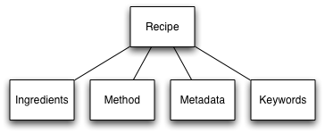
The Move from Relational Modeling
All of our data is in tables,
We split complex data across multiple tables,
We have a very rigid, inflexible schema, and
All of our data records are forced to look the same.
We use complex JOINS, WHERE Clauses and ORDER BY Clauses
Our ‘Recipe’ table uses “JOINS” to aggregate info from other Tables.

Slide 14
The Move to NoSQL
In Couchbase, we’re going to model our Documents in JSON.
Contrary to Relational DBs, we can hit the database as much as we like as Gets and Sets are so quick, they’re trivial.
We can make changes to our Data structures at any time, without having to use ALTER_TABLE statements allowing for agile model development.
There is no implied schema, so each record in our DB could look entirely different to the last.
Getting our heads around modeling data in JSON can be tricky. Let’s look at how we can get started in JSON Modeling:
Notes:
Instead of having to split or Normalise complex in-memory data structures down into multiple tables,
JSON allows you to serialize these objects including nested complex data structures without normalization in a single document

Slide 15
Modeling an Application… The JSON way

Slide 16
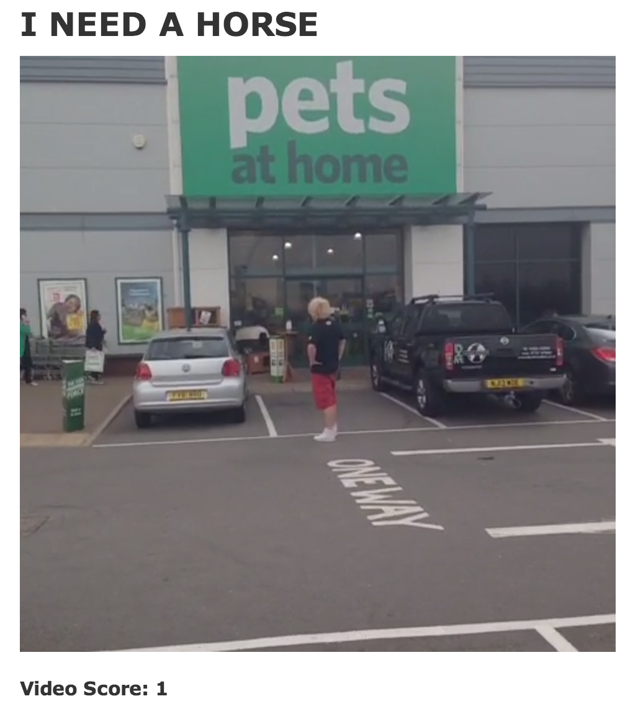
Rate My Vine…
Social Application in which people can vote on other User’s Vine videos and see a Global Ranking of the Best and Worst Vine Videos!
Top Rated Vines
Cooking w/ Hugh Fearnley-Whittingstall
I love doing Housework
What happened to Amanda Bynes
Random Access Memories
I don’t even know
Twerking gone wrong
Too cold to Dance
How To Scare Your Friends
176
143
120
112
107
98
74
37

Slide 17
Technology Used:
This is an actual Sample App for Couchbase, fully Open Source
Built on Ruby, Rails & Couchbase
Using the Couchbase-Model Ruby Gem for Active-Record style (easy) data modeling
Puma as web server for concurrent connections

Slide 18
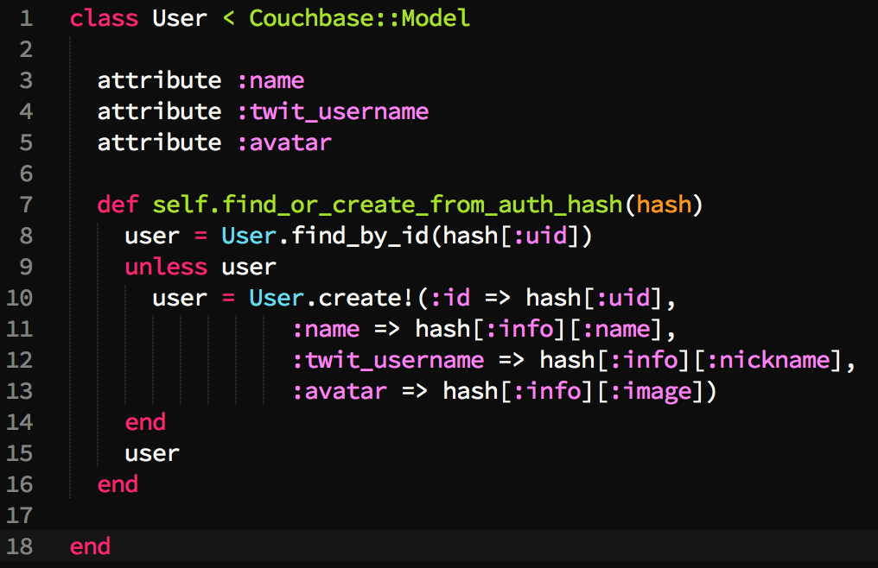
User.rb
Users must Auth with Twitter before Submitting Vines
We simply register their Name, Twitter Username & Avatar upon T-auth
Notes:
No password / authentication model to write, as it’s all just Auth with Twitter.

Slide 19
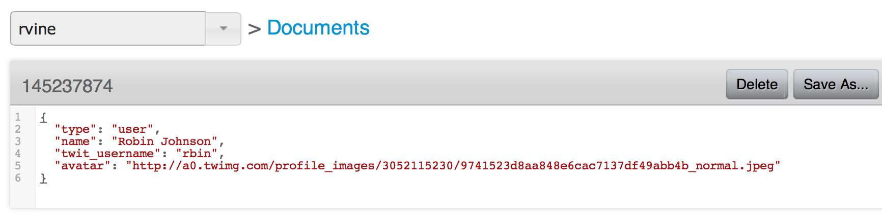
How that looks as JSON in Couchbase:
Key created by a hash of Twitter UID
Explicit ‘type’ of Document
Standard JSON structure with simple String fields
This JSON is editable within the Couchbase Console
Notes:
We explicitly state the type of document as we have multiple types of documents in 1 bucket. i.e. – Users and Vine Videos
A bucket is just a logical namespace for our data and we can have data of all different kinds in there. We could have user documents, video documents, beer documents or Brewery docs.
To split these documents up, we give them a ‘type’ which makes it much simpler when it comes to structuring our data at Querytime.

Slide 20
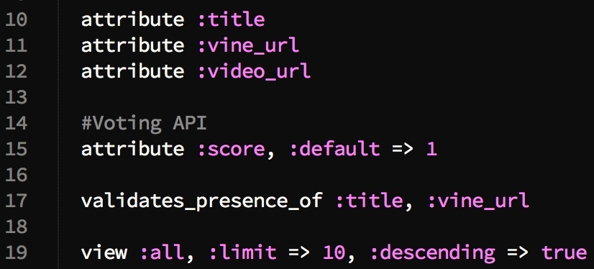
Vine.rb
Vine has no public API, so we’ve written a cheeky script to Rip the true URI of the video, from the entered URL by the user
Vines need a Name, A Video URL, a User and a Score
Notes:
Extract_Video_URL is our cheeky script that takes the user’s entered Vine URL and strips the Video URI from the SRC. It does this as a save callback when a Vine is created.

Slide 21
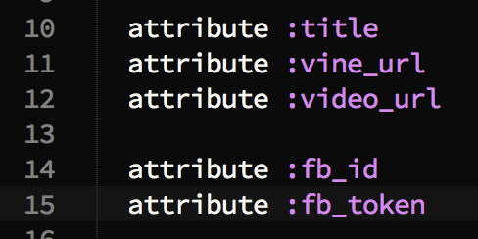
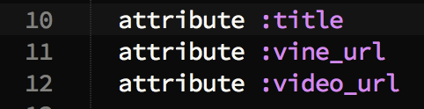
The Joys of a Flexible Schema!
Marketing have informed us that we need to add a new field for Facebook Sharing into our Vine Videos!
In a relational world, we would have problems!
In the Couchbase world, IT’S TRIVIAL!
Notes:
In a relational world, we would have to consult our devs, then our DBA, hope that our DBA has had a good day so far, because he is about to make dreaded changes to his precious schema!
The DBA would have to perform an expensive data migration too, often completely pulling our app offline!
Because of Couchbase’ flexible schema, we simply add the attributes into our model, and we’re done! NO expensive ALTER TABLE statements, NO data migrations, NO DBA necessary!
The point is, we can change our model AT ANY TIME, without any drama! (Applications grow, and rarely ever keep the same data model forever!)

Slide 22
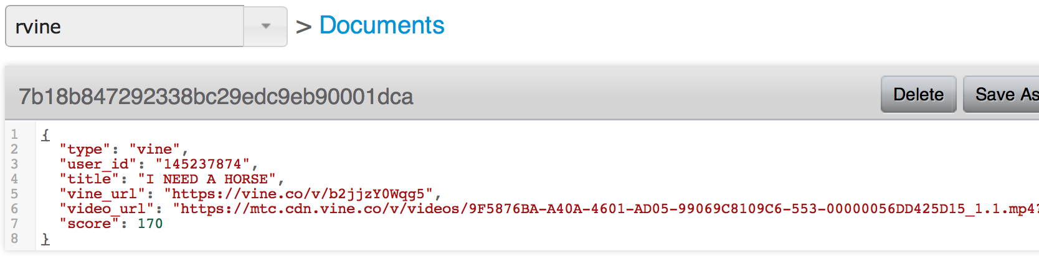
Again, the JSON within Couchbase:
Random Hash generated Key
User_ID reference
User_ID included so we know who each Vine belongs to
Score is inside each Vine document. This brings it’s own challenges, but Couchbase solves them!

Slide 23

Optimistic Concurrency:
We have chosen to have the Score inside each Vine doc.
We need to be able to deal with concurrent score updates.
UPDATE
UPDATE
{
“score" : 174
}
Notes:
Because we have chosen to leave the score inside the doc, how are we going to handle 2 updates at the same time?
2 people have to GET the doc, update the value, and UPDATE the SCORE value at the same time.

Slide 24
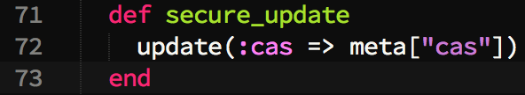
CAS – Compare and Swap
To handle the Concurrent updates, we can utilise Couchbase’ inbuilt CAS value.
We simply write a new Update method in our application controller to use the CAS value on update.
Notes:
You will have heard about CAS this morning. This is actually using it in a real life application to handle concurrency.
We’re defining a new method named secure_update that is going to ensure the document is saved with the correct CAS value and NOT throw a CAS Mismatch.
It may seem simple, and that’s because it is. Now when people click on the Upvote button from the frontend of our application, the resulting UPDATE command that is sent to the document
Must have a matching CAS value to be able to update.

Slide 25
A Better way of keeping Score…
Instead of embedding the Score within each document, we could split it out into it’s own attribute; as an Atomic Counter.
We would create a new data model named score.rb
Score.rb would ‘belong_to’ Vine.rb in our Rails model
Each score would be ID’d with a referential ID to the Vine it belongs to.
{ “7b18b847292338bc29edc9eb90001dca::score”, 270 }
(Vine ID)
This could be a major performance improvement for us, but does make modeling slightly trickier.
Notes:
By splitting the Score out into it’s own Atomic Counter, we no longer have to ‘Get’ and re-save the full document to update the score.
It will also allow for Greater concurrent ‘Upvotes’ on our videos.

Slide 26
Document Relationships
Just as in SQL, our JSON Documents also have various types of ‘Relationship’.
For example, a User can own many Videos as a 1 to many relationship.
video:1
{
type: “vine”,
title: “My Epic Video”,
owner: “rbin”
}
user:rbin
{
type: “user”,
name: “Robin Johnson”,
id: “rbin”
}
Video:2
{
type: “vine”,
title: “I NEED A HORSE!”,
owner: “rbin”
}

Slide 27
Single vs. Multiple Documents
Marketing have informed us we need to add a Comment mechanism to our Vine Videos.
We need to decide the best way to approach this in JSON document design.
Single
Multiple
Document
{
Comment
vs.
Comment
}
Comment
Notes:
Do the who thinks hands up thing. It depends. Fun times.

Slide 28
Single vs. Multiple - Single
Comments are nested within their respective Vine documents.
Great when we know we have a finite amount of Results.
7b18b847292338bc29
{
"type": "vine",
"user_id": "145237874",
"title": "I NEED A HORSE",
"vine_url": "https://vine.co/v/b2jjzY0Wqg5",
"video_url": "https://mtc.cdn.vine.co……,
"score": 247,
"comments": [
{"format": "markdown", "body": "I LOVE this video!"},
{"format": "markdown", "body": "BEST video I have ever seen!"},
]
}
Notes:
Comments are nested within the document. To add / change them, we’d use CAS as we’ve just seen.
Embedding attributes within the document is great when you know you’ve got a finite amount of results.
But what if it gets over 9000 comments!? Document bloating then is the problem.

Slide 29
Single vs. Multiple - Multiple
Comments are split from the parent document.
Comments use referential ID’s, incremented by 1
7b18b847292338bc29::1
7b18b847292338bc29
{
"format": "markdown",
"body": "I LOVE this video!”
}
{
"type": "vine",
"user_id": "145237874",
"title": "I NEED A HORSE",
"score": 247,
}
7b18b847292338bc29::2
{
"format": "markdown",
"body": “BEST video ever!”
}
Notes:
Sometimes it’s better to split attributes out into multiple documents. In this case, we don’t know how many comments we might get.
If we get LOTS of comments, keeping them inside 1 document could get bloated as hell.
In this case, or a case when there’s an infinite amount of items; splitting out into multiple documents is best.
Our comments here are split out into their own document and keyed by using the Vine’s ID, with an incremented number on the end to track them.
We would then set up a Counter for the Parent Vine document that tracked how many comments there are.

Slide 30
Versioning our Documents:
Couchbase has no inbuilt mechanism for Versioning.
There are many ways to approach document Versioning.
Copy the versions of the document into new documents,
Copy the versions of the document into a list of nested documents,
Store the list of mutated / modified attributes:
In nested Element,
In separate Documents.
In this case, we’re going to look at the simplest way…

Slide 31
Versioning our Documents:
Current Version:
mykey
Version 1:
mykey::v1
Version 2:
mykey::v2
Get the current version of the document,
Increment the version number,
Create the version with the new key "mykey::v1”,
Save the document in it’s current version.
Notes:
Simplest way: Create new document for each version in which the key isn’t changed, but appended with the v. number for each version.
Creating a new document for each version looks like the above…
With this approach, existing applications will always use the current version of the document, since the key is not changed.
This approach creates new documents that will be indexed by existing views.
We must re-write our View code to exclude all but the Current Version of the Doc.

Slide 32
Questions so far?

Slide 33
Views & Indexing in Couchbase
Notes:
Before we start – What’s a view? So what’s an index?
if you are ingesting Tweets, git commits, and linked-in API data,
there’s little value in transforming it before you save it.
just store it and sort it out later — the same holds for user data

Slide 34
Terminology:
What’s a View?
A view within Couchbase takes in Unstructured / Semi-Structured data and uses that data to build an Index…
So what’s an Index?
An index is just an optimised way of finding data. (In list format or other)
Notes:
OTHER INDICES: Dewey Decimal System, Card Catalogs, Categories for Notes, File Folders, Table of Contents

Slide 35
Unstructured Data…
Ingesting Tweets from the Twitter API
Taking in data from the LinkedIn API
Taking Git Commit data etc.
There is little point in trying to sort the data before we store it.
We can simply store the unstructured data, and structure it at query time.
Notes:
If you saw the first session, we saw the unstructured JSON from Twitter, with a BUNCH of other data we didn’t need, when all we wanted was the tweet.
Similar for Linkedin or even Git Commits. We can simply store those unstructured docs and sort later.

Slide 36
Couchbase Server: Views
Storing Data and Indexing Data are separate processes in all database systems.
With explicit schema like RDBMS systems, Indexes are general optimized based on the data type(s), every row has an entry, everything is known.
In flexible schema scenarios Map-Reduce is a technique for gathering common components of data into a collection and in Couchbase, that collection is an Index.

Slide 37
Map-Reduce in General
A Map function locates data items within datasets and outputs an optimized data structure that can be searched and traversed rapidly.
A Reduce function takes the output of a Map function and can calculate various aggregates from it, generally focused on numeric data.
Together they make up a technique for working with data that is semi-structured or unstructured.
Notes:
Index Documents by different JSON Values
Query Documents by JSON Values
Create Statistics and Aggregates

Slide 38
Couchbase Server 2.0: Map-Reduce
In Couchbase, Map-Reduce is specifically used to create an Index.
Map functions are applied to JSON Documents and they output or “emit” a data structure designed to be rapidly queried and traversed.
Notes:
Our JSON documents pass through our Map function. And it’s important to remember that all of our documents pass through this.
The map function builds and emits rows into our index. This index is highly optimised for speed in querying.
We use what’s called a B-Tree index, but you will found out more about that later.

Slide 39
Map() Function => Index
Every Document passes through View Map() functions
Map
json doc
doc metadata
function(doc, meta) {
emit(doc.username, doc.email)
}
create row
indexed key
output value(s)
Notes:
Built on the Javascript V8 engine. Our query language is simple Javascript, so very easy to write our map functions.

Slide 40
Single Element Keys (Text Key)
Map
function(doc, meta) {
emit(doc.email, null)
}
text key
doc.email | meta.id
abba@couchbase.com | u::1
jasdeep@couchbase.com | u::2
zorro@couchbase.com | u::3
Notes:
How we can write our map functions: We could use a Single Element key, or “Primary key.”
Reason we’ve got Meta.id is because it’s always included in our output, because we specified meta on the top line of the view.

Slide 41





Indexing Architecture
App Server
Doc 1
Couchbase Server Node
Doc Updated in RAM Cache First
3
2
3
Managed Cache
To other node
Replication Queue
Doc 1
Doc 1
Disk Queue
Disk
Doc 1
All Documents & Updates Pass Through View Engine
Indexer Updates Indexes After On Disk, in Batches
View Engine
Notes:
Index Build phase:
Build out on each node indy in parallel, builds an on disk B-Tree data structure, optimised for:
Key lookups (i.e. all breweries in London,) (Primary Index)
In Order Access (All comments by Robin in March), (Secondary Index)
Aggregations which are pre-cached for sub-segments of the ranges we can query.
Unlike Hadoop, we don't have to periodically re-run the index update job, Couchbase makes sure the index reflects the state of the database plus or minus a few seconds. We auto index every 3 seconds, or every 5000 changes, but this configurable.

Slide 42
Buckets >> Design Documents >> Views
Couchbase Bucket
Indexers Are Allocated Per Design Doc
Design Document 1
Design Document 2
Can Only Access Data in the Bucket Namespace
Can Only Access Data in the Bucket Namespace
View
View
View
View
View
All Updated at Same Time
All Updated at Same Time
All Updated at Same Time
Notes:
Per data bucket, we have multiple Design Docs which contain the view definitions for a number of views. This means our views are all batched together to be incrementally updated.
Best practise is splitting our views up into relevant ownerships / writers. So i.e. 1 Design Document holds all the views for the Frontend UI of the website, and another Design Document holds the views for the Backend Admin interface (used to list and edit users, or posts etc etc.)
In a worst case Design Doc scenario, there would be a 1 view in a dozen design documents, meaning we have 12 view functions to run, whereas we should structure it as multiple views per design document. But, getting the balance right is important, as we also wouldn't want to have a design document with 100 views in it!
When we change 1 view definition, it will update the index for the ENTIRE design doc, this is why it's logical to split views into relevant Design Doc categories etc.

Slide 43
Querying Views

Slide 44
Parameters used in View Querying
key = “”
used for exact match of index-key
keys = []
used for matching set of index-keys
startkey/endkey = “”
used for range queries on index-keys
startkey_docID/endkey_docID = “”
used for range queries on meta.id
stale=[false, update_after, true]
used to decide indexer behavior from client
group/group_by
used with reduces to aggregate with grouping
Notes:
First, walk through the options
Then mention Observe

Slide 45
Most Common Query’s Are Ranges
doc.email | meta.id
abba@couchbase.com | u::1
beta@couchbase.com | u::7
jasdeep@couchbase.com | u::2
math@couchbase.com | u::5
matt@couchbase.com | u::6
yeti@couchbase.com | u::4
zorro@couchbase.com | u::3
?startkey=”b1” & endkey=”zz”
?startkey=”bz” & endkey=”zn”
?startkey=”math@couchbase.com”
&endkey=”math@couchbase.com”
Pulls the Index-Keys between UTF-8 Range specified by the startkey and endkey.
Range of a single item (can also be done with key= parameter).
Pulls the Index-Keys between UTF-8 Range specified by the startkey and endkey.

Slide 46
Index-Key Matching
doc.email | meta.id
abba@couchbase.com | u::1
beta@couchbase.com | u::7
jasdeep@couchbase.com | u::2
math@couchbase.com | u::5
matt@couchbase.com | u::6
yeti@couchbase.com | u::4
zorro@couchbase.com | u::3
?key=”math@couchbase.com”
Match a Single Index-Key

Slide 47
Index-Key Set Matches
doc.email | meta.id
abba@couchbase.com | u::1
beta@couchbase.com | u::7
jasdeep@couchbase.com | u::2
math@couchbase.com | u::5
matt@couchbase.com | u::6
yeti@couchbase.com | u::4
zorro@couchbase.com | u::3
?keys=[“math@couchbase.com”,
“yeti@couchbase.com”]
Query Multiple in the Set (Array Notation)

Slide 48
Beer Sample Views Demo
Notes:
Give tour of Beer Sample Views – The maps and simple Reduce. (stats on one of the views)
Look at Development Views / Production views.
Development on Subset of data, Prod on Full cluster data set etc.

Slide 49
Scoring and Leaderboard-ing
Top Rated Vines
I NEED A HORSE!
I love doing Housework
Cooking w/ Hugh Fearnley-Whittingstall
Random Access Memories
I don’t even know
Twerking gone wrong
Too cold to Dance
How To Scare Your Friends
Using Couchbase for the first Time
What does a fox say?
Top 10
Top 100
Top Users
Login
220
207
182
164
143
120
103
94
86
81
Notes:
So Keeping what we’ve just learned about Views in mind, let’s go back to our Sample app and see how the leaderboard was constructed.
We can see it contains a list of Vines, limited to 10, ordered with the highest score at the top.

Slide 50
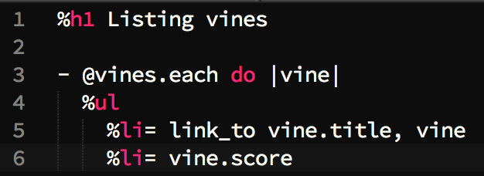
The Code Behind the Board
Although this is the main feature of our app, the code behind it is very simple.
We need to create a View in Couchbase, and query the View to populate our Leaderboard…
We then tell Rails to use our Specific View on the Vine Leaderboard page
List each Vine, linking the Title to its URL and print its Score.

Slide 51
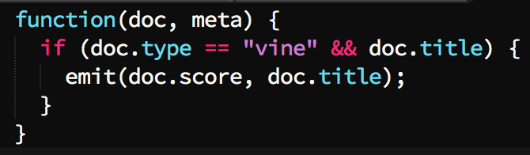

The Leaderboard View
The Map Function:
The Query:
Notes:
In our Map Function, we check for attributes type == vine, and make sure the Vine has a doc.Title.
We then output the SCORE as the Indexed Key. We do this because we can then Unicode sort on this key automatically. And make the output value the Vine Title.
The query in this case, is actually stated in our Vine.rb Rails Model because of the Couchbase-Model gem. We have set a limit to 10, for top-10 and set descending => true meaning because of our unicode sorting, our score integers are going to get sorted, highest first.

Slide 52
Scoring and Leaderboard-ing
Top Rated Vines
I NEED A HORSE!
I love doing Housework
Cooking w/ Hugh Fearnley-Whittingstall
Random Access Memories
I don’t even know
Twerking gone wrong
Too cold to Dance
How To Scare Your Friends
Using Couchbase for the first Time
What does a fox say?
Top 10
Top 100
Top Users
Login
220
207
182
164
143
120
103
94
86
81
Notes:
Score ordered by indexed key, in descending order.
RE-ITTERATE WHAT WE’VE LEARNED AND WHAT WE CAN SEE ON THE LEADERBOARD AND HOW USING VIEWS ETC WE BUILT IT.

Slide 53
Questions?

