Slide 2
Indexing and Querying Map-Reduce Basics (Part 1)
Jasdeep Jaitla
Technical Evangelist

Slide 3
Agenda
Introduction to Indexing and Querying in Couchbase
Understand Map/Reduce Basics
Architectural Overview
Simple Indexes
Simple Queries

Slide 4
Indexing and Querying

Slide 5
Couchbase Server 2.0: Views
Views are Indices, like any Index, it is a methodology used to speed up access to data
Other Indices: Dewey Decimal System, Card Catalogs, Categories for Notes, File Folders, Table of Contents

Slide 6
Couchbase Server 2.0: Views
Storing Data and Indexing Data are separate processes in all database systems
With explicit schema like RDBMS systems, Indexes are general optimized based on the data type(s), every row has an entry, everything is known
In flexible schema scenarios Map-Reduce is a technique for gathering common components of data into a collection and in Couchbase, that collection is an Index

Slide 7
Map-Reduce in General
A Map function locates data items within datasets and outputs an optimized data structure that can be searched and traversed rapidly
A Reduce function takes the output of a Map function and can calculate various aggregates from it, generally focused on numeric data
Together they make up a technique for working with data that is semi-structured or unstructured

Slide 8
Couchbase Server 2.0: Map-Reduce
In Couchbase, Map-Reduce is specifically used to create an Index.
Map functions are applied to JSON Documents and they output or “emit” a data structure designed to be rapidly queried and traversed.

Slide 9
Couchbase Server 2.0: Map-Reduce
function (doc, meta) {
if (doc.type == “beer” && doc.brewery_id && doc.name) {
emit(doc.name, doc.abv);
}
}
Create an View/Index of Beer Names
Filter only Documents with a JSON key “type” == “beer” and also has JSON keys “brewery_id” and “name”
Output the Beer Name, and a Alcohol By Volume (ABV) value

Slide 10
Couchbase Server 2.0: Map-Reduce
Views can cover a few different use cases
Simple secondary indexes (the most common)
Complex secondary, tertiary and composite indexes
Aggregation functions (reduction)
Example: count the number of North American Ales
Organizing related data
Built using Map/Reduce
Map function creates a matrix from document fields
Reduce function summarizes (reduces) information
Written using superfast Javascript (Google V8)

Slide 11
Map() Function => Index
Every Document passes through View Map() functions
Map
json doc
doc metadata
function(doc, meta) {
emit(doc.username, doc.email)
}
create row
indexed key
output value(s)
Notes:
Built on the Javascript V8 engine. Our query language is simple Javascript, so very easy to write our map functions.

Slide 12
Single Element Keys (Text Key)
Map
function(doc, meta) {
emit(doc.email, null)
}
text key
doc.email | meta.id
abba@couchbase.com | u::1
jasdeep@couchbase.com | u::2
zorro@couchbase.com | u::3
Notes:
How we can write our map functions: We could use a Single Element key, or “Primary key.”

Slide 13
Compound Keys (Array)
Array Based Index Keys get sorted as Strings,
but can be grouped by array elements
Map
function(doc, meta) {
emit(dateToArray(doc.timestamp), 1)
}
array key
dateToArray(doc.timestamp) | value
[2012,7,9,18,45] | 1
[2012,8,26,11,15] | 1
[2012,9,13,2,12] | 1
Notes:
Group_level queries
We can use the built in dateToArray Javascript helper function to find a rollup of i.e. documents edited by date (by year, month, day, hour etc.)
Group_level=2 we'd segment by year,month and Group_level=3 we'd segment by year,month,day etc.

Slide 14





Indexing Architecture
App Server
Doc 1
Couchbase Server Node
Doc Updated in RAM Cache First
3
2
3
Managed Cache
To other node
Replication Queue
Doc 1
Doc 1
Disk Queue
Disk
Doc 1
All Documents & Updates Pass Through View Engine
Indexer Updates Indexes After On Disk, in Batches
View Engine
Notes:
Index Build phase:
Build out on each node indy in parallel, builds an on disk B-Tree data structure, optimised for:
Key lookups (i.e. all breweries in London,) (Primary Index)
In Order Access (All comments by Robin in March), (Secondary Index)
Aggregations which are pre-cached for sub-segments of the ranges we can query.
Unlike Hadoop, we don't have to periodically re-run the index update job, Couchbase makes sure the index reflects the state of the database plus or minus a few seconds. We auto index every 3 seconds, or every 5000 changes, but this configurable.

Slide 15
Buckets >> Design Documents >> Views
Couchbase Bucket
Indexers Are Allocated Per Design Doc
Design Document 1
Design Document 2
Can Only Access Data in the Bucket Namespace
Can Only Access Data in the Bucket Namespace
View
View
View
View
View
All Updated at Same Time
All Updated at Same Time
All Updated at Same Time
Notes:
Per data bucket, we have multiple Design Docs which contain the view definitions for a number of views. This means our views are all batched together to be incrementally updated.
Best practise is splitting our views up into relevant ownerships / writers. So i.e. 1 Design Document holds all the views for the Frontend UI of the website, and another Design Document holds the views for the Backend Admin interface (used to list and edit users, or posts etc etc.)
In a worst case Design Doc scenario, there would be a 1 view in a dozen design documents, meaning we have 12 view functions to run, whereas we should structure it as multiple views per design document. But, getting the balance right is important, as we also wouldn't want to have a design document with 100 views in it!
When we change 1 view definition, it will update the index for the ENTIRE design doc, this is why it's logical to split views into relevant Design Doc categories etc.

Slide 16
Querying Views: Parameters

Slide 17
Parameters used in View Querying
key = “”
used for exact match of index-key
keys = []
used for matching set of index-keys
startkey/endkey = “”
used for range queries on index-keys
startkey_docID/endkey_docID = “”
used for range queries on meta.id
stale=[false, update_after, true]
used to decide indexer behavior from client
group/group_by
used with reduces to aggregate with grouping
Notes:
First, walk through the options
Then mention Observe

Slide 18
Query Pattern: Range

Slide 19
Index-Key Matching
doc.email | meta.id
abba@couchbase.com | u::1
beta@couchbase.com | u::7
jasdeep@couchbase.com | u::2
math@couchbase.com | u::5
matt@couchbase.com | u::6
yeti@couchbase.com | u::4
zorro@couchbase.com | u::3
?key=”math@couchbase.com”
Match a Single Index-Key

Slide 20
Range Query
?startkey=”math@couchbase.com”
&endkey=”math@couchbase.com”
doc.email | meta.id
abba@couchbase.com | u::1
beta@couchbase.com | u::7
jasdeep@couchbase.com | u::2
math@couchbase.com | u::5
matt@couchbase.com | u::6
yeti@couchbase.com | u::4
zorro@couchbase.com | u::3
?startkey=”b1” & endkey=”zz”
?startkey=”bz” & endkey=”zn”
Pulls the Index-Keys between UTF-8 Range specified by the startkey and endkey.
Pulls the Index-Keys between UTF-8 Range specified by the startkey and endkey.
Range of a single item (can also be done with key= parameter).

Slide 21
Index-Key Set Matches
doc.email | meta.id
abba@couchbase.com | u::1
beta@couchbase.com | u::7
jasdeep@couchbase.com | u::2
math@couchbase.com | u::5
matt@couchbase.com | u::6
yeti@couchbase.com | u::4
zorro@couchbase.com | u::3
?keys=[“math@couchbase.com”,
“yeti@couchbase.com”]
Query Multiple in the Set (Array Notation)

Slide 22
Query Pattern: Basic Aggregations

Slide 23
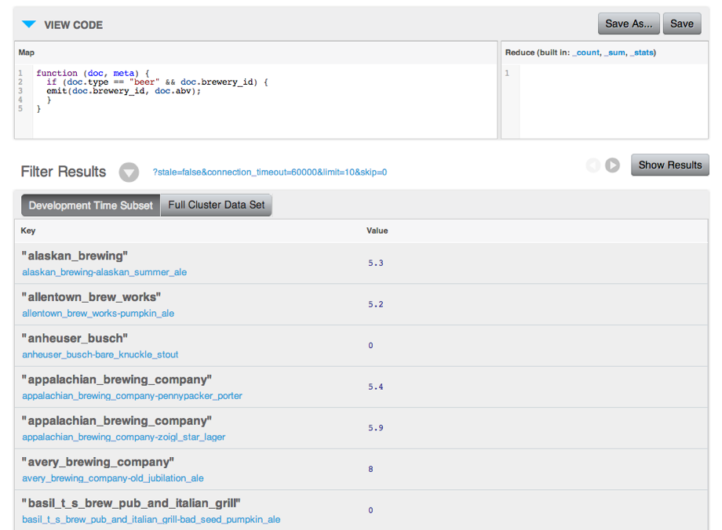
Simple secondary Index
Lets find average abv for each brewery!

Slide 24
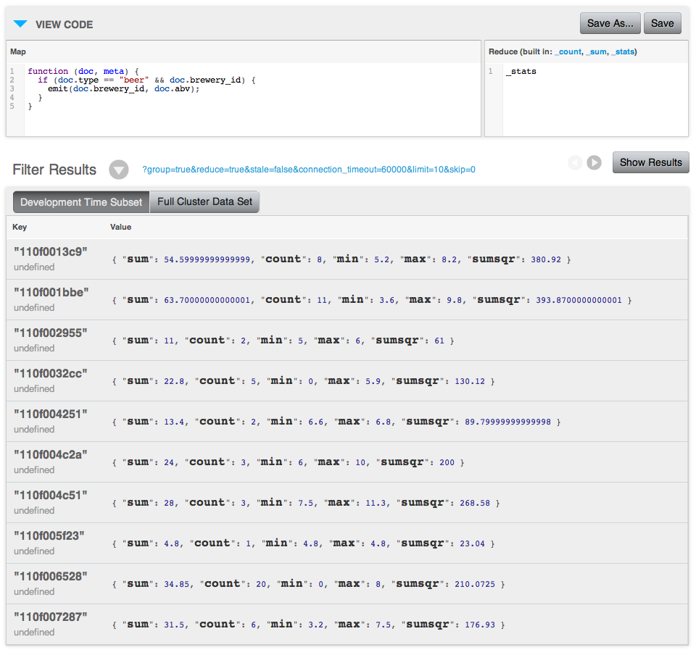
Aggregation: Reducing doc.abv with _stats

Slide 25
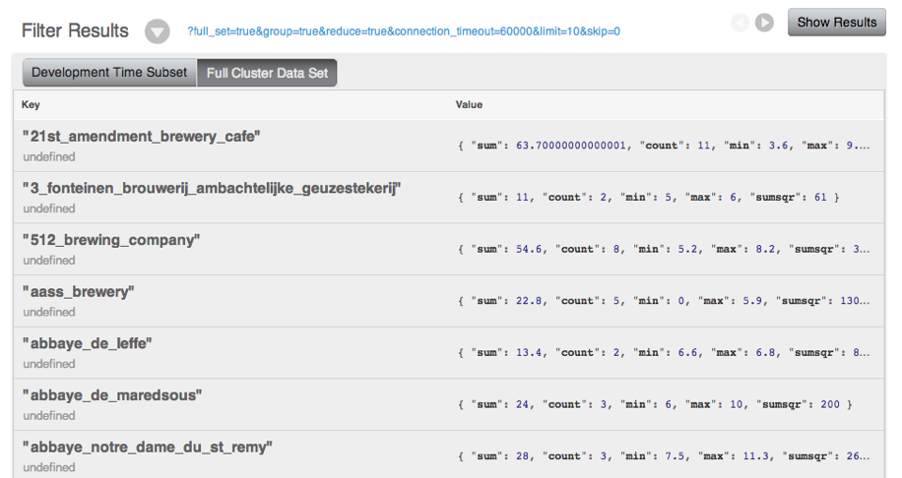
Group reduce (reduce by unique key)
Notes:
If Sum = 11 and Count = 2, the Average is 5.5

Slide 26
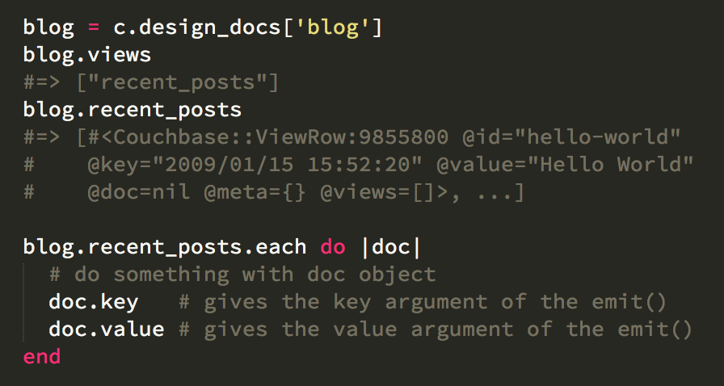
Querying from Views Querying from Ruby Client

Slide 27
Query Pattern: Time Based Rollups

Slide 28
Find Comment Counts By Time
{
"type": "comment",
"about_id": "beer_Enlightened_Black_Ale",
"user_id": 525,
"text": "tastes like college!",
"updated": "2010-07-22 20:00:20"
}
timestamp
{
"id": "u525_c1"
}

Slide 29
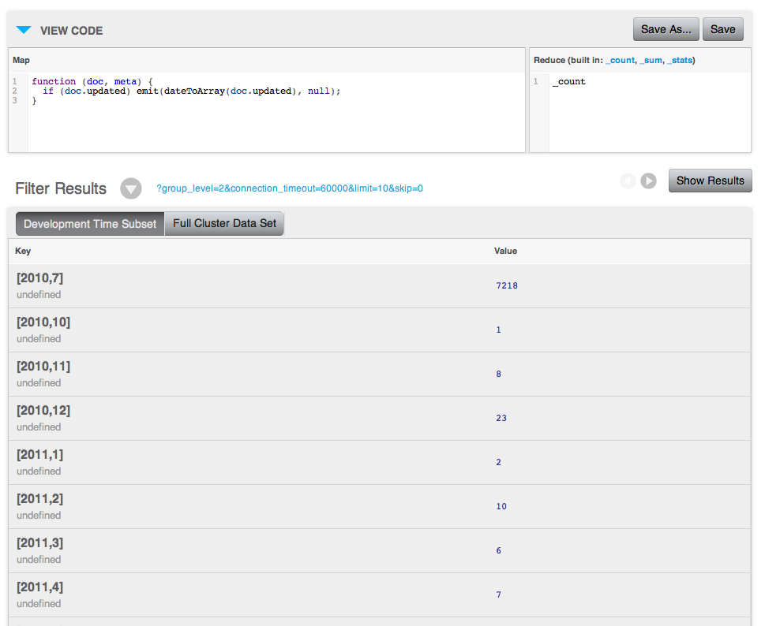
dateToArray() converts DateTime strings to Array of values
String or Integer based timestamps
Output optimized for group_level queries
array of JSON numbers: [2012,9,21,11,30,44]

Slide 30
Query with group_level=2 to get monthly rollups

Slide 31
group_level=2 results
Monthly rollup
Sorted by time—sort the query results in your application if you want to rank by value—no chained map-reduce

Slide 32
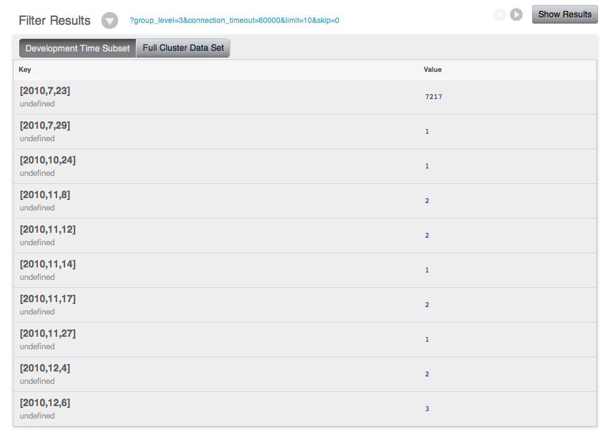
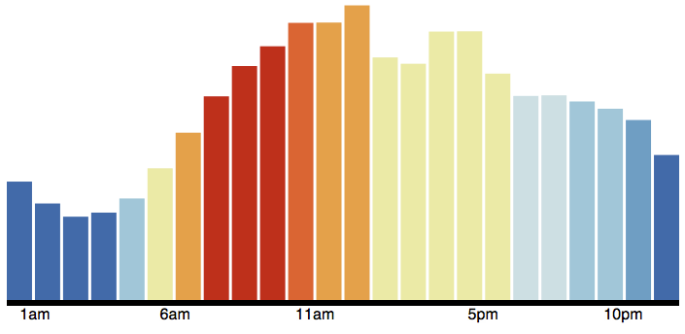
group_level=3 - daily results - great for graphing
Daily, hourly, minute or second rollup all possible with the same index.
http://crate.im/posts/couchbase-views-reddit-data/

Slide 33
Query Pattern: Leaderboard

Slide 34
Aggregate value stored in a document
Lets find the top-rated beers!
{
"brewery": "New Belgium Brewing",
"name": "1554 Enlightened Black Ale",
"style": "Other Belgian-Style Ales",
"updated": "2010-07-22 20:00:20",
“ratings” : {
“ingenthr” : 5,
“jchris” : 4,
“scalabl3” : 5,
“damienkatz” : 1
},
“comments” : [ “f1e62”, “6ad8c“ ]
}
ratings
Notes:
ratings are stored in a hash to ensure each user can only rate each beer once

Slide 35
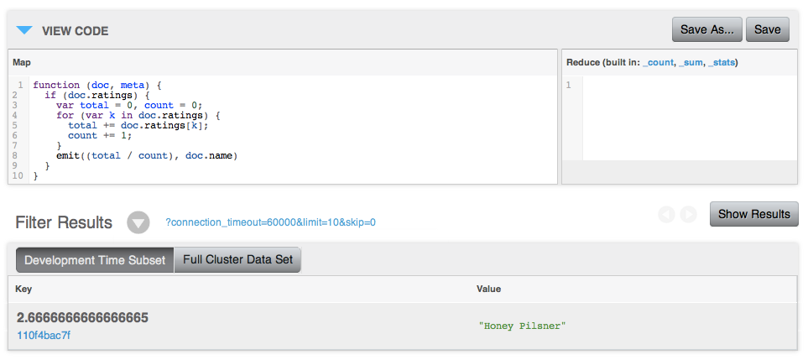
Sort each beer by its average rating
Lets find the top-rated beers!
average
35

Slide 36
Q&A

Slide 37
Thanks!

