Slide 1
How Many Nodes? Properly Sizing your Couchbase Cluster
Perry Krug
Sr. Solutions Architect
Notes:
This session is all about properly sizing a Couchbase cluster for production.

Slide 2
Size Couchbase Server
Sizing == performance
Serve reads out of RAM
Enough IO for writes and disk operations
Mitigate inevitable failures
Reading Data
Writing Data
Give me document A
Please store document A
A
Here is document A
A
OK, I stored
document A
Couchbase Server
Couchbase Server

Slide 3
Scaling out permits matching of aggregate flow rates so queues do not grow
Couchbase Server
Couchbase Server
Couchbase Server
network
network
network
Notes:
The solution to scale writes is to add more servers to the couchbase cluster ensuring AGGREGATE back-end IO performance to match AGGREGATE front-end data rate (or to at least allow the absorption of the maximum write spike you expect). If queues get too built up and Couchbase can’t drain them fast enough, Couchbase will eventually tell your application to “slow down” that it needs time to ingest the spike. As we’ll discuss in the sizing section, ensuring aggregate back end disk IO is available and sizing RAM to match working set size are the two primary requirements for getting your cluster correctly configured. Likewise, monitoring will primarily focus on ensuring you’ve done that job correctly and don’t need to make adjustments.

Slide 4
5 Factors of Sizing
Notes:
Before getting into the detailed recommendations and considerations for operating Couchbase across the application lifecycle, we’ll cover a few key concepts and describe the “high level” considerations for successfully operating Couchbase in production.

Slide 5

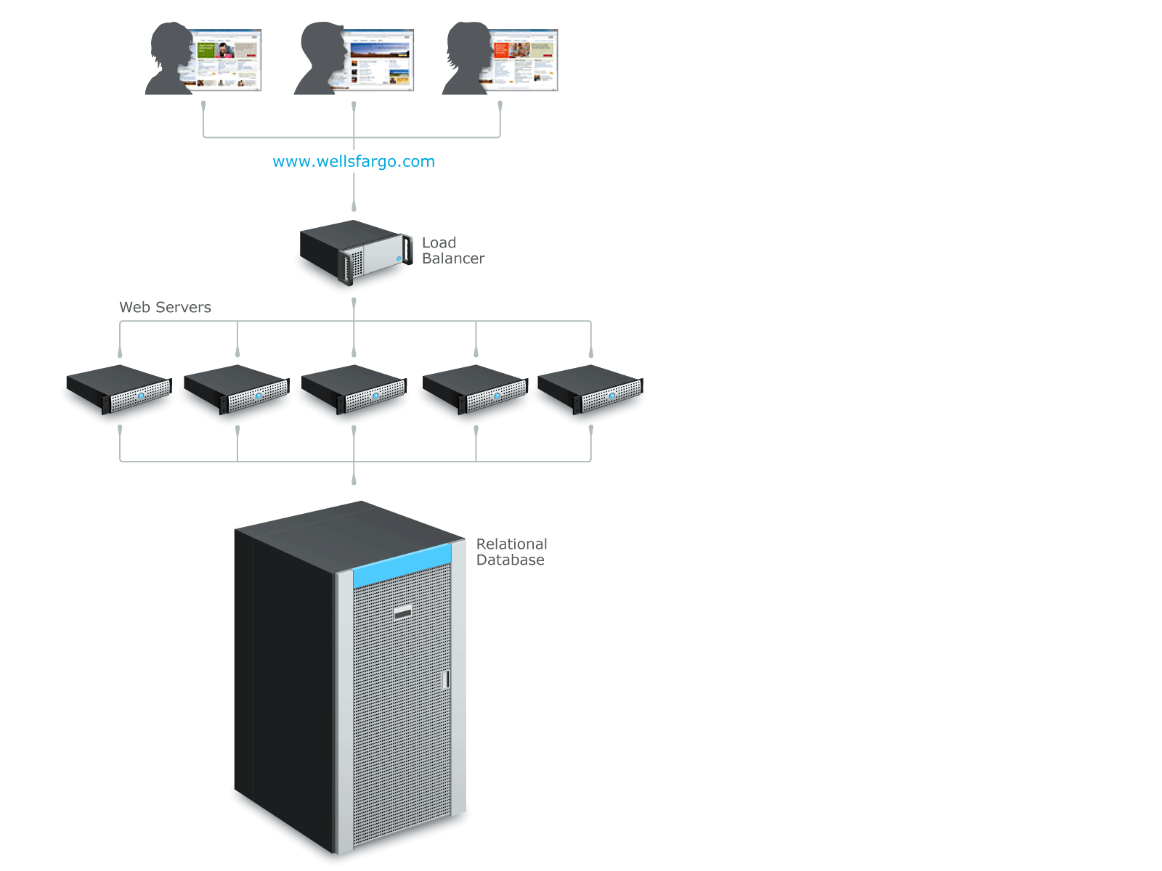


How many nodes?
5 Key Factors determine number of nodes needed:
1) RAM
2) Disk
3) CPU
4) Network
5) Data Distribution/Safety
(per-bucket, multiple buckets aggregate)
Application user
Web application server
Couchbase Servers
Notes:
Each on of these can determine the number of nodes
Data sets, work load, etc.

Slide 6
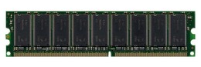
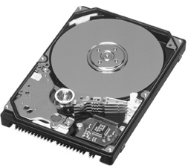

RAM sizing
Reading Data
Keep working set in RAM
for best read performance
Give me document A
A
Here is document A
1) Total RAM:
Managed document cache:
Working set
Metadata
Active+Replicas
Index caching (I/O buffer)
A
A
Server
Notes:
Calculate for both Active and number of replicas.
Replicas will be the first to be dropped out of ram if not enough memory

Slide 7
Working set depends on your application
working/total set = .01
working/total set = .33
working/total set = 1
Couchbase Server
Couchbase Server
Couchbase Server
Late stage social game Many users no longer active; few logged in at any given time.
Business application Users logged in during the day. Day moves around the globe.
Ad Network Any cookie can show up at any time.
Notes:
Different applications, and even where the application is in its lifecycle, will lead to different required ratios between data in RAM and data only on disk (i.e. the working set to total set ratio will vary by application). We have three examples of very different working set to total dataset size ratios.

Slide 8
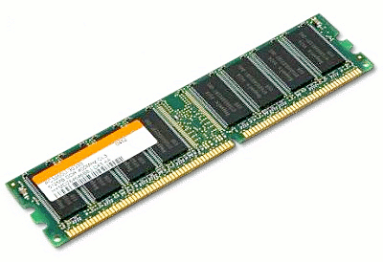
RAM Sizing - View/Index cache (disk I/O)
File system cache availability for the index has a big impact performance:
Test runs based on 10 million items with 16GB bucket quota and 4GB, 8GB system RAM availability for indexes
Performance results show that by doubling system cache availability
query latency reduces by half
throughput increases by 50%
Leave RAM free with quotas

Slide 9
Disk Sizing: Space and I/O
Writing Data
2) Disk
Sustained write rate
Rebalance capacity
Backups
XDCR
Views/Indexes
Compaction
Total dataset:
(active + replicas + indexes)
Append-only
Please store document A
OK, I stored
document A
A
A
I/O
A
Space
Server
Notes:
Each on of these can determined the number of nodes
Data sets, work load, etc.

Slide 10
Disk Sizing: Space and I/O
Disk Writes are Buffered
Bursts of data expand the disk write queue
Sustained writes need corresponding throughput
Disk throughput affected by disk speed
SSD > 10K RPM > EBS
SSDs give a huge boost to write throughput and startup/warmup times
RAID can provide redundancy and increase throughput
Throughput = read/write+compaction+indexing+XDCR
2.1 introduces multiple disk threads
Default is 3 (1 writer / 2 readers), max is 8 combined
Best to configure different paths for data and indexes
Plan on about 3x space (append-only, compaction, backups, etc)

Slide 11

CPU sizing
3) CPU
Disk writing
Views/compaction/XDCR
RAM r/w performance not impacted
Min. production requirement: 4 cores
+1 per bucket
+1 core per Design Doc
+1 core per XDCR stream
Notes:
Replication is needed only for writes/updates. Gets are not replicated.

Slide 12
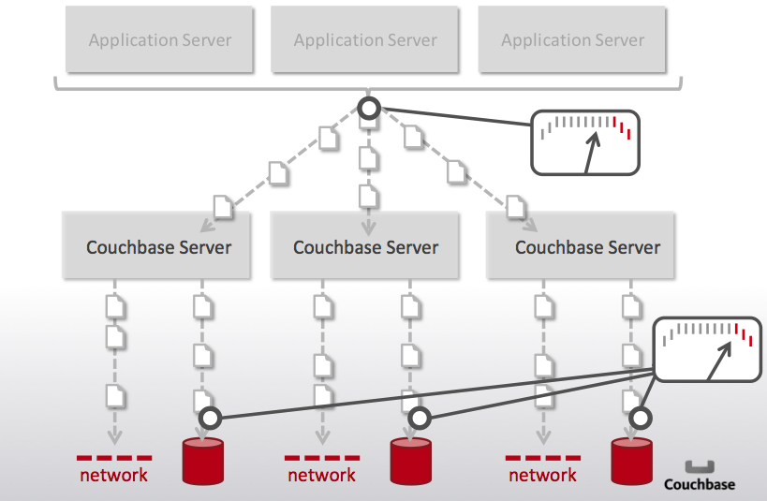
Network sizing
4) Network
Client traffic
Replication (writes)
Rebalancing
XDCR
Reads+Writes
Replication (multiply writes) and Rebalancing
Notes:
Replication is needed only for writes/updates. Gets are not replicated.

Slide 13
Network Considerations
Low latency, high throughput (LAN) - within cluster
Eliminate router hops:
Within Cluster nodes
Between clients and cluster
Check who else is sharing the network
Increase bandwidth by:
Add more nodes (will scale linearly)
Upgrade routers/switches/NIC’s/etc

Slide 14
Data Distribution
Servers fail, be prepared.
The more nodes, the less impact a failure will have.
5) Data Distribution / Safety (assuming one replica):
1 node = Single point of failure
2 nodes = +Replication
3+ nodes = Best for production
Autofailover
Upgrade-ability
Further scale-ability
Note: Many applications will need more than 3 nodes
Notes:
The more nodes you have the less impactful a failure of one node on the remaining nodes on the cluster.
1 node is a single point of failure, obviously bad
2 nodes gives you replication which is better, but if one node goes down, the whole load goes to just one node and now you’re at an spof
3 nodes is the minimal recommendation because a failure of one distributes the load over two
The more node the better, as recovering from a single node failure is easier with more nodes in the cluster

Slide 15
How many nodes recap
5 Key Factors determine number of nodes needed:
1) RAM
2) Disk
3) CPU
4) Network
5) Data Distribution/Safety
Application user
Web application server
Couchbase Servers
Notes:
Each on of these can determine the number of nodes
Data sets, work load, etc.

Slide 16
Hardware Minimums
Hardware requirements/recommendations are the intersection of what’s needed versus what’s available.
RAM: At least ~4GB (highly dependent on data set)
Disk: Fastest “local” storage available
-SSD is better
-RAID 0 or 10, not 5
CPU (minimums): 4 cores
+ 1-per bucket
+ 1-per design document
+ 1-per XDCR stream
Notes:
Each on of these can determine the number of nodes
Data sets, work load, etc.

Slide 17
Effects of…

Slide 18
Views/Indexes
Effect on scale/sizing:
Increase the CPU and disk IO requirements
More complex views require more CPU
More view output requires more disk IO
More RAM should be left out of the quota for better IO caching
Indication:
Indexes significantly behind data writes (or growing delays)
What do to:
Make sure you follow best practices in view writing
Add more nodes to distribute processing “work”
Look into SSD’s
Notes:
Each on of these can determined the number of nodes
Data sets, work load, etc.

Slide 19
XDCR
Effect on scale/sizing:
XDCR is CPU Intensive
Disk IO will double
Memory needs to be sized accordingly (bi-directional may mean more data)
Indication:
A rising XDCR queue on source
What to do:
More nodes on source and destination will drain queue faster (scales linearly)
Tune replication streams according to CPU availability
Notes:
Each on of these can determined the number of nodes
Data sets, work load, etc.

Slide 20
As your workload grows…
Effects on scale/sizing:
More reads:
Individual documents will not be impacted (static working set)
Views may require faster disks, more disk IO caching
More writes will increase disk IO needs
Indications:
Cache miss ratio rising
Growing disk write queue / XDCR queue
Compaction not keeping up
What to do:
Revise sizing calculations and add more nodes if needed
Most applications don’t need to scale the number of nodes based upon normal workload variation.
Notes:
Each on of these can determined the number of nodes
Data sets, work load, etc.

Slide 21
As your dataset grows…
Effects on scale/sizing:
Your RAM needs will grow:
Metadata needs increase with item count
Is your working set increasing?
Your disk space will likely grow (duh?)
Indications:
Dropping resident ratio
Rising ejections/cache miss ratio
What to do:
Revise sizing calculations, add more nodes
Remove un-needed data
This is the most common need for scaling and will most likely result in needing more nodes
Notes:
Each on of these can determined the number of nodes
Data sets, work load, etc.

Slide 22
Rebalancing
Yes there is resource utilization during a rebalance but a “properly” sized cluster should not have any effect on performance during a rebalance:
Distribution of data and work across all nodes
Managed caching layer separates RAM-based performance from IO utilization
Rebalance automatically manages working set in RAM
Rebalance automatically throttles itself if needed
Can be stopped midway without endangering data or progress
Proper sizing includes not maxing out all resources: leave some headroom in preparation
Notes:
Each on of these can determined the number of nodes
Data sets, work load, etc.

Slide 23
Monitor and Grow

Slide 24
What to Monitor
Application
Ops/sec (breakdown of r/w/d/e(xpiration))
Latency at client
RAM
Cache miss ratio
Resident Item Ratio
Disk
Disk Write Queue (proxy for IO capacity)
Space (compaction and failed-compaction frequency)
See Anil’s presentation on health and monitoring later today

Slide 25
Adding Capacity
Couchbase is completely “shared-nothing” and almost all factors scale linearly
Need more RAM? Add more nodes…
Need more disk IO? Add more nodes…
Better to add nodes than to incrementally increase capacity
Add more nodes BEFORE you need them

Slide 26
Sizing is tricky business…
Work with the Couchbase Team
Validate your “on-paper” numbers with testing
Constantly monitor production
Notes:
Do not failover a healthy node!

Slide 27
Dive in…
Gather your workload and dataset requirements:
Item counts and sizes, read/write/delete ratios
Review our documentation and formulas
Test, Deploy, Monitor…rinse and repeat
Notes:
Do not failover a healthy node!

Slide 28
Want more?
Lots of details and best practices in our documentation:
http://www.couchbase.com/docs/
And my sizing blog:
http://blog.couchbase.com/how-many-nodes-part-1-introduction-sizing-couchbase-server-20-cluster
Notes:
Do not failover a healthy node!

Slide 29
Thank you Couchbase NoSQL Document Database perry@couchbase.com @couchbase

Slide 30
Appendix

Slide 31
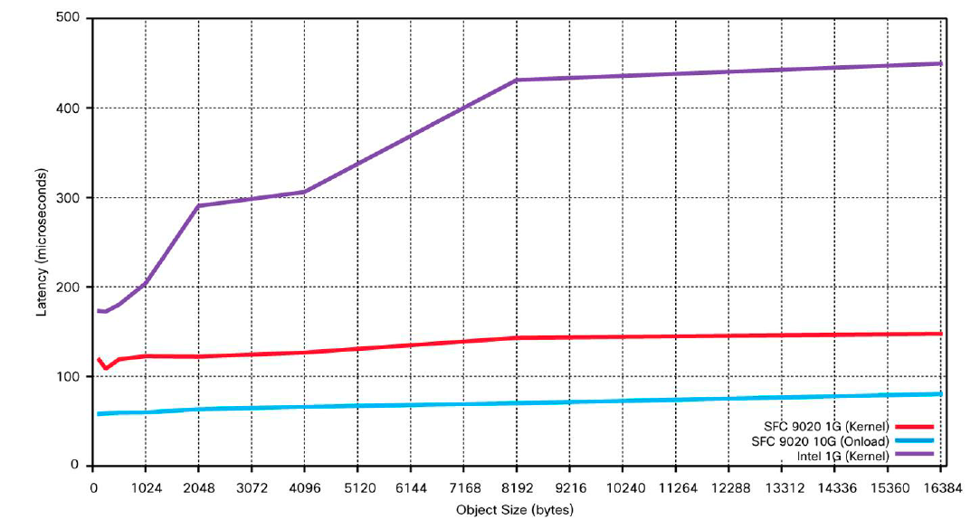
Consistent low latency with varying doc sizes
Consistently low latencies in microseconds for varying documents sizes with a mixed workload
http://www.cisco.com/en/US/prod/collateral/switches/ps9441/ps9670/white_paper_c11-708169.pdf
Notes:
Chart shows average latency (response times) across varying document sizes (1KB – 16KB)
It demonstrates that Couchbase Server is ridiculously fast and responds in microsecond responses. (That is latency is < 100 μsec on a 10gig Ethernet network for documents of all sizes)
The network latency has an impact on a 1GIG Ethernet network, however latency is flat / consistent on a 10GIG Ethernet network
Couchbase Server gives you a consistent, predictable latency at any document size

Slide 32
Understand your environment: Dataset, Workload, Resources
Notes:
Before getting into the detailed recommendations and considerations for operating Couchbase across the application lifecycle, we’ll cover a few key concepts and describe the “high level” considerations for successfully operating Couchbase in production.

Slide 33
Dataset
Data:
How many documents?
How large are they (on average)? Keys and values
How many replicas?
Working set (more on that in a bit…)
Indexes:
How many views?
How many documents per view?
Growth:
Next 3 months?
Next 6 months?
Notes:
Each on of these can determine the number of nodes
Data sets, work load, etc.

Slide 34
Workload
Application-level (per-second):
Reads (individual documents)
Writes (upserts, deletes, expirations)
Queries (view access)
XDCR (uni- versus bi-directional)
Data Lifecycle:
Retention needs? Manual or automatic?
Access policy?
Growth:
Next 3 months?
Next 6 months?
Notes:
Each on of these can determine the number of nodes
Data sets, work load, etc.

Slide 35
Resources
Infrastructure:
Physical/VM/Cloud
Server specs:
RAM
Disk (SSD, HDD, EBS)
CPU
Notes:
Each on of these can determine the number of nodes
Data sets, work load, etc.

Slide 36
RAM Sizing: Managed Cache
As memory grows, some cached data will be removed from RAM to make space:
Active and replica data share RAM
Threshold based (NRU, favoring active data)
Only cleanly persisted data can be “ejected”
Only data values can be “ejected” which means RAM can fill up with metadata
Notes:
Each on of these can determined the number of nodes
Data sets, work load, etc.

Slide 37
Disk sizing: Append only
Append-only file format puts all new/updated/deleted items at the end of the on-disk file.
Better performance and reliability
No more fragmentation!
This can lead to invalidated data in the “back” of the file.
Need to compact data
Notes:
not unique to Couchbase…MySQL suffers as well for example

Slide 38
Disk compaction
Initial file layout:
Update some data:
After compaction:
Doc A
Doc B
Doc C
Doc A
Doc A
Doc B
Doc B
Doc C
Doc A’
Doc A’
Doc B’
Doc D
Doc A’’
Doc C
Doc B’
Doc D
Doc A’’
Notes:
not unique to Couchbase…MySQL suffers as well for example

