Slide 1
CFD-2011 Trondheim
A model of a gas-liquid slug flow, accompanied with mass transfer, in a microchannel
Dmitry Eskin and Farshid Mostowfi
Schlumberger DBR Technology Center,
Edmonton, AB, Canada

Slide 2
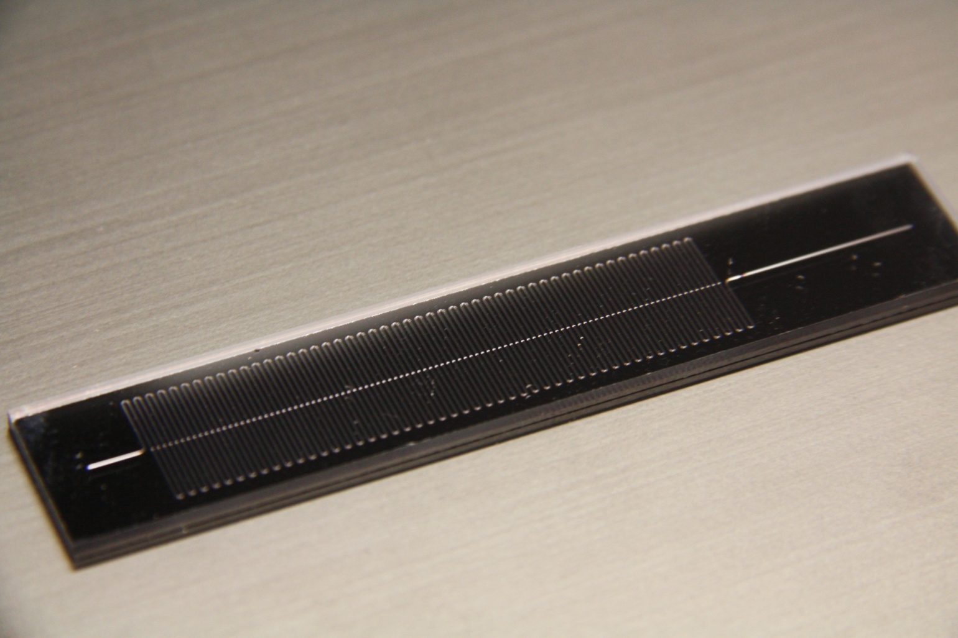
Objectives
Develop a Model
Evaluate how significantly a two-component mixture, transported through a microhannel, deviates from phase equilibrium

Slide 3
A Diagram for of a Bubble-Train Flow in a Micro-channel
Flow Diagram
q_{si-1}
δ_{i}
q_{cfi-1}
c_{0i}
p₀
p_{e}
slug # i-1
bubble # i-1
i
c_{si}
i
i+1
i+1
x
x
W_{sei}
W_{Bi}
L_{lBi-1}

Slide 4
Major Assumptions
The mean pressure gradient is constant along the channel
Gas is ideal (a model can be extended to a non-ideal gas case)
The dissolved gas concentration at the interphase boundary equals the saturation concentration
Perfect mixing within a liquid slug
The bubble side caps are semispherical

Slide 5



Mass Conservation Equations
Equation of i-th bubble expansion
mass flux to the i-th bubble
mean pressure gradient
Equation describing the dissolved gas
concentration c0i in a liquid slug
Δpi
c_{0i}
i
i-1
W_{sei}
W_{Bi}

Slide 6
Major Relations For a Bubble Train Flow
Pressure Drop Linearity
Kreutzer semi-empirical equation
Ca=μUB/γ - capillary number
Relation between the mean flow velocity and the superficial liquid velocity
Li
Δpi
Molla S., Eskin D., Mostowfi S., Pressure drop of slug flow in microchannels with increasing void fraction: experiment and modeling, Lab on a Chip, 2011, 11, 1968-1978.
c_{0i}
i
i-1
W_{sei}
W_{Bi}

Slide 7
Major Relations For a Bubble Train Flow
Bubble and Slug Velocities
Assuming that the liquid film is immobile we can write:
where
Experimental data of Taylor (1961) for are available

Slide 8

Major Relations For a Bubble Train Flow
Liquid Film Thickness
- correlation of Aussillous and Quere (2000):
Ca=μUB/γ - capillary number

Slide 9



Mass Fluxes to the Bubble
at y
at
at
Through cylindrical bubble surface
Convection-diffusion equation for a liquid film
x=0
- Henry law
B.C.
y=0
Diagram in a coordinate system of a moving bubble
U_{B}
y
c(x,y)
c_{s}
c₀
0
x

Slide 10
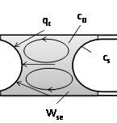

Mass Fluxes to the Bubble
Through spherical caps
- Mass transfer coefficient by Van Baten and Krishna (2004)

Slide 11
Computational Examples:
C₁-C₁₀ mixture
Bubble Velocity

Slide 12
Volumetric Mass Transfer Coefficient

Slide 13
Effect of the Channel Diameter
criteria of closeness to the phase equilibrium

Slide 14
Effect of the Channel Length

Slide 15
Effect of the Bubble Generation Frequency

Slide 16
Conclusions
The model of a Taylor flow, accompanied with mass transfer, in a long microchannel has been developed
The model demonstrates that closeness to the phase equilibrium improves with a decrease in the channel diameter, increase in the channel length and an increase in the bubble generation frequency

