Slide 1
Figures

Slide 2
Figure 1
Contact angle does not depend on substrate curvature. Benchmark
Literature – from experiments we don’t expect it
Literature - Simulation results are consistent with previous simulations
Previous simulation
Flat substrate
Curved substrate
Contact angle
Phase gradient

Slide 3
Figure 2
Collision simulation
equilibration
Acceleration
Collision pre wetting
Collision wetting

Slide 4
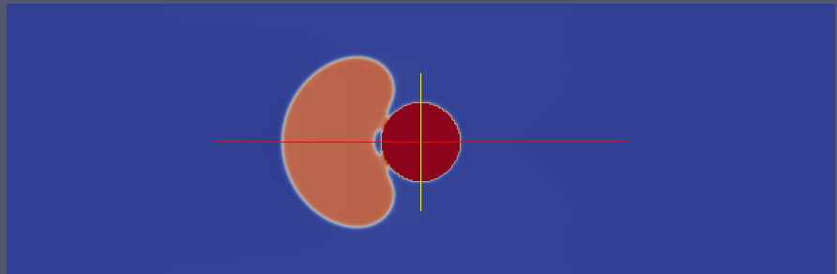
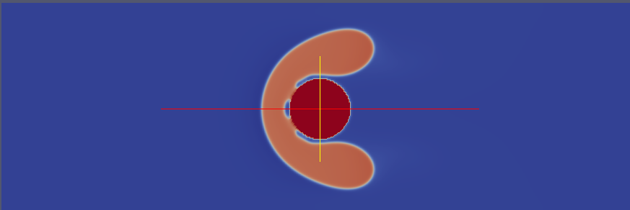
R50-F1
R50-F5
Notes:
Droplet deformation at wetting for two different force field. It is clear that for higher collision speed there is a larger droplet deformation

Slide 5
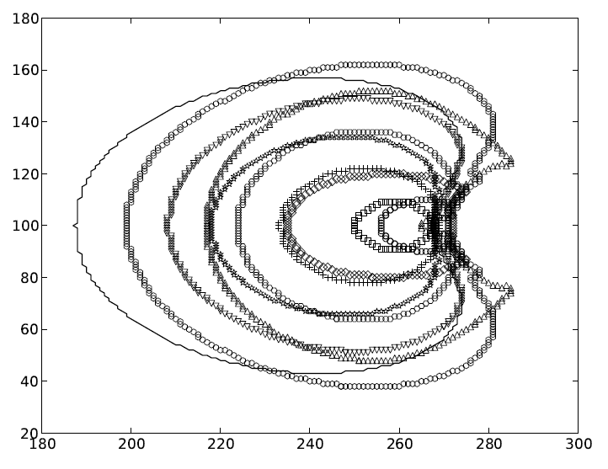

Slide 6
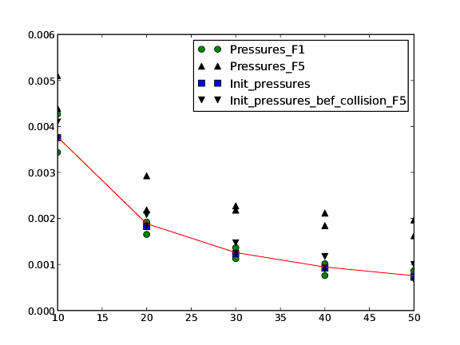
Droplet radius
Droplet radius

Slide 7
Experiments
Force
Distance

