Slide 1
Figures

Slide 2
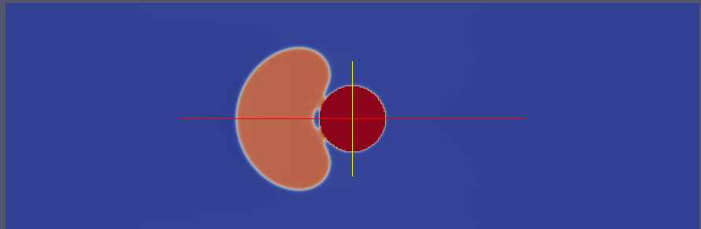
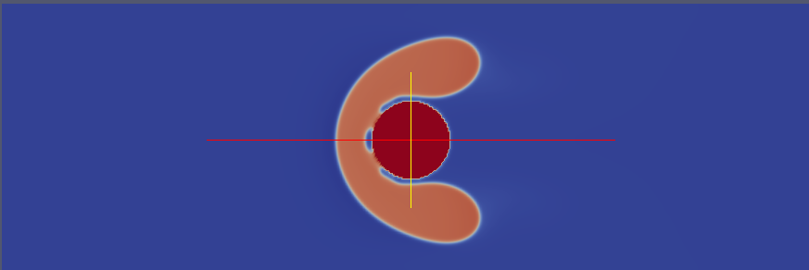
R50-F1
R50-F5
Notes:
Droplet deformation at wetting for two different force field. It is clear that for higher collision speed there is a larger droplet deformation

Slide 3
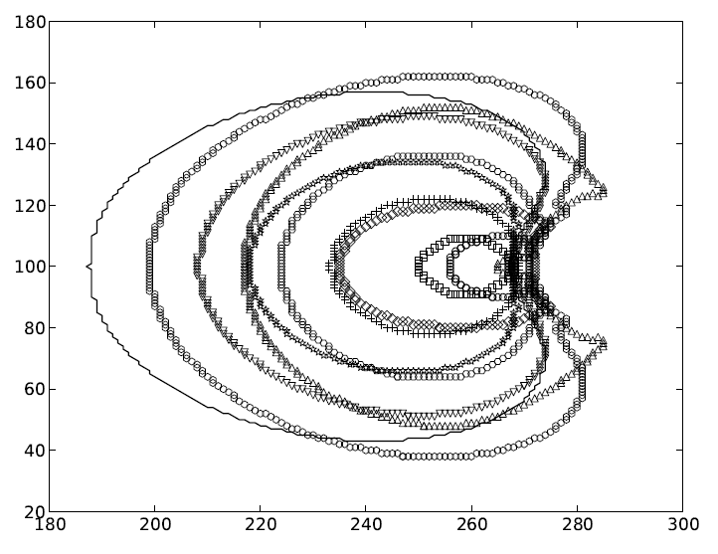

Slide 4
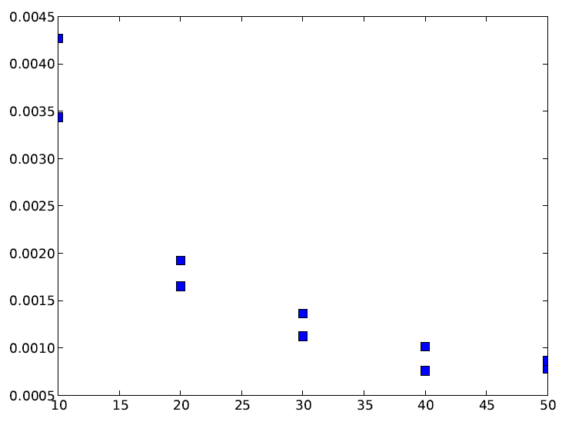
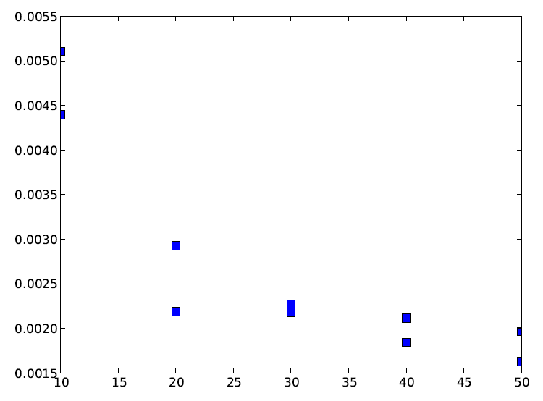
F1
F5
Pressure
Droplet radius
Droplet radius

