Slide 1


Predictive Maintenance in Solar Power Systems
Acharya Institute of Graduate Studies
Riya Kumari
Vivek Das
Rohit Patel
Shushant Kumar

Slide 2
Problem Statement
Brief Overview:
The case study addresses the challenge of predicting maintenance needs in solar power systems to optimize efficiency, reduce downtime, and lower operational costs.
Key Objectives:
Predict whether a solar panel requires maintenance.
Improve efficiency and reduce system downtime.
Identify key factors influencing solar panel performance.
Source :
www.freepik.com/

Slide 3
Dataset Overview
Dataset Description:
The dataset consists of solar power system performance data, sourced from real-world solar farms and simulated data. It includes over 5000 records, covering key parameters such as:
Temperature (°C)
Voltage (V)
Current (A)
Efficiency (%)
Dust Level (%)
Maintenance Needed (Target Variable)
Source :
www.freepik.com/

Slide 4
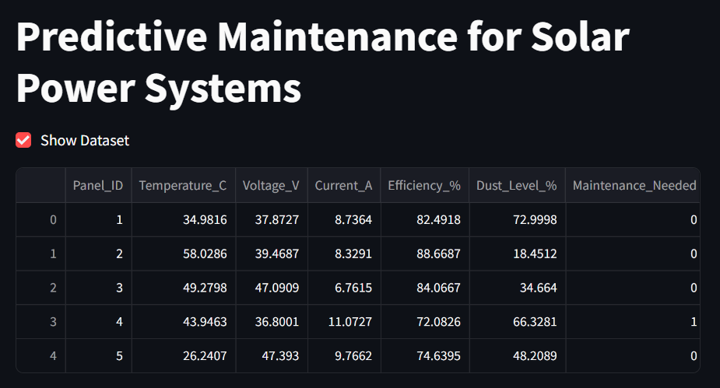
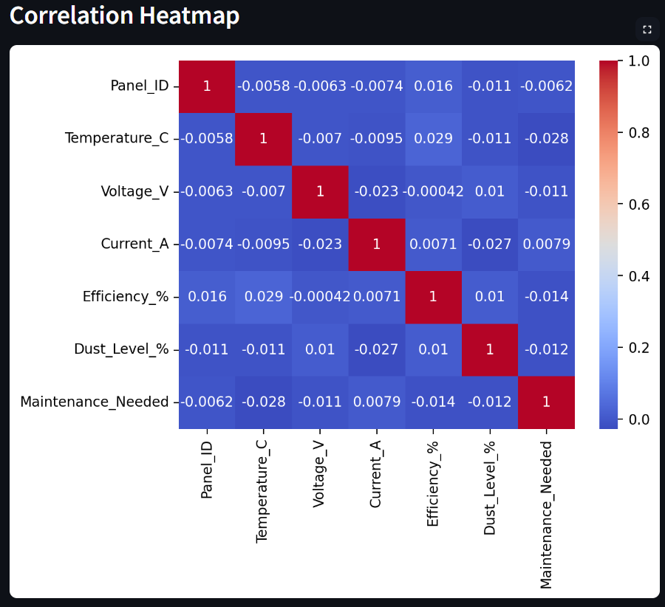
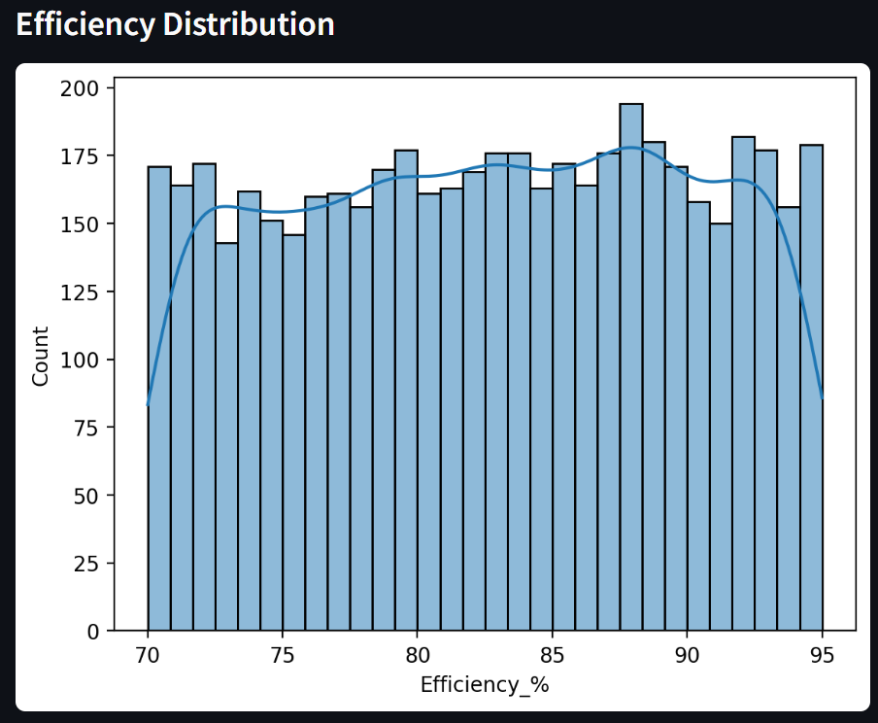
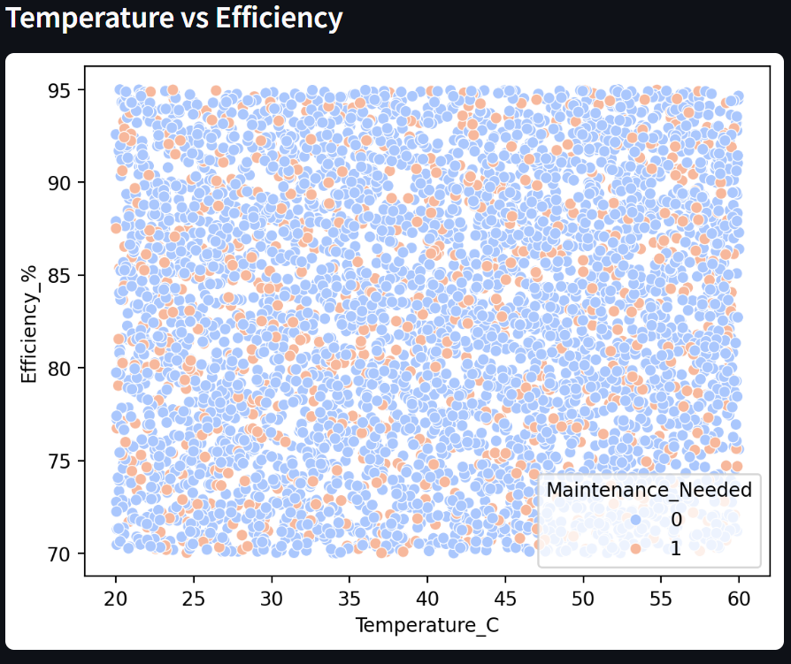
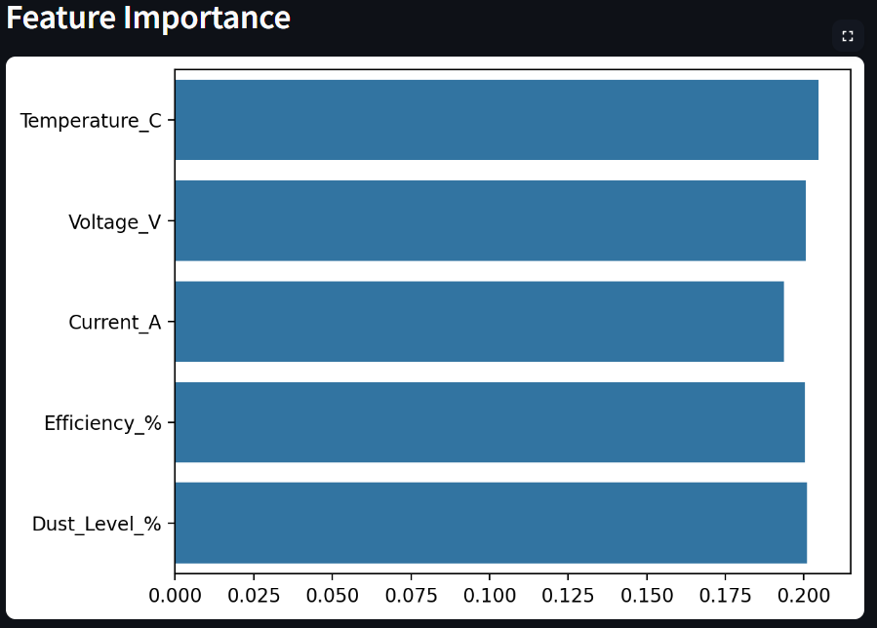
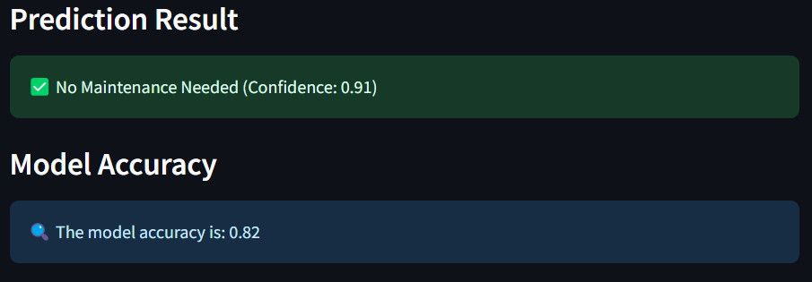
Source :
www.freepik.com/

Slide 5
Methodology
Approach:
Data Collection & Cleaning – Prepared high-quality data.
Feature Selection – Identified key variables impacting maintenance.
Model Selection – Applied machine learning models.
Training & Evaluation – Assessed model performance.
Visualization & Insights – Generated actionable insights.
Algorithms Used:
Random Forest Classifier: Used for its robustness and ability to handle non-linear relationships.
Logistic Regression: For baseline comparison.
XGBoost: Considered for improved accuracy and performance.
Source :
www.freepik.com/

Slide 6

Conclusion
Summary:
This study developed a machine learning model for predictive maintenance in solar power systems, achieving 82% accuracy. The solution helps in reducing downtime, improving efficiency, and supporting sustainability.
Future Work:
IoT Integration: Real-time monitoring for automated maintenance.
Smart Grid Support: Predict energy fluctuations for better distribution.
Cloud Deployment: Remote predictive maintenance services.
Source :
www.freepik.com/

Slide 7
References
Scikit-learn Documentation – https://scikit-learn.org
Kaggle Solar Panel Fault Detection Dataset – https://www.kaggle.com
XGBoost Documentation – https://xgboost.readthedocs.io

Slide 8
Thank You
Notes:
Thank You !!

