Slide 1
Water Resource: Conservation and Management
Submitted to: Submitted by:
Prof. Shiraz Hussain Ashutosh Namdev(18100BTCMCI02943)
Vaibhav Verma(19100BTCMCI05563)

Slide 2
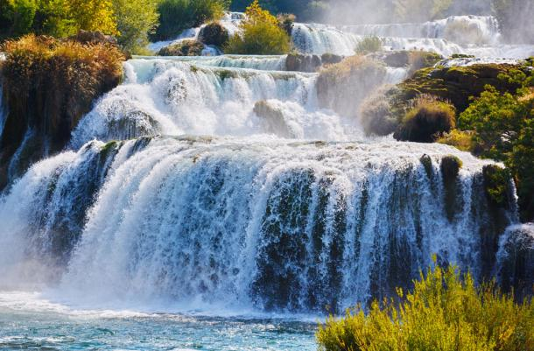
Water Resource:
Water is a vital elixir for all living beings.
It is a renewable resource.
Water covers 75% of the surface of the earth.
Although consumable water, fresh water, is only around 3%.
Due to global warming and water pollution a considerable amount of water is unfit for human use.
As a result, water is very scarce.

Slide 3
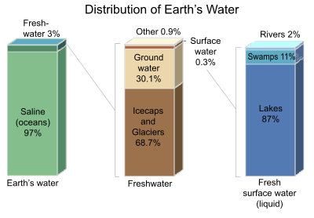
Distribution of water resources:
The distribution of water on Earth’s surface is very uneven.
Only 3% of water on the surface is fresh.
Remaining 97% resides in oceans.
Out of 3%, 69% resides in glaciers.
30% is underground water.
1% is located in lakes, rivers and swamps.

Slide 4
Types of Water Resources:
Surface Water Resources
Surface water resources are the most commonly used method of supplying water to various regions in the United States.
This classification primarily includes rivers, lakes, streams, reservoirs, and wetlands—all of which contain fresh water rather than saltwater.
Groundwater Resources
Believe it or not, there’s actually a larger source of water underneath your feet than there is in all the rivers and lakes combined.
We rarely get to tap into these sources due to how difficult they are to reach.
Groundwater fills the cracks in bedrock and sand beneath the surface, making contaminants tedious to filter out in large quantities.

Slide 5
Types of Water Resources:
Stormwater Resources
Otherwise known as runoff or rainwater, stormwater is water that comes from heavy weather such as rain, snow, and hail.
This water flows over the land and, in the process, collects a variety of pollutants such as engine oil, fertilizer, and pesticides.
As it picks up these contaminants, it eventually gathers in different areas, potentially combining with some of our other water sources.
Wastewater Resources
You might not initially think of it as an option, but wastewater is another type of water source in the world
This is the water we use for our household, manufacturing, and agricultural activities.
This water has already been used, it may contain several potentially toxic elements that must be filtered out and disposed of before the water can be used again

Slide 6
Types of Water Resources:
Saltwater Resources
It’s common knowledge that our oceans make up over 70 percent of the planet.
However, the salty, abrasive nature of this water makes using it for any of our current processes extremely difficult.
In fact, the amount of salt present in ocean water makes it impossible for us to safely drink it in large enough quantities to survive.
Ice Cap Water Resources
It’s theoretically possible for us to retrieve some water from the polar ice caps and glaciers.
These large bodies of ice float through the oceans, but they actually consist of fresh water.
This makes them some of our most ideal resources—if we can develop reliable ways to tap into them.
Unfortunately, the glaciers are too far away for us to regularly utilize, and we have yet to come up with an effective way to melt them.

Slide 7
Uses of Water Resources:
Water resources are used for agricultural, industrial, domestic, recreational, and environmental activities. Majority of the uses require fresh water- Agricultural Use
Agriculture accounts for 69 percent of all water consumption basically in agricultural economies like India. Agriculture, therefore, is the largest consumer of the Earth’s available freshwater.
By 2050, the global water demand of agriculture is estimated to increase by a further 19% due to irrigational needs. Expanding irrigation needs are likely to put undue pressure on water storage. It is still inconclusive whether further expansion of irrigation, as well as additional water withdrawals from rivers and groundwater, will be possible in future.

Slide 8
Uses of Water Resources:
Industrial Uses:
Water is the lifeblood of the industry. It is used as a raw material coolant, a solvent, a transport agent, and as a source of energy. Manufacturing industries account for a considerable share in the total industrial water consumption. Besides, paper and allied products, chemicals and primary metals are major industrial users of water.
Worldwide, the industry accounts for 19 percent of total consumption. In industrialized countries, however, industries use more than half of the water available for human use.

Slide 9
Uses of Water Resources:
Domestic Use
It includes drinking, cleaning, personal hygiene, garden care, cooking, washing of clothes, dishes, vehicles, etc. Since the end of World War II there has been a trend of people moving out of the countryside to the ever-expanding cities. This trend has important implications on our water resources.
Government and communities have had to start building large water-supply systems to deliver water to new populations and industries. Of all water consumption in the world, domestic use accounts for about 12 percent.

Slide 10
Uses of Water Resources:
Use for Hydropower Generation
Electricity produced from water is hydropower.
Hydropower is the leading renewable source of electricity in the world.
It accounts for about 16 percent of total electricity generation globally.
There are many opportunities for hydropower development throughout the world.
Today, the leading hydropower generating countries are China, the US, Brazil, Canada, India, and Russia.

Slide 11
Overutilization of Surface and Ground Water
Water scarcity has become a burning global issue.
The UN has held several conventions on water in recent decades.
Continuous overutilization of surface and ground water has led to virtual water scarcity in the world today.
The depleting sources for high growth in human population over the centuries and increased man-induced water pollution across the world have created unforeseen water scarcity around the globe.
As a result, there has been continuous overutilization of the existing water sources due to mammoth growth in world population.
Groundwater is the major source of water in many parts of the world.
However, there has been continuous depletion of this source due to its overexploitation by rising human population and the rapid rise in industrialization and urbanization in modern times.

Slide 12
Consequences of Overutilization
Water scarcity now becomes an important topic in international diplomacy.
From village to the United Nations, water scarcity is a widely-discussed topic in decision making.
Nearly three billion people in the world suffer from water scarcity.
International, intrastate and regional rivalries on water are not new to world.
The ongoing Jordan River conflict, Nile River conflict, and Aral Sea conflict are cases in point.
The intra-state issues such as Cauvery Water dispute in South India, 2000 Cochabamba protests in Bolivia is still a simmering cauldron causing periodic tension at the national and regional levels.

Slide 13
Climate Change
Scientists, environmentalists, and biologists worldwide are now alarmed that climate change can have an impact on the drainage pattern and hydrological cycle on the earth thereby severely affecting the surface and groundwater availability.
Climate change is believed to rise the global temperature at an increasing pace.
Temperature increase affects the hydrological cycle by directly increasing evaporation of available surface water and vegetation transpiration.
As a result, precipitation amount, timing and intensity rates are largely affected.
It impacts the flux and storage of water in surface and subsurface reservoirs.

Slide 14
Floods
Floods and droughts are two well-known natural hazards in the world.
The former is due to excess in water flow and the latter is due to scarcity of water.
The amount of rainfall received by an area varies from one place to another depending on the location of the place.
In some places it rains almost throughout the year whereas in other places it might rain for only few days. India records most of its rainfall in the monsoon season.
Heavy rains lead to rise in the water level of rivers, seas, and oceans.
Water gets accumulated in the coastal areas, which results in floods.
Floods bring in extensive damage to crops, domestic animals, property and human life. During floods, many animals get carried away by the force of water and eventually die.

Slide 15
Draughts
On the other hand, droughts set in when a particular region goes without rain for a long period of time.
In the meantime, the soil will continuously lose groundwater by the process of evaporation and transpiration.
Since this water is not brought back to earth in the form of rains, the soil becomes very dry.
The level of water in the ponds and rivers goes down and in some cases water bodies get dried up completely.
Ground water becomes scarce and this leads to droughts.
In this conditions, it is very difficult to get food and fodder for the survival. Life gets difficult and many animals perish in such conditions
Frequent floods and droughts are mostly due to climate change and global warming.
Various environmental organizations world over are of the view that climate change is a long-term change in weather patterns, either in average weather conditions or in the distribution of extreme weather events

Slide 16
Ways to Conserve Water Resources
Turn off the faucet/taps when not in use while brushing, bathing, washing clothes, dishes, etc.
Do not flush chemicals, sprays, medicine, and other toxins as they contaminate groundwater, rivers, lakes, and
Reduce shower time.
Install water-efficient shower-heads, toilet flush and other appliances at homes or business.
Reuse Gray-water for watering plants and flushing toilets.
Ensure that there is not any leakage.
Practice rainwater harvesting.
Install water treatment plants and seawater desalination plants.

Slide 17
Water Resource Management System
Water Resources Management (WRM) is the process of planning, developing, and managing water resources, in terms of both water quantity and quality, across all water uses.
Water resources management seeks to harness the benefits of water by ensuring there is sufficient water of adequate quality for drinking water and sanitation services and protecting the aesthetic and spiritual values of lakes, rivers, and estuaries.
Water security is achieved when water's productive potential is leveraged and its destructive potential is managed.
The Water Security and Integrated Water Resources Management Global Solutions Group (GSG) supports the Bank's analytical, advisory, and operational engagements to help clients achieve their goals of water security.

Slide 18
Water crisis In Rajasthan:
This is the situation most women and girl children in semi-avid Rajasthan find themselves in for much of the year.
On an average, a rural woman walks more than 14000 km a year just to fetch water.
In every household, particularly in the rural areas in Rajasthan women and girl children bear the responsibility of collecting transporting, storing, providing and managing water.
This impacts on the education of the girl child.
The chore of water collection is a back breaking having adverse effects.
Regular contacts with water also makes women prone to water borne diseases such as Schistosomiasis and dracunculosis spread by guina worm.

Slide 19
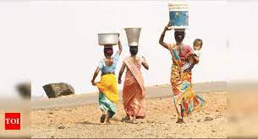
Innovative Ways to Save Water:
The women have formed ‘water committees’ and revived traditional methods of water harvesting.
Bathing on a string cot so that they can reuse the water falling through.
Wearing bone bangles wrist upwards to the armpit so that only the hands have to be washed delivering babies on sand to avoid soiling clothes and cleaning utensils with hot sand speak volumes about their harsh life style.

Slide 20
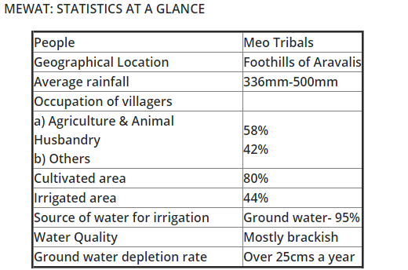
Harvesting water harnessing life: A case study of Kotla village in Mewat, Rajasthan

Slide 21
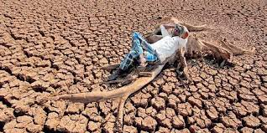
KOTLA CASE STUDY:
Kotla is a village at the foothills of Aravallis.
It has the worst development indices.
In the absence of recharging, ground water was depleting at more than 300-500 mm every year.
Ridge to valley approach was unique as it was able to reduce the flow velocity.
The fresh water pockets were depleting year by year due to high exploitation of these.

Slide 22

INTERVENTION:
In Kotla, the construction of two check dams has improved the quality of water and increased ground water table.
Apart from the check dams, the abandoned dry wells have been transformed to harvesting structures by diverting the rainwater into the abandoned wells.

Slide 23
Conclusion:
Climate change is having a significant impact on weather patterns.
The growing uncertainty of surface water availability and increasing levels of water pollution.
Ground water resources can, in any instance, supplement surface water, particularly as a source of drinking water.
Many traditional methods are being refined while more recent advances are being developed further.
The projected increased variability and distribution of freshwater resources demands political commitment.

Slide 24
References:
https://www.greenfacts.org/en/water-resources/l-3/7-protecting-water-resources.htm#0p0
https://hindi.indiawaterportal.org/content/water-crisis-rajasthan/content-type-page/53102
https://www.commonfloor.com/guide/10-innovative-ways-to-save-water-in-your-apartment-community-2710#:~:text=Shorten%20your%20shower%20by%20a,washing%20machines%2C%20showers%20and%20baths.
https://www.tutorialspoint.com/environmental_studies/environmental_studies_water_resources.htm
https://www.earthreminder.com/ways-to-save-natural-resources-its-conservation/

Slide 25


