Slide 1
My Favorite Restaurant Docker+ Node.js+ Json
SHUSHU CHENG
U01359337

Slide 2
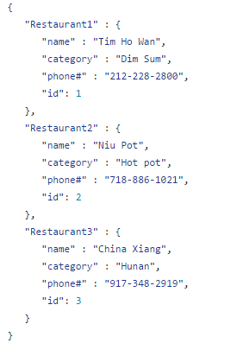
Data Model
Restaurant | ID | Name | category | Phone#
Restaurant1 | 1 | Tim Ho Wan | Dim Sum | 212(228)-2800
Restaurant2 | 2 | Niu Pot | Hot Pot | 718(886)-1021
Restaurant3 | 3 | China Xiang | Hunan | 917(348)-2919

