Slide 1

Deep Convolutional Neural Network-Based Rice Leaf Disease Detection
26 June, 2025

Slide 2

Group Information
Name | ID | Contribution
01. SHUSMITA ANJUM AZIZ | 22-47733-2 | Methodology
02. FARZANA BINTE KAFIL | 22-46086-1 | Results And Discussion
03. MD AHSAMUL HAQUE | 22-46089-1 | Literature Review & Conclusion
04. MARUF BILLAH SIDDIKI | 22-47177-1 | Introduction

Slide 3

Presentation Overview
1. Introduction
2. Related works
3. Proposed model
4. Results
5. Discussion with Comparision
6. conclusion with future works

Slide 4

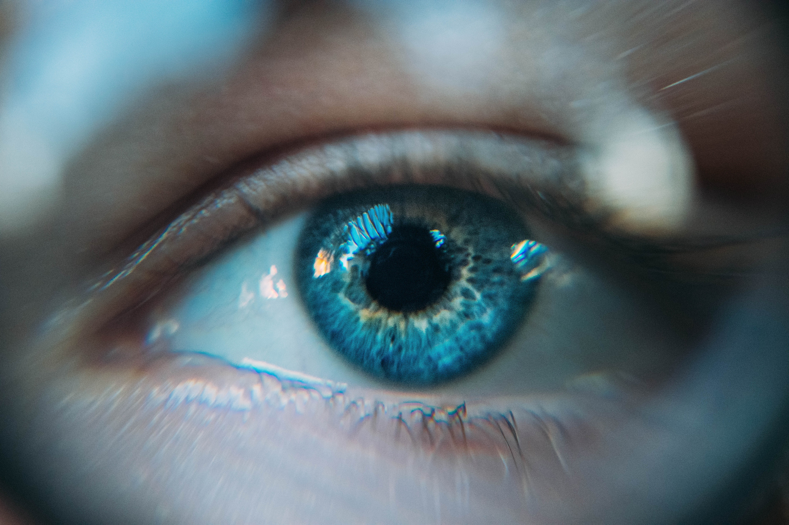
Introduction
Rice feeds over 40% of the global population and is crucial for Bangladesh
.
Leaf diseases like blast and blight cause major yield losses.
Traditional detection methods are slow, costly, and error-prone.
This study applies CNN models (EfficientNet, ResNet50, DenseNet) for accurate rice leaf disease detection

Slide 5


Related works
Author(s) | Model/Method | Dataset | Accuracy | Limitations
M.A. Islam et al. | VGG-19, Inception-ResNet-V2, ResNet-101 | Local+Online | 92.68% | Small dataset, image variation issues
D.C. Trinh et al. | Alpha-EIOU-YOLOv8 | 3175 images (3 diseases) | 89.9% | Poor performance under bad lighting/weather
V.S. Kumar et al. | YOLOv5 + DenseNet-201 + Bi-FAPN | Custom rice dataset | 94.87% | Misses small infected areas
L. Feng et al. | HSI + Fine-tuning + CORAL, DDC | 4 varieties, ~250 samples/variety | >88% | Small, less diverse dataset
N. Bharanidharan et al. | Thermal imaging + MLOA + KNN, RFC, etc. | 636 thermal images | 90% (KNN) | Single dataset, limited generalization
R. Deng et al. | Ensemble (DenseNet-121, SE-ResNet, etc.) | 33,026 mobile images (6 diseases) | 91% | Large models not mobile-friendly
R.R. Patil & S. Kumar | CNN + MLP (Rice-Fusion) | 3,200 multimodal samples | 95.31% | Class imbalance, modality dependency

Slide 6
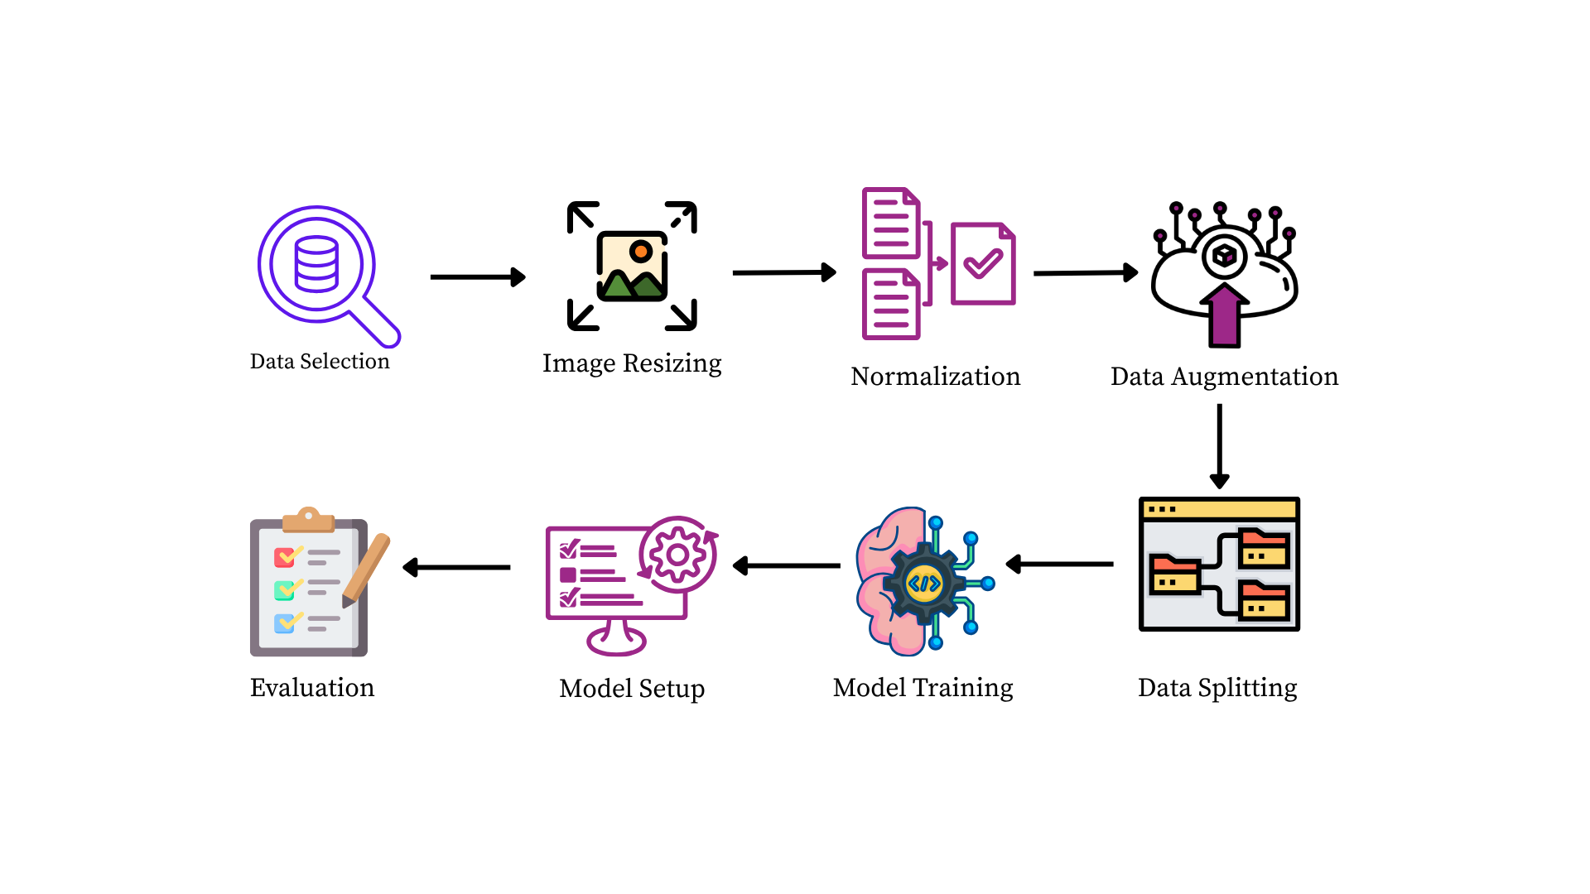
Workflow of the Methodology
Fig. 1: Methodology Workflow

Slide 7
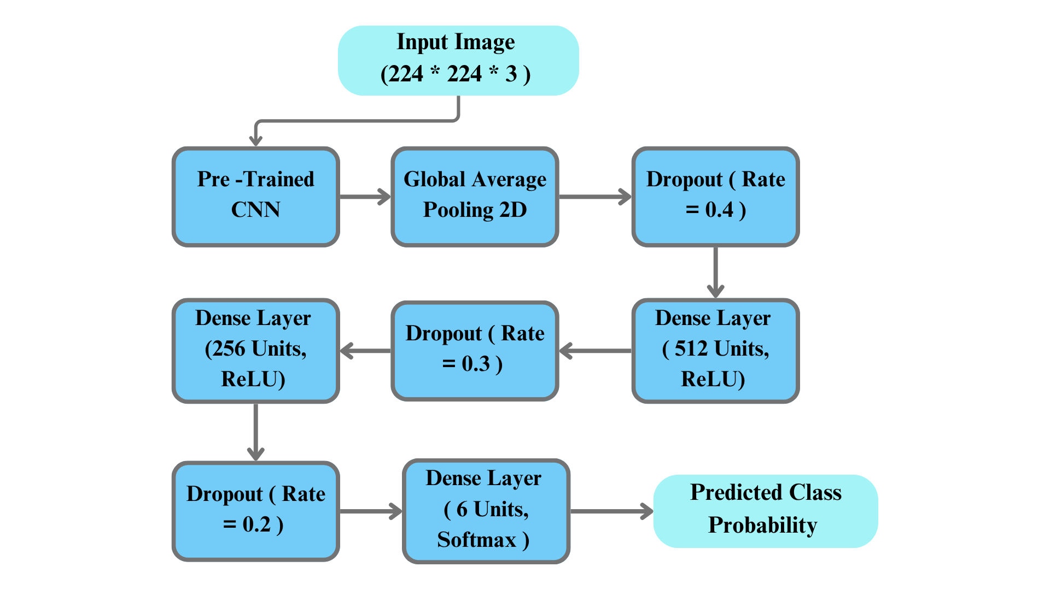
CNN Architecture
Fig. 2: CNN Architecture

Slide 8
Results
Models | Test Accuracy | AUC Score
EifficentNetB2 | 0.9617 | 0.9976
EfficientNetB0 | 0.9148 | 0.9919
ResNet50 | 0.9809 | 0.9979
DenseNet121 | 0.9809 | 0.9976

Slide 9
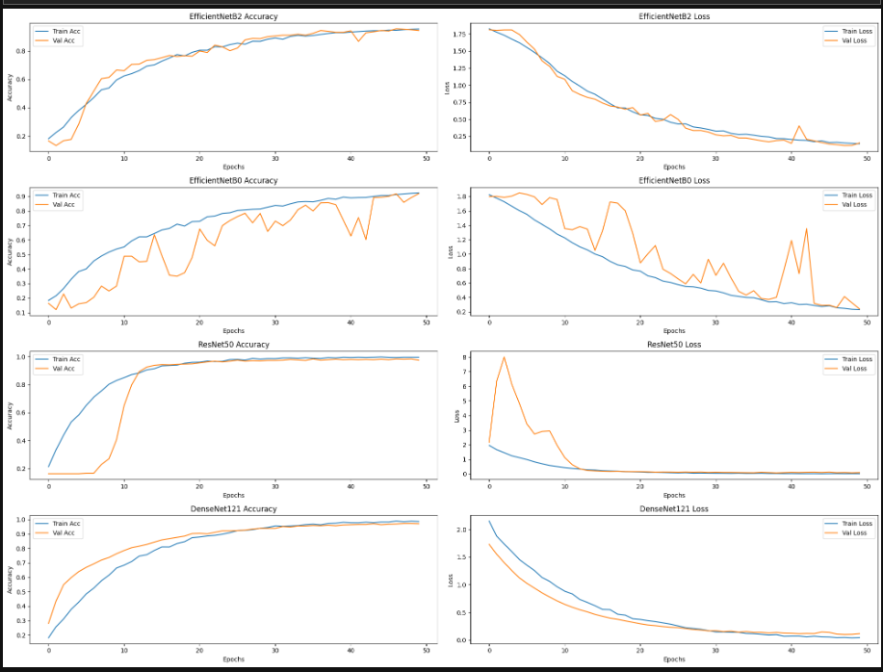
Evaluation

Slide 10
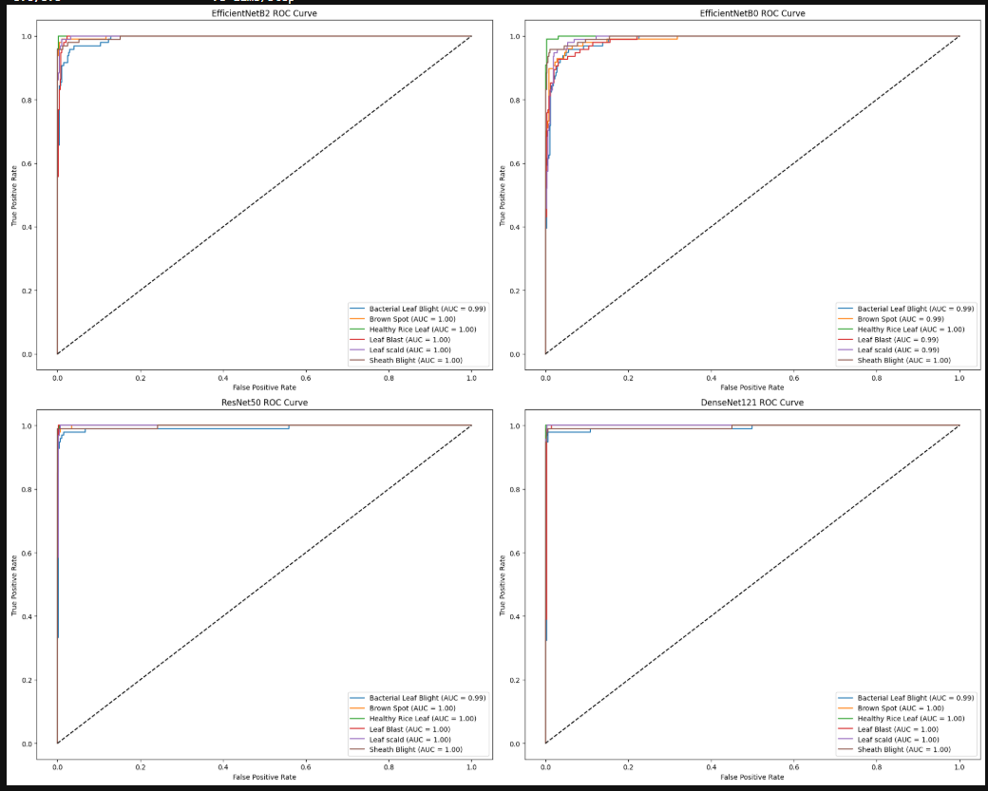
AUC ROC CURVE

Slide 11
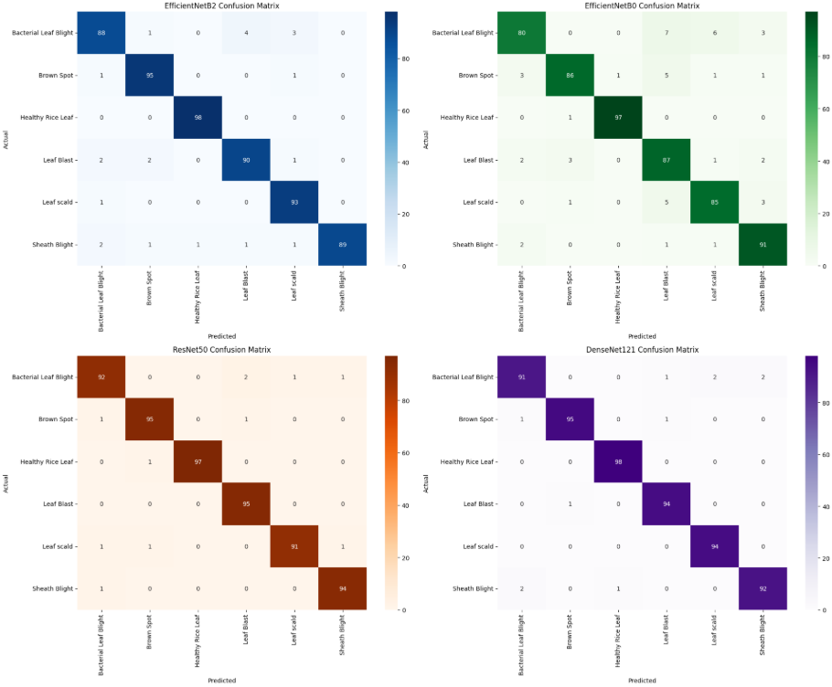
Confusion Matrix

Slide 12
Conclusion with Future Works
Compared deep learning models for rice leaf disease detection.
ResNet50 and DenseNet121 performed best.
ResNet50 had the highest AUC.
Deeper models gave better feature extraction.
Future work: simplify models for low-resource use.
Explore ensemble methods and domain-specific learning.

Slide 13
Comparison
Research Work | Model Used | Highest Accuracy | Dataset Size (Images) | Augmentation
Proposed Method | ResNet50 & DenseNet121 | 98.09% | 3829 | Rotation, Zoom, Horizontal and Vertical Shifts, Horizontal Flips
M. A. Islam et al. (2021) | Inception-ResNet-V2 | 92.68%, | 984 | Rotation, Width and Height Shift, Zoom and Shear, Horizontal Flip, Rescaling.
R. R. Patil et al. Kumar (2022) | CNN+MLP | 95.31% | 3,200 | No
R. Deng et al. (2021) | DenseNet-121+ResNeSt-50,+SE-ResNet-50 | 91% | 33,026 | Flipping, Rotation, Affine Transformation, and Gaussian Blur,
N. Bharanidharan et al. (2023) | KNN | 90% | 636 | No

Slide 14

Studio Shodwe
Thank you

