Slide 1
Openness in Goods and Financial Markets
Chapter 17

Slide 2
Chapter 17 Outline
Openness in Goods and Financial Markets
17-1 Openness in Goods Markets
17-2 Openness in Financial Markets
17-3 Conclusions and a Look Ahead

Slide 3
Openness in Goods and Financial Markets
Openness in goods markets: The ability of consumers and firms to choose between domestic goods and foreign goods. Even countries most committed to free trade have tariffs (taxes on imported goods) and quotas (restrictions on the quantity of goods that can be imported).
Openness in financial markets: The ability of financial investors to choose between domestic assets and foreign assets—until recently, even some rich countries had capital controls—restrictions on the foreign assets their domestic residents could hold and the domestic assets foreign could hold.

Slide 4
Openness in Goods and Financial Markets
Openness in factor markets: The ability of firms to choose where to locate production, and of workers to choose where to work, e.g., the North American Free Trade Agreement (NAFTA) signed in 1993 by the U.S., Canada, and Mexico centered on how it would affect the relocation of U.S. firms to Mexico.

Slide 5
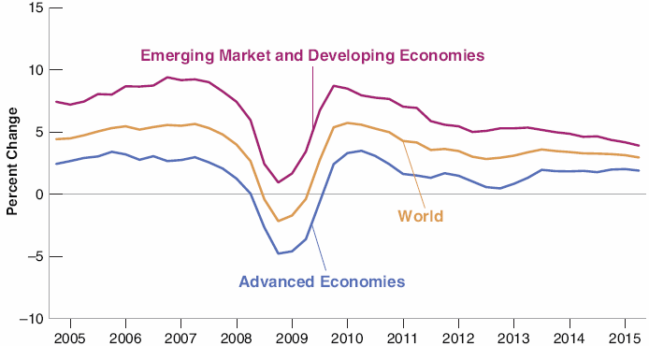

Figure 17-1 Growth in Advanced and Emerging Economies since 2005
The crisis started in the United States, but it affected nearly every country in the world.

Slide 6
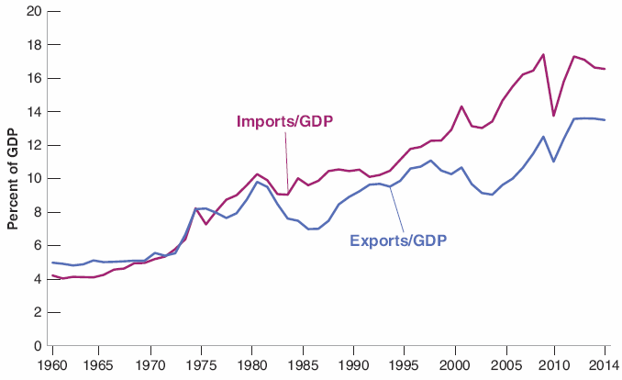

17-1 Openness in Goods Markets
Figure 17-2 U.S. Exports and Imports as Ratios of GDP since 1960
Since 1960, exports and imports have more than tripled in relation to GDP. The United States has become a much more open economy.

Slide 7
17-1 Openness in Goods Markets
The volume of trade is not necessarily a good measure of openness.
Tradable goods: Goods that compete with foreign goods in either domestic markets or foreign markets.
Tradable goods represent about 60% of aggregate output in the United States today.

Slide 8
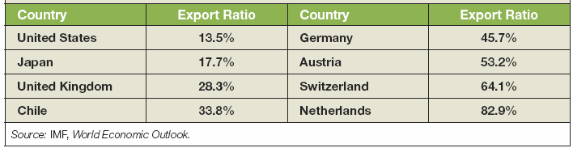
17-1 Openness in Goods Markets
The United States is at the low end of the range of export ratios.
Table 17-1 Ratios of Exports to GDP for Selected OECD Countries, 2014

Slide 9
FOCUS: Can Exports Exceed GDP?
Since a country cannot export more than it produces, the export ratio must be less than one?
No, exports may be larger than GDP because exports and imports may include exports and imports of intermediate goods.
In 2014, the ratio of exports to GDP in Singapore was 188%!

Slide 10
17-1 Openness in Goods Markets
Real exchange rate: The price of domestic goods relative to foreign goods.
Nominal exchange rate: The price of the domestic currency in terms of foreign currency.
(Nominal) appreciation: An increase in the price of the domestic currency in terms of a foreign currency, i.e., an increase in the exchange rate.
(Nominal) depreciation: A decrease in the price of the domestic currency in terms of a foreign currency, i.e., a decrease in the exchange rate.

Slide 11
17-1 Openness in Goods Markets
Fixed exchange rates: A system in which two or more countries maintain a constant exchange rate between their currencies.
In the fixed exchange rate system, revaluations are increases in the exchange rate, and devaluations are decreases in the exchange rate.

Slide 12
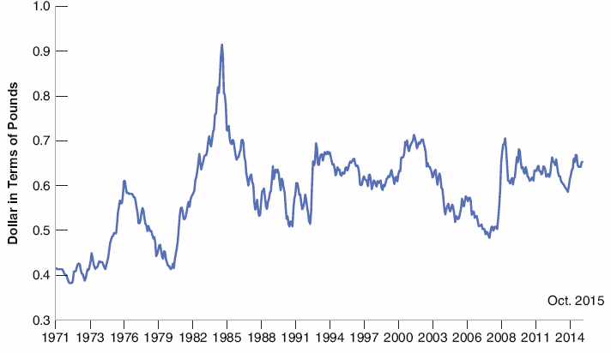

17-1 Openness in Goods Markets
Figure 17-3 The Nominal Exchange Rate between the Dollar and the Pound since 1971
Although the dollar has appreciated
relative to the pound over the past four decades, this appreciation has come with large swings in the nominal exchange rate between the two currencies.

Slide 13

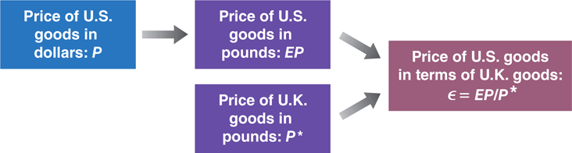
17-1 Openness in Goods Markets
The real exchange rate, the price of U.S. goods in terms of British goods, is
Figure 17-4 The Construction of the Real Exchange Rate

Slide 14
17-1 Openness in Goods Markets
Real appreciation: An increase in the real exchange rate, i.e., an increase in the relative price of domestic goods in terms of foreign goods.
Real depreciation: A decrease in the real exchange rate, i.e., a decrease in the relative price of domestic goods in terms of foreign goods.

Slide 15
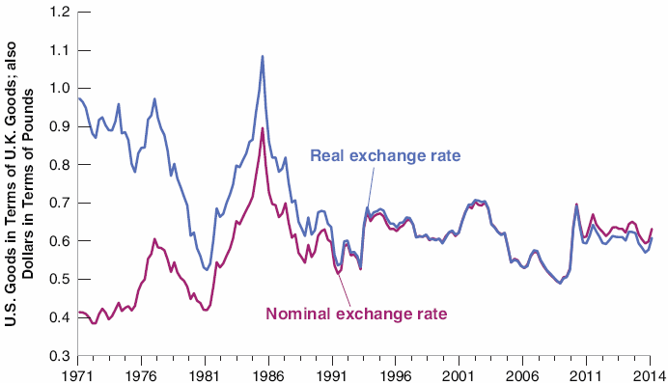

17-1 Openness in Goods Markets
Figure 17-5 Real and Nominal Exchange Rates between the United States and the United Kingdom since 1971
Except for the difference in trend reflecting higher average inflation in the United Kingdom than in the United States until the early 1990s, the nominal
and the real exchange rates have moved largely together.

Slide 16
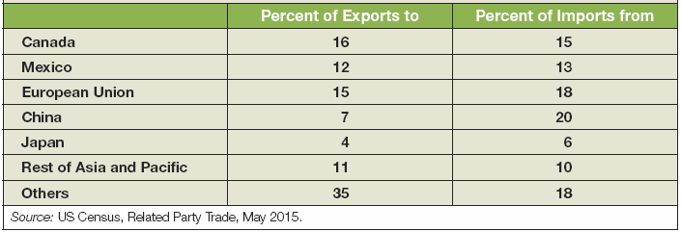
17-1 Openness in Goods Markets
Example of going from bilateral exchange rates (two countries) to multilateral exchange rates: The Multilateral real U.S. Exchange rate (or U.S. real exchange rate) requires data on the geographic composition of U.S. trade for both exports and imports.
Table 17-2 The Country Composition of U.S. Exports and Imports, 2014

Slide 17
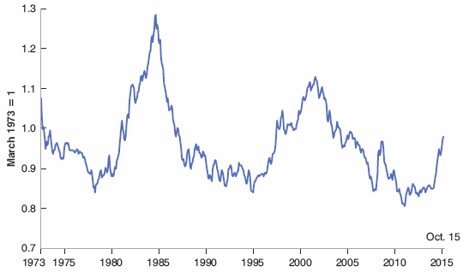

17-1 Openness in Goods Markets
Figure 17-6 The U.S. Multilateral Real Exchange Rate, since 1973
Since 1973 there have been two large real appreciations of the U.S. dollar and two large real depreciations.

Slide 18
17-2 Openness in Financial Markets
Foreign exchange: Buying and selling foreign currency.
Balance of payments: A set of accounts that summarize a country’s transactions with the rest of the world.
Current account: Transactions above the line record payments to and from the rest of the world.
Exports and imports of goods and services (trade balance)
Net income balance between income received from the rest of the world and income paid to foreigners
Net transfer received—the difference in foreign aid given and received

Slide 19
17-2 Openness in Financial Markets
Current account balance: The sum of net payments to and from the rest of the world
Current account surplus: Positive net payments from the rest of the world
Current account deficit: Negative net payments from the rest of the world

Slide 20
17-2 Openness in Financial Markets
Capital account: Transactions below the line record net foreign holdings of domestic assets
Net capital flows or capital account balance: An increase in net foreign indebtedness (holdings of domestic assets minus the increase in domestic holdings of foreign assets)
Capital account surplus: Positive net capital flows
Capital account deficit: Negative net capital flows
Statistical discrepancy: Difference between current and capital account transactions

Slide 21
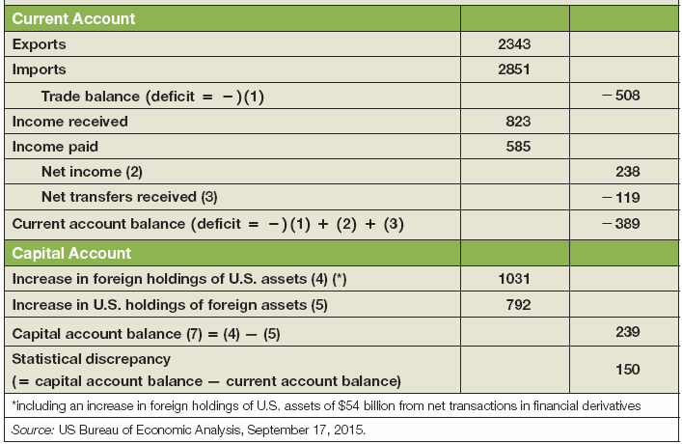
17-2 Openness in Financial Markets
Table 17-3 The U.S. Balance of Payments, 2014, in Billions of U.S. Dollars

Slide 22
17-2 Openness in Financial Markets
GDP measures value added domestically.
Gross national product (GNP) measures the value added by domestic factors of production
GNP = GDP + NI
where NI denotes net income—payments received from the rest of the world less income paid to the rest of the world

Slide 23
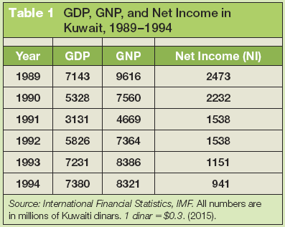
FOCUS: GDP versus GNP: The Example of Kuwait
Kuwait ran a large current account surplus and accumulated large foreign assets, resulting in larger GNP compared to GDP.
Table 1 GDP, GNP, and Net Income in Kuwait, 1989–1994

Slide 24
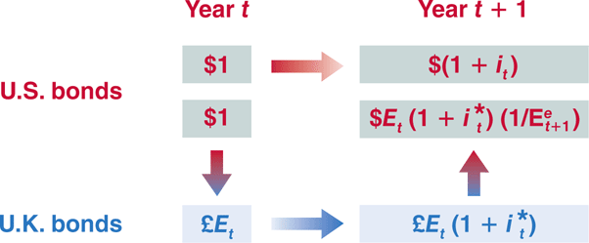
17-2 Openness in Financial Markets
Consider a U.S. investor’s decision between holding U.S. one year bonds and U.S. one-year bonds.
Figure 17-7 Expected Returns from Holding One-Year U.S. Bonds vs. One-Year U.K. Bonds

Slide 25


17-2 Openness in Financial Markets
Arbitrage implies that:
or
which is called the uncovered interest parity relation or the interest parity relation.
The assumption that financial investors hold only the bonds with the highest expected rate of return ignores transactions costs and risk.

Slide 26


17-2 Openness in Financial Markets
Equation (17.2) implies:
which gives a good approximation of the the interest parity condition:
Arbitrage by investors implies that the domestic interest rate must be equal to the foreign interest rate minus the expected appreciation rate of the domestic currency.

Slide 27
17-2 Openness in Financial Markets
Equation (17.4) can also be stated as the condition that the domestic interest rate must be equal to the foreign interest rate minus the expected depreciation of the foreign currency.
If , then the interest parity condition implies .

Slide 28
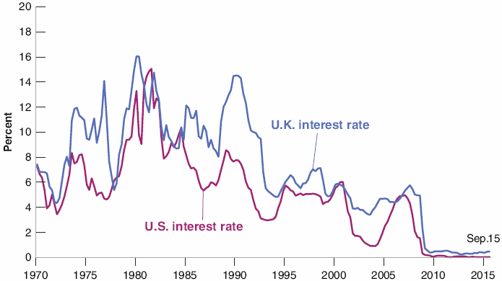

17-2 Openness in Financial Markets
Figure 17-8 Three-Month Nominal Interest Rates in the United States and in the United Kingdom since 1970
U.S. and U.K. nominal interest rates have largely moved together over the last 40 years.

Slide 29
17-3 Conclusions and a Look Ahead
Openness in goods markets allows people and firms to choose between domestic goods and foreign goods. This choice depends primarily on the real exchange rate.
Openness in financial markets allows investors to choose between domestic assets and foreign assets. This choice depends primarily on their relative rates of return, and on the expected rate of appreciation of the domestic currency.

