Slide 1
The Goods Market in an Open Economy
Chapter 18

Slide 2
Chapter 18 Outline
The Goods Market in an Open Economy
18-1 The IS Relation in the Open Economy
18-2 Equilibrium Output and the Trade Balance
18-3 Increases in Demand−Domestic or Foreign
18-4 Depreciation, the Trade Balance, and Output
18-5 Looking at Dynamics: The J-Curve
18-6 Saving, Investment, and the Current Account Balance

Slide 3
The Goods Market in an Open Economy
The U.S. recession in 2009 led to a world recession.
To understand what happened, we must expand the treatment of the goods market in Chapter 3 of the core and account for openness in the analysis of goods markets.
This is what we do in this chapter.

Slide 4

18-1 The IS Relation in the Open Economy
In an open economy, the demand for domestic goods is
where C, I, and g constitute the total domestic demand for goods, domestic or foreign.

Slide 5


18-1 The IS Relation in the Open Economy
Imports is positively related to domestic income (Y) and the real exchange rate (ε):
Exports is positively related to foreign income (Y*) and negatively related ε:

Slide 6
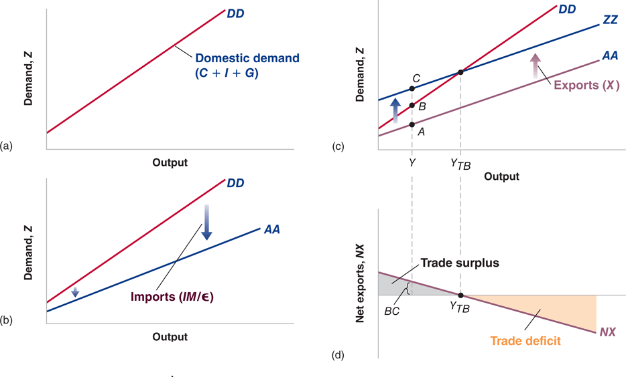
18-1 The IS Relation in the Open Economy
Figure 18-1 The Demand for Domestic Goods and Net Exports
(a), The domestic demand for goods is an increasing function of income (output).
(b) and (c), The demand for domestic goods is obtained by subtracting the value of imports from domestic demand and then adding exports.
(d), The trade balance is a decreasing function of output.

Slide 7
18-1 The IS Relation in the Open Economy
The line AA represents the domestic demand for domestic goods, and the line DD represents domestic demand.
AA is flatter than DD.
As long as some of the additional demand falls on domestic goods, AA has positive slope.
The line ZZ represents the demand for domestic goods (including exports).
The distance between ZZ and AA is constant because exports do not depend on domestic income but they depend on foreign income.

Slide 8
18-2 Equilibrium Output and the Trade Balance
Because Y = Z, the equilibrium condition for output can be expressed as:
Graphically, equilibrium output is at the point where demand equals output, the intersection of ZZ and the 45-degree line.

Slide 9
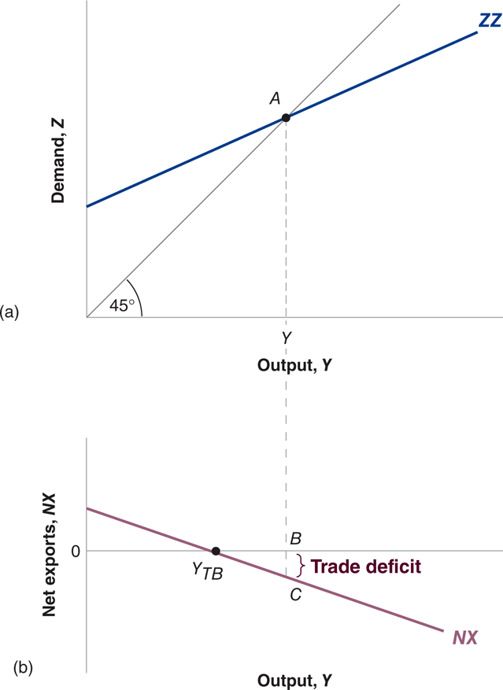
18-2 Equilibrium Output and the Trade Balance
Figure 18-2 Equilibrium Output and Net Exports
The goods market is in equilibrium when domestic output is equal to the demand for domestic goods. At the equilibrium level of output, the trade
balance may show a deficit or a surplus.

Slide 10
18-3 Increases in Demand− Domestic or Foreign
Differences with a closed economy:
Effect on trade balance: An increase in output leads to a trade deficit
Smaller effect of government spending on output: Because ZZ is flatter than DD, the multiplier is smaller in the open economy

Slide 11
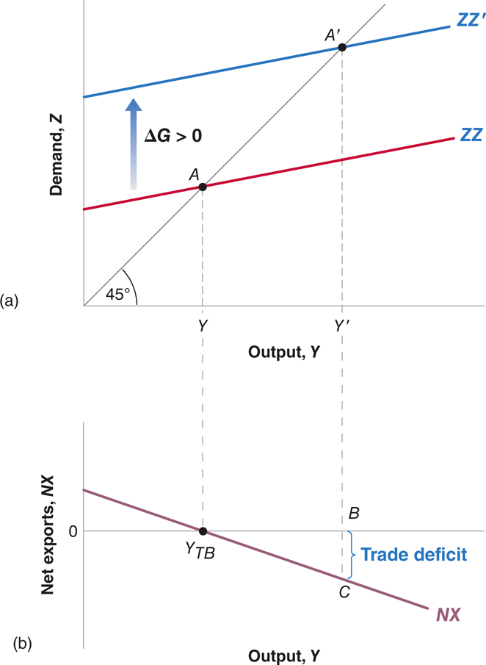
18-3 Increases in Demand− Domestic or Foreign
Figure 18-3 The Effects of an Increase in Government Spending
An increase in government spending leads to an increase in output and to a trade deficit.

Slide 12
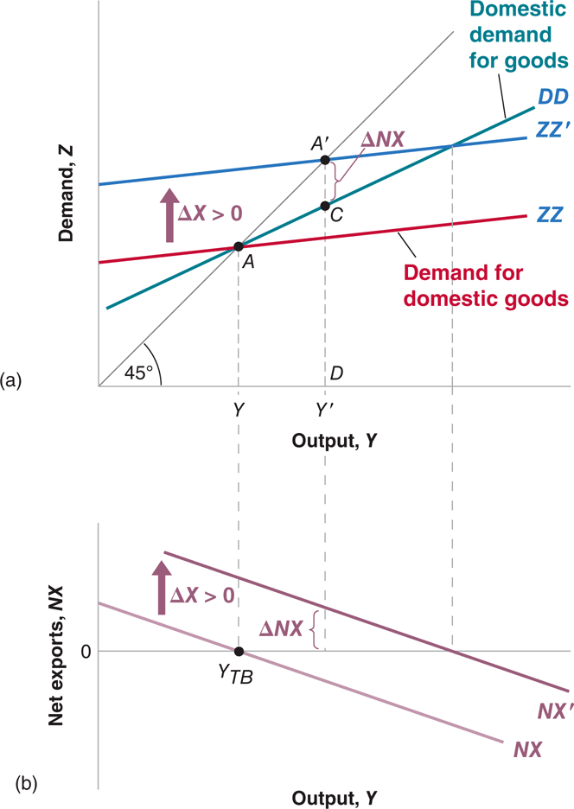
18-3 Increases in Demand− Domestic or Foreign
Figure 18-4 The Effects of an Increase in Foreign Demand
An increase in foreign demand leads to an increase in output and to a trade surplus.

Slide 13
18-3 Increases in Demand− Domestic or Foreign
Summary:
An increase in domestic demand leads to an increase in domestic output but leads also to a deterioration of the trade balance.
An increase in foreign demand leads to an increase in domestic output and an improvement in the trade balance.
Implications:
Shocks to demand in one country affect all other countries.
Economic interactions complicate the task of policy makers. Policy coordination is not so easy to achieve.

Slide 14
FOCUS: Fiscal Stimulus and Structural Reforms amid Negative Interest Rates
To fight the ills of the global financial crisis, 2007–2008, global fiscal and monetary agents successfully implemented stimulus packages that helped the international economy to emerge from one of the worst global recessions.
To prevent the Eurozone from falling into a deflationary spiral, in mid-2015, the ECB took the lead in applying a negative interest rate (NIR) to some amounts of the legal reserve balances that central banks hold with the ECB.
With the mounting criticism of NIR policies, central bankers are pressurizing their fiscal agent counterparts to rapidly reverse NIR policies.

Slide 15


18-4 Depreciation, the Trade Balance, and Output
Recall the real exchange rate equation:
and the definition of net exports:
Given the expressions from equations (18.2) and (18.3):

Slide 16
18-4 Depreciation, the Trade Balance, and Output
Real deprecation affects the trade balance through three separate channels:
Exports, X, increase.
Imports, IM, decrease.
The relative price of foreign goods in terms of domestic goods, 1/ε , increases.
Marshall-Lerner condition: A real depreciation leads to an increase in net exports.
Depreciation leads to a shift in demand, both foreign and domestic, toward domestic goods. The shift in demand leads, in turn, to both an increase in domestic output and an improvement in their trade balance.

Slide 17
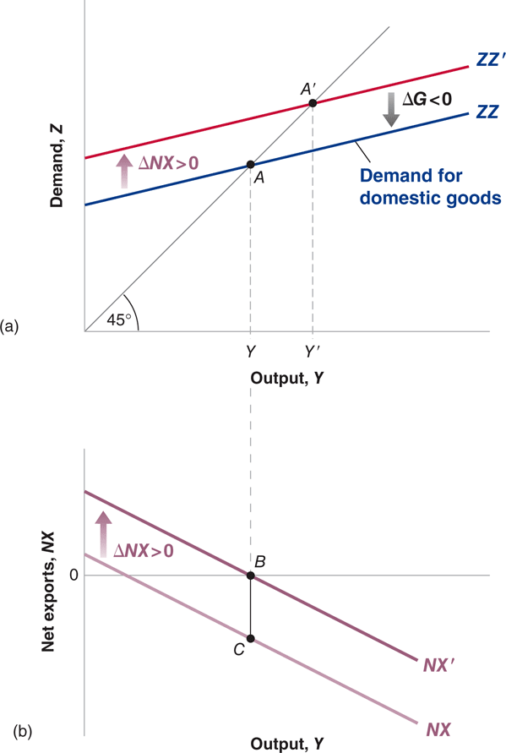
18-4 Depreciation, the Trade Balance, and Output
Figure 18-5 Reducing the Trade Deficit without Changing Output
To reduce the trade deficit without changing output, the government must both achieve a depreciation and decrease
government spending.

Slide 18
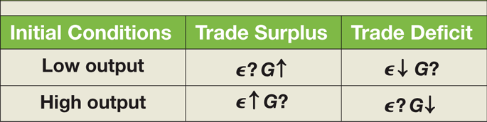
18-4 Depreciation, the Trade Balance, and Output
If the government wants to eliminate the trade deficit without changing output, it must do two things:
achieve a depreciation sufficient to eliminate the trade deficit
reduce government spending so as to shift ZZ back
Table 18-1 Exchange Rate and Fiscal Policy Combinations

Slide 19
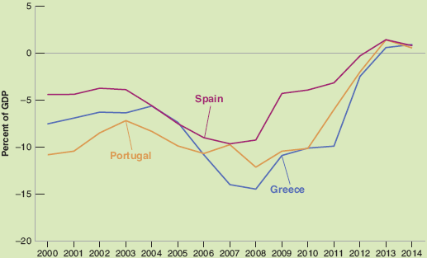
FOCUS: The Disappearance of Current Account Deficits in Euro Periphery Countries: Good News or Bad News?
Import compression: A decrease in imports (improved current account balance) triggered by a decrease in output.
Figure 1 Euro Periphery Current Account Deficits since 2000

Slide 20
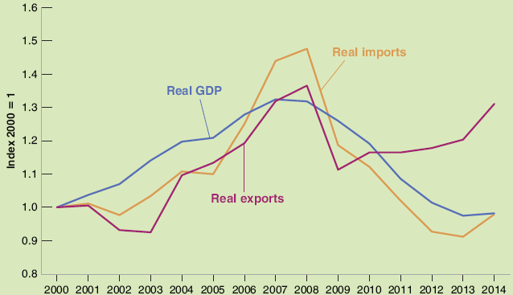
FOCUS: The Disappearance of Current Account Deficits in Euro Periphery Countries: Good News or Bad News (continued)
Greece’s real GDP, imports and exports all declined after 2008.
Figure 2 Imports, Exports and GDP in Greece since 2000

Slide 21
18-5 Looking at Dynamics: The J-Curve
J-curve: The adjustment process in the trade balance in response to a real depreciation.
A depreciation initially increases the trade deficit and, over time, exports increase and import decrease, reducing the trade deficit.

Slide 22
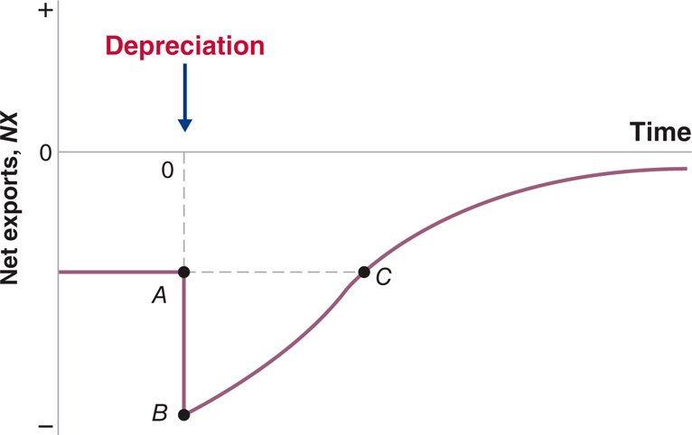
18-5 Looking at Dynamics: The J-Curve
Figure 18-6 The J-Curve
A real depreciation leads initially to a deterioration and then to an improvement of the trade balance.

Slide 23
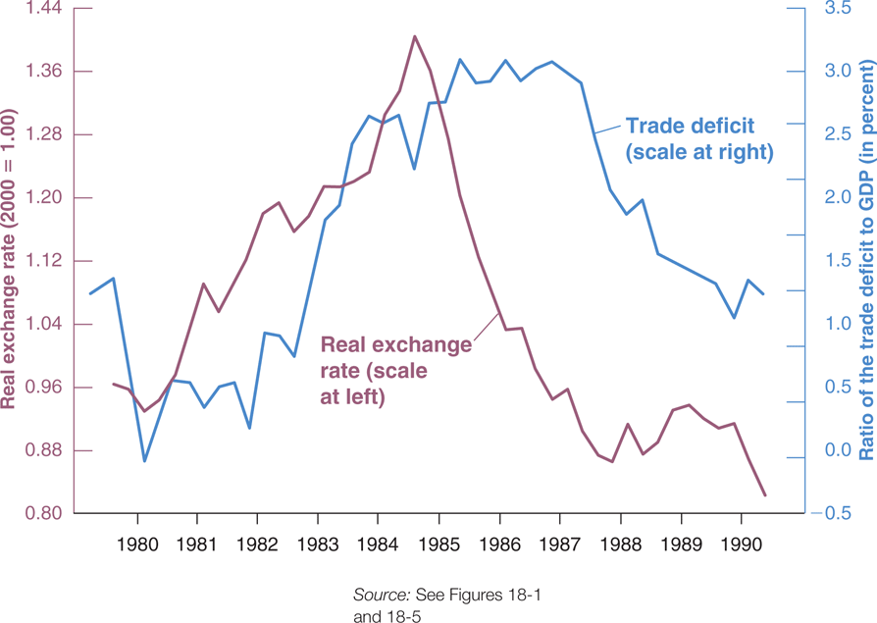
18-5 Looking at Dynamics: The J-Curve
Figure 18-7 The Real Exchange Rate and the Ratio of the Trade Deficit to GDP: United States, 1980–1990
The large real appreciation and subsequent real depreciation from 1980 to 1990 were mirrored, with a lag, by an increase and then a decrease
in the trade deficit.

Slide 24

18-6 Saving, Investment, and the Current Account Balance
Recall the income of domestic residents in an open economy:
Denote the current account by CA, so that the above equation becomes:
meaning that the current account balance equal to saving minus investment:

Slide 25
18-6 Saving, Investment, and the Current Account Balance
An increase in investment must be reflected either an increase in private saving or public saving, or in a deterioration of the current account balance.
A deterioration in the government budget balance must be reflected in an increase in either private saving, or in a decrease in investment, or else in a deterioration of the current account balance.
A country with a high saving rate must have either a high investment rate or a large current account surplus.

Slide 26

APPENDIX: Derivation of the Marshall-Lerner Condition
The Marshall-Lerner condition is the condition under which a real depreciation (lower U) leads to an increase in net exports.
Given the definition of net exports: NX = X – IM/ε
Multiply both sides by ε to get: εNX = εX – IM, which can be written as: ε(∆NX )= (∆ε)X + ε (∆X) – (∆IM)
Divide both sides by εX to get:
If trade is initially balanced (εX = IM), then:

