Slide 1
Should Policy Makers Be Restrained?
Chapter 21

Slide 2
Chapter 21 Outline
Should Policy Makers Be Restrained?
21-1 Uncertainty and Policy
21-2 Expectations and Policy
21-3 Politics and Policy

Slide 3
Should Policy Makers Be Restrained?
We have seen how the right mix of fiscal and monetary policies could potentially help an economy.
This conclusion, however, appears to be at odds with frequent demands that policy markets be tightly restrained.
This chapter looks at the case for such restraints on macroeconomic policy.

Slide 4
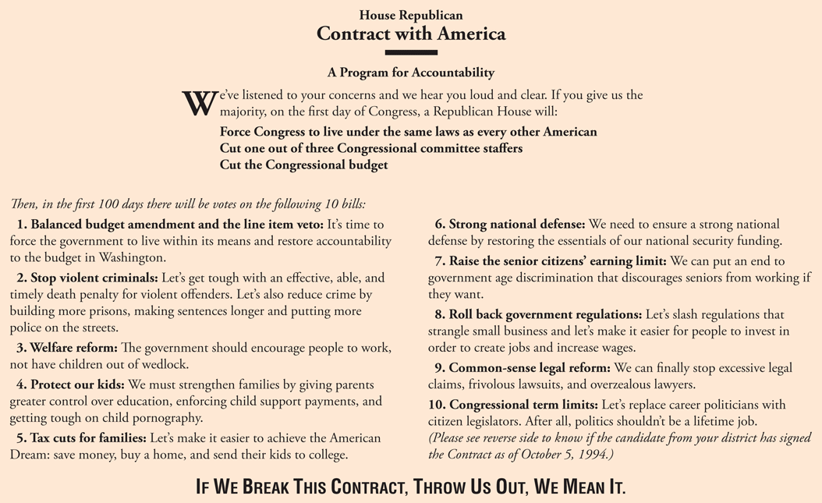
Figure 21-1 The Contract with America

Slide 5
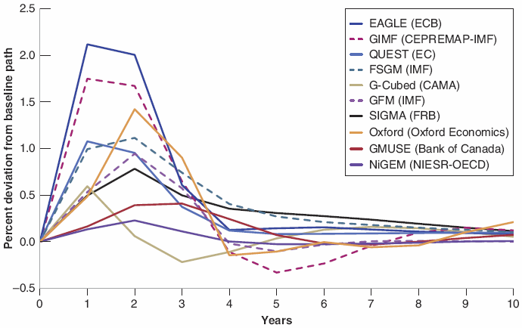
21-1 Uncertainty and Policy
Figure 21-2 The Response of Output to a Monetary Expansion. Predictions from 10 Models
Although all 10 models predict that output will increase for some time in response to a monetary expansion, the range of answers regarding the size and the length of the output response is large.

Slide 6
21-1 Uncertainty and Policy
There is substantial uncertainty about the effects of macroeconomic policies.
This uncertainty should lead policy makers to be cautious and to limit the use of active policies.
Policies should be broadly aimed at avoiding large prolonged recessions, slowing down booms, and avoiding inflationary pressure.
The higher unemployment or the higher inflation, the more active the policies should be.
In normal times, macroeconomic policies should stop well short of fine tuning—trying to achieve constant unemployment or constant output growth.

Slide 7
21-2 Expectations and Policy
Rather than optimal control theory, macroeconomic policy must be thought of as a game between the policy makers and the people and the firms in the economy—game theory.
In economics, games are strategic interactions between players.

Slide 8
21-2 Expectations and Policy
Recall the relation between inflation and unemployment in Chapter 8 (without the time index):
Suppose the Fed announces a monetary policy consistent with zero inflation, and if expected inflation is zero, then equation (21.1) becomes:
If the Fed follows through with its announced policy, inflation will be equal to zero.

Slide 9
21-2 Expectations and Policy
Recall from Chapter 8 that α is roughly equal to 0.5, i.e., the Fed can accept just 1% if it achieves an unemployment rate of 2% below the natural rate of unemployment.
Time inconsistency of optimal policy: An incentive to deviate from the announced policy once the other player has made his move.
The end result is an economy with the same unemployment rate that would have prevailed if he Fed had followed its announced policy, but with much higher inflation.
Attempts by the Fed to make things better lead in the end to things being worse.

Slide 10
21-2 Expectations and Policy
One way for a central bank to establish its credibility not to deviate from its announced policy is to give up its policy-making power as defined by law.
A first step to deal with the problem of time inconsistency is to set up an independent central bank, where interest rate and money supply decisions are made independent of the influence of the currently elected politicians.
A second step is to give incentives to the central banks to take the long view about the costs from higher inflation.
A third step may be to appoint a “conservative” central banker, who dislikes inflation very much.

Slide 11
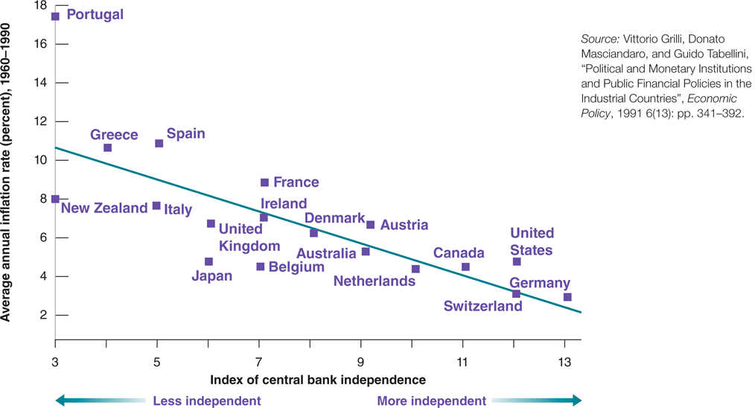
21-2 Expectations and Policy
Figure 21-3 Inflation and Central Bank Independence
Across OECD countries, the higher the degree of central bank independence, the lower the rate of inflation.

Slide 12
FOCUS: Was Alan Blinder Wrong in Speaking the Truth?
In 1994, Alan Blinder, vice-chairman of the Federal Reserve Board, indicated his belief that the Fed has both the responsibility and ability to use monetary policy to help the economy recover when unemployment is high.
Bond prices fell in response because Blinder was perceived to be not a conservative central banker and higher expected inflation would lead to higher interest rates.

Slide 13
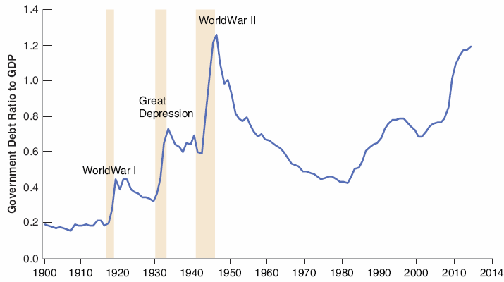

21-3 Politics and Policy
Figure 21-4 The Evolution of the U.S. Debt to GDP Ratio since 1900
The three major buildups of debt since 1900 have been associated with World War I, the Great Depression, and World War II. The buildup since 1980 has not been caused by either wars or adverse economic shocks.

Slide 14
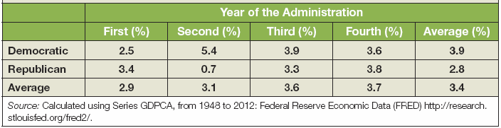
21-3 Politics and Policy
Political business cycle: Economic fluctuations induced by political elections, resulting in higher growth on average before elections than after elections.
Table 21-1 Growth during Democratic and Republican Presidential
Administrations: 1948−2012

Slide 15
21-3 Politics and Policy
Wars of attrition: The hope in that the other side will give in leads to long and often costly delays.
Wars of attrition happen often in the context of fiscal policy in games between policy makers, and deficit reduction occurs long after it should.

Slide 16
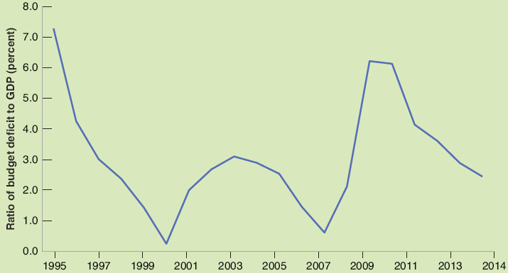
FOCUS: Euro Area Fiscal Rules: A Short History
The Stability and Growth Pact was signed in 1997 by would be members of the Euro area aimed to reduce excessive budget deficits.
The ratio of deficit to GDP indeed declined through 2007.
Figure 1 Euro Area Budget Deficits as a Percentage of GDP, since 1995

Slide 17
21-3 Politics and Policy
To eliminate the problem of deficits, the U.S. government can pass a constitutional amendment to balance the budget each year.
A better approach is to put in place rules that put limits either on deficits or on debt.
The Budget Enforcement Act passed in 1990 introduced two main rules:
Spending caps: Constraints on discretionary spending.
PAYGO rule (pay-as-you-go): A new transfer program could only be adopted if it could be shown not to increase deficits in the future.

