Slide 1
Financial Markets II
Chapter 6

Slide 2
Chapter 6 Outline
Financial Markets II
6-1 Nominal versus Real Interest Rates
6-2 Risk and Risk Premia
6-3 The Role of Financial Intermediaries
6-4 Extending the IS-LM
6-5 From a Housing Problem to a Financial Crisis

Slide 3
Financial Markets II
Until now, we assumed that there were only two financial assets—money and bonds—and just one interest rate—the rate on bonds—determined by monetary policy.
The financial system also plays a major role in the economy.
This chapter looks more closely at the role of the financial system and its macroeconomic implications.

Slide 4
6-1 Nominal versus Real Interest Rates
Nominal interest rate is the interest rate in terms of dollars.
Real interest rate is the interest rate in terms of a basket of goods.
We must adjust the nominal interest rate to take into account expected inflation.

Slide 5
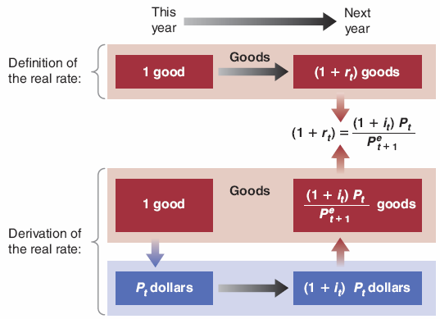
6-1 Nominal versus Real Interest Rates
Figure 6-1 Definition and Derivation of the Real Interest Rate

Slide 6



6-1 Nominal versus Real Interest Rates
One-year real interest rate r_{t}:
Denote expected inflation between t and t + 1 by:
so that equation (6.1) becomes

Slide 7
6-1 Nominal versus Real Interest Rates
If the nominal interest rate and expected inflation are not too large, a close approximately to equation (6.3) is:
When expected inflation equals zero, the nominal interest rate and the real interest rate are equal.
Because expected inflation is typically positive, the real interest rate is typically lower than the nominal interest rate.
For a given nominal interest rate, the higher expected inflation, the lower the real interest rate.

Slide 8
6-1 Nominal versus Real Interest Rates
The real interest rate (1 − π^{e}) is based on expected inflation, so it is sometimes called the ex-ante (“before the fact”) real interest rate.
The realized real interest rate (1 − π) is called the ex-post (“after the fact”) interest rate.
The interest rate that enters the IS relation is the real interest rate.
The zero lower bond of the nominal interest rate implies that the real interest rate cannot be lower than the negative of inflation.

Slide 9
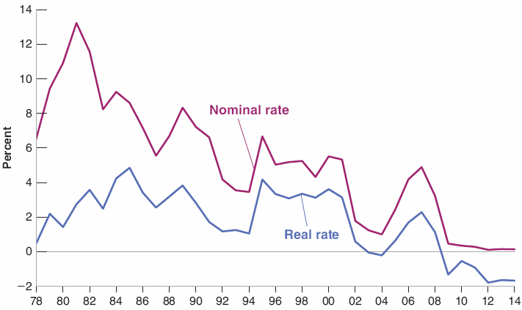
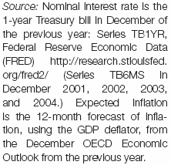
6-1 Nominal versus Real Interest Rates
Figure 6-2 Nominal and Real One-Year T-Bill Rates in the United States since 1978
The nominal interest rate has declined considerably since the early 1980s, but because expected inflation has declined as well, the real rate has declined much less than the nominal rate.

Slide 10
6-1 Nominal versus Real Interest Rates
Some bonds are risky, so bond holders require a risk premium.
Let i be the nominal interest rate on a riskless bond, x be the risk premium, and p is the probability of defaulting, then to get the same expected return on the risky bonds as on the riskless bond:
(1 + i) = (1 – p)(1 + i + x) + (p)(0)
so that
x = (1 + i)p / (1 – p)

Slide 11
6-2 Risk and Risk Premia
Some bonds are risky, so bond holders require a risk premium.
Risk premia are determined by:
The probability of default
The degree of risk aversion of bond holders

Slide 12
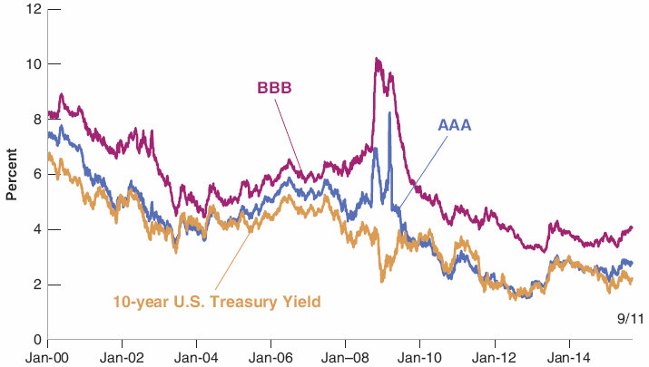

6-2 Risk and Risk Premia
Figure 6-3 Yields on 10-Year U.S. Government Treasury, AAA, and BBB Corporate Bonds, since 2000
In September 2008, the financial crisis led to a sharp increase in the rates at which firms could borrow.

Slide 13
6-3 The Role of Financial Intermediaries
Until now, we have looked at direct finance—borrowing directly by the ultimate borrowers from the ultimate lenders.
In fact, much of the borrowing and lending takes place through financial intermediaries—financial institutions that receive funds from investors and then lend these funds to others.

Slide 14
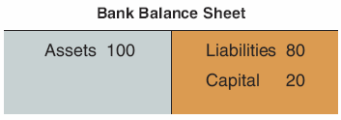
6-3 The Role of Financial Intermediaries
Figure 6-4 Bank Assets, Capital, and Liabilities
Capital ratio (the ratio of capital to assets) = 20/100 = 20%
Leverage ratio (the ratio of assets to capital) = 100/20 = 5
A higher leverage ratio implies a higher expected profit rate, but also implies a higher risk of insolvency and bankruptcy.

Slide 15
6-3 The Role of Financial Intermediaries
The lower the liquidity of bank assets means the more difficult they are to sell, the higher the risk of being sold at fire sale prices (prices far below the true value) and the risk that the bank becomes insolvent.
The higher the liquidity of the liabilities (e.g., checkable or demand deposits), the higher the risk of fire sales, and the risk that the bank becomes insolvent and thus faces bank runs.

Slide 16
FOCUS: Bank Runs
The U.S. financial history up to the 1930s is full of bank runs, as seen in the classic movie It’s a Wonderful Life.
One potential solution to bank runs is narrow banking, which restricts banks from making loans, and to hold liquid and safe government bonds.
To limit bank runs, the United States introduced federal deposit insurance in 1934.
The Fed also implemented liquidity provision so that banks could borrow overnight from other financial institutions.

Slide 17

6-4 Extending the IS-LM
Now we extend the IS-LM to reflect the distinction between:
the nominal interest rate and the real interest rate
the policy rate set by the central bank and the interest rates faced by borrowers
Rewrite the IS-LM:
where expected inflation π^{e} and the risk premium x enter the IS relation.

Slide 18
6-4 Extending the IS-LM
The central bank now chooses the real policy rate r, which enters the IS equation as part of the borrowing rate (r + x) for consumers and firms:
where expected inflation π^{e} and the risk premium x enter the IS relation.

Slide 19
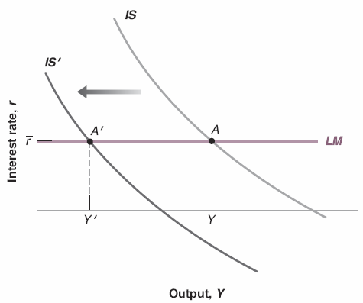
6-4 Extending the IS-LM
Figure 6-5 Financial Shocks and Output
An increase in x leads to a shift of the IS curve to the left and a decrease in equilibrium output.

Slide 20
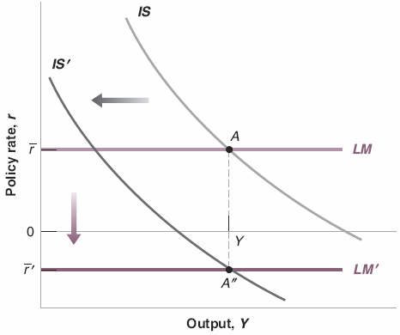
6-4 Extending the IS-LM
Figure 6-6 Financial Shocks, Monetary Policy, and Output
If sufficiently large, a decrease in the policy rate can in principle offset the increase in the risk premium.
The zero lower bound may however put a limit on the decrease in the real policy rate.

Slide 21
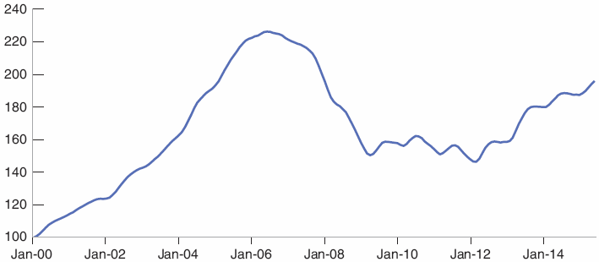

6-5 From a Housing Problem to a Financial Crisis
Figure 6-7 U.S. Housing Prices since 2000
The increase in housing prices from 2000 to 2006 was followed by a sharp decline thereafter.

Slide 22
6-5 From a Housing Problem to a Financial Crisis
The 2000s were a period of unusually low interest rates, which stimulated housing demand.
Mortgage lenders was increasingly willing to make loans to risky borrowers with subprime mortgages, or subprimes.
From 2006 on, many home mortgages went underwater (when the value of the mortgage exceeded the value of the house).
Lenders faced large losses as many borrowers defaulted.

Slide 23
6-5 From a Housing Problem to a Financial Crisis
Banks were highly leveraged because:
Banks probably underestimated the risk,
Bank managers had incentives to go for high expected returns without fully taking the risk of bankruptcy,
Banks avoided financial regulations with structured investment vehicles (SIVs)
Securitization is the creation of securities based on a bundle of assets, such as mortgage-based securities (MBS).

Slide 24
6-5 From a Housing Problem to a Financial Crisis
Senior securities have first claims on the return from the bundle of assets; junior securities, such as collateralized debt obligations (CDOs), come after.
Securitization was a way of diversifying risk, but it came with costs:
The bank that sold the mortgage had few incentives to keep the risk low
Even for toxic assets, the risk is difficult for rating agencies to assess

Slide 25
6-5 From a Housing Problem to a Financial Crisis
Wholesale funding is a process in which banks rely on borrowing from other banks or investors to finance the purchase of their assets.
In 2000s, SIVs were entirely funded through wholesale funding.
Wholesale funding resulted in liquid liabilities.

Slide 26
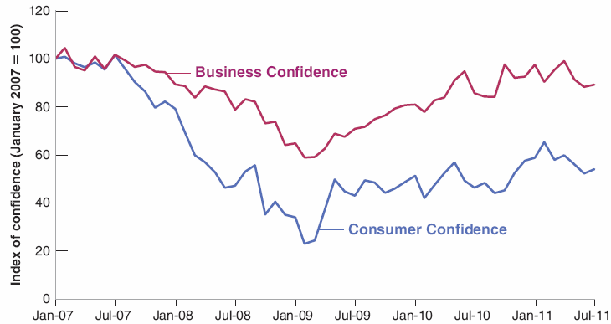
6-5 From a Housing Problem to a Financial Crisis
Figure 6-8 U.S. Consumer and Business Confidence, 2007−2011
The financial crisis led to a sharp drop in confidence, which bottomed in early 2009.

Slide 27
6-5 From a Housing Problem to a Financial Crisis
The demand for goods decreased due to the high cost of borrowing, lower stock prices, and lower confidence.
The IS curve shift to the left.
Policy makers responded to this large decrease in demand.

Slide 28
6-5 From a Housing Problem to a Financial Crisis
Financial Policies:
Federal deposit insurance was raised from $100,000 to $250,000,
The Fed provided widespread liquidity to the financial system through liquidity facilities, and increased the number the assets that could serve as collateral,
The government introduced the Troubled Asset Relief Program (TARP)

Slide 29
6-5 From a Housing Problem to a Financial Crisis
Monetary policy:
The federal funds rate was down to zero by December 2008.
The Fed also used unconventional monetary policy, which involved buying other assets as to directly affect the rate faced by borrowers.
Fiscal Policy:
The American Recovery and Reinvestment Act was passed in February 2009, calling for $780 billion in tax reductions and spending increases

Slide 30
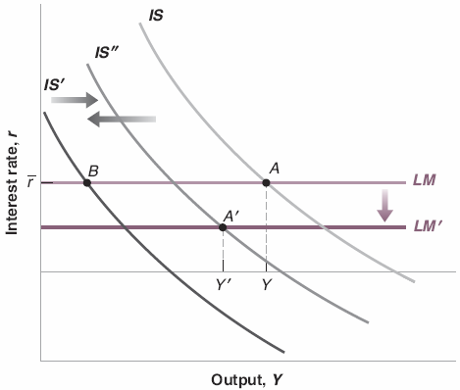
6-5 From a Housing Problem to a Financial Crisis
Figure 6-9 The Financial Crisis, and the Use of Financial, Fiscal, and Monetary Policies
The financial crisis led to a shift of the IS to the left.
Financial and fiscal policies led to some shift back to the IS to the right.
Monetary policy led to a shift of the LM curve down.
Policies were not enough however to avoid a major recession.

