Slide 1
From the Short to the Medium Run: The IS-LM-PC Model
Chapter 9

Slide 2
Chapter 9 Outline
From the Short to the Medium Run: The IS-LM-PC Model
9-1 The IS-LM-PC Model
9-2 Dynamics and the Medium Run Equilibrium
9-3 Fiscal Consolidation Revisited
9-4 The Effects of an Increase in the Price of Oil
9-5 Conclusions

Slide 3
From the Short to the Medium Run: The IS-LM-PC Model
In Chapters 3 through 6, we looked at equilibrium in the goods and financial markets, and how output is determined in the short run.
In Chapters 7 and 8, we looked at equilibrium in the labor market.
We now put the two parts together and use this IS-LM-PC (PC for Phillips curve) model to characterize the behavior of output both in the short run and the medium runs.

Slide 4
9-1 The IS-LM-PC Model
In Chapter 6, output in the short run is determined by demand (IS curve):
In Chapter 8, the relation between inflation and unemployment is called the Phillips curve:
When u = u_{n}, natural employment is Nn = L(1 – u_{n})
When u = u_{n}, potential output is Y_{n} = L(1 – u_{n})
Output gap: Y – Y_{n} = L((1 – u) – (1 – u_{n}) = – L(u – u_{n})

Slide 5
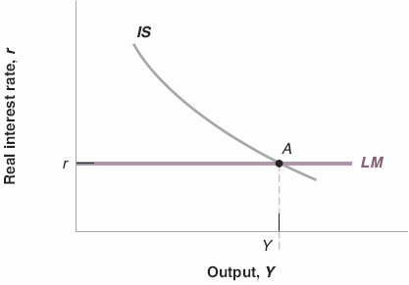
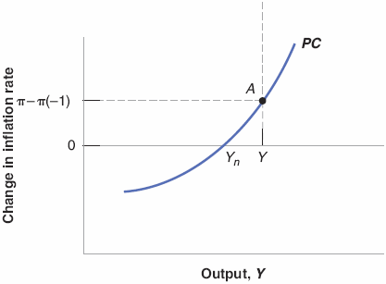
9-1 The IS-LM-PC Model
Figure 9-1 The IS-LM-PC Model
Short-run equilibrium
Top graph: A low policy rate leads to higher output.
Bottom graph: A higher output leads to a larger change in inflation.

Slide 6
9-1 The IS-LM-PC Model
Output gap: Y – Y_{n} = L((1 – u) – (1 – u_{n}) = – L(u – u_{n})
Replacing u – u_{n} in equation (9.2) gives:
Assume wage setters expect inflation this year to be the same last year:
When output is above potential (positive output gap), inflation increases, and vice versa.

Slide 7
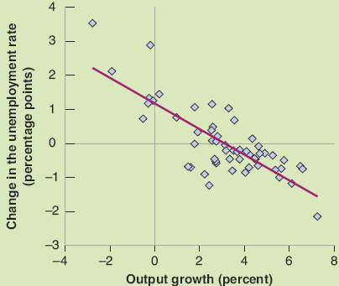
FOCUS: Okun’s Law across Time and Countries
Figure 1 Changes in the Unemployment Rate versus Output Growth in the United States, 1960−2014
High output growth is associated with a reduction in the unemployment rate; low growth is associated with an increase in the unemployment rate.

Slide 8
FOCUS: Okun’s Law across Time and Countries
Okun’s law can be written as the change in the unemployment that is approximately equal to the negative of the growth rate of output:
u – u(–1) ≈ – g_{x} (9B.1)
The regression that fits the points in Figure 1 is:
u – u(–1) = – 0.4( g_{x} – 3%) (9B.2)
Annual output growth has to be at least 3% to prevent the unemployment rate from rising.
Output growth 1% above normal leads only to a 0.4% reduction in the unemployment rate due to such factors as labor hoarding and discouraged workers.
The coefficient (0.4) is called the Okun coefficient.

Slide 9
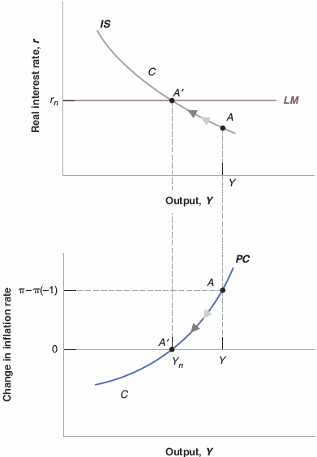
9-2 Dynamics and the Medium Run Equilibrium
Figure 9-2 Medium-Run Output and Inflation
Over the medium run, the economy converges to the natural level of output and stable inflation.
At the medium-run equilibrium (point A’), r_{n} is called the natural, neutral, or Wicksellian rate of interest.
If the central bank wants to achieve a constant level of inflation, then the initial boom must be followed by a recession.

Slide 10
9-2 Dynamics and the Medium Run Equilibrium
Assume instead that the expected inflation rate is a constant, then equation (9.3) becomes:
A positive output gap generates a higher level of inflation, rather than an increase in inflation.
So long as inflation expectations remain anchored, the central bank does not need to compensate for the initial boom by a recession later.

Slide 11
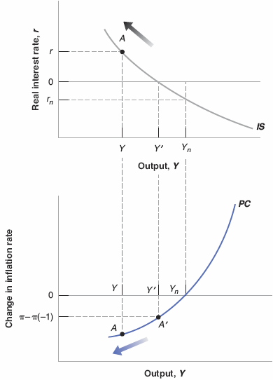
9-2 Dynamics and the Medium Run Equilibrium
Figure 9-3 The Deflation Spiral
If the zero lower bound prevents monetary policy from increasing output back to potential, the result may be a deflation spiral. More deflation leads to a higher real policy rate, and the higher policy rate in turn leads to lower output and more deflation.

Slide 12
9-2 Dynamics and the Medium Run Equilibrium
The zero lower bound constraint may make it impossible to achieve a negative real policy rate.
Deflation spiral or deflation trap occurs at Y’ (Figure 9-3) when output is still below potential, and thus inflation is still decreasing.
Lower output leads to more deflation, and more deflation leads to a higher real interest rate and lower output.

Slide 13
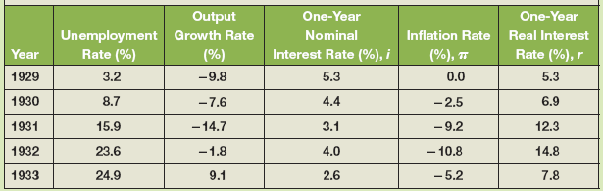
FOCUS: Deflation in the Great Depression
The economy seemed to be in a deflation trap between 1929 and 1933.
Monetary policy decreased the nominal interest rate from 5.3% to 2.3% in 1933, but with negative inflation rates, the real rate reached 12.3% in 1931 and 7.8% in 1933.
Table 1 The Nominal Interest Rate, Inflation, and the Real Interest Rate, 1929−1933

Slide 14
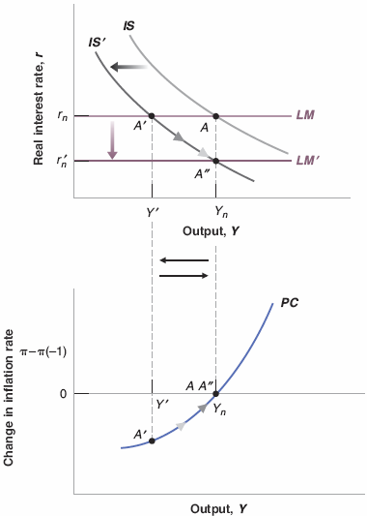
9-3 Fiscal Consolidation Revisited
Figure 9-4 Fiscal Consolidation in the Short Run and the Medium Run
Fiscal consolidation leads to a decrease in output in the short run.
In the medium run, output returns to potential, and the interest rate is lower.

Slide 15
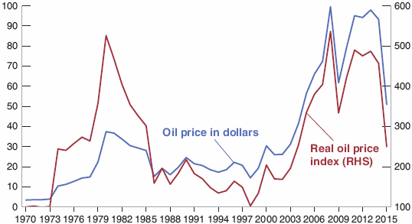

9-4 The Effects of an Increase in the Price of Oil
Figure 9-5 The Nominal and the Real Price of Oil, 1970−2015
Over the last 40 years, there have been two sharp increases in the real price of oil, the first in the 1970s and the second in the 2000s.

Slide 16
9-4 The Effects of an Increase in the Price of Oil
1970s: OPEC (the Organization of Petroleum Exporting Countries) act as a monopoly and increased oil prices.
2000s: The fast growth of emerging economies led a rapid increase in world oil demand, and thus a steady increase in real oil prices.
2008: A large recession led to a sudden decrease in the demand for oil, and thus falling oil prices.
2014 and after: A combination of increased supply due to the increase in U.S. shale oil production and the partial breakdown of OPEC led to sudden drop in oil prices.

Slide 17
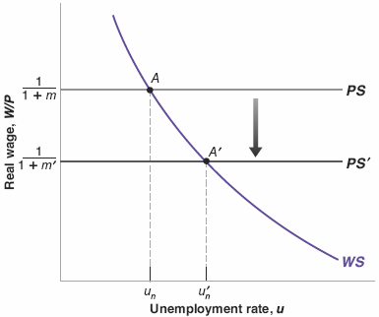
9-4 The Effects of an Increase in the Price of Oil
Figure 9-6 The Effects of an Increase in the Price of Oil on the Natural Rate of Unemployment
An increase in the price of oil is equivalent to an increase in the markup.
It leads to lower real wages and a higher natural rate of unemployment.

Slide 18
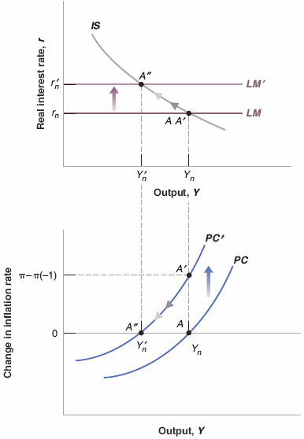
9-4 The Effects of an Increase in the Price of Oil
Figure 9-7 Short and Medium Run Effects of an Increase in the Price of Oil
If A’ is the short-run equilibrium, then if the central bank increases the policy rate to stabilize inflation, then the economy moves to its medium-run equilibrium at point A”.
Stagflation (lower output and higher inflation) occurs along the way.

Slide 19
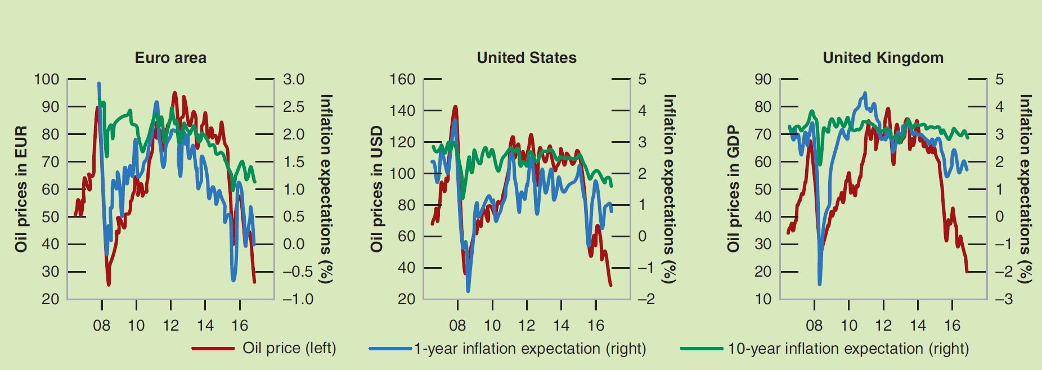
FOCUS: Plummeting Oil Price and Consumer Price Expectations
Figure 1 Inflation Expectations
Source: Zsolt Darvas and Pia Hüttl “Oil Prices and Inflation Expectations,” Bruegel | The Brussels-Based Economic Think Tank, January 21, 2016.

Slide 20
9-5 Conclusions
Shocks or changes in policy typically have different effects in the short run and in the medium run.
Disagreements about the effects of various policies depend on how fast you think the economy adjusts to shocks.
Movements in output around its trend are called output fluctuations (business cycles).
Economic fluctuations are the results of shocks and their dynamic effects, called the propagation mechanism.

