Slide 1
Exchange Rate Regimes
Chapter 20

Slide 2
Chapter 20 Outline
Exchange Rate Regimes
20-1 The Medium Run
20-2 Exchange Rate Crises under Fixed Exchange Rates
20-3 Exchange Rate Movements under Flexible Exchange Rates
20-4 Choosing between Exchange Rate Regimes
APPENDIX 1 Deriving the IS Relation under Fixed Exchange Rates
APPENDIX 2 The Real Exchange Rate and Domestic and Foreign Real Interest Rates

Slide 3
Exchange Rate Regimes
During the Bretton Woods period between 1944 and 1972, a number of countries adopted a system of fixed exchange rates, with all member countries other than the United States fixing the price of their currency in terms of dollar.
Since then, the world has been characterized by many exchange rate arrangements.
Which exchange rate regime to choose is the issue of this chapter.

Slide 4

20-1 The Medium Run
The real exchange rate is:
which can adjust either:
through a change in the nominal exchange rate, E: If the domestic price level and foreign price level do not change in the short run, this is the only way to adjust the real exchange rate in the short run.
through a change in the domestic price level relative to the foreign price level: In the medium run, as prices adjust, this option is open even to a country with a fixed nominal exchange rate.

Slide 5
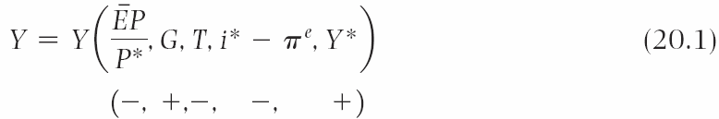
20-1 The Medium Run
The IS relation in an open economy with fixed exchange rates:
Demand and output depend:
negatively on the real exchange rate
positively on government spending and negatively on taxes
negatively on the domestic real interest rate
positively on foreign output through the effect on exports

Slide 6

20-1 The Medium Run
The Phillips curve relation in the medium run (Chapter 9):
Assume constant expected inflation so that :
which implies that, if two economies are operating at potential, inflation rates would be the same, relative prices would remain constant, and so would the real exchange rate.
In the medium run, if domestic and foreign inflation being equal, the real exchange rate is constant.

Slide 7
20-1 The Medium Run
In the short run, a fixed nominal exchange rate implies a fixed real exchange rate.
In the medium run, the real exchange rate can adjust even if the nominal exchange rate is fixed.
This adjustment is achieved through movements in the relative price levels over time.

Slide 8
FOCUS: The Return of Britain to the Gold Standard: Keynes versus Churchill
The gold standard was a system in which each country fixed the price of its currency in terms of gold and stood ready to exchange gold for currency at the stated parity.
In 1925, Britain decided to return to the gold standard, which was in place from 1870 until World War I.
As Keynes predicted, because the prices of British goods had increased more than the foreign price level, Britain faced a real appreciation at a given nominal exchange rate and remained in recession for the rest of the decade while other countries were growing.

Slide 9

20-2 Exchange Rate Crises under Fixed Exchange Rates
To let a currency float is to allow a move from a fixed to a flexible exchange rate regime.
Given the interest rate condition (Chapter 17):
which implies that as soon as financial markets believe a devaluation may be coming, maintaining the exchange rate requires an increase in the domestic interest rate.
Expectations that a devaluation may be coming can trigger an exchange rate crisis.

Slide 10
20-2 Exchange Rate Crises under Fixed Exchange Rates
Faced with the expectations of devaluation, the government has two options:
Give in and devalue, or
Fight and maintain the parity, at the cost of high interest rates and a potential recession.

Slide 11
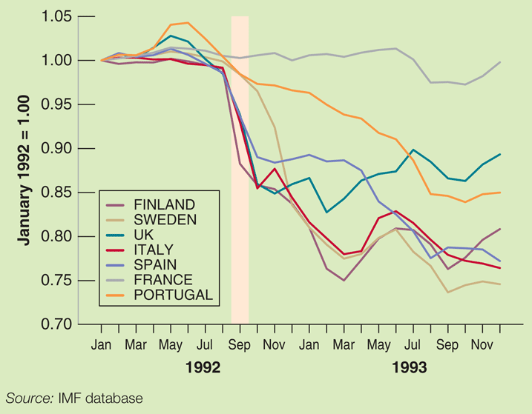
FOCUS: The 1992 EMS Crisis
In September 1992, financial markets became convinced realignments of the EMS’s fixed exchange parities with bands were coming soon.
Speculative attacks led to ensuring depreciations/devaluations of different countries.
Figure 1 Exchange Rates of Selected European Countries Relative to the Deutsche Mark, January 1992 to December 1993

Slide 12



20-3 Exchange Rate Movements under Flexible Exchange Rates
Recall the interest parity condition (Chapter 17.2):
Multiply both sides by gives:
Continue to solve forward in time for the expected exchange rate:

Slide 13
20-3 Exchange Rate Movements under Flexible Exchange Rates
Implications of Equation (20.5):
The level of today’s exchange rate will move one-for-one with the future expected exchange rate.
Today’s exchange rate will move when future expected interest rates move in either country.
Because today’s exchange rate moves with any change in expectations, the exchange rate will be volatile, i.e., move frequently and perhaps by large amounts.
A country that decides to operate under flexible exchange rates must accept the fact that it will be exposed to substantial exchange rate fluctuations over time.

Slide 14
20-4 Choosing between Exchange Rates Regimes
According to Robert Mundell, an optimal currency area needs to satisfy one of the two conditions:
The countries have to experience similar shocks.
If the countries experience different shocks, they must have high factor mobility.
The common currency area composed of the 50 states of the United States is close to an optimal currency area, which has high factor mobility, although different states are affected by different shocks.

Slide 15
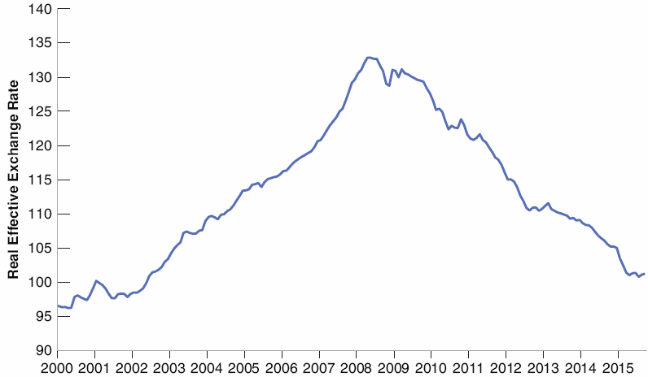
20-4 Choosing between Exchange Rates Regimes
There is less agreement on whether Europe constitutes an optimal currency area.
Figure 20-1 The Evolution of the Real Exchange Rate in Spain since 2000
A steady real appreciation from 2000 to 2008 has been followed by a long real depreciation since then.

Slide 16
FOCUS: The Euro: A Short History
Stages moving to a European Monetary Union (EMU):
Stage I: Beginning in 1990, capital controls were abolished.
Stage II: Beginning in 1994, fixed parities of the exchange rate were maintained.
Stage III: Beginning in 1999, parities between the currencies and a common currency, the euro, were “irrevocably” fixed; the new European Central Bank (ECB) became responsible for monetary policy for the Euro area.

Slide 17
20-4 Choosing between Exchange Rates Regimes
Ways to fix the exchange rate and convince financial investors that the exchange rate is fixed today and also in the future:
Make the fixed exchange rate be part of a more general macroeconomic package
Make a hard peg so that it is symbolically or technically harder to change the parity
Examples of a hard peg:
Dollarization: Replace the domestic currency with the dollar
Currency board: A central bank stands ready to exchange foreign currency for domestic currency at the official exchange rate set by the government

Slide 18
FOCUS: Lessons from Argentina’s Currency Board
In 1991, the Argentina’s president of announced the adoption of a currency board that would stand ready to exchange its pesos for dollars on demand.
The currency board appeared to work well for a while as inflation fell from 2,300% in 1990 to 4% in 1994.
However, as appreciation of the dollar in the second half of the 1990s led to a decrease in demand for Argentina’s goods, leading to declines in output.
In early 2002, Argentina gave up the currency board and let the peso float.

Slide 19

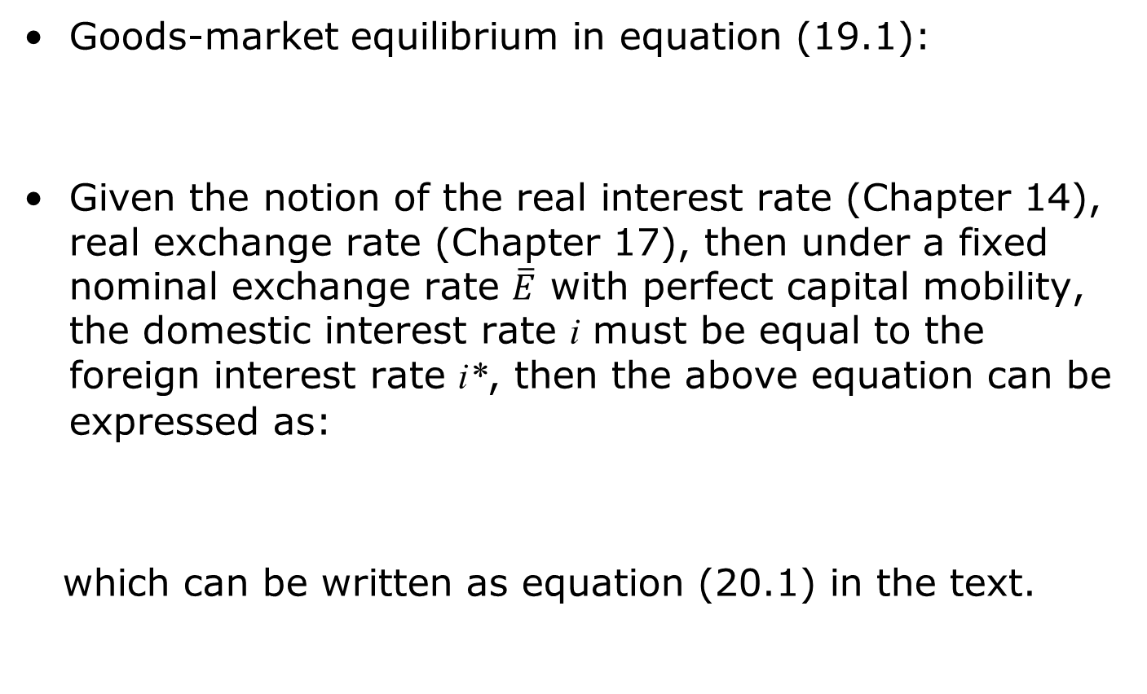
APPENDIX 1: Deriving the IS Relation under Fixed Exchange Rates
Goods-market equilibrium in equation (19.1):
Given the notion of the real interest rate (Chapter 14), real exchange rate (Chapter 17), then under a fixed nominal exchange rate $\overline{E}$ with perfect capital mobility, the domestic interest rate i must be equal to the foreign interest rate i*, then the above equation can be expressed as:
which can be written as equation (20.1) in the text.

Slide 20



APPENDIX 2: The Real Exchange Rate and Domestic and Foreign Real Interest Rates
Recall the nominal interest rate parity condition of equation (19.2)
and the real interest rate of equation (6.3):
Use this relation to eliminate the domestic nominal interest rate (i) and foreign nominal interest rate (i*) in the interest parity condition:

Slide 21



APPENDIX 2: The Real Exchange Rate and Domestic and Foreign Real Interest Rates
Replace the definition of the real exchange rate:
in equation (20.A1) gives the real interest rate parity condition:
or, equivalently,

Slide 22




APPENDIX 2: The Real Exchange Rate and Domestic and Foreign Real Interest Rates
Equation (20.A2) implies that the real exchange rate in year t + 1 is given by:
Take expectations as of year t:
Solving for and so on gives a function of current and expected future domestic and foreign real interest rates and of the expected real exchange rate in year t+n:

