Slide 1
Monetary Policy: A Summing Up
Chapter 23

Slide 2
Chapter 23 Outline
Monetary Policy: A Summing Up
23-1 What We Have Learned
23-2 From Monetary Targeting to Inflation Targeting
23-3 The Optimal Inflation Rate
23-4 Unconventional Monetary Policy

Slide 3
Monetary Policy: A Summing Up
For the two decades (a period known as the Great Moderation) before the crisis, most central banks had converged toward a framework for monetary policy, called inflation targeting.
The inflation targeting framework has two principles: (1) Keep inflation stable and low; and (2) follow, explicitly and implicitly, an interest rate rule.
This chapter reviews what we have learned about monetary policy so far, and describe the logic of inflation targeting and the use of an interest rate rule.

Slide 4
23-1 What We Have Learned
Chapter 4: Money demand and money supply and the determination of the interest rate
Chapter 5: The short-run effects of monetary policy on output
Chapter 6: The distinction between the nominal and real interest rate, and between the borrowing rate and the policy rate
Chapter 9: The effects of monetary policy in the medium run
Chapter 14: The distinction between short- and long-term interest rates

Slide 5
23-1 What We Have Learned
Chapter 16: The effects of expectations on spending and output, and the role of monetary policy in this context
Chapter 19: The effects of monetary policy in an economy open in both goods markets and financial markets
Chapter 20: The pros and cons of different monetary policy regimes, namely flexible exchange rates versus fixed exchange rates
Chapter 21: The problems facing macroeconomic policy and monetary policy

Slide 6
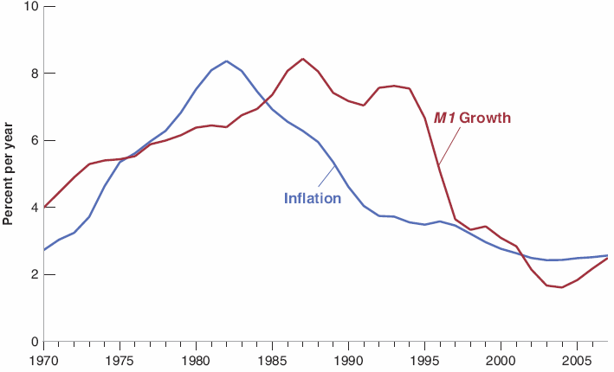

23-2 From Money Targeting to Inflation Targeting
M1: The measure of money stock equal to the sum of currency and checkable deposits.
Figure 23-1 M1 Growth and Inflation: 10-Year Averages, 1970 to the crisis
There is no tight relation between M1 growth and inflation, even in the medium run

Slide 7


23-2 From Money Targeting to Inflation Targeting
Recall the Phillips curve equation (8.9):
Let the inflation target be π* that is also credible, so that people expect inflation to be equal t o the target. The Phillips curve becomes:
If the central bank is able to hit its inflation target, unemployment will be equal to its natural rate.

Slide 8
23-2 From Money Targeting to Inflation Targeting
Divine coincidence: Keeping inflation stable is a way of keeping output at potential.
A focus on keeping stable inflation is the right approach to monetary policy, both in the short and the medium run.
Flexible inflation targeting: Central banks adjust the interest rate to return to the target inflation rate over time, rather than right away.

Slide 9
23-2 From Money Targeting to Inflation Targeting
In the 1990s, John Taylor suggested a rule of the policy rate i_{t}, now known as the Taylor rule:
where i* = r_{n} + π*, which is the neutral rate of interest plus the target inflation rate; and a and b are coefficient chosen by the central bank.
If π_{t} = π*, the central bank should set i_{t} = i*.
If π_{t} > π*, the central bank should increase i_{t} above i*.
If u_{t} > u_{n}, the central bank should decrease the nominal interest rate.
The coefficient b reflects how much the central bank cares about unemployment.

Slide 10
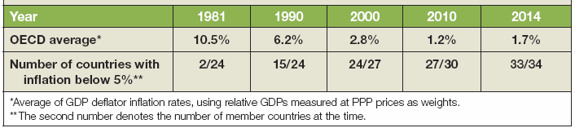
23-3 The Optimal Inflation Rate
Inflation steadily decreased in advanced economics from the early 1980s.
Whether central banks should have aimed for an inflation rate of about 2% depends on the costs and benefits of inflation.
Table 23-1 Inflation Rates in the OECD, 1981–2014

Slide 11
23-3 The Optimal Inflation Rate
Four main costs of inflation:
Shoe-leather costs: Costs associated with more trips to the bank as people reduce their money balances.
Tax distortions: High inflation leads to more higher capital gains taxes and higher income tax (bracket creep that pushes people into higher tax brackets)
Money illusion: People appear to make systematic mistakes in assessing nominal versus real changes in incomes and interest rates.
Inflation variability: Higher inflation is typically associated with more variable inflation, which increases the risk of financial assets that promise fixed nominal payments in the future.

Slide 12
FOCUS: Money Illusion
There is a lot of anecdotal evidence that people fail to properly adjust for inflation in their financial computations.
Two psychologists designed a survey aimed at finding how prevalent money illusion is.
The survey, which asked respondents to ranks their preference of three financial conditions.
Money illusion was prevalent: More people preferred more about situations better in nominal terms as opposed to situations in real terms.

Slide 13
23-3 The Optimal Inflation Rate
Three benefits of inflation:
Seignorage: Money creation—the ultimate source of inflation—is one way in which the government can finance its spending.
The use of the interaction between money illusion and inflation in facilitating real wage adjustments.
The option of negative real interest rates for macroeconomic policy: High inflation decreases the probability of hitting the zero lower bound.

Slide 14
23-4 Unconventional Monetary Policy
One example of unconventional monetary policy is quantitative easing or credit easing: Central banks buy assets other than short term bonds, with the intention of decreasing the premium on those assets, and thus decreasing the corresponding borrowing rates with the aim of stimulating economic activity.
Central banks finance their purchases through money creation, leading to an increase in the money supply.
Although the increase in the money supply has no effect on the policy rate, the purchase of other assets lead to lower borrowing rates.

Slide 15
23-4 Unconventional Monetary Policy
QE1 (Quantitative Easing 1): The Fed started its first quantitative easing program in November 2008 by buying certain types of mortgage-based securities.
QE2: In November 2010, the Fed started buying longer term Treasury bonds with the intent of decreasing the term premium on these long term bonds.
QE3: In September 2012, the Fed purchased more mortgage-based securities in an effort to decrease the cost of mortgages.

Slide 16
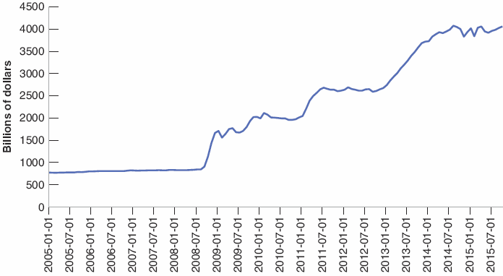
23-4 Unconventional Monetary Policy
Figure 23-2 The Evolution of the U.S. Monetary Base from 2005 to 2015
As a result of quantitative easing, the monetary base more than quadrupled between 2005 and 2015.

Slide 17
23-5 Monetary Policy and Financial Stability
Lender of last resort: A function of the Fed that provides a bank the liquidity it needs to pay the depositors without having to sell its assets.
The crisis has forced central banks to consider whether they want to provide liquidity to institutions they do not regulate.
The consensus is:
It is risky to wait for a bubble to build up and burst
To deal with bubbles or dangerous behavior in the financial system, rather than the interest rate, the right instruments are macroprudential tools—rules that are aimed directly at any financial institutions involved

Slide 18
23-5 Monetary Policy and Financial Stability
Macroprudential tools aimed at borrowers:
Maximium loan-to-value ratio (LTV): A ceiling on the size of the loan borrowers can take relative to the value of the house they buy.
Reducing the maximum LTV is likely to decrease the demand for housing and thus slow down the housing price increase.
Macroprudential tools aimed at lenders:
Basel II and Basel III agreements among countries imposed on their banks minimum capital ratios in order to limit bank leverage.
Imposing Capital controls on inflows.
Lowering taxes on foreign direct investment.

Slide 19
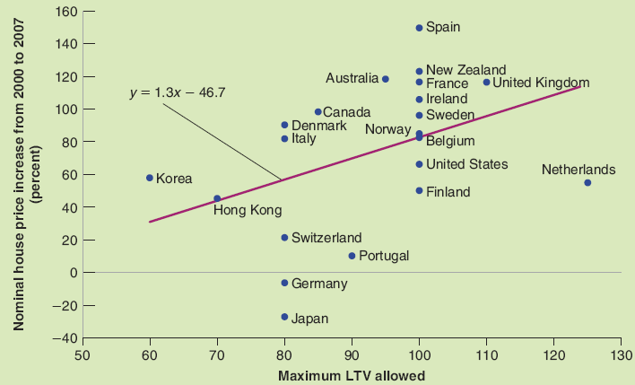

FOCUS: LTV Ratios and Housing Price Increases from 2000 to 2007
Countries with more stringent restrictions on borrowing had lower price increases from 2000 to 2007.
Figure 1 Maximum LTV Ratios and Housing Price Increases, 2000−2007

