Slide 1
Financial Markets I
Chapter 4

Slide 2
Chapter 2 Outline
Financial Markets
4-1 The Demand for Money
4-2 Determining the Interest Rate: I
4-3 Determining the Interest Rate: II
4-4 The Liquidity Trap
APPENDIX The Determination of the Interest Rate When People Hold Both Currency and Checkable Deposits

Slide 3
Financial Markets
Financial markets are intimidating, but they play an essential role in the economy.
In this chapter, we focus on the role of the central bank in affecting these interest rates.
We learn how the interest rate on bonds is determined, and the role of the central bank (Federal Reserve Bank, or the Fed, in the United States) in this determination.

Slide 4
4-1 The Demand for Money
Suppose you only have a choice between two assets: money and bonds.
Money are used for transactions, but it pays no interest.
Two types of money: currency and checkable deposits.
Bonds pay a positive interest rate, i (the rate of interest), but cannot be used for transaction.

Slide 5
4-1 The Demand for Money
The holding of money and bonds depends on:
Your level of transactions
The interest rate on bonds
You can hold bonds indirectly through money market funds, or money market mutual funds.
In the early 1980s, the interest rate on money market funds reached 14% per year, so people earned more interest by moving their wealth from checking accounts to these funds.

Slide 6
FOCUS: Semantic Traps: Money, Income, and Wealth
Money is what can be used to pay for transactions.
Income is what you earn, and it is a flow.
Saving is the part of after-tax income that you do not spend, and it is also a flow.
Savings is the value of what you have accumulated over time.
Financial wealth, or wealth, is the value of all your financial assets minus all your financial liabilities, and it is a stock variable
Investment is what economists refer to as the purchase of new capital goods.
Financial investment is the purchase of shares or other financial assets.

Slide 7

4-1 The Demand for Money
Demand for money (M^{d}) is equal to nominal income $Y (a measure of level of transactions in the economy) times a decreasing function of the interest rate i:
An increase in the interest rate decreases the demand for money, as people put more of their wealth into bonds.

Slide 8
4-1 The Demand for Money
Equation (4.1) means that he demand for money:
increases in proportion to nominal income, and
depends negatively on the interest rate.
The relation between the demand for money and interest rate for a given level of income $Y is represented by the M^{d} curve.

Slide 9
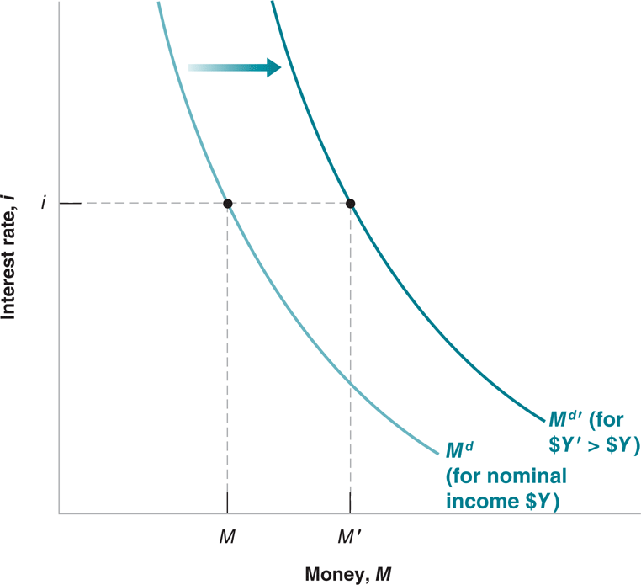
4-1 The Demand for Money
Figure 4-1 The Demand for Money
For a given level of nominal income, a lower interest rate increases the demand for money.
At a given interest rate, an increase in nominal income shifts the demand for money to the right.

Slide 10
FOCUS: Who Holds U.S. Currency
The amount of currency in circulation in 2006 was $750 billion.
U.S. households together held $170 billion in currency.
U.S. firms held another $80 billion.
Foreigners abroad held $500 billion, or 66% of the total, for transactions, especially in countries suffering from high inflation in the past.

Slide 11
4-2 Determining the Interest Rate: I
Suppose the central bank decides to supply an amount of money equal to M:
M^{s} = M
Equilibrium in financial markets requires that M^{s}=M^{d}=M:

Slide 12
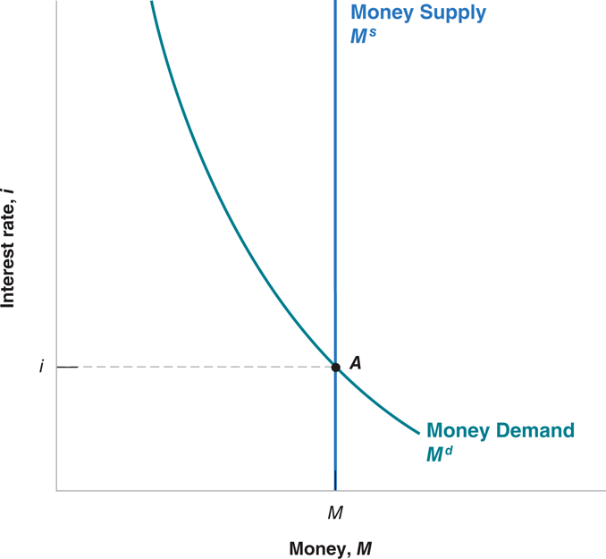
4-2 Determining the Interest Rate: I
Figure 4-2 The Determination of the Interest Rate
The interest rate must be such that the supply of money (which is independent of the interest rate) is equal to the demand for money (which does depend on the interest rate).

Slide 13
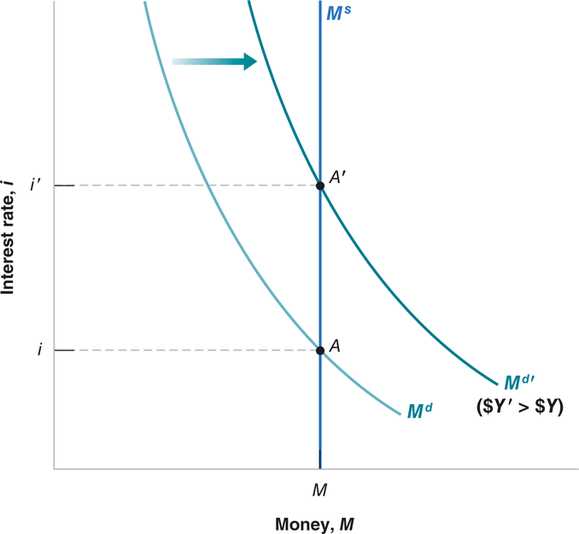
4-2 Determining the Interest Rate: I
Figure 4-3 The Effects of an Increase in Nominal Income on the Interest Rate
Given the money supply, an increase in nominal income leads to an increase in the interest rate.

Slide 14
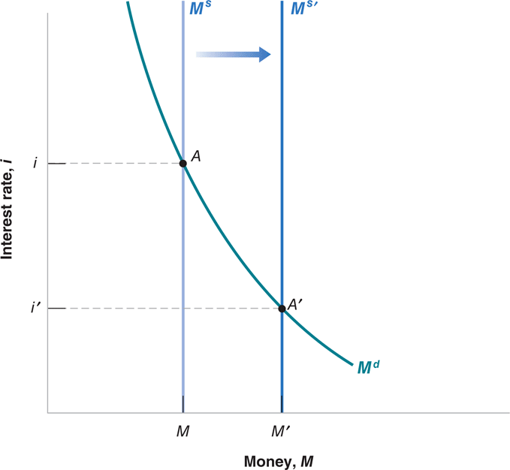
4-2 Determining the Interest Rate: I
Figure 4-4 The Effects of an Increase in the Money Supply on the Interest Rate
An increase in the supply of money leads to a decrease in the interest rate.

Slide 15
4-2 Determining the Interest Rate: I
For a given money supply, an increase in nominal income leads to an increase in the interest rate.
An increase in the supply of money by the central bank leads to a decrease in the interest rate.

Slide 16
4-2 Determining the Interest Rate: I
Central banks typically change the supply of money by buying or selling bonds in the bond market—open market operations.
Expansionary open market operation: the central bank expands the supply of money by buying bonds.
Contractionary open market operation: the central bank contracts the supply of money by selling bonds.

Slide 17
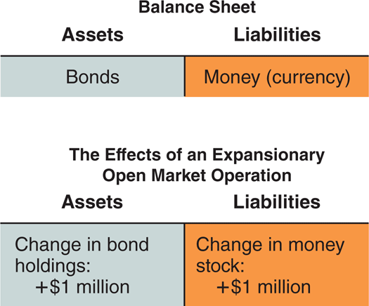
4-2 Determining the Interest Rate: I
Figure 4-5 The Balance Sheet of the Central Bank and the Effects of an Expansionary Open Market Operation
The assets of the central bank are the bonds it holds.
The liabilities are the stock of money in the economy.
An open market operation in which the central bank buys bonds and issues money increases both assets and liabilities by the same amount.

Slide 18
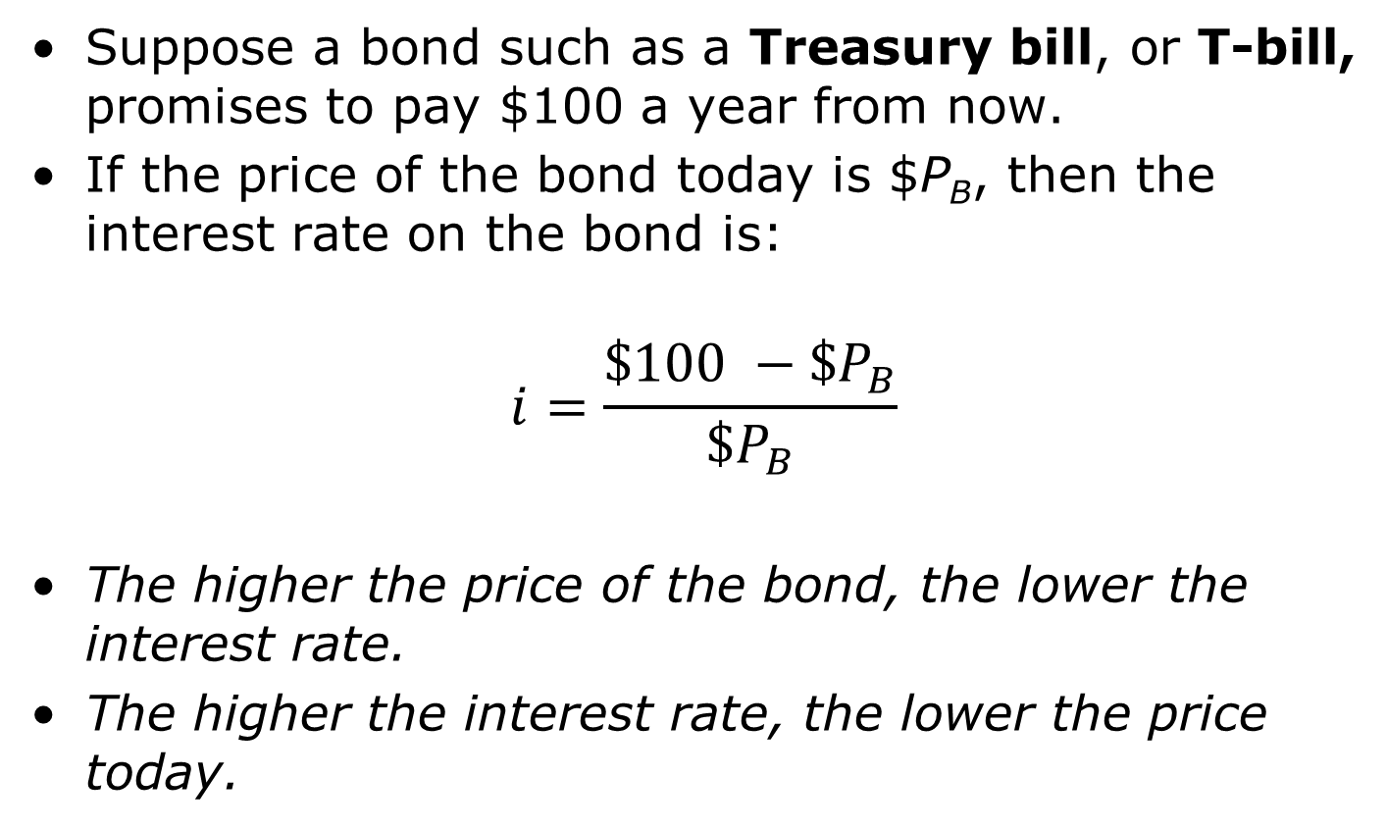
4-2 Determining the Interest Rate: I
Suppose a bond such as a Treasury bill, or T-bill, promises to pay $100 a year from now.
If the price of the bond today is $P_{B}, then the interest rate on the bond is:
$$i=\frac{\$100 −\$P_{B}}{\$P_{B}}$$
The higher the price of the bond, the lower the interest rate.
The higher the interest rate, the lower the price today.

Slide 19
4-2 Determining the Interest Rate: I
Rather than the money supply, the central bank could have chosen the interest rate and then adjusted the money supply so as to achieve the interest rate it had chosen.
Choosing the interest rate, instead of the money supply, is what modern central banks, including the Fed, typically do.

Slide 20
4-3 Determining the Interest Rate: II
Financial intermediaries: Institutions that receive funds from people and firms and use these funds to buy financial assets or to make loans to other people and firms.
Banks are financial intermediaries that have money, in the form of checkable deposits, as their liabilities.
Banks keep as reserves some of the funds they receive.
The liabilities of the central bank are the money it has issued, called central bank money.

Slide 21
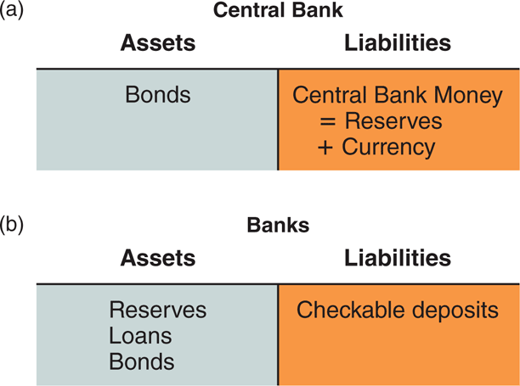
4-3 Determining the Interest Rate: II
Figure 4-6 The Balance Sheet of Banks, and the Balance Sheet of the Central Bank Revisited

Slide 22

4-3 Determining the Interest Rate: II
Assume people hold no currency so the demand for money by people is the demand for checkable deposits:
The demand for reserves by banks depends on the amount of checkable deposits:
θ is the reserve ratio, and H^{d} is demand for high-power money or the monetary base.

Slide 23
4-3 Determining the Interest Rate: II
Let H denote the supply of central bank money, then the equilibrium condition:
Or using equation (4.4):
An increase in H leads to a decrease in the interest rate, and a decrease in H leads to an increase in the interest rate.

Slide 24
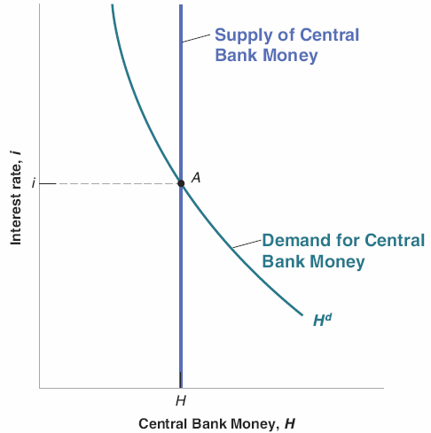
4-3 Determining the Interest Rate: II
Figure 4-7 Equilibrium in the Market for Central Bank Money and the Determination of the Interest Rate
The equilibrium interest rate is such that the supply of central bank money is equal to the demand for central bank money.

Slide 25
4-3 Determining the Interest Rate: II
The federal funds market is an actual market for bank reserves.
The federal funds rate is the interest rate determined in the federal funds market.
The federal funds rate is the main indicator of U.S. monetary policy because the Fed can choose the federal funds rate it wants by changing H.

Slide 26
4-4 The Liquidity Trap
Zero lower bound: The interest rate cannot go below zero.
The economy is in a liquidity trap when the interest rate is down to zero, monetary policy cannot decrease it further.

Slide 27
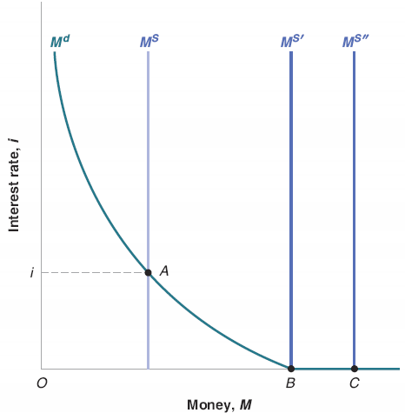
4-4 The Liquidity Trap
Figure 4-8 Money Demand, Money Supply, and the Liquidity Trap
When the interest rate is equal to zero, and once people have enough money for transaction purposes, they become indifferent between holding money and holding bonds.
The demand for money becomes horizontal.
This implies that, when the interest rate is equal to zero, further increases in the money supply have no effect on the interest rate, which remains equal to zero.

Slide 28
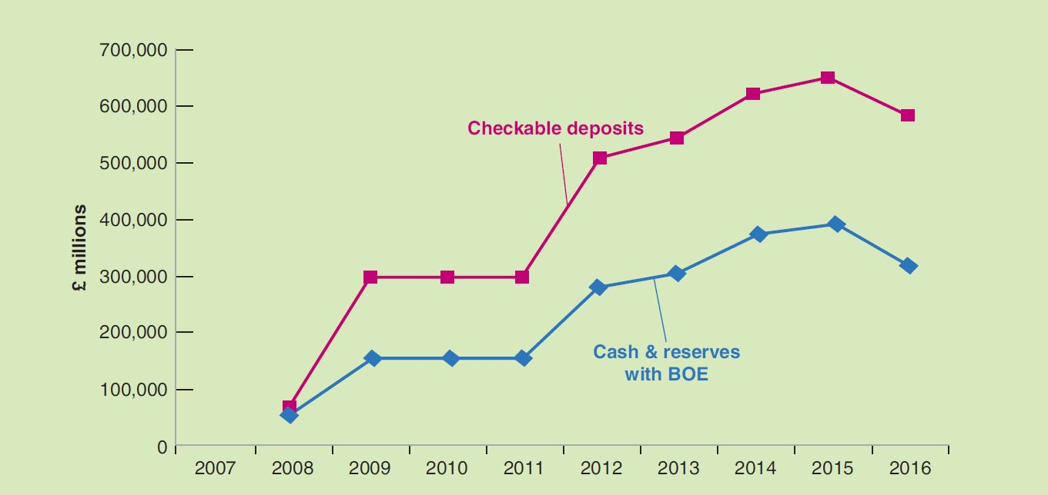
FOCUS: The Liquidity Trap in the United Kingdom
The large increase in the supply of central bank money between 2007 and 2014 was absorbed by households and banks.
Figure 1 Checkable Deposits and Reserves with BoE, 2007−2016.
Source: Bank of England, Bankstats (Monetary & Financial Statistics).

Slide 29


APPENDIX: The Determination of the Interest Rate When People Hold Both Currency and Checkable Deposits
Assume that overall money demand is:
Also assume that people hold a fixed proportion of their money in currency c, and (1−c) in checkable deposits, so the demand for currency and the demand for checkable deposits are respectively:

Slide 30
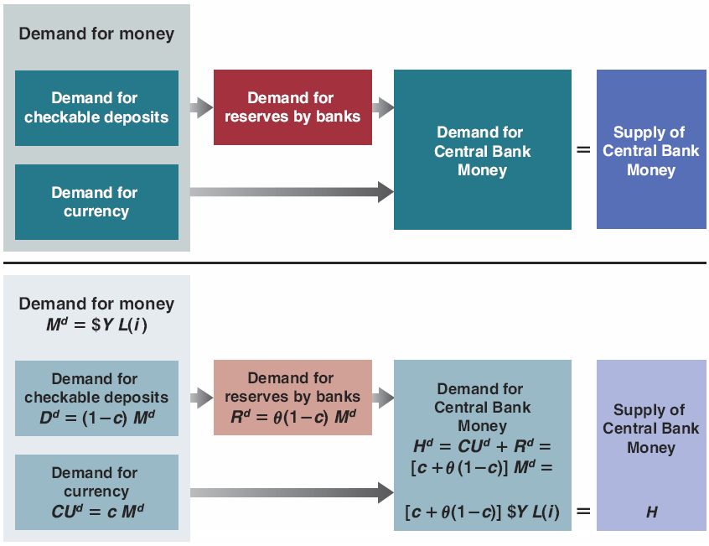
APPENDIX: The Determination of the Interest Rate When People Hold Both Currency and Checkable Deposits
Figure 4-A1 Determinants of the Demand and the Supply of Central Bank Money.

Slide 31
APPENDIX: The Determination of the Interest Rate When People Hold Both Currency and Checkable Deposits
Let R be the reserves of banks, D be the dollar amount checkable deposits, and θ be the reserve ratio:
Combining (4.A2) and (4.A4) gives the demand for reserves by banks:

Slide 32
APPENDIX: The Determination of the Interest Rate When People Hold Both Currency and Checkable Deposits
Demand for central bank money is:
so that:
which gives the demand for central bank money:

Slide 33
APPENDIX: The Determination of the Interest Rate When People Hold Both Currency and Checkable Deposits
The equilibrium condition is that the supply of central bank money be equal to the demand for central bank money:
or using equation (4.9):

Slide 34
APPENDIX: The Determination of the Interest Rate When People Hold Both Currency and Checkable Deposits
The supply of central bank money (the left side of equation (4.A9) is equal to the demand for central bank money (the right side of equation (4.A9), which is equal to the term in brackets times the overall demand for money.

