Slide 1
Fiscal Policy: A Summing Up
Chapter 22

Slide 2
Chapter 22 Outline
Fiscal Policy: A Summing Up
22-1 What We Have Learned
22-2 The Government Budget Constraint: Deficits, Debt, Spending, and Taxes
22-3 Ricardian Equivalence, Cyclical Adjusted Deficits, and War Finance
23-4 The Dangers of High Debt

Slide 3
Fiscal Policy: A Summing Up
In most advanced economies, the crisis has led to large budget deficits and a large increase in debt-to-GDP ratios.
This calls for governments to reduce deficits, stabilize the debt, and reassure investors.
The purpose of this chapter is to review what we have learned about fiscal policy so far, to explore in more depth the dynamics of deficits and debt, and to shed light on the problems associated with high public debt.

Slide 4
22-1 What We Have Learned
What we have learned about fiscal policy:
Chapter 3: How government spending and taxes affect demand and output in the short run
Chapter 5: The short-run effects of fiscal policy on output and the interest rate
Chapter 6: How fiscal policy was used during the recent crisis to limit the fall in output
Chapter 9: The effects of fiscal policy in the short run and in the medium run
Chapter 11: How saving affects capital accumulation and output in the long run
Chapter 16: The short-run effects of fiscal policy including the effects on expectations

Slide 5
22-1 What We Have Learned
What we have learned about fiscal policy (cont’d):
Chapter 18: The effects of fiscal policy when the economy is open in the goods market
Chapter 19: The role of fiscal policy in an economy open in both goods markets and financial markets
Chapter 21: Problems facing policy makers given the uncertainty about the effects of policy to issues of time consistency and credibility
We have not paid close attention to the government budget constraint.

Slide 6
22-2 The Government Budget Constraint: Deficits, Debt, Spending, and Taxes
The budget deficit (inflation-adjusted deficit) equals spending, including real interest payments on the debt (rB_{t-1}), minus taxes net of transfers (G_{t} – T_{t}):
Government budget constraint: The change in government debt during year t equals the deficit during year t:

Slide 7
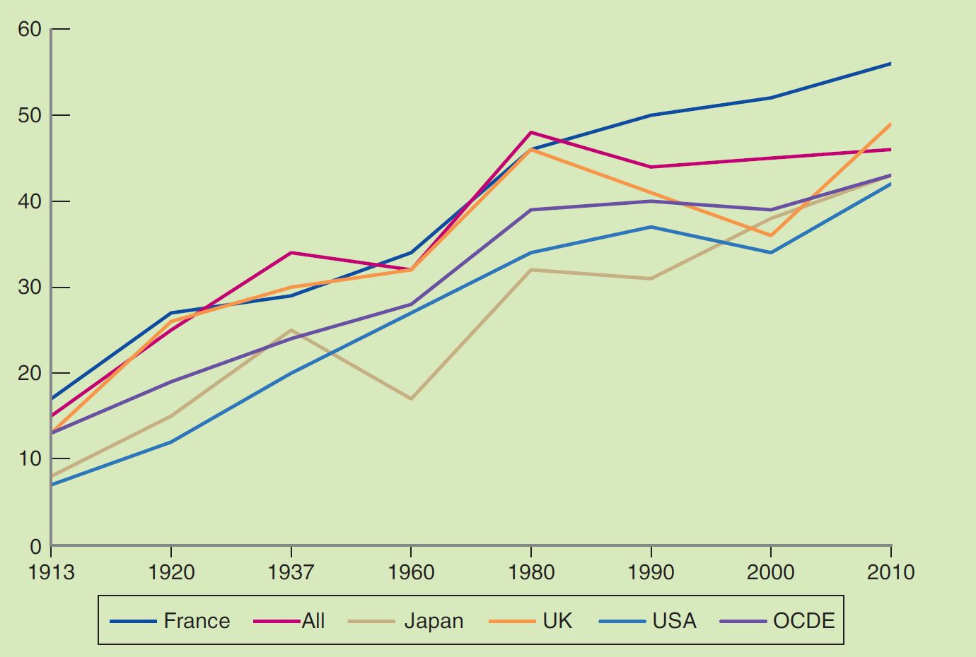
FOCUS: Irresistible Growth of Public Spending Worldwide
Figure 1 Ratio of Public Spending to GDP
Source: Public Spending in the 20th century, V Tanzi, L. Scheknecht.

Slide 8


22-2 The Government Budget Constraint: Deficits, Debt, Spending, and Taxes
The term (G_{t} – T_{t}) is called the primary deficit and (T_{t} – G_{t}) is called the primary surplus, so:

Slide 9
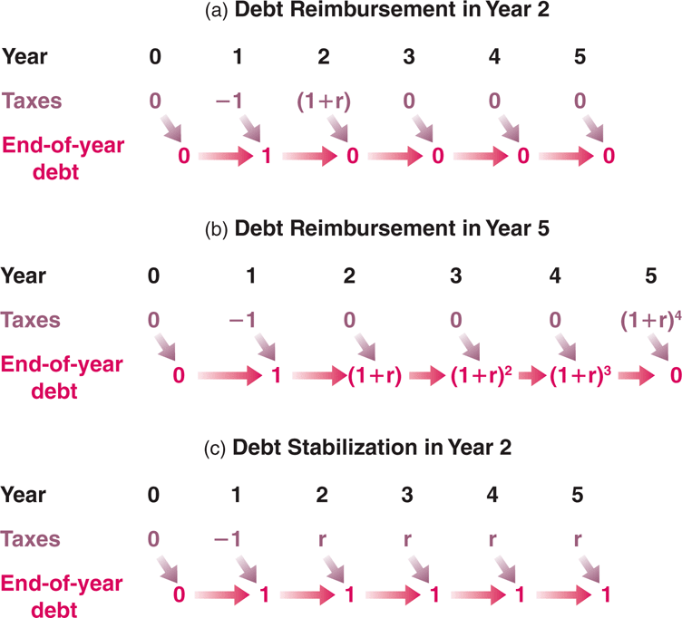
22-2 The Government Budget Constraint: Deficits, Debt, Spending, and Taxes
Figure 22-1 Tax Cuts, Debt Repayment, and Debt Stabilization
(a), If the debt is fully repaid
during year 2, the decrease in
taxes of 1 in year 1 requires
an increase in taxes equal to
(1 + r) in year 2. (b), If the
debt is fully repaid during year
5, the decrease in taxes of 1
in year 1 requires an increase
in taxes equal to (1 + r)⁴ during
year 5. (c), If the debt is
stabilized from year 2 on, then
taxes must be permanently
higher by r from year 2 on.

Slide 10
22-2 The Government Budget Constraint: Deficits, Debt, Spending, and Taxes
From equation (22.3), debt at the end of year 2:
and at the end of year 3:
As long as the primary deficit equals zero, debt grows at:

Slide 11

22-2 The Government Budget Constraint: Deficits, Debt, Spending, and Taxes
If debt is fully repaid during year t, then equation (22.4) becomes:
which implies:
If government spending is unchanged, a decrease in taxes must eventually be offset by an increase in taxes in the future.
The longer the government waits to increase taxes, or the higher the real interest rate is, the higher the eventual increase in taxes must be.

Slide 12
22-2 The Government Budget Constraint: Deficits, Debt, Spending, and Taxes
The legacy of past deficits is higher government debt today.
To stabilize the debt, the government must eliminate the deficit.
To eliminate the deficit, the government must run a primary surplus equal to the interest payments on the existing debt. This requires higher taxes forever.

Slide 13


22-2 The Government Budget Constraint: Deficits, Debt, Spending, and Taxes
Now consider the debt-to-GDP ratio (or debt ratio) instead of the level of debt.
Divide equation (22.3) by real output
which can be rewritten as:

Slide 14

22-2 The Government Budget Constraint: Deficits, Debt, Spending, and Taxes
Assume that output Y grows at a constant rate of g:
or
which implies that the increase in the ratio of debt to GDP is larger:
the higher the real interest rate
the lower the growth rate of output
the higher the initial debt ratio
the higher the ratio of the primary debt to GDP

Slide 15
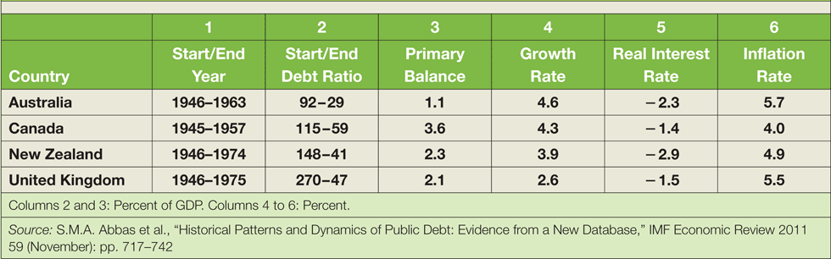
FOCUS: How Countries Decreased Their Debt Ratios after World War II
The debt ratios of many countries declined in decades after World War II.
The declines in debt were not mainly the result of primary surplus, but the result of high growth and sustained negative real interest rates.
Table 1 Changes in Debt Ratios Following World War II

Slide 16
22-3 Ricardian Equivalence, Cyclical Adjusted Deficits, and War Finance
Ricardian equivalence proposition (Ricardo-Barro proposition): Once the government budget constraint is taken into account, neither deficit nor debt have an effect on economic activity.
If a government finances a given path of spending through deficits, private saving will increase one-for-one with the decrease in public saving, leaving total saving unchanged.

Slide 17
22-3 Ricardian Equivalence, Cyclical Adjusted Deficits, and War Finance
The benchmark against which to judge the direction of fiscal policy: full-employment deficit, mid-cycle deficit, standardized employment deficit, structural deficit, or cyclically adjusted deficit.
If the actual deficit is large but the cyclically adjusted deficit is zero, then current fiscal policy is consistent with no systematic increase in debt overtime.
The debt will increase as long as output is below its potential level.

Slide 18
22-3 Ricardian Equivalence, Cyclical Adjusted Deficits, and War Finance
Steps to construct the cyclically adjusted deficit:
Establish how much lower the deficit would be if output were, say, 1% higher.
Assess how far output is from potential.
Automatic stabilizer: A recession naturally generates a deficit, and a fiscal expansion in turn partly counteracts the recession.

Slide 19
22-3 Ricardian Equivalence, Cyclical Adjusted Deficits, and War Finance
Wars typically bring about large deficits because:
Deficit finance is a way to pass some of the burden of the war to those alive after the war
Deficit spending helps reduce tax distortions—tax smoothing implies that large deficits when government spending is exceptionally high, and small surplus the rest of the time.

Slide 20
FOCUS: Deficits, Consumption, and Investment in the United Sates during World War II
During World War II, the U.S. government increased spending on national defense from 1% of GDP in 1939 to 36% in 1994.
The result was a sequence of large budget deficits.
At the same time, the share of consumption in GDP fell by 23 percentage points from 74% to 51%, and the share of private investment in GDP decreased by 6 percentage points from 10% to 4%.

Slide 21
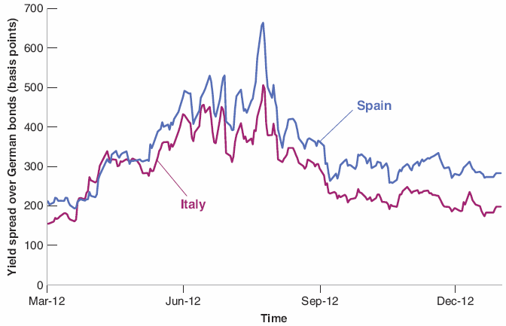
22-4 The Dangers of High Debt
The spread is the difference between two interest yields, measured in basis points (a hundredth of a percent).
Figure 22-2 The Increase in European Bond Spreads
The spreads on Italian and Spanish two-year government bonds over German two-year bonds increased sharply between March and July 2012. At the end of July, when the European Central Bank stated that it would do whatever was necessary to prevent a breakup of the Euro, the spreads decreased.

Slide 22
22-4 The Dangers of High Debt
When a government finds itself unable to repay the outstanding debt, it may decide to default.
Haircut: The percentage that creditors will not received compared to what they were owed.
Default also comes under different names: debt restructuring, debt rescheduling, private sector involvement

Slide 23

22-4 The Dangers of High Debt
The government can also finance itself by printing money.
Money finance, debt monetization, or fiscal dominance of monetary policy: The government issues bonds and then forces the central bank to buy its bonds in exchange for money.
Seignorage: The revenue, in real terms, that the government generates with money creation (∆H).

Slide 24

22-4 The Dangers of High Debt
The relation between seignorage, the rate of nominal money growth, and real money balances (relative to GDP):
This implies that to finance a deficit of say 10% of GDP through seignorage, given a ratio of central bank money to GDP of 1, the growth rate of nominal money must be equal to 10%.
As money growth increases, inflation typically follows. Hyperinflation refers to very high inflation.

Slide 25
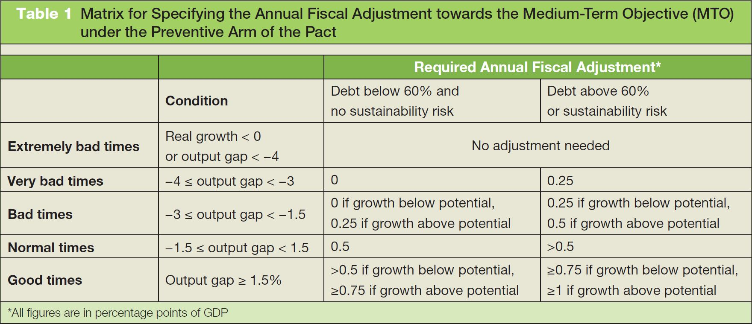
FOCUS: Rules versus Discretion: New Absolute Budgetary Rules in the EU
Source: European Commission, “Making the Best Use of the Flexibility within the Existing Rules of the Stability and Growth Pact,” COM(2015) 12 final provisional, January 2015.

Slide 26
22-4 The Dangers of High Debt
Today, debt is indeed high in many advanced economies, often in excess of 100% of GDP.
It is now widely accepted that the strong fiscal consolidation that took place in Europe from 2011 on, known as fiscal austerity, was excessive.

Slide 27
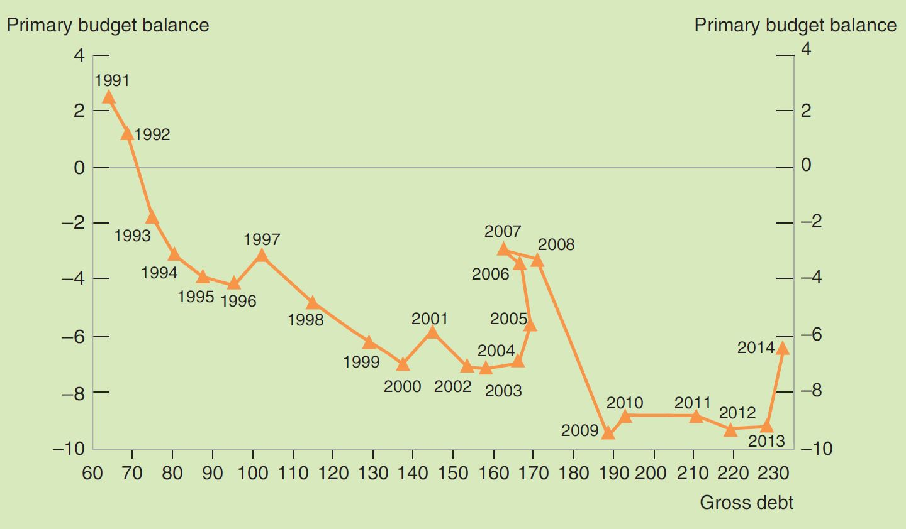
FOCUS: How Japan Could Stand Such a Huge Debt?
Figure 1 Budget and Debt Projections
Source: Jones, R. S. and S. Urasawa (2013), “Restoring Japan's Fiscal Sustainability,” OECD Economics Department Working Papers, No. 1050, OECD Publishing.

