Slide 1
The Labor Market
Chapter 7

Slide 2
Chapter 7 Outline
The Labor Market
7-1 A Tour of the Labor Market
7-2 Movements in Unemployment
7-3 Wage Determination
7-4 Price Determination
7-5 The Natural Rate of Unemployment
7-6 Where We Go from Here
APPENDIX Wage- and Price-Setting Relations versus Labor Supply and Labor Demand

Slide 3
The Labor Market
We have focused on the short run by assuming a constant price level in the IS-LM model.
We now turn to the medium run and explore how prices and wages adjust over time, and how this in turn affects output.
The labor market is the center of that sequence of events.

Slide 4
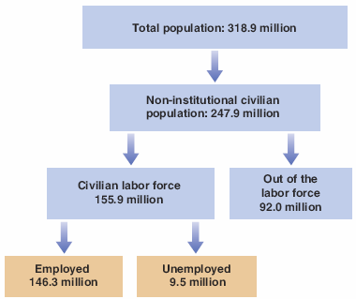
7-1 A Tour of the Labor Market
Figure 7-1 Population, Labor Force, Employment, and Unemployment in the United States (in millions), 2014
The unemployment rate is the ratio of the unemployed to the labor force, was 9.5/155.9 = 6.1%.

Slide 5
7-1 A Tour of the Labor Market
A given unemployment rate may reflect either:
An active labor market: Many separations and hires, i.e, many workers entering and exiting unemployment
A sclerotic labor market: Few separations and hires, and a stagnant unemployment pool
The Current Population Survey (CPS) shows the average monthly flows.
Separations include quits and layoffs.
The average duration of unemployment—the length of time people spend unemployed—is 2 to 3 months.

Slide 6
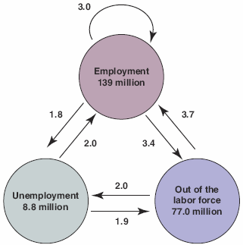

7-1 A Tour of the Labor Market
Figure 7-2 Average Monthly Flows between Employment, Unemployment, and Nonparticipation in the United States, 1996 to 2014 (millions)
(1) The flows of workers in and out of employment are large.
(2) The flows in and out of unemployment are large relative to the number of unemployed.
(3) There are also large flows in and out of the labor force, much of it directly to and from employment.

Slide 7
7-1 A Tour of the Labor Market
Many who are classified as “out of the labor force” are in fact discouraged workers—not actively looking for a job but will take it if they find one.
So, rather than the unemployment rate, economists sometimes focus on the employment rate—the ratio of employment to the population.

Slide 8
FOCUS: The Australian Monthly Population Survey
The Australia Bureau of Statistics’ Monthly Population Surveys (MPS) gathers varied information about the country's labor force. One of the main objectives of the survey is to measure changes in the households over time.
The sample size used has increased from 30,000 to 300,000 households.
Census data are used in compiling the monthly national statistics on employment, unemployment, gender, size, and earnings of households.
It also counts individuals in each geographic area to allocate Commonwealth funds to state and local governments.

Slide 9
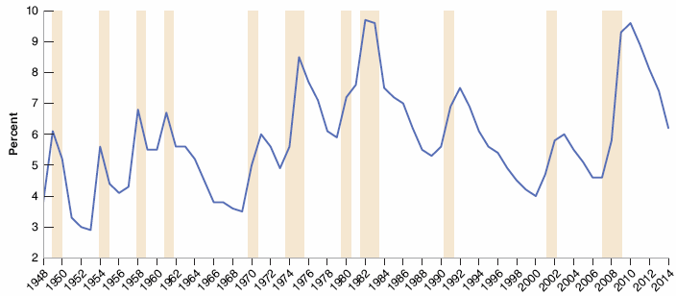
7-2 Movements in Unemployment
Figure 7-3 Movements in the U.S. Unemployment Rate, 1948–2014
Since 1948, the average yearly U.S. unemployment rate has fluctuated between 3 and 10%.

Slide 10
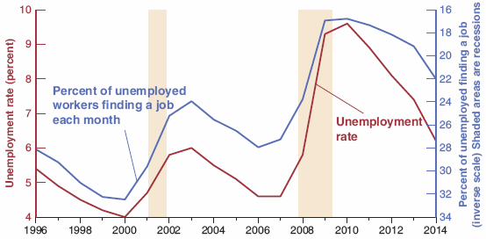
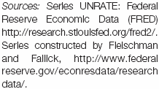
7-2 Movements in Unemployment
Figure 7-4 The Unemployment Rate and the Proportion of Unemployed Finding Jobs, 1996–2014
When unemployment is higher, the proportion of unemployed finding jobs within one month is lower. Note that the scale on the right is an inverse scale.

Slide 11
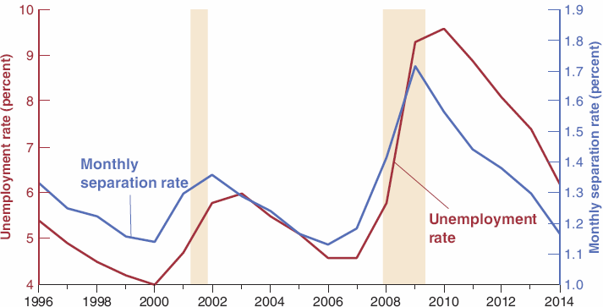
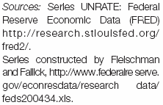
7-2 Movements in Unemployment
Figure 7-5 The Unemployment Rate and the Monthly Separation Rate from Employment, 1996–2014
When unemployment is higher, a higher proportion of workers lose their jobs.

Slide 12
7-2 Movements in Unemployment
When unemployment is high, workers are worse off in two ways:
Employed workers face a higher probability of losing their job.
Unemployed workers face a lower probability of finding a job; or they can expect to remain unemployed for a longer time.

Slide 13
7-3 Wage Determination
Sometimes wages are set by collective bargaining—a bargaining between unions and firms.
Slightly more than 10% of U.S. workers’ wages are set by collective bargaining.
The higher the skills needed to do the job, the more likely there is to be bargaining between employers and individual employees.
Collective bargaining plays an important role in Japan and most European countries.

Slide 14
7-3 Wage Determination
Workers are typically paid a wage exceeding their reservation wage—the wage that would make them indifferent between working or being unemployed.
Wages typically depends on labor-market conditions: The lower the unemployment rate, the higher the wages.
Workers’ bargaining power depends on:
How costly for the firm to find other workers
How hard for workers to find another job if they were to leave the firm

Slide 15
7-3 Wage Determination
Efficiency wage theories link the productivity of the efficiency of workers to the wage they are paid.
Firms may want to pay a wage above the reservation wage in order to decrease workers’ turnover and increase productivity.
Firms that see employee morale and commitment as essential to the quality of workers’ work will pay more than those whose activities are routine.
When unemployment is low, firms that want to avoid an increase in quits will increase wages to induce workers to stay with the firms.

Slide 16
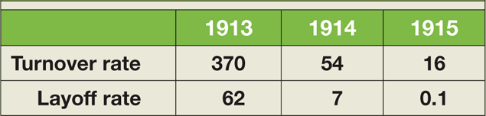

FOCUS: Henry Ford and Efficiency Wages
Table 1 Annual Turnover and Layoff Rates (%) at Ford, 1913–1915
In 1914, Henry Ford, the builder of Model-T, announced that his company would pay all qualified employees a minimum of $5.00 a day for an eight-hour day, compared to previously an average $2.30 for a nine-hour day.
The turnover rate plunged from 370% in 1913 to 16% in 1915.
The layoff rate collapsed from 62% to nearly 0%.

Slide 17

7-3 Wage Determination
The aggregate nominal wage W depends on:
the expected price level P^{e}
the unemployment rate u
a catch-all variable z

Slide 18
7-3 Wage Determination
Both workers and firms care about real wages (W/P), not nominal wages.
The nominal wage depends on the expected price level (rather than the actual price level) because when nominal wages are set, the relevant price levels are not yet known.

Slide 19
7-3 Wage Determination
An increase in the unemployment rate decreases wages.
Higher unemployment either weakens worker’ bargaining power, or allows firms to pay lower wages and still keep workers willing to work.
z stands for all the factors that affect wages given the expected price level and the unemployment rate, for example:
unemployment insurance as the payment of unemployment benefits to workers who lose their jobs
employment protection makes it more expensive for firms to lay off workers

Slide 20
7-4 Price Determination
The prices set by firms depends on their costs, which in turn depends on the nature of the production function:
Y = AN
where Y is output, N is employment and A is labor productivity (output per worker).
The production function is the relation between the inputs used in production and the quantity of output produced, and on the prices of these inputs.

Slide 21
7-4 Price Determination
Assume that A is constant and A = 1, then:
which implies that the cost of producing one more unit of output is the cost of employing one more worker at W.
The marginal cost of production is equal to W.
Now assume firms set their price according to a markup m over the cost so that:

Slide 22

7-5 The Natural Rate of Unemployment
Assume that W depends on the actual price level (P) rather than the expected price level (P^{e}), equation (7.1) becomes:
The higher the unemployment rate, the lower the real wage chosen by wage setters.
The wage-setting relation is the relation between the real wage and the rate of unemployment.

Slide 23
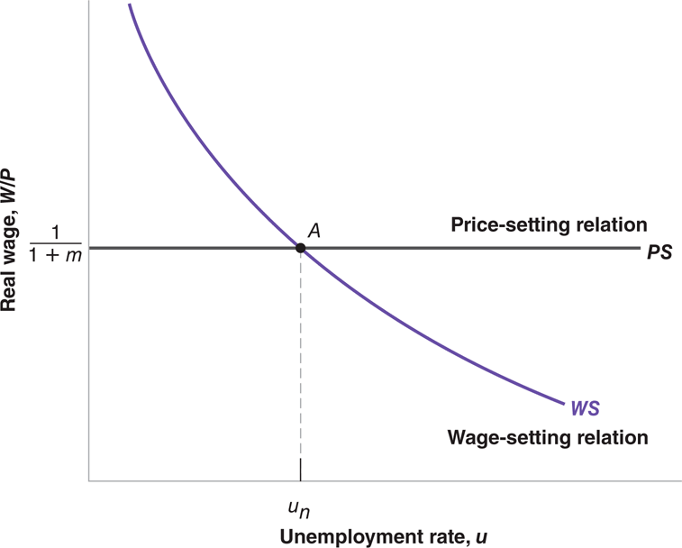
7-5 The Natural Rate of Unemployment
Figure 7-6 Wages, Prices, and the Natural Rate of Unemployment
The natural rate of unemployment is the unemployment rate such that the real wage chosen in wage setting is equal to the real wage implied by price setting.

Slide 24


7-5 The Natural Rate of Unemployment
Now divide both sides of the price-determination equation (7.3) by the nominal wage:
Inverting both sides gives the implied real wage, or the price-setting relation:
Price-setting decisions determine the real wage paid by firms.

Slide 25

7-5 The Natural Rate of Unemployment
The equilibrium unemployment rate u_{n} can be derived by eliminating W/P between equations (7.4) and (7.6):
u_{n} depends on z and m.
u_{n} is also called the natural rate of unemployment or the structural rate of unemployment.

Slide 26
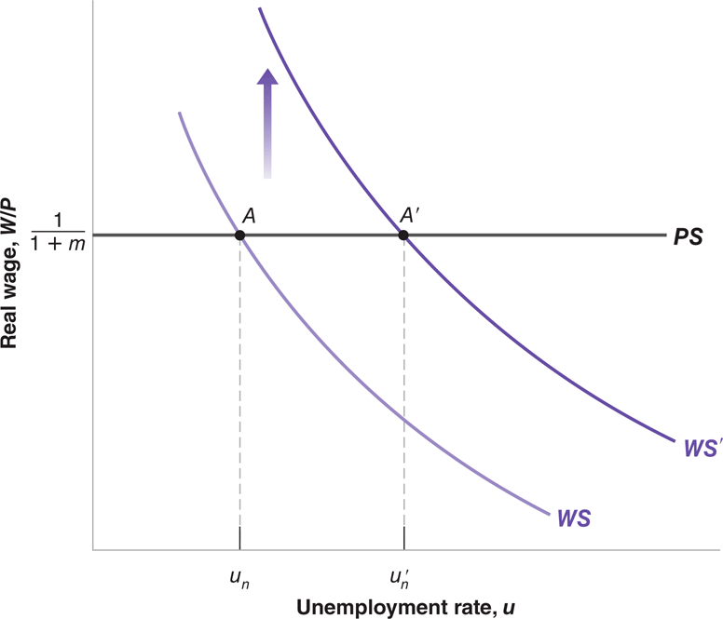
7-5 The Natural Rate of Unemployment
Figure 7-7 Unemployment Benefits and the Natural Rate of Unemployment
An increase in unemployment benefits leads to an increase in the natural rate of unemployment.

Slide 27
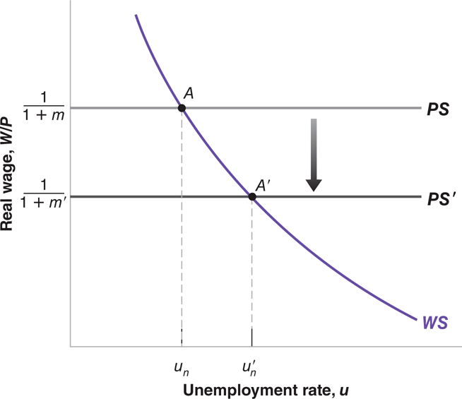
7-5 The Natural Rate of Unemployment
Figure 7-8 Markups and the Natural Rate of Unemployment
An increase in the markup leads to an increase in the natural rate of unemployment.

Slide 28
7-6 Where We Go from Here
We have assumed that the price level is equal to the expected price level.
In the short run, the price level may well turn out to be different from what is expected when nominal wages are set, so that unemployment is not necessarily equal to the natural rate or output equal to its natural level.
Because expectations are unlikely to be systematically wrong, in the medium run, output tends to return to its natural level.
The next chapter will relax the assumption that the price level is equal to the expected price level.

Slide 29
APPENDIX: Wage- and Price-Setting Relations versus Labor Supply and Labor Demand
The representation of labor-market equilibrium in terms of labor supply and labor demand in microeconomics is similar to the representation of the labor market in terms of wage setting and price setting.
To see this, we redraw Figure 7-6 in terms of the real wage on the vertical axis and the level of employment (N) on the horizontal axis.
Unemployment U is the labor force (L) minus employment N, i.e., U = L − N.

Slide 30
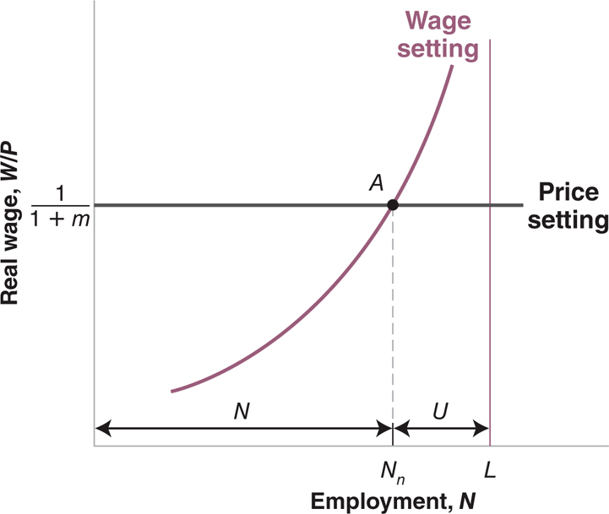
APPENDIX: Wage- and Price-Setting Relations versus Labor Supply and Labor Demand
Figure 1 Wage and Price Setting and the Natural Level of Employment

Slide 31
APPENDIX: Wage- and Price-Setting Relations versus Labor Supply and Labor Demand
The wage-setting relation is now upward sloping: Higher employment implies a higher real wage.
The price-setting relation is still a horizontal line.
The equilibrium is given by point A, with “natural” employment N_{n}.
The price-setting relation looks like a flat labor-demand relation.

