Slide 1
The Phillips Curve, the Natural Rate of Unemployment, and Inflation
Chapter 8

Slide 2
Chapter 8 Outline
The Phillips Curve, the Natural Rate of Unemployment, and Inflation
8-1 Inflation, Expected Inflation, and Unemployment
8-2 The Phillips Curve and Its Mutations
8-3 The Phillips Curve and the Natural Rate of Unemployment
8-4 A Summary and Many Warnings
APPENDIX How to go from the Relation between the Price Level, the Expected Price Level, and Unemployment to a Relation between Inflation, Expected Inflation, and Unemployment

Slide 3
The Phillips Curve, the Natural Rate of Unemployment, and Inflation
In 1958. A.W. Phillips found a negative relation between inflation and unemployment.
Two years later, Paul Samuelson and Robert Solow labeled this relation the Phillips curve, which became central to macroeconomic thinking and policy.

Slide 4
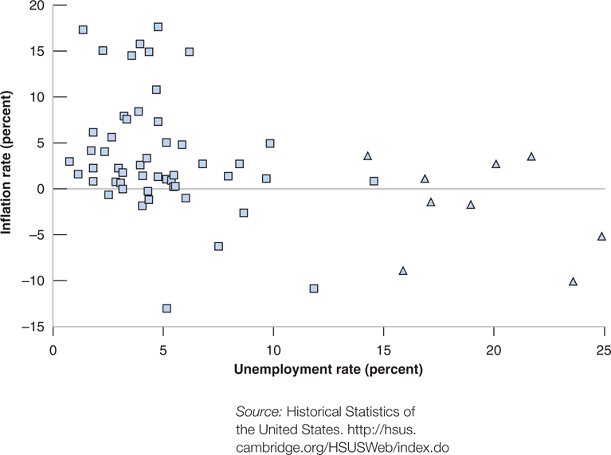
Figure 8-1 Inflation versus Unemployment in the United States, 1900–1960
During the period 1900-1960 in the United States, a low unemployment rate was typically associated with a high inflation rate, and a high unemployment rate was typically associated with a low or negative inflation rate.

Slide 5

8-1 Inflation, Expected Inflation, and Unemployment
Recall the wage determination equation (7.1):
and the price determination equation (7.3):
Substitute equation (7.1) for W in equation (7.3):

Slide 6
8-1 Inflation, Expected Inflation, and Unemployment
Assume a specific form for F:
so that the relation between the price level, the expected price level, and the unemployment rate is:
or in terms of inflation rate π and the expected inflation rate π^{e}:

Slide 7
8-1 Inflation, Expected Inflation, and Unemployment
An increase in π^{e} leads to an increase in π.
Given π^{e}, an increase in m, or an increase in z, leads to an increase in π.
Given π^{e}, a decrease in u leads to an increase in π.
Equation (2.2) with a time index t:

Slide 8

8-2 The Phillips Curve and Its Mutations
Assume , so that equation (8.3) becomes:
which is a negative relation between unemployment and inflation.
This Phillips curve relation was observed in the United States in the 1960s.
The relation vanished in the 1970s because wage setters changed the way they formed inflation expectations.

Slide 9
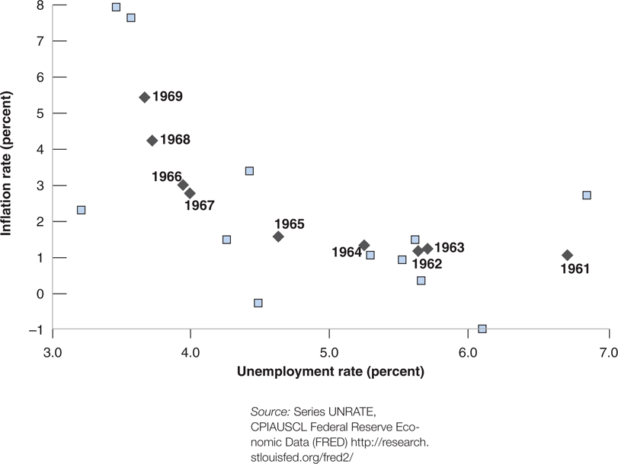
8-2 The Phillips Curve and Its Mutations
Figure 8-2 Inflation versus Unemployment in the United States, 1948–1969
The steady decline in the U.S. unemployment rate throughout the 1960s was associated with a steady increase in the inflation rate.

Slide 10
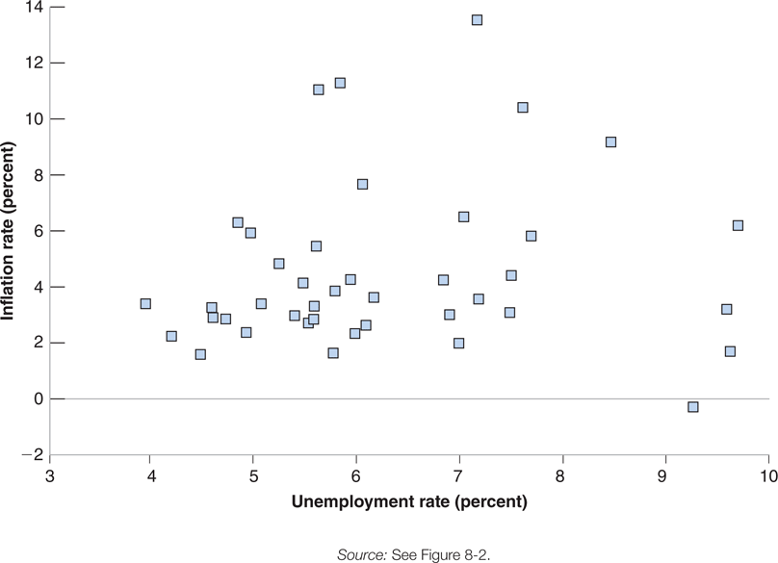
8-2 The Phillips Curve and Its Mutations
Figure 8-3 Inflation versus Unemployment in the United States, 1970–2010
Beginning in 1970 in the United States, the relation between the unemployment rate and the inflation rate disappeared.

Slide 11
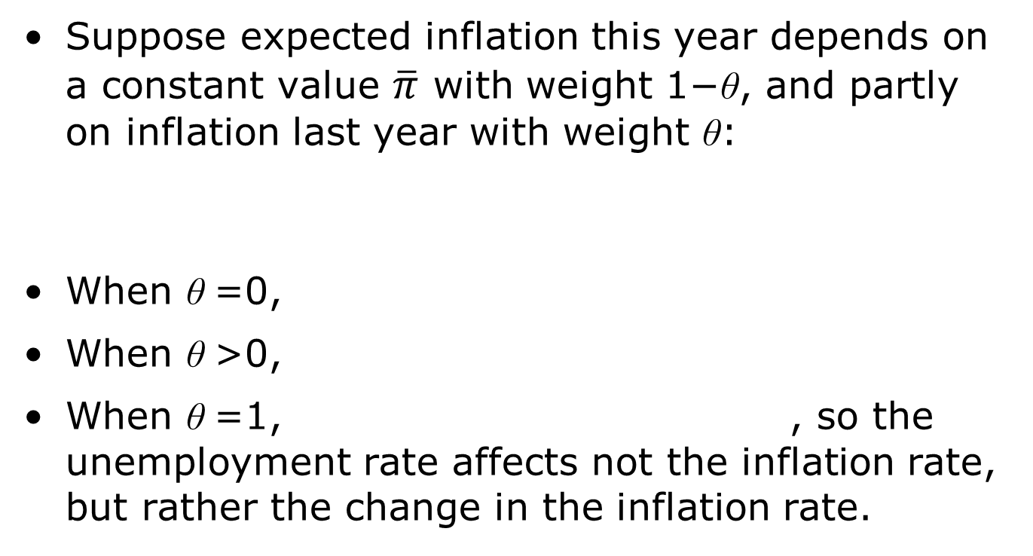
8-2 The Phillips Curve and Its Mutations
Suppose expected inflation this year depends on a constant value $\overline{π}$ with weight 1−θ, and partly on inflation last year with weight θ:
When θ =0,
When θ >0,
When θ =1, , so the unemployment rate affects not the inflation rate, but rather the change in the inflation rate.

Slide 12
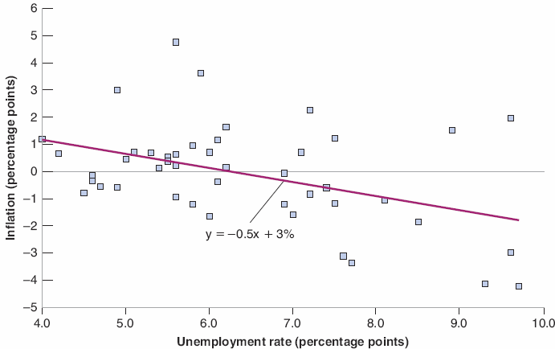

8-2 The Phillips Curve and Its Mutations
Figure 8-4 Change in Inflation versus Unemployment in the United States, 1974–2014
Since 1970, there has been a negative relation between the unemployment rate and the change in the inflation rate in the United States.

Slide 13
8-2 The Phillips Curve and Its Mutations
The line that best fits the scatter of points in Figure 8-4 is:
which is called the modified Phillips curve, or the expectations-augmented Phillips curve, or the accelerationist Phillips curve.
We shall simply called equation (8.7) the Phillips curve, as opposed to the original Phillips curve (8.4).

Slide 14

8-3 The Phillips Curve and the Natural Rate of Unemployment
Suppose π = π^{e} and solve for u_{n} in equation (8.3):
Rewrite equation (8.3) as
so equation (8.8) can be rewritten as

Slide 15
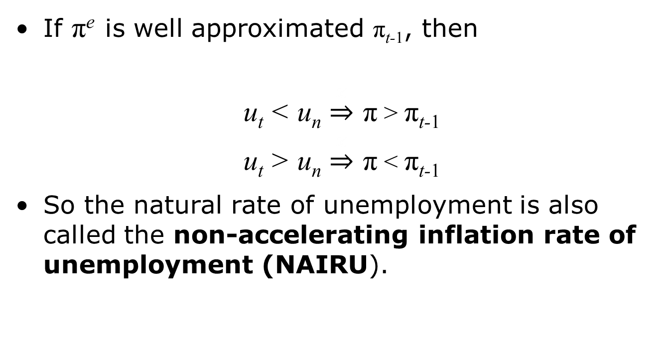
8-3 The Phillips Curve and the Natural Rate of Unemployment
If π^{e} is well approximated π_{t-1}, then
u_{t} < u_{n} $\underset{⇒}{x}$ π > π_{t-1}
u_{t} > u_{n} $\underset{⇒}{x}$ π < π_{t-1}
So the natural rate of unemployment is also called the non-accelerating inflation rate of unemployment (NAIRU).

Slide 16
FOCUS: Theory ahead of Facts: Milton Friedman and Edmund Phelps
Milton Friedman and Edmund Phelps argued that the trade-off between inflation and unemployment in the late 1960s was an illusion.
Accordingly, the Phillips curve is a temporary, rather than a permanent, trade-off between inflation and unemployment that comes not from inflation per se, but from a rise rate of inflation, which results in unanticipated inflation.

Slide 17
8-4 A Summary and Many Warnings
The relation between unemployment and inflation in the United States today is well captured by a relation between the change in the inflation rate and the deviation of the unemployment rate from the natural rate of unemployment.
When the unemployment rate is above (below) the natural rate of unemployment, the inflation rate typically decreases (increases).
The natural rate of unemployment differ across counties due to, e.g., labor-market rigidities, and also over time.

Slide 18
FOCUS: What Explains European Unemployment?
Factors for labor-market rigidities:
A generous system of unemployment insurance
A high degree of employment protection
Minimum wages
Bargaining rules, such as extension agreements
Key facts of unemployment in Europe:
Unemployment was not always high
Some European counties actually had low unemployment prior to the start of the current crisis

Slide 19
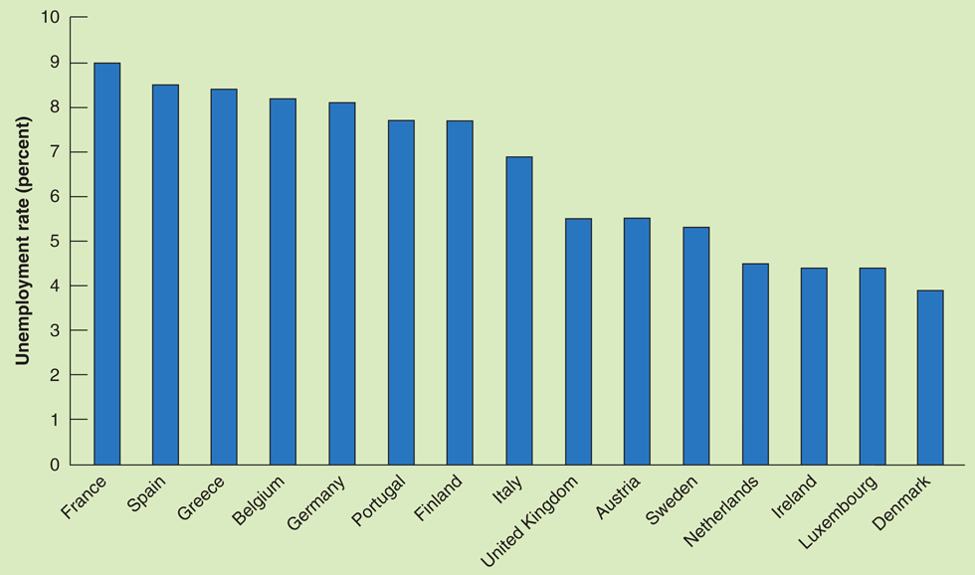
FOCUS: What Explains European Unemployment?
Figure 1 Unemployment Rates in 15 European Countries, 2006

Slide 20
FOCUS: Changes in the U.S. Natural Rate of Unemployment since 1990
Possible explanations for the decrease of the European natural rate of unemployment to 8 - 9% today:
Institutions were different earlier and labor-market rigidities only appeared in the last 40 years.
Interaction between institutions and shocks; firms that cannot adjust their labor force quickly may be unable to compete and will go out of business.

Slide 21
8-4 A Summary and Many Warnings
When the inflation rate becomes high, the terms of wage agreements tend to change with the level of inflation.
Wage indexation is a provision that automatically increases wages in line with inflation.
Suppose λ a proportion of labor contracts that is indexed, so nominal wages move one-for-one with changes in the actual price level, equation (8.9) becomes

Slide 22

8-4 A Summary and Many Warnings
When λ=0, equation (8.11) becomes equations (8.10).
When λ>0, equation (8.11) becomes:
Wage indexation increases the effect of unemployment on inflation.
Without wage indexation, lower unemployment increases wages, which in turn increases prices.

Slide 23
8-4 A Summary and Many Warnings
When low inflation or deflation occurs, the Phillips curve relation breaks down.
One possible reason is the reluctance of workers to accept cuts in nominal wages.

Slide 24
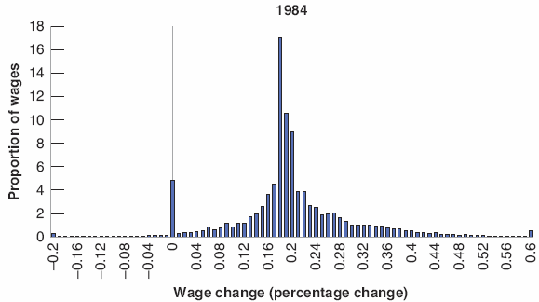
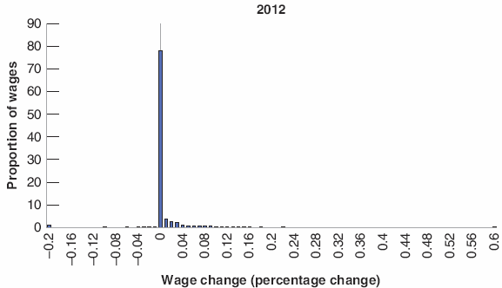
8-4 A Summary and Many Warnings
Figure 8-5 Distribution of wage changes in Portugal, in times of high and low inflation
In 1984, the inflation rate was 27%, and the distribution of wage wages was roughly symmetric.
In 2012, the inflation rate was just 2.1%, and the distribution of wages was bunched at zero with nearly no negative wage changes.

Slide 25


APPENDIX: How to go from the Relation between the Price Level, the Expected Price Level, and Unemployment to a Relation between Inflation, Expected Inflation, and Unemployment
Equation (8.1) with time subscripts becomes:
Divide both sides by P_{t-1}:
Rewrite P_{t} /P_{t-1} as 1+π_{t} and do the same for the expected inflation rate, equation (8A.1) becomes:
If the left side is not large, it becomes and so:

