Slide 1
APPENDIX to Chapter 01
Graphs in Economics

Slide 2
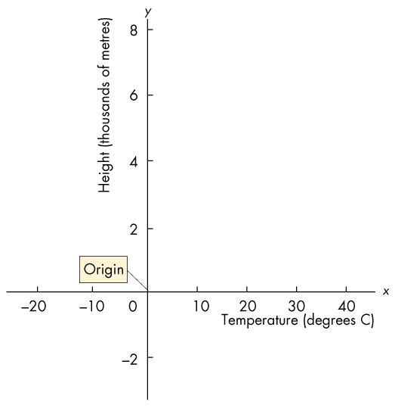
Graphing Data (1 of 9)
A graph reveals a relationship.
A graph represents “quantity” as a distance.
A two-variable graph uses two perpendicular scale lines.
The vertical line is the y-axis.
The horizontal line is the
x-axis.
The zero point in common to both axes is the origin.

Slide 3
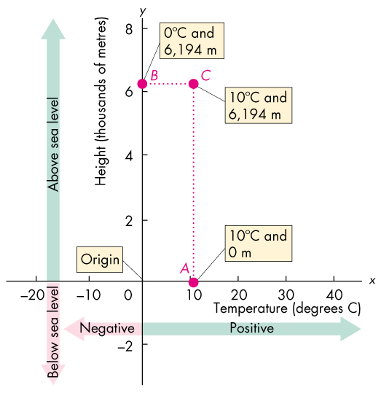
Graphing Data (2 of 9)
To plot a point 6,194 m above sea level at 10 degrees, we need the x-value and the
y-value of the point.
Point A shows an x-value of 10 degrees C.
Point B shows a y-value of 6,194 m above sea level.
Point C plot a point 6,194 m above sea level when the temperature is 10 degrees C.

Slide 4
Graphing Data (3 of 9)
Economists measure variables that describe what, how, and for whom goods and services are produced.
These variables are quantities produced and prices.
Figure A1.2 shows two examples of economic graphs.

Slide 5
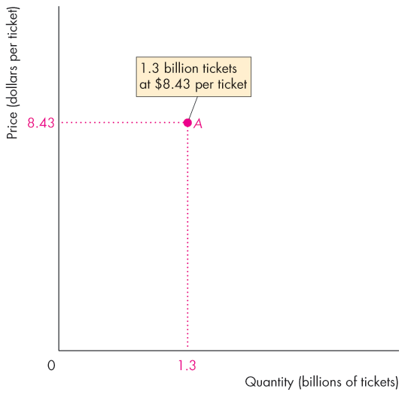
Graphing Data (4 of 9)
Figure A1.2 shows how to make an economics graph.
Point A tells us the quantity of tickets bought in 2016 and the average price of a ticket.
You can “read” this graph as telling you that in 2016:
1.3 billion movie tickets were bought at a price of $8.43 a ticket.

Slide 6
Graphing Data (5 of 9)
Scatter Diagrams
A scatter diagram plots the value of one variable against the value of another variable for a number of different values of each variable.
A scatter diagram reveals whether a relationship exists between the two variables.
Figure A1.3 shows the production budget for ten popular movies and their worldwide box office revenues.
The table gives the data and the graph describes the relationship between each movie’s production budget and its box office revenue.

Slide 7
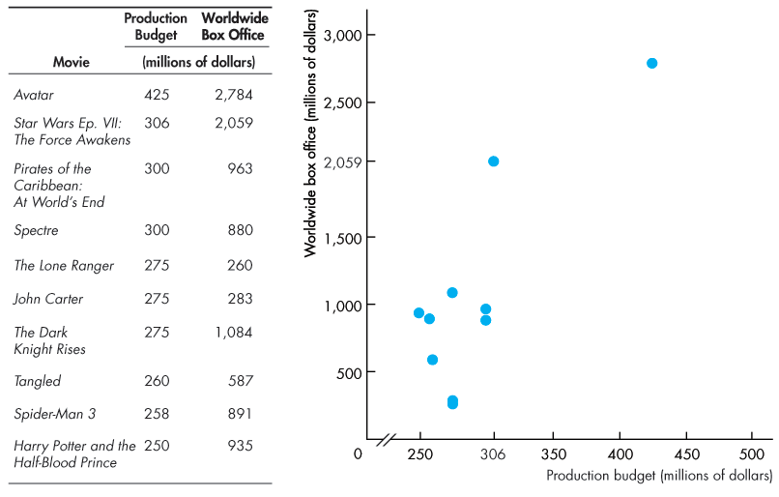
Graphing Data (6 of 9)

Slide 8
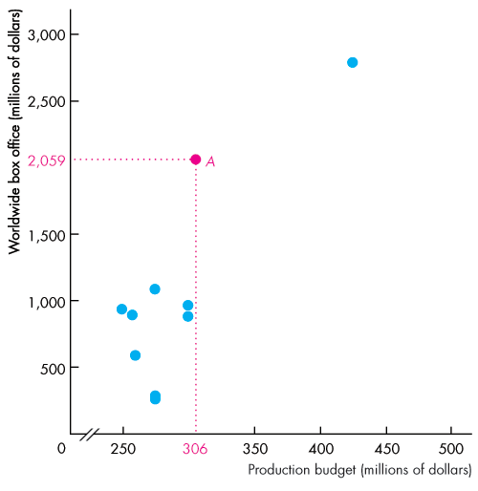
Graphing Data (7 of 9)
Point A tells us that Star Wars: The Force Awakens cost $306 million to produce and brought in $2,059 million at the box office.
The pattern of the points reveal that there is no clear tendency for a larger production budget to bring a greater box office revenue.

Slide 9
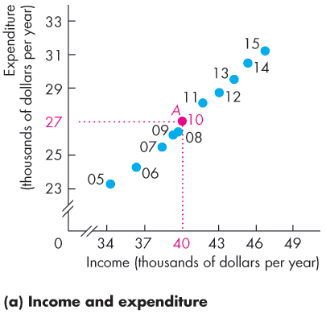
Graphing Data (8 of 9)
Figure A1.4(a) is a scatter diagram of income and expenditure in Canada, on average, from 2005 to 2015.
Point A shows that in 2010, income was $40,000 and expenditure was $27,000.
The graph shows that as income increases, so does expenditure, and the relationship is a close one.

Slide 10
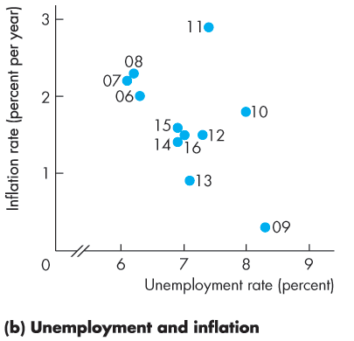
Graphing Data (9 of 9)
Figure A1.4(b) is a scatter diagram of inflation and unemployment in Canada from 2005 to 2015.
The points show no relationship between the two variables.
For example, when unemployment as high, inflation was high in 2010 and low in 2009.

Slide 11
Graphs Used in Economic Data (1 of 9)
Graphs are used in economic models to show the relationship between variables.
The patterns to look for in graphs are the four cases in which
Variables move in the same direction.
Variables move in opposite directions.
Variables have a maximum or a minimum.
Variables are unrelated.

Slide 12
Graphs Used in Economic Data (2 of 9)
Variables That Move in the Same Direction
A relationship between two variables that move in the same direction is called a positive relationship or a direct relationship.
A line that slopes upward shows a positive relationship.
A relationship shown by a straight line is called a linear relationship.
The three graphs on the next slide show positive relationships.

Slide 13
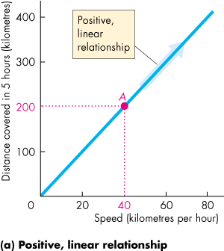
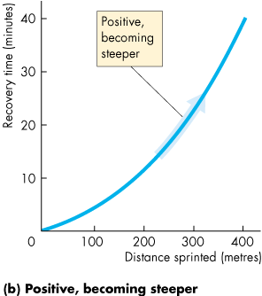
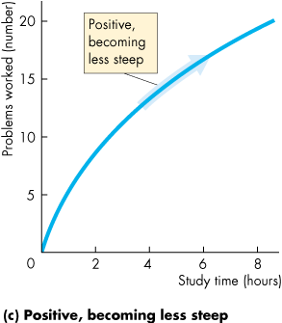
Graphs Used in Economic Data (3 of 9)

Slide 14
Graphs Used in Economic Data (4 of 9)
Variables That Move in Opposite Directions
A relationship between two variables that move in opposite directions is called a negative relationship or an inverse relationship.
A line that slopes downward shows a negative relationship.
The three graphs on the next slide show negative relationships.

Slide 15
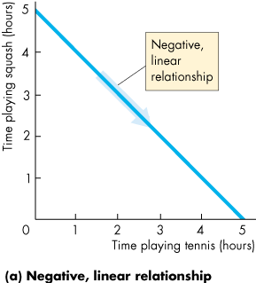
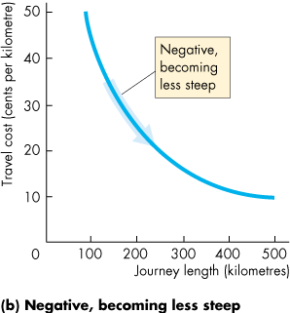
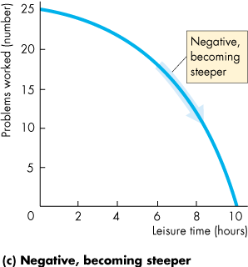
Graphs Used in Economic Data (5 of 9)

Slide 16
Graphs Used in Economic Data (6 of 9)
Variables That Have a Maximum or a Minimum
The two graphs on the next slide show relationships that have a maximum and a minimum.
These relationships are positive over part of their range and negative over the other part.

Slide 17
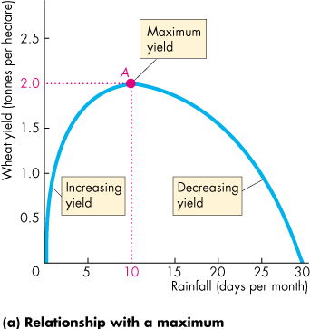
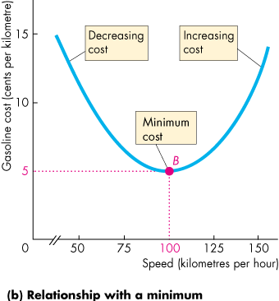
Graphs Used in Economic Data (7 of 9)

Slide 18
Graphs Used in Economic Data (8 of 9)
Variables That are Unrelated
Sometimes, we want to emphasize that two variables are unrelated.
The two graphs on the next slide show examples of variables that are unrelated.

Slide 19
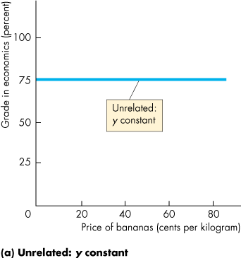
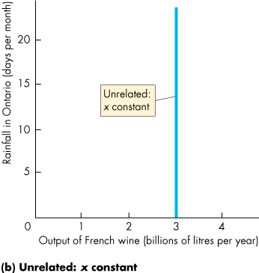
Graphs Used in Economic Data (9 of 9)

Slide 20
The Slope of a Relationship (1 of 6)
The slope of a relationship is the change in the value of the variable measured on the y-axis divided by the change in the value of the variable measured on the x-axis.
We use the Greek letter Δ (capital delta) to represent “change in.”
So Δy means the change in the value of the variable measured on the y-axis and Δx means the change in the value of the variable measured on the x-axis.
Slope equals Δy/Δx.

Slide 21
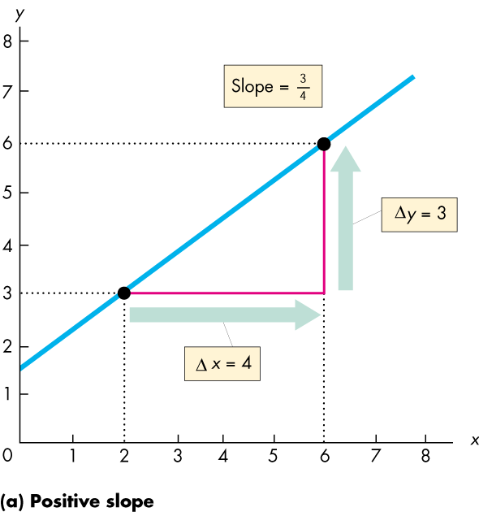
The Slope of a Relationship (2 of 6)
The Slope of a Straight Line
The slope of a straight line is constant.
Graphically, the slope is calculated as the “rise” over the “run.”
The slope is positive if the line is upward sloping.

Slide 22
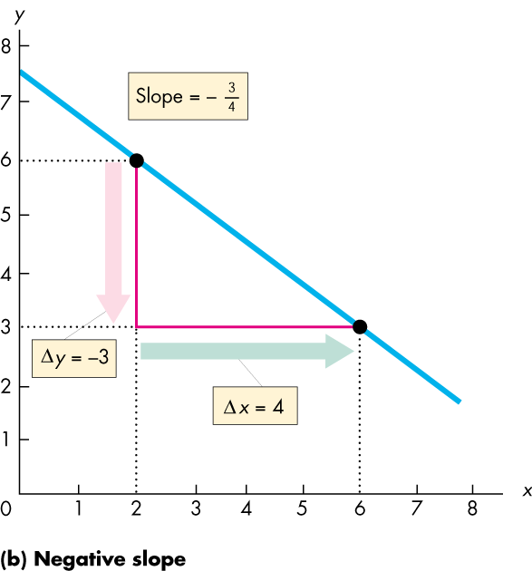
The Slope of a Relationship (3 of 6)
The slope is negative if the line is downward sloping.

Slide 23
The Slope of a Relationship (4 of 6)
The Slope of a Curved Line
The slope of a curved line at a point varies depending on where along the curve it is calculated.
We can calculate the slope of a curved line either at a point or across an arc.

Slide 24
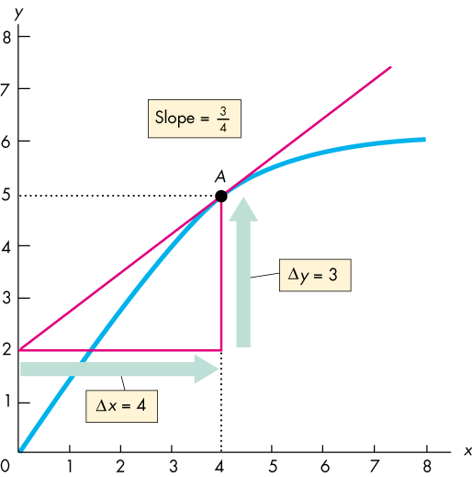
The Slope of a Relationship (5 of 6)
Slope at a Point
The slope of a curved line at a point is equal to the slope of a straight line that is the tangent to that point.
Here, we calculate the slope of the curve at point A.

Slide 25
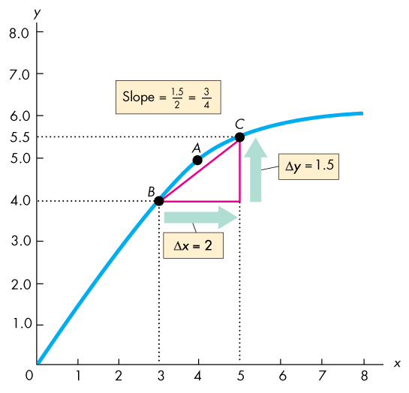
The Slope of a Relationship (6 of 6)
Slope Across an Arc
The average slope of a curved line across an arc is equal to the slope of a straight line that joins the endpoints of the arc.
Here, we calculate the average slope of the curve along the arc BC.

Slide 26
Graphing Relationships Among More Than Two Variables (1 of 8)
When a relationship involves more than two variables, we can plot the relationship between two of the variables by holding other variables constant—by using ceteris paribus.
Ceteris paribus means “if all other relevant things remain the same.”
Figure A1.12 shows a relationship among three variables.

Slide 27
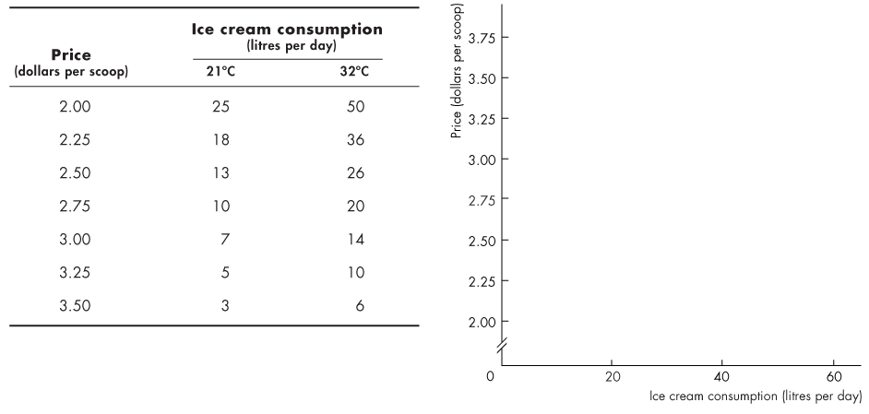
Graphing Relationships Among More Than Two Variables (2 of 8)
The table gives the quantity of ice cream consumed at different prices as the temperature varies.

Slide 28
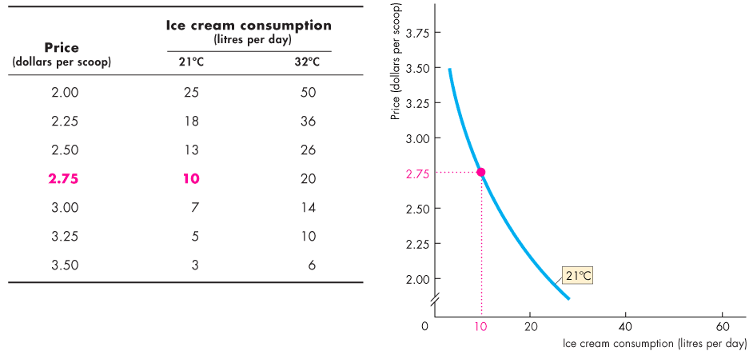
Graphing Relationships Among More Than Two Variables (3 of 8)
Ceteris Paribus
To plot this relationship we hold the temperature at 21°C.
At $2.75 a scoop, 10 litres are consumed.

Slide 29
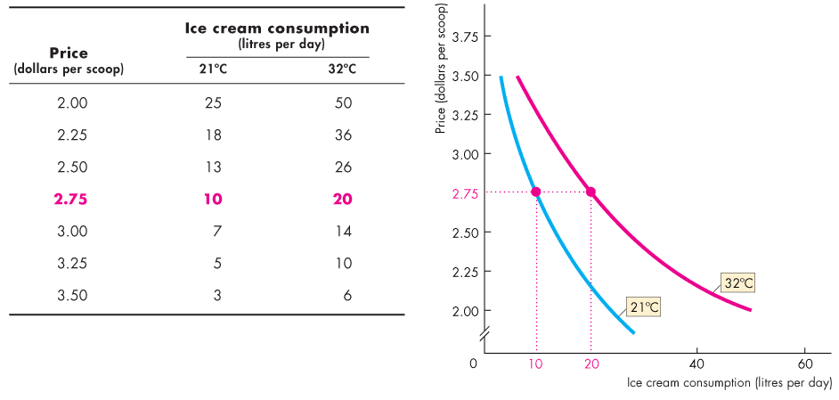
Graphing Relationships Among More Than Two Variables (4 of 8)
We can also plot this relationship by holding the temperature constant at 32°C.
At $2.75 a scoop, 20 litres are consumed.

Slide 30
Graphing Relationships Among More Than Two Variables (5 of 8)
When temperature is constant at 21°C and the price of ice cream changes, there is a movement along the blue curve.

Slide 31
Graphing Relationships Among More Than Two Variables (6 of 8)
When temperature is constant at 32°C and the price of ice cream changes, there is a movement along the red curve.

Slide 32
Graphing Relationships Among More Than Two Variables (7 of 8)
When Other Things Change
The temperature is held constant along each curve, but in reality the temperature can change.

Slide 33
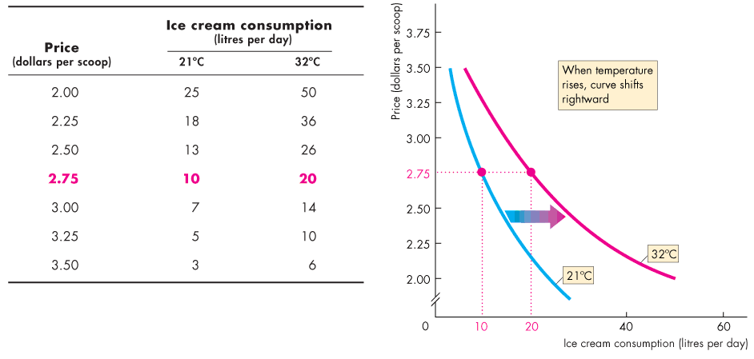
Graphing Relationships Among More Than Two Variables (8 of 8)
When the temperature rises from 21°C to 32°C,
the curve showing the relationship shifts rightward from the blue curve to the red curve.

