Slide 1
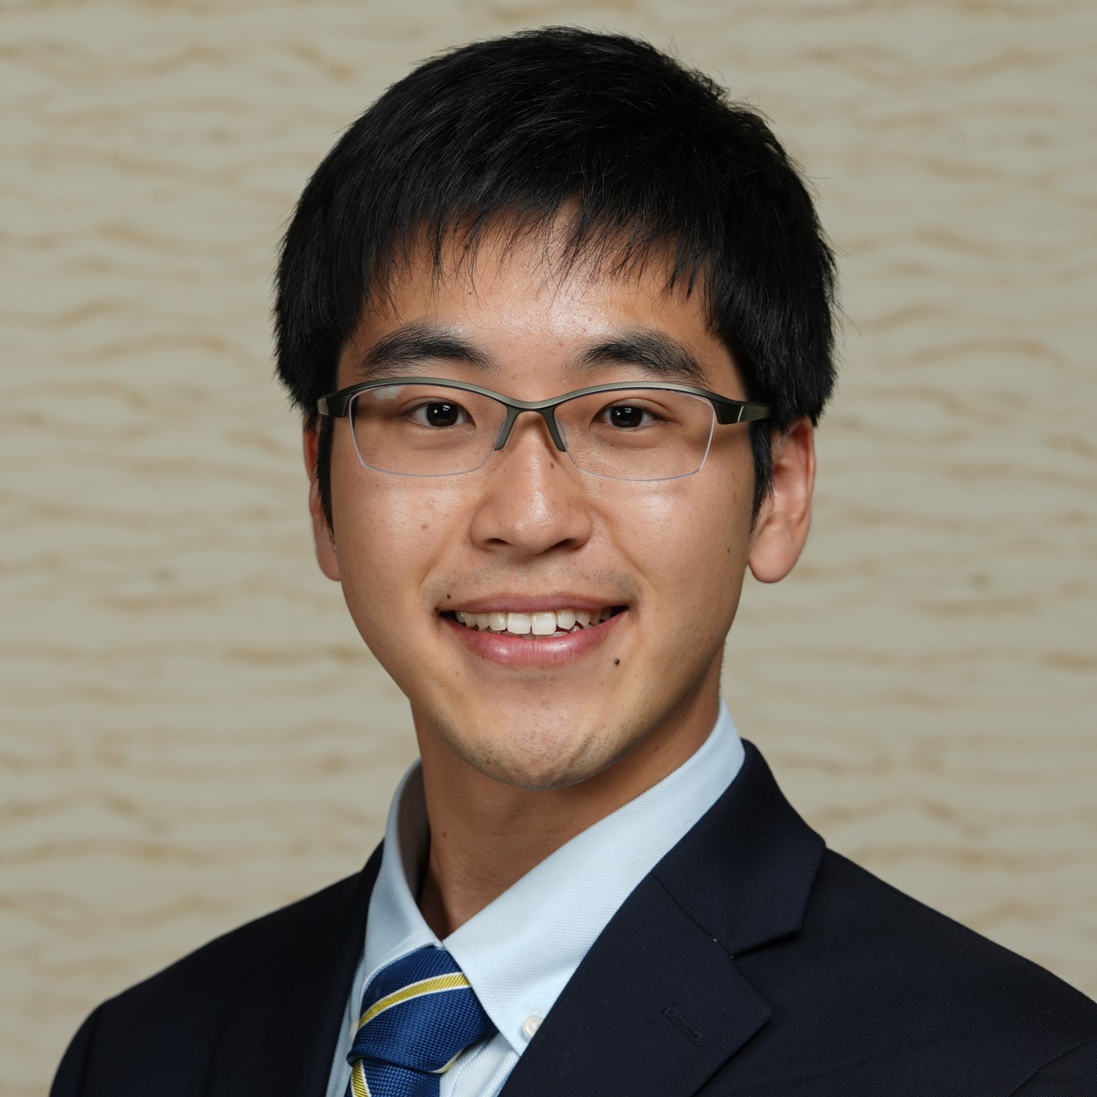
Shuta Suzuki (鈴木秀汰)
Advisory Senior Consultant | Cyber Risk Services
Profile
Shuta Suzuki is an Advisory Senior Consultant in the Cyber Identity practice at Deloitte & Touche LLP. Shuta specializes in Identity & Access Management, and he is also part of Deloitte’s AWS Cyber Team. Shuta is bilingual in English and Japanese which he leverages as a member of Deloitte US’s Japanese Services Group (JSG).
Technical Exposure
Programming Languages: Python, C/C++, HTML, CSS, JavaScript, SQL, VBA, LaTeX
Operating Systems: Windows, MacOS, Linux (Ubuntu, Red Hat, Debian, Kali)
IAM Software: SailPoint IdentityIQ, CyberArk
Other Technologies: Cloud Computing, Infrastructure as Code, Microsoft Office Suite
Familiar with various software engineering/development processes with hands-on experience in version control, static/dynamic testing, and continuous integration
Limited experience in contributing to an open-source project
Certifications
Associate of (ISC)²
AWS Certified Cloud Practitioner / Solutions Architect Associate
SailPoint Certified IdentityIQ Professional
HashiCorp Certified: Terraform Associate
CyberArk Certified Trustee
Adobe Certified Associate in Photoshop / Flash / Dreamweaver
Education
University of Michigan-Ann Arbor: B.S. in Computer Science and Minor in Linguistics
Shuta Suzuki 30 Rockefeller Plaza New York, NY, 10112-0015 Tel/Direct: +1 212 436 3130 Mobile: +1 646 265 1228 Email: shusuzuki@deloitte.com
As used in this document, “Deloitte Risk and Financial Advisory” means Deloitte & Touche LLP, which provides audit and risk advisory services; Deloitte Financial Advisory Services LLP, which provides forensic, dispute, and other consulting services; and its affiliate, Deloitte Transactions and Business Analytics LLP, which provides a wide range of advisory and analytics services. Please see www.deloitte.com/us/about for a detailed description of our legal structure. Certain services may not be available to attest clients under the rules and regulations of public accounting.

