Slide 1
Measuring AI Patent Enforceability with Large Language Models: Evidence from Recentive
Shutong Dong, & Minghao Yan
May 2026

Slide 2
Research Question
Does the Recentive decision lead banks to reprice and restructure syndicated loan contracts for firms with greater pre-existing exposure to vulnerable applied ML patents?
Do banks respond more strongly when vulnerable AI patents are more likely to matter as collateral, such as for firms with prior patent pledging activity, low tangible assets, or near-term refinancing needs?

Slide 3
Institutional Setting
The eligiblility of patent claim
- 35 U.S.C. Section 101 defines patent eligible subject matter as any new and useful process, machine, manufacture, or composition of matter.
Alice framework
(Alice Corp. v. CLS Bank Int'l, 2014)
Recentive boundary
(Recentive. In Aon Re, Inc. v. Zesty.AI, Inc., 2025)
Step 1: Is the claim directed to a patent-ineligible abstract idea?
Step 2: Is there an inventive concept that transforms the claim into eligible subject matter?
within-AI legal boundary
The decision holds vulnerable claims ineligible when they
do no more than apply generic ML to a new data
environment, without improving the ML model itself.

Slide 4
Literature Review
Patents as collaterals
- Patents support debt when lenders can identify, value, enforce, and transfer the underlying rights (Mann, 2018; Hochberg et al., 2018). Patent invalidation reduces leverage, suggesting that legal strength is priced in debt markets (Horsch et al., 2021).
IP protection decline
- When IP protection is weakened, firms adjust protection strategies, including greater secrecy and NDA use (Acikalin et al., 2022).
AI and economic consequences
- Previous studies mainly study growth, labor, innovation, and equity valuation rather than bank loan contract design (Babina et al., 2024; Kogan et al., 2023; Eisfeldt & Schubert, 2025). This study adds legal enforceability and pledgeability of AI knowledge as a financing channel.

Slide 5
Hypothesis Developments
H1 (Price Channel). Following Recentive, firms with higher pre-period Recentive Vulnerability Scores face higher all-in drawn spreads on newly originated syndicated loans.
H2 (Collateral-Package and Control-Rights Reconfiguration). Higher exposure to Recentive- vulnerable claims leads to tighter non-price loan terms, including more stringent collateral requirements, stronger IP-specific reporting, negative pledges, IP-transfer restrictions, shorter maturities, smaller facilities, and tighter covenants.
H3 (Asset-Form Substitution). Firms with greater exposure to vulnerable applied-ML patent claims are expected to exhibit partial substitution from patent-form protection toward secrecy-form protection.

Slide 6
Data for Main Analysis
The empirical dataset links AI patent text, firm financials, disclosures, and syndicated loan contracts.
AI patent data
Firm linkages
Loan contracts
Financials & disclosure
PatentsView utility patents
USPTO AIPD 2023
CPC G06N and keyword supplements
Patent assignment records
KPSS patent–PERMNO
WRDS CCM to GVKEY
DealScan facilities
2018Q1–2026Q1
SEC Exhibit 10 credit agreements
Compustat controls
CRSP event-study returns
10-K secrecy markers via LLM
Primary sample
U.S. public AI-patenting firms with at least three AI patents granted before 2025Q1 and at least one DealScan facility in the sample window.
Identification focuses within the AI-patenting universe; non-AI firms serve as external placebo observations.

Slide 7
Measuring Vulnerability Through AI
After collection of patent information, vulnerability score is constructed through the textual analysis of AI
Primary input
Recentive Vulnerability Score
Independent claims
DeepSeek-Chat / DeepSeek-R1
Prompt asks for:
• score from 0.00 to 1.00
• confidence rating
• one-sentence legal justification
• quoted claim language
Supplemental context
Abstract
0.00
technical ML improvement
0.50
mixed
1.00
applied-only ML
Robustness input
Technical-improvement passages
Human validation: a stratified sample of 300 AI patent claims is hand-coded on the same 0–1 vulnerability scale to benchmark the LLM classifier.

Slide 8
Measuring Vulnerability Through AI
Prompt
“ You are a patent attorney applying the Federal Circuit's two-step Alice test as articulated in
Recentive Analytics, Inc. v. Fox Corp. Read the patent material below and output a score from 0.00 to
1.00 reflecting the degree to which this claim resembles Recentive-vulnerable applied-only ML claim
language. Anchors: 0.00 = the claim recites a clear technological improvement to the machine learning
model itself (a new architecture, loss function, training procedure, or representation); 0.50 = mixed or
ambiguous; 1.00 = the claim recites only the application of established machine learning techniques to a
new data environment, business problem, or domain, without disclosing a technological improvement to
the model. Provide the score, a confidence rating, and a one-sentence justification quoting the specific
claim language that drove the decision.”

Slide 9
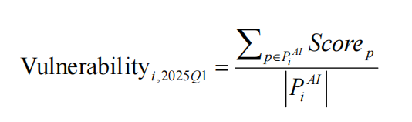
Measuring Vulnerability Through AI
Pᵢᴬᴵ = firm i’s stock of AI patents granted before 2025Q1.
Alternative measurements as robustness tests
Citation-weighted mean
Top-quartile exposure
Predicted vulnerable stock
Vulnerable stock / assets
weights measured before Apr. 18, 2025
high-treatment indicator
count-based exposure
scaled by firm balance sheet

Slide 10
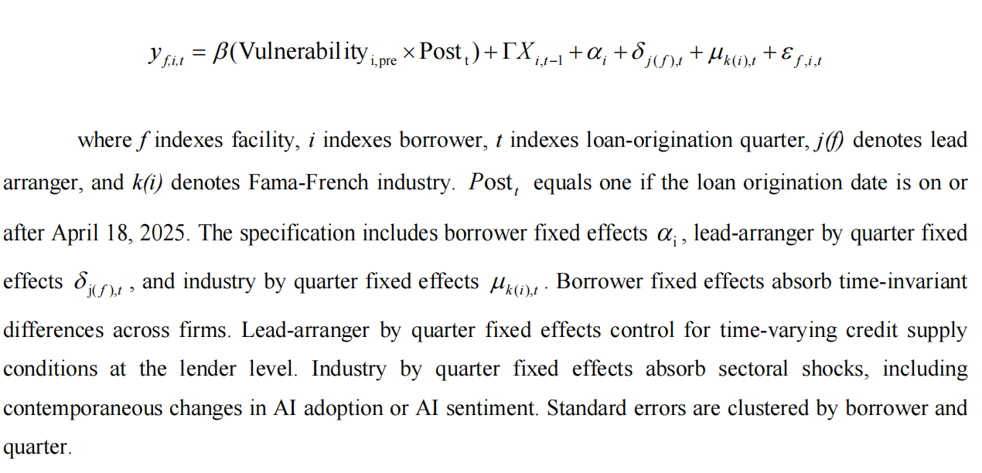
Baseline Estimation Model

Slide 11
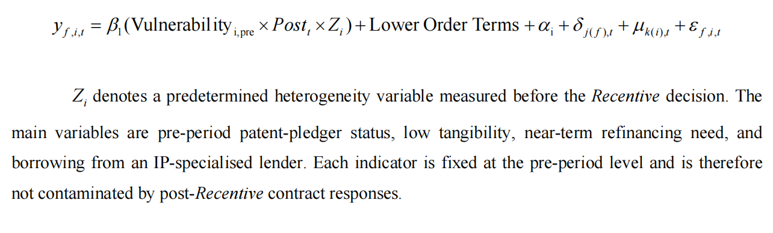
Heterogeneity tests

Slide 12
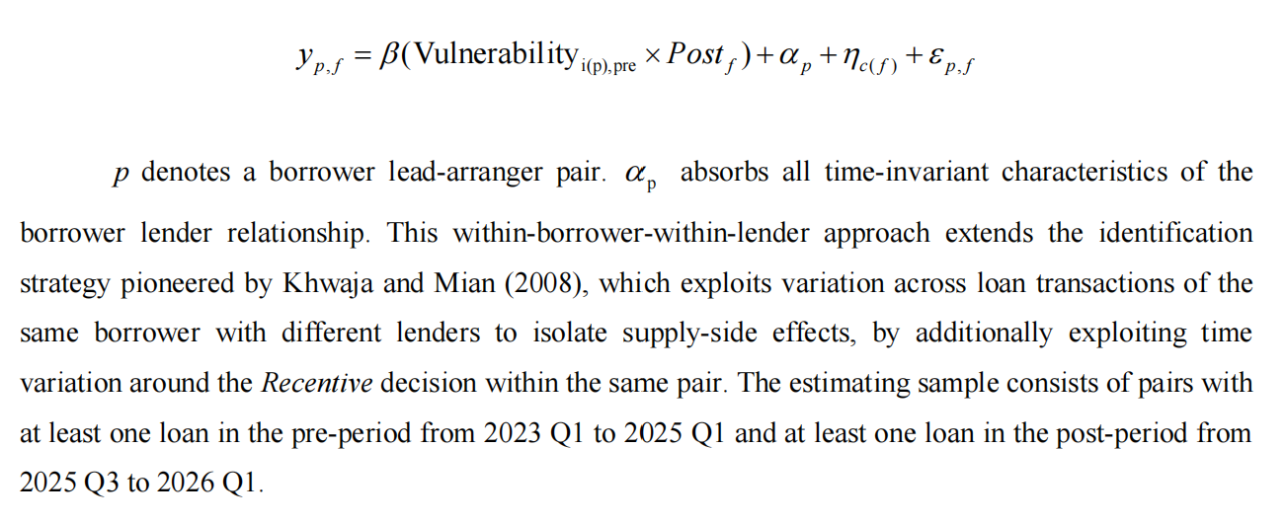
Subsample test

Slide 13
Robustness tests
Event-study diagnostics
Estimate quarterly leads and lags from 2022 Q1 to 2026 Q1.
Key diagnostic: no systematic pre-trends before the April 18, 2025 decision.
Special attention to 2024 Q4–2025 Q1 because oral argument occurred on October 1, 2024, creating possible anticipation.
Donut specifications
Exclude loans originated within 30 days of the decision date.
Repeat using a 60-day exclusion window.
Purpose: avoid classifying loans negotiated before Recentive but signed shortly after as post-shock responses.
Conservative post-period
Redefine Post = 1 only for loans originated in 2025 Q3 or later.
This allows time for banks to update legal-risk assessments and renegotiate contract terms.
Results should remain directionally consistent under this stricter timing definition.

Slide 14
Robustness tests
Within-AI placebo
Replace Vulnerability with core-machine-learning share.
Prediction: null effect.
Interpretation: Recentive should affect applied-only ML claims more than patents claiming genuine model improvements.
Non-AI and non-U.S. placebos
Use non-AI software-patent share × Post.
Use European or Chinese AI-patent share × Post.
Prediction: null effects, helping rule out general software shocks and global AI sentiment shocks.
Fake event dates
Re-estimate using placebo event dates in 2023 Q2 and 2024 Q2.
Prediction: no treatment effect around these artificial dates.
Purpose: test whether results are driven by pre-existing trends.
IV robustness
Instrument firm vulnerability using leave-one-out examiner leniency toward generic/applied-only ML claims within art unit × year.
Reported as robustness, not primary identification, because the exclusion restriction is potentially contestable.

Slide 15
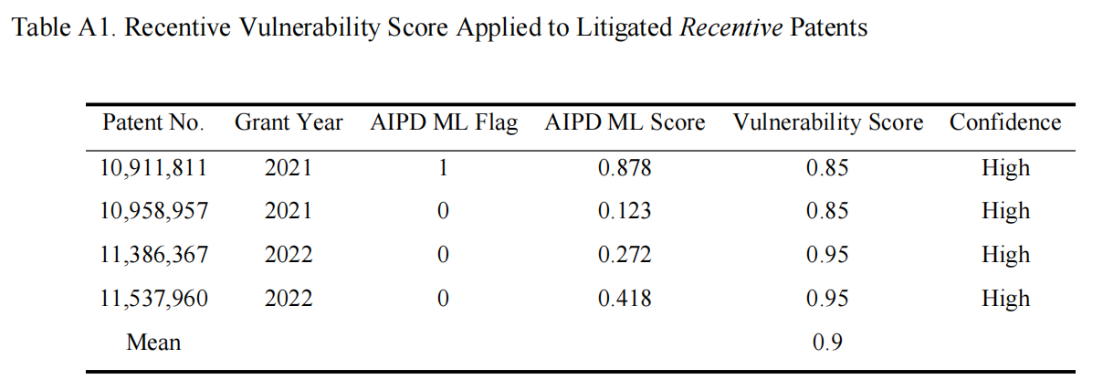
Preliminary Results

Slide 16
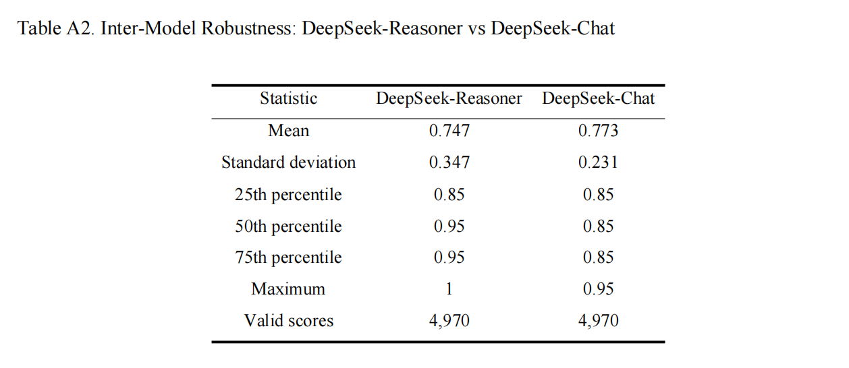
Preliminary Results

Slide 17
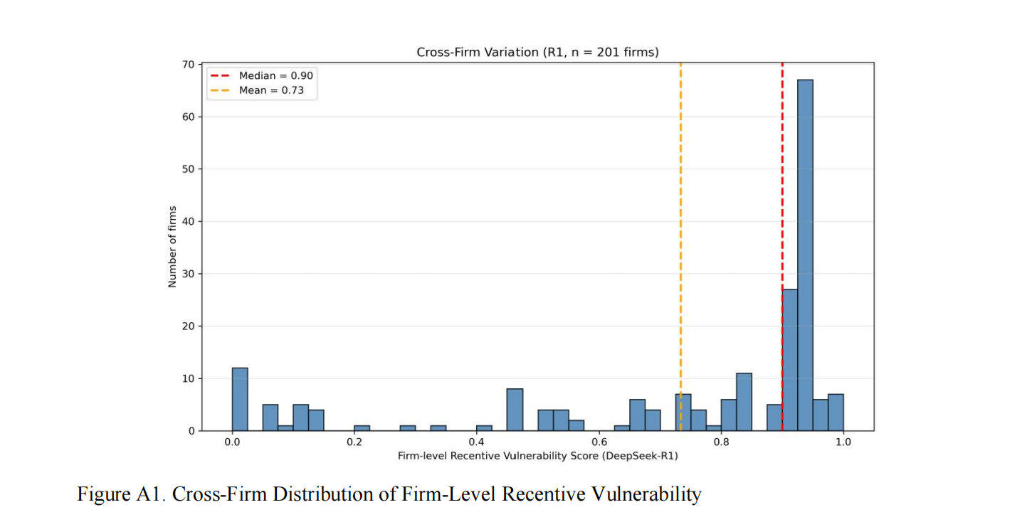
Preliminary Results

Slide 18
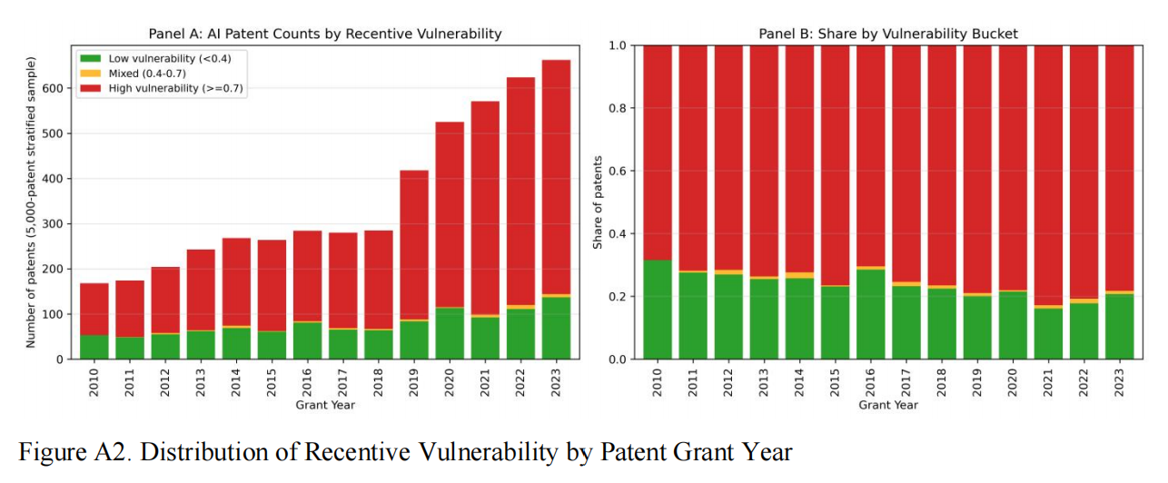
Preliminary Results

Slide 19
Contributions and Takeaways
Recentive turns AI patent enforceability into an observable financing variable.
1
Within-AI legal shock
Uses the applied-ML versus model-improvement boundary rather than a broad software-patent shock.
2
AI-based empirical measurement
Transforms legal doctrine into a scalable LLM-derived vulnerability score over patent claims.
3
Debt contract architecture
Studies spreads jointly with covenants, collateral, maturity, facility size, and monitoring rights.
4
Asset-form channel
Shows how AI knowledge may move from patent-form collateral toward secrecy-form protection.
Main takeaway: AI affects corporate finance not only through productivity or valuation, but through the legal pledgeability of AI knowledge.

