Slide 1
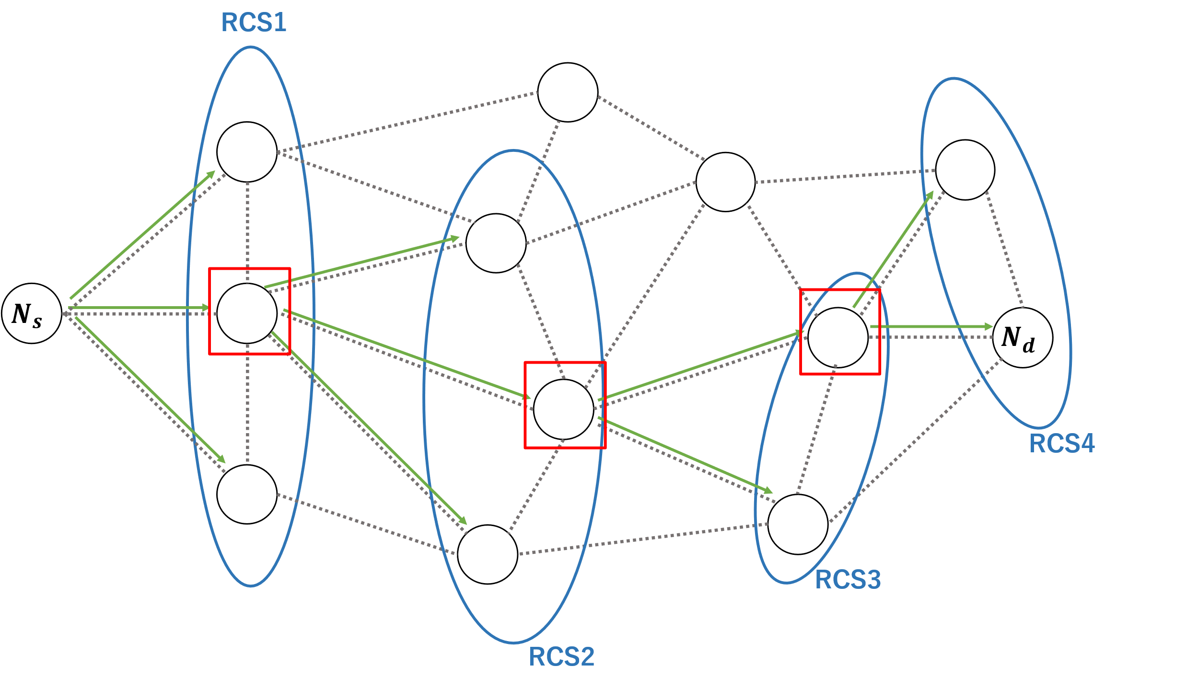
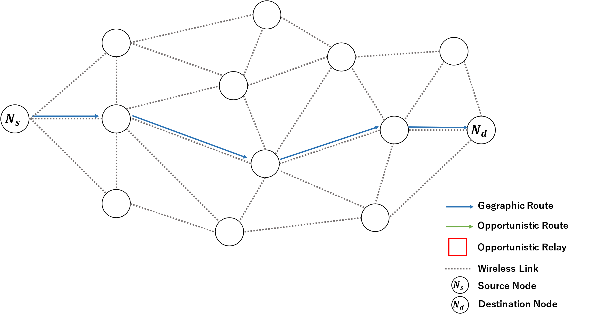
修士論文図2.2

Slide 2










修士論文図2.3 2.4
$$N_{2}$$
再ブロードキャストキャンセル
中継タイマー: 0.04s
$$N_{2}$$
×
$$N_{s}$$
$$N_{1}$$
$$N_{d}$$
中継タイマー: 0s
・・・
$$N_{s}$$
$$N_{1}$$
$$N_{d}$$
$$N_{n}$$
中継タイマー: 0.12s
×
$$N_{n}$$
×
再ブロードキャストキャンセル

Slide 3











修士論文図2.5
$$A$$
$$O$$
$$B$$
Geocast Region
$$P$$
$$Q$$
×
$$X$$
$$Z$$
$$W$$
$$Y$$
Forwarding Region
$$S$$
$$C$$
Network Space

Slide 4






修士論文図2.6
Geocast Region
Center Coordinates
$$Dist_{w}$$
$$Dist_{x}$$
$$Dist_{y}$$
$$W$$
$$Dist_{s}$$
$$X$$
×
$$S$$
$$Y$$
Network Space

Slide 5
修士論文図2.7
D
S
Local optimum
problem 発生

Slide 6



修士論文図2.8
Recovery 成功
$N_{1}$より宛先に近い
$$N_{2}$$
D
S
$$N_{1}$$
Local optimum
problem 発生
Greedy Route
Recovery Route

Slide 7
修士論文図2.9 2.10
z
u
D
y
D
w
x
x
S
Transmission range
Perimeter forwarding
Right-hand rule

Slide 8

修士論文図2.12
D
minangleB
B
A
minangleA
S
$$C_{1}$$
Local optimum problem
交差点ノードが存在する場合のルート
交差点ノードが存在しない場合のルート

Slide 9
修士論文図3.2 3.3 3.4 3.5

Slide 10
修士論文図3.6 3.7

Slide 11














$$Z$$
$$Z$$
$$D$$
$$D$$
$$Y$$
×
×
$$X$$
$$Y$$
$$X$$
$$S$$
$$V$$
$$W$$
$$S$$
$$V$$
$$W$$
Local optimum problem
or
Local shadowing problem
(a)
(b)
Reachable Route
Unreachable Route
D
Destination Node
修士論文図3.9

Slide 12


D
修士論文図4.3
$$r_{1}\left(t\right)$$
$$r_{2}\left(t\right)$$
送信ノード
宛先ノード
交差点ノード
Road segmentの中心座標
Closest road segment
Road segment

Slide 13

修士論文図4.4
D
$$θ_{i}$$
送信ノード
宛先ノード
交差点ノード
Intersection area

Slide 14




修士論文図4.5
D
1
2
$$θ_{i}$$
3
$$X$$
$$Y$$
$$Z$$
送信ノード
宛先ノード
交差点ノード
Intersection area

Slide 15
1 hop
N1
2 hop
Ns
N2
Nd
・・・
Nn

Slide 16

Cancel rebroadcast
$$N_{2}$$
$$N_{2}$$
×
priority2
relay time:0.04s
$$N_{s}$$
priority1
$$N_{1}$$
$$N_{d}$$
$$N_{s}$$
$$N_{1}$$
$$N_{d}$$
relay time:0s
priority3
・・・
$$N_{n}$$
×
$$N_{n}$$
×
relay time:0.12s
Cancel rebroadcast

Slide 17


$$N_{2}$$
再ブロードキャストキャンセル
$$N_{2}$$
×
中継タイマー: 0.04s
$$N_{s}$$
$$N_{1}$$
$$N_{d}$$
$$N_{s}$$
$$N_{1}$$
$$N_{d}$$
中継タイマー: 0s
・・・
$$N_{n}$$
中継タイマー: 0.12s
×
$$N_{n}$$
×
再ブロードキャストキャンセル

Slide 18


RCS1
$$N_{s}$$
$$N_{d}$$
RCS4
RCS3
RCS2

Slide 19







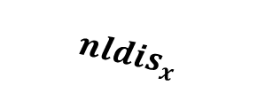





RCS候補
$$z$$
$$P$$
$$cldis$$
$$S$$
$$y$$
$$mndis_{x}$$
$$nldis_{x}$$
$$x$$
$$w$$
$$S$$
: 送信ノード
$$P$$
: 1ホップ前のノード
$$x, y, z$$
: RCSの条件を満たすノード
$$w$$
: RCSの条件を満たさないノード

Slide 20




$$N_{s}$$
$$N_{d}$$
Gegraphic Route
Opportunistic Route
Opportunistic Relay
Wireless Link
$$N_{s}$$
Source Node
$$N_{d}$$
Destination Node

Slide 21
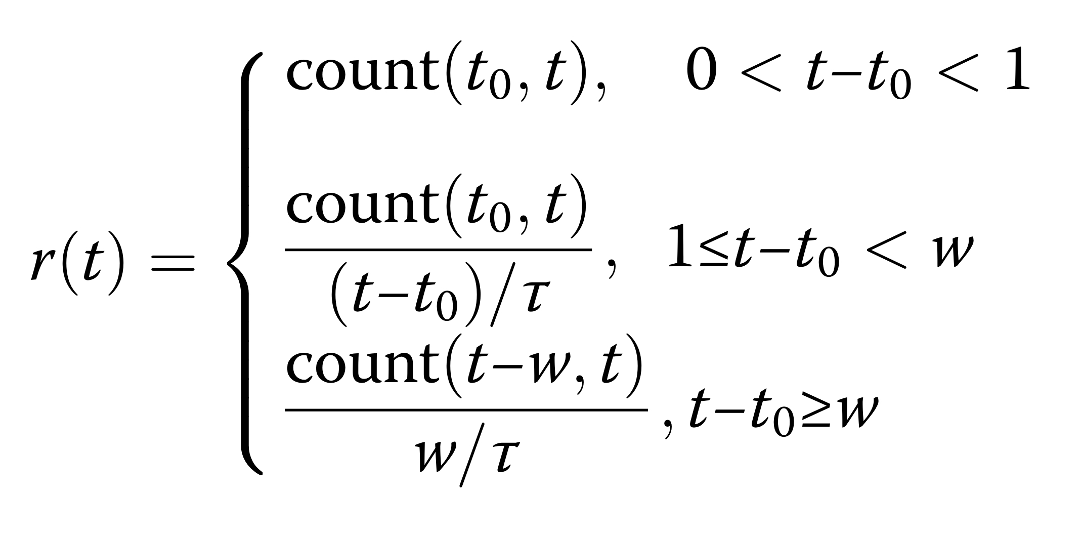

Slide 22
N1
D1d
Dsd
Ns
Nd
D2d
N2
・・・
Nn

Slide 23
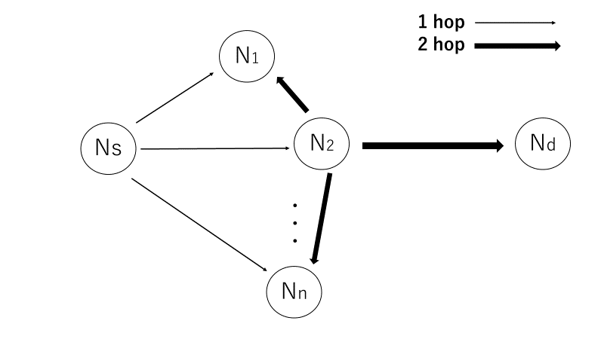
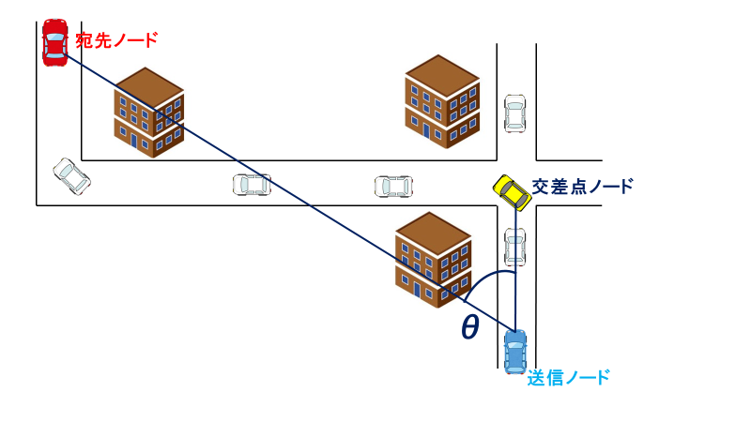

Slide 24


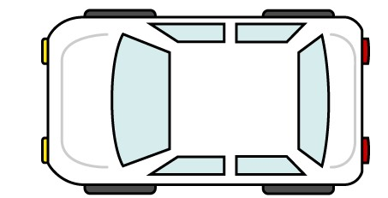


宛先ノード
交差点ノード
θ
送信ノード

Slide 25
Building
4
目的地方向
3
2
交差点ノード
1

Slide 26
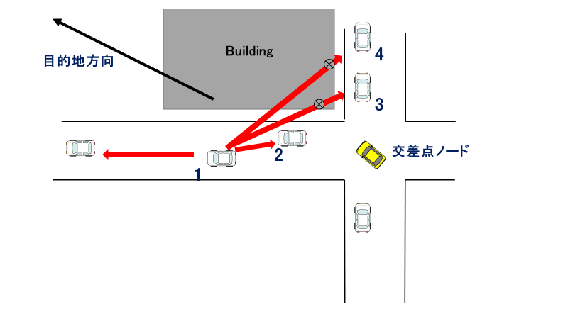

Slide 27
D
３
S
２
１
S

Slide 28
D
３
S
２
１
S

Slide 35

Building Area
Two-way street
300 m
300 m

Slide 36
Building Area
Two-way street
300 m
300 m

Slide 37
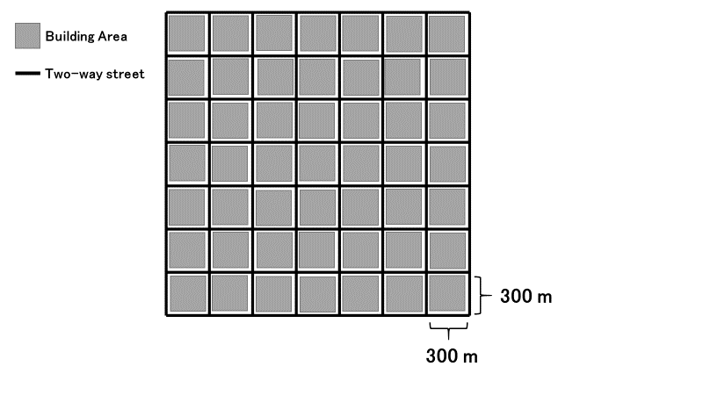
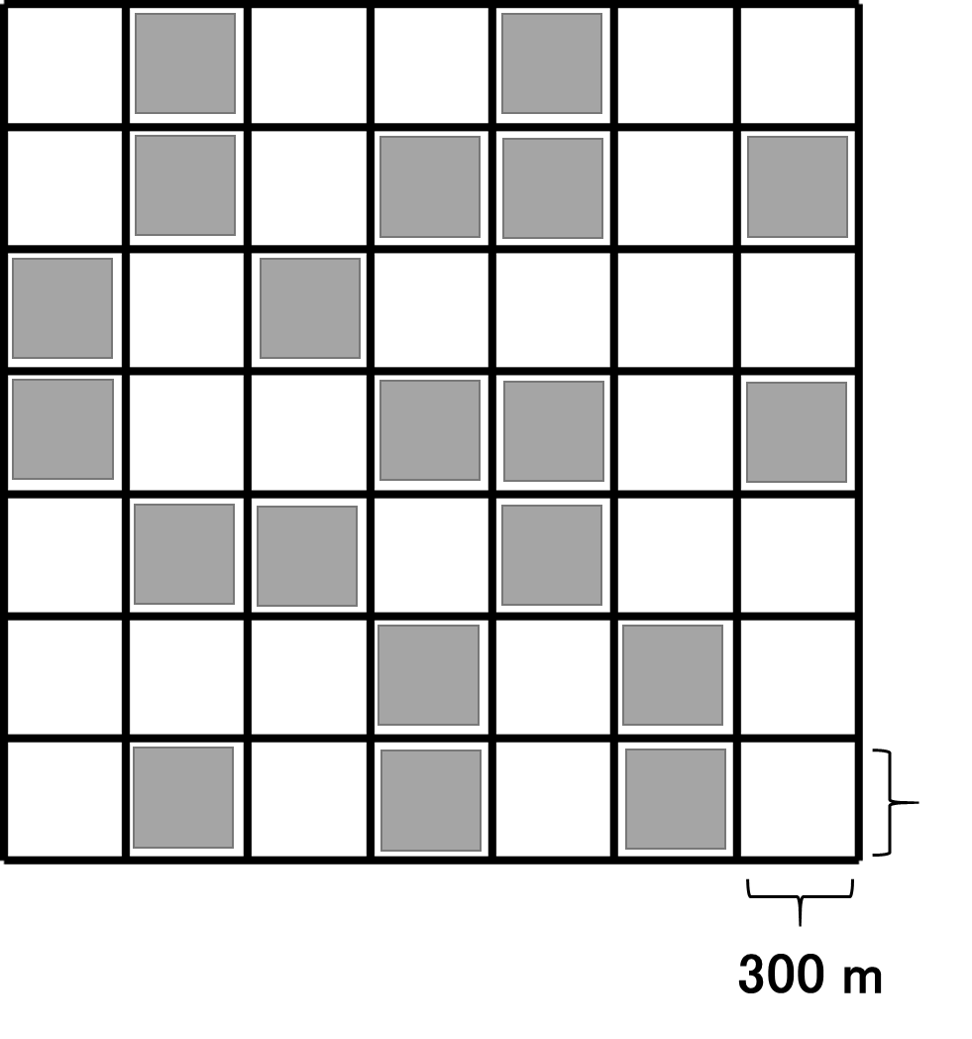

Slide 38
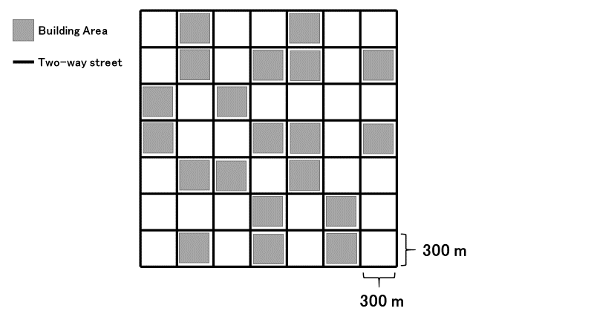

Slide 39
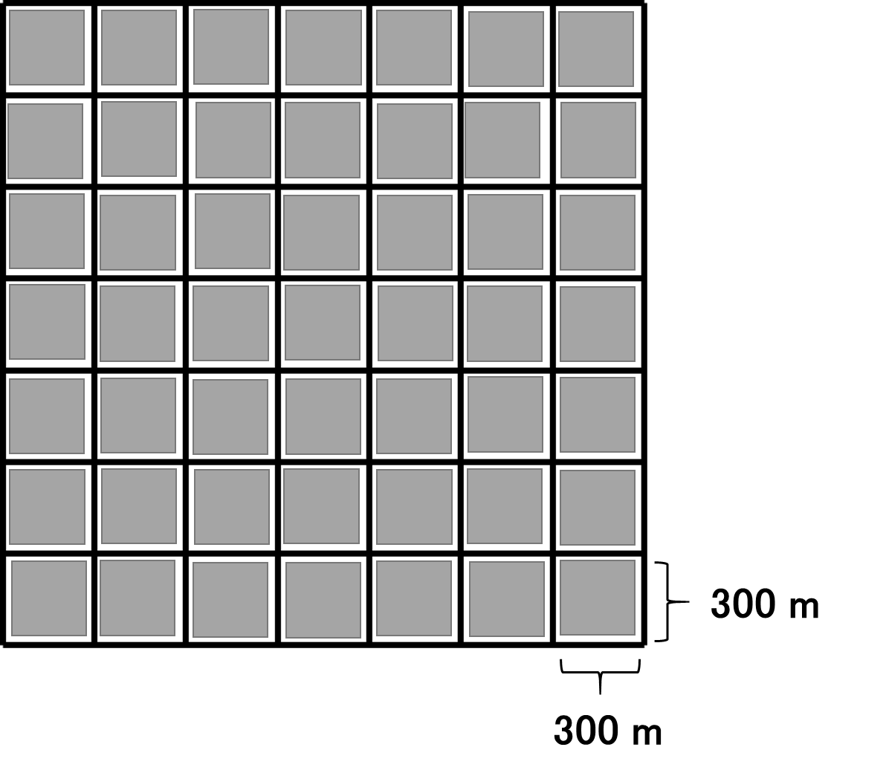
Building Area
Two-way street

Slide 40
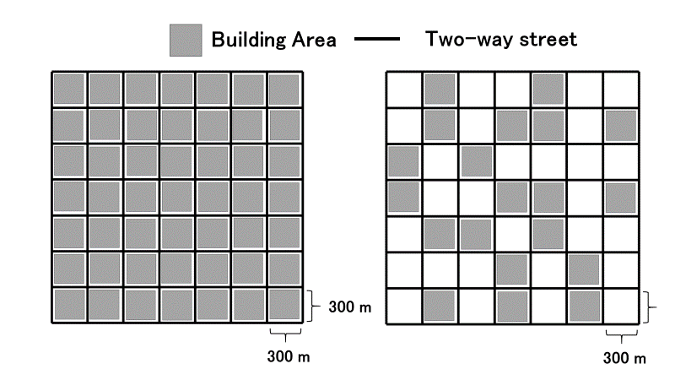

Slide 41
Building
Gray-Zone

Slide 42
宛先ノード
道路の中心座標
θ
交差点車両
Building
送信車両

Slide 43

$$SourceId$$ | $$DstId$$ | $$DstXpos$$ | $$DstYpos$$ | $$ID_{1}$$ | $$ID_{2}$$ | $$ID_{i}$$ | ... | $$ID_{N}$$ | $$Data$$
header
Data packet format
$$ID$$ | $$X$$ | $$Y$$ | $$v$$ | $$a$$ | $$θ$$
Hello packet format

Slide 44


Destination Node
Building
Building
Closest road segment
$$r_{1}\left(t\right)$$
$$r_{2}\left(t\right)$$
Intersection area
Transmitting Node
Road center coordinates

Slide 45
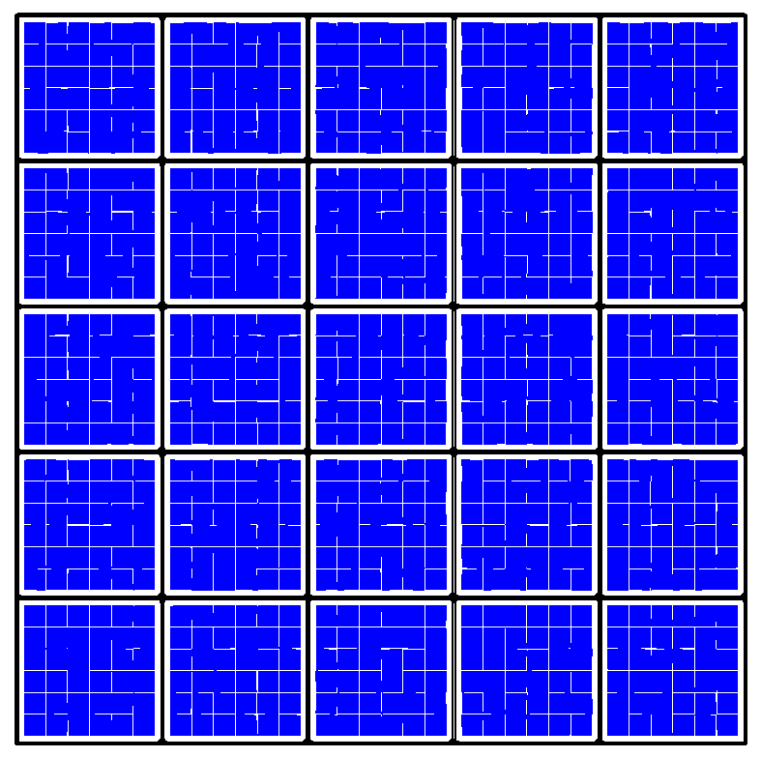
Destination area
Source area

Slide 46

Destination Node
Building
Building
$$θ_{I}$$
Intersection node
Transmitting Node

Slide 47


Slide 48
Inefficient route
no shadowing
shadowing
efficient route
Destination Node
Building
Building
Building
③
③
①
②
Send Node
Building

Slide 49
Destination Node
Destination Node
Building
Building
C
×
×
D
A
A
Building
Building
B
B
(a) unreachable case in LSGO
(b) reachable case

Slide 50
Intersection-based routing
Other routing schemes
Building
Building
Destination Node
Building

Slide 56
Destination direction
Building
Building
1
2
3
Intersection node
4

Slide 57
(a) simulation scenario
(b) packet delivery ratio
(c) overhead

Slide 58


Destination Node
Building
Building
Closest road segment
$$r_{1}\left(t\right)$$
$$r_{2}\left(t\right)$$
送信ノード
Intersection area
中心座標

Slide 59



D
D
minanle2
sdangle
R2
$$r_{1}\left(t\right)$$
minanle1
snangle2
R1
$$r_{2}\left(t\right)$$
$$θ_{I}$$
snangle1
S
Transmitting node
Destination
LSN
Destination
Intersection node
Road center coordinates
PLSN
Relay candidate node
Closest road segment
Road segment
Transmitting node
(a)The closest road segment
(b)Minimum angle method

Slide 60

D
D
minanle2
sdangle
R2
$$r_{1}\left(t\right)$$
minanle1
snangle2
R1
$$r_{2}\left(t\right)$$
$$θ_{i}$$
snangle1
Transmitting node
Destination
LSN
Destination
Intersection node
Road center coordinates
PLSN
Relay candidate node
Closest road segment
Road segment
Transmitting node
(a)The closest road segment
(b)Minimum angle method

Slide 61



D
D
minanle2
sdangle
R2
$$r_{1}\left(t\right)$$
minanle1
snangle2
R1
$$r_{2}\left(t\right)$$
$$θ_{i}$$
snangle1
Transmitting node
Destination
LSN
Destination
Intersection node
Road center coordinates
PLSN
Relay candidate node
Closest road segment
Road segment
Transmitting node
(a)The closest road segment
(b)Minimum angle method

Slide 62
D
minanle2
sdangle
R2
minanle1
snangle2
R1
snangle1
LSN
Destination
PLSN
送信ノード
RCSの条件を満たすノード

Slide 63
D
1
×
×
3
S
2

Slide 64




D
$$y$$
$$x$$
$$C_{1}$$
S
Local optimum
problem 発生
最小角度法により$xを$選択する
Greedy Route
Recovery Route

Slide 65
Geocast Region
Center Coordinates
$$S$$
Network Space
SIGO forwarding
Flooding
RCS

Slide 66
D
minanleB
B
A
minanleA
S
$$C_{1}$$
最小角度法を用いて中継ノードを決定
同一の道路内ではGreedy fowarding
交差点ノードが存在する場合のルート
交差点ノードが存在しない場合のルート

Slide 67





D
minanleB
B
A
minanleA
$${mndis}_{3}$$
$$N_{4}$$
$$N_{1}$$
LSN
$$N_{3}$$
$$N_{2}$$
式4.7 が適応される範囲

Slide 68
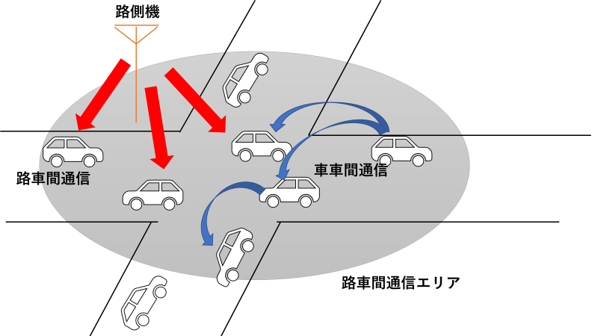

Slide 69
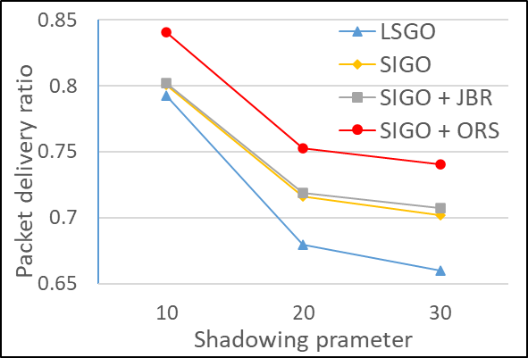
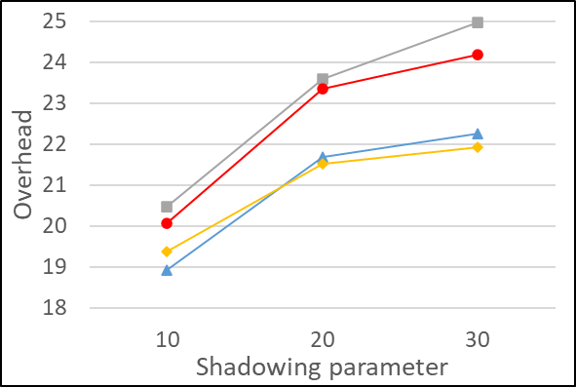
(a) simulation scenario
(b) packet delivery ratio
(c) overhead

Slide 70
(a) simulation scenario
(b) packet delivery ratio
(c) overhead

Slide 71
D
minanle2
sdangle
R2
minanle1
snangle2
R1
snangle1
S
Local source node
Destination
Previous local source node
Relay candidate node
(b)Minimum angle method

Slide 72
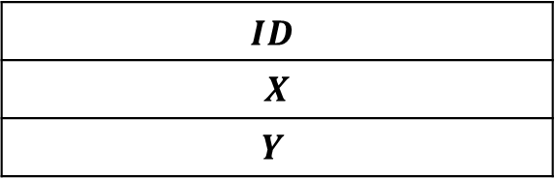
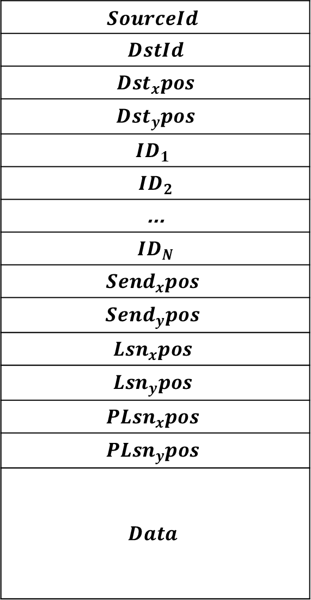
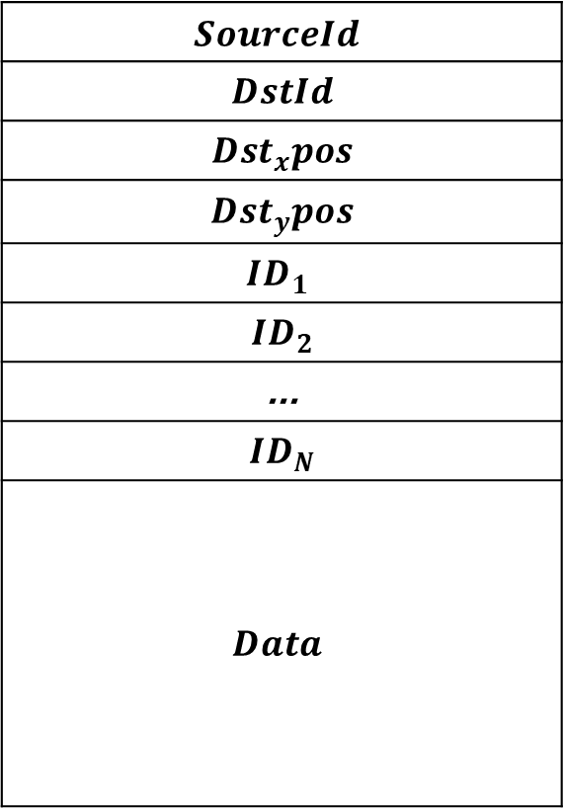
$$SourceId$$
$$DstId$$
$$Dst_{x}pos$$
$$Dst_{y}pos$$
$$ID_{1}$$
$$ID_{2}$$
$$\text{...}$$
$$ID_{N}$$
$$Data$$
$$SourceId$$
$$DstId$$
$$Dst_{x}pos$$
$$Dst_{y}pos$$
$$ID_{1}$$
$$ID_{2}$$
$$\text{...}$$
$$ID_{N}$$
$${Send}_{x}pos$$
$${Send}_{y}pos$$
$$Lsn_{x}pos$$
$$Lsn_{y}pos$$
$$PLsn_{x}pos$$
$$PLsn_{y}pos$$
$$Data$$
$$ID$$
$$X$$
$$Y$$

