Slide 1
1 hop
N1
2 hop
Ns
N2
Nd
・・・
Nn

Slide 2










Cancel rebroadcast
$$N_{2}$$
$$N_{2}$$
×
priority2
relay time:0.04s
$$N_{s}$$
priority1
$$N_{1}$$
$$N_{d}$$
$$N_{s}$$
$$N_{1}$$
$$N_{d}$$
relay time:0s
priority3
・・・
$$N_{n}$$
×
$$N_{n}$$
×
relay time:0.12s
Cancel rebroadcast

Slide 3
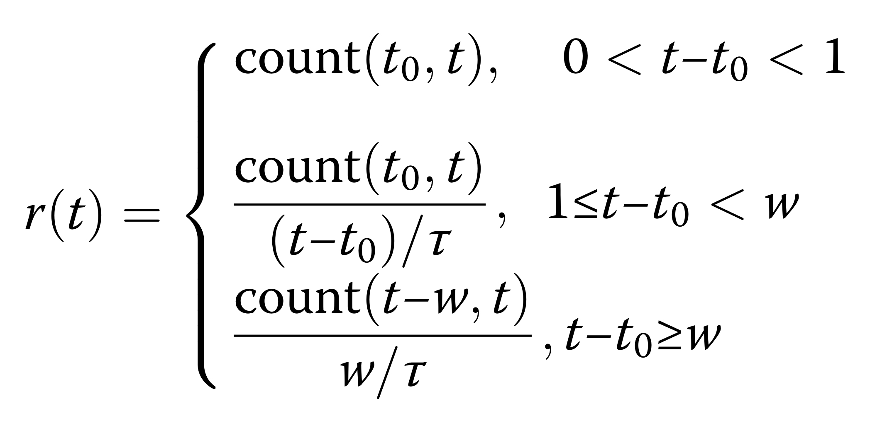

Slide 4
N1
D1d
Dsd
Ns
Nd
D2d
N2
・・・
Nn

Slide 5
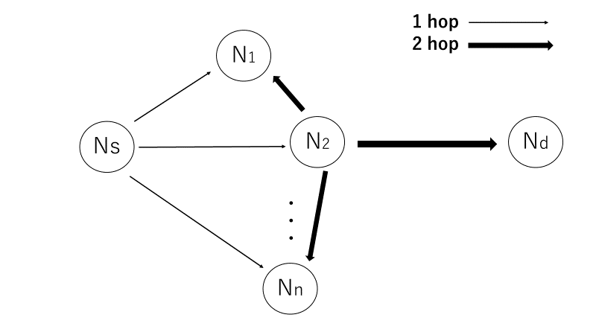
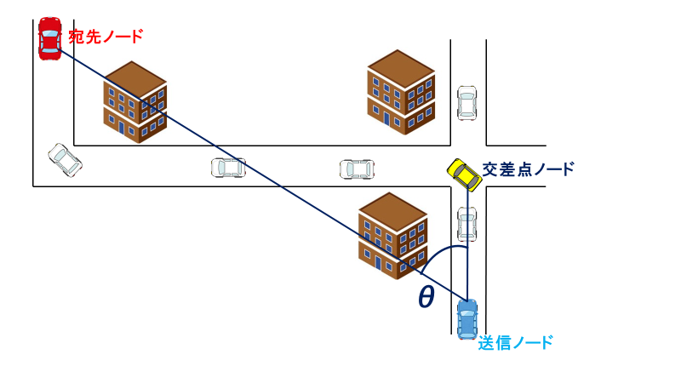

Slide 6


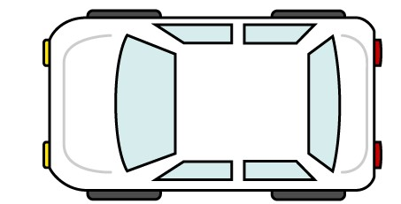


宛先ノード
交差点ノード
θ
送信ノード

Slide 7
Building
4
目的地方向
3
2
交差点ノード
1

Slide 8
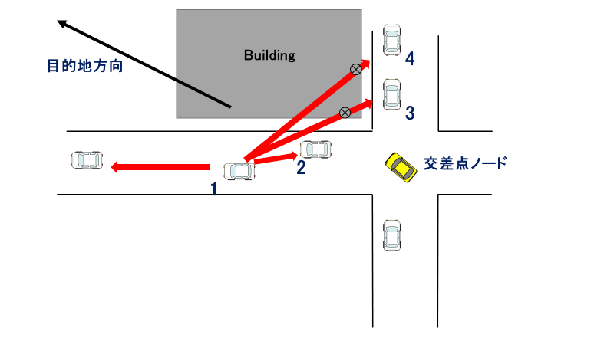

Slide 9
D
３
S
２
１
S

Slide 10
D
３
S
２
１
S

Slide 17

Building Area
Two-way street
300 m
300 m

Slide 18
Building Area
Two-way street
300 m
300 m

Slide 19
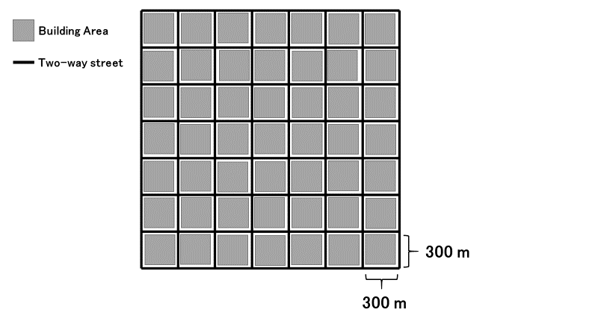
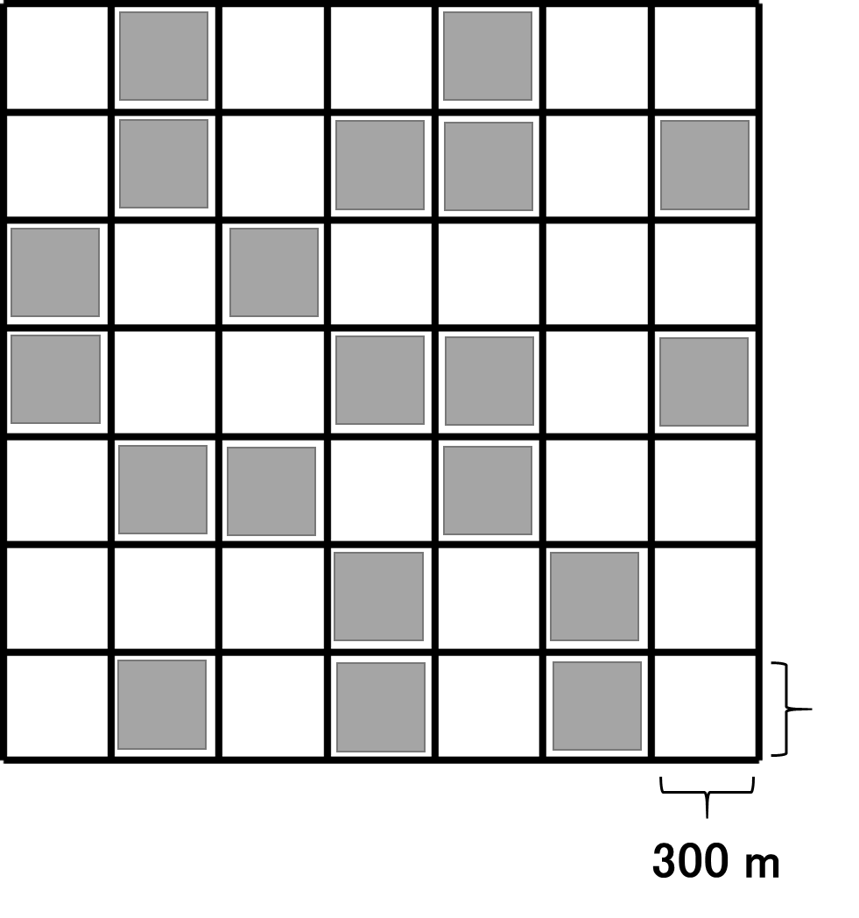

Slide 20
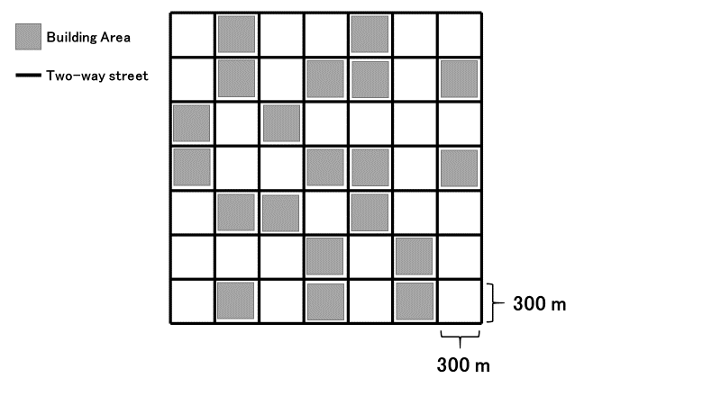

Slide 21
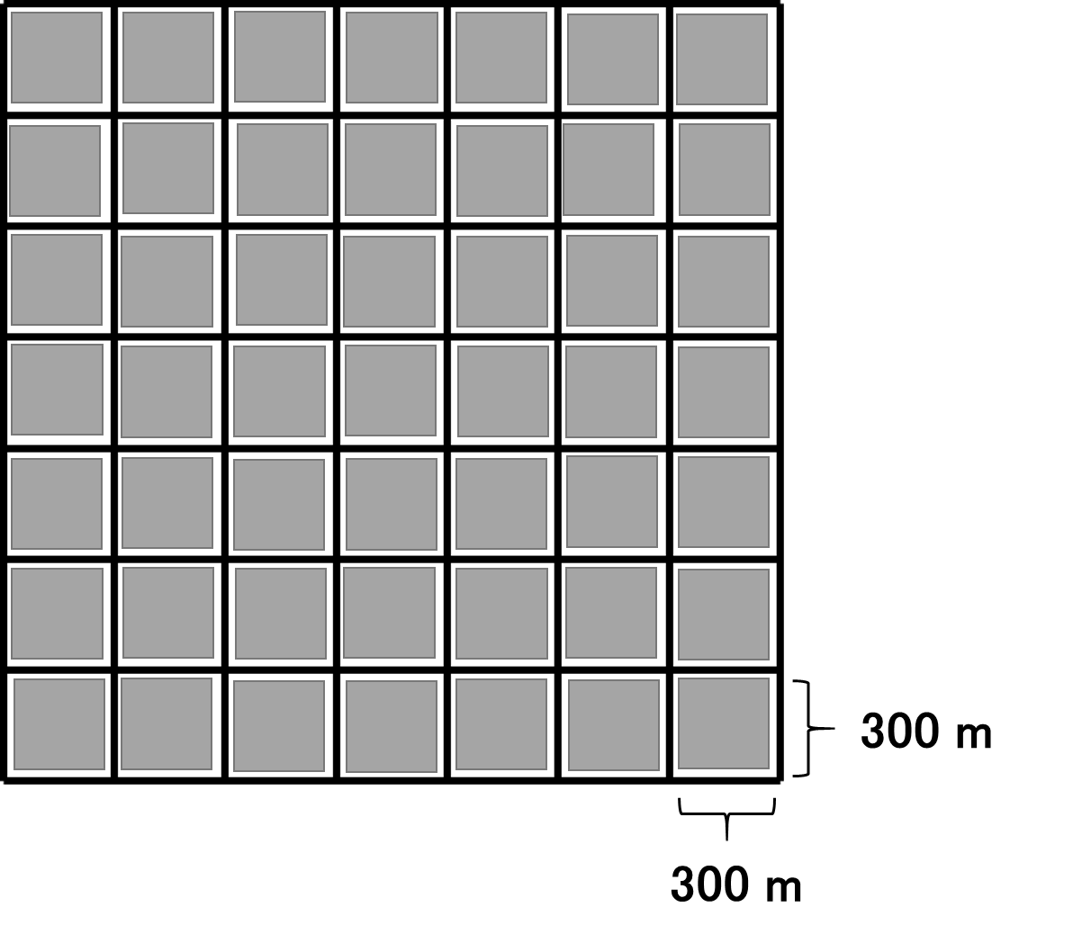
Building Area
Two-way street

Slide 22
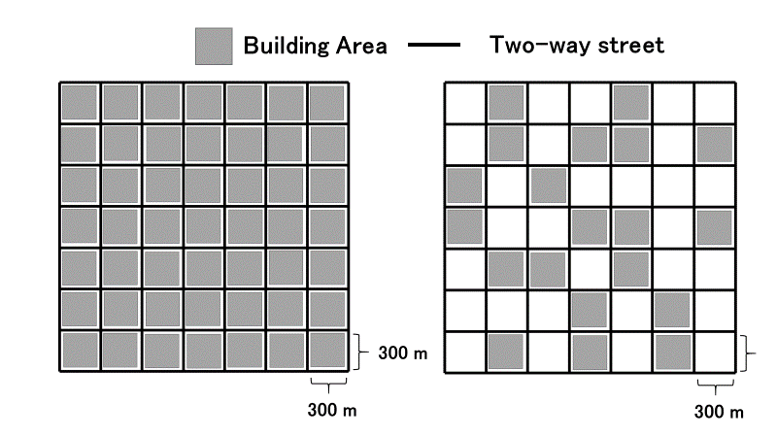

Slide 23
Building
Gray-Zone

Slide 24
宛先ノード
道路の中心座標
θ
交差点車両
Building
送信車両

Slide 25

$$SourceId$$ | $$DstId$$ | $$DstXpos$$ | $$DstYpos$$ | $$ID_{1}$$ | $$ID_{2}$$ | $$ID_{i}$$ | ... | $$ID_{N}$$ | $$Data$$
header
Data packet format
$$ID$$ | $$X$$ | $$Y$$ | $$v$$ | $$a$$ | $$θ$$
Hello packet format

Slide 26


Destination Node
Building
Building
Closest road segment
$$r_{1}\left(t\right)$$
$$r_{2}\left(t\right)$$
Intersection area
Transmitting Node
Road center coordinates

Slide 27
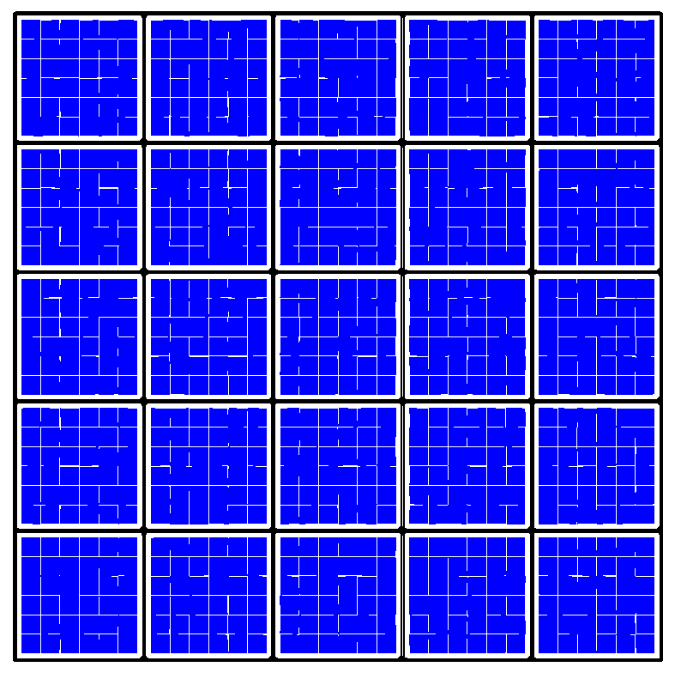
Destination area
Source area

Slide 28

Destination Node
Building
Building
$$θ_{I}$$
Intersection node
Transmitting Node

Slide 29


Slide 30
Inefficient route
no shadowing
shadowing
efficient route
Destination Node
Building
Building
Building
③
③
①
②
Send Node
Building

Slide 31
Destination Node
Destination Node
Building
Building
C
×
×
D
A
A
Building
Building
B
B
(a) unreachable case in LSGO
(b) reachable case

Slide 32
Intersection-based routing
Other routing schemes
Building
Building
Destination Node
Building

Slide 38
Destination direction
Building
Building
1
2
3
Intersection node
4

Slide 39
(a) simulation scenario
(b) packet delivery ratio
(c) overhead

Slide 40


Destination Node
Building
Building
Closest road segment
$$r_{1}\left(t\right)$$
$$r_{2}\left(t\right)$$
Transmitting Node
Intersection area
Road center coordinates

Slide 41



D
D
minanle2
sdangle
R2
$$r_{1}\left(t\right)$$
minanle1
snangle2
R1
$$r_{2}\left(t\right)$$
$$θ_{I}$$
snangle1
S
Transmitting node
Destination
LSN
Destination
Intersection node
Road center coordinates
PLSN
Relay candidate node
Closest road segment
Road segment
Transmitting node
(a)The closest road segment
(b)Minimum angle method

Slide 42

D
D
minanle2
sdangle
R2
$$r_{1}\left(t\right)$$
minanle1
snangle2
R1
$$r_{2}\left(t\right)$$
$$θ_{i}$$
snangle1
Transmitting node
Destination
LSN
Destination
Intersection node
Road center coordinates
PLSN
Relay candidate node
Closest road segment
Road segment
Transmitting node
(a)The closest road segment
(b)Minimum angle method

Slide 43
D
D
minanle2
sdangle
R2
$$r_{1}\left(t\right)$$
minanle1
snangle2
R1
$$r_{2}\left(t\right)$$
$$θ_{i}$$
snangle1
Transmitting node
Destination
LSN
Destination
Intersection node
Road center coordinates
PLSN
Relay candidate node
Closest road segment
Road segment
Transmitting node
(a)The closest road segment
(b)Minimum angle method

Slide 44
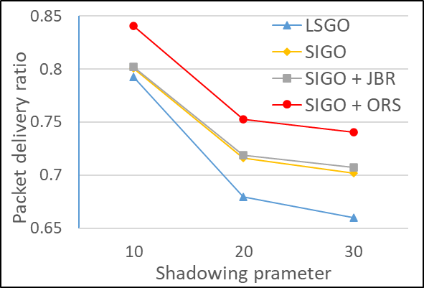
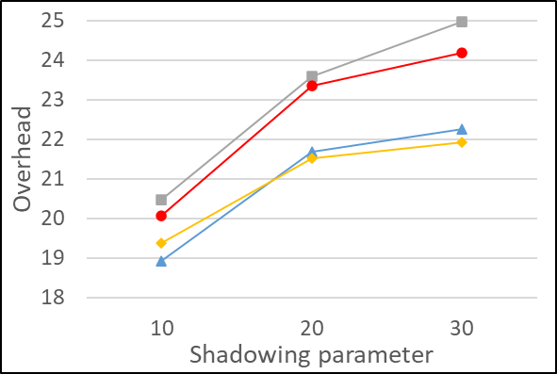
(a) simulation scenario
(b) packet delivery ratio
(c) overhead

Slide 45
(a) simulation scenario
(b) packet delivery ratio
(c) overhead

Slide 46
D
minanle2
sdangle
R2
minanle1
snangle2
R1
snangle1
S
Local source node
Destination
Previous local source node
Relay candidate node
(b)Minimum angle method

Slide 47
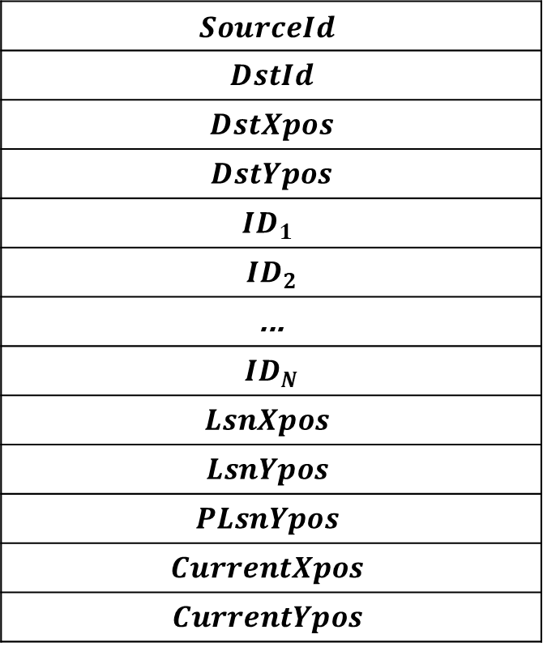
$$SourceId$$
$$DstId$$
$$DstXpos$$
$$DstYpos$$
$$ID_{1}$$
$$ID_{2}$$
$$\text{...}$$
$$ID_{N}$$
$$LsnXpos$$
$$LsnYpos$$
$$PLsnYpos$$
$$CurrentXpos$$
$$CurrentYpos$$

