Slide 1
1 hop
N1
2 hop
Ns
N2
Nd
・・・
Nn

Slide 2










Cancel rebroadcast
$$N_{2}$$
$$N_{2}$$
×
priority2
relay time:0.04s
$$N_{s}$$
priority1
$$N_{1}$$
$$N_{d}$$
$$N_{s}$$
$$N_{1}$$
$$N_{d}$$
relay time:0s
priority3
・・・
$$N_{n}$$
×
$$N_{n}$$
×
relay time:0.12s
Cancel rebroadcast

Slide 3
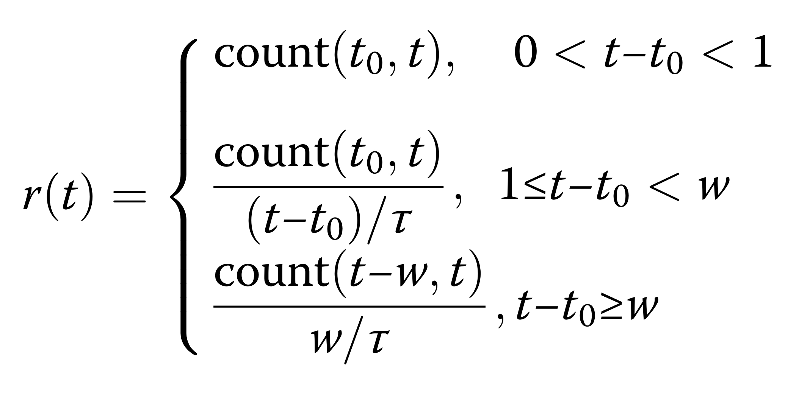

Slide 4
N1
D1d
Dsd
Ns
Nd
D2d
N2
・・・
Nn

Slide 5
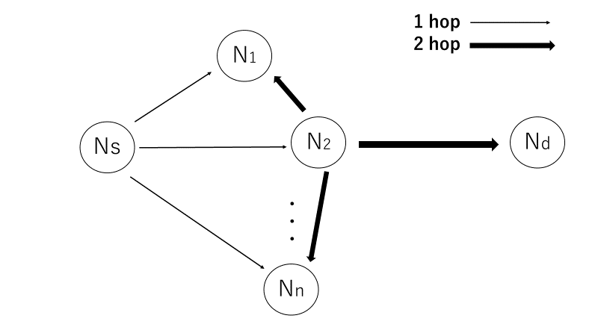
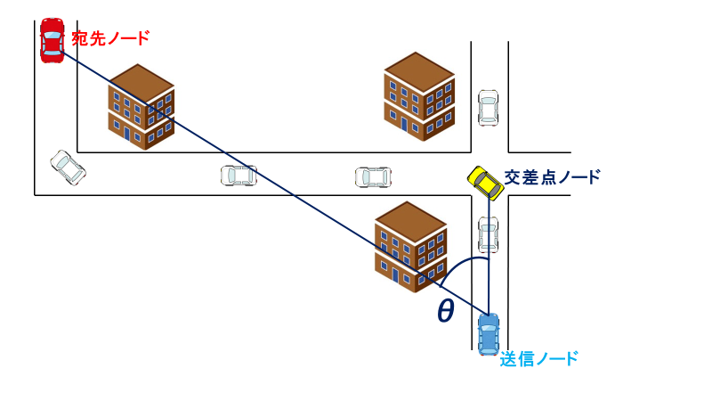

Slide 6


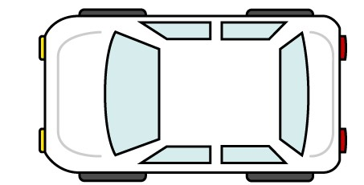


宛先ノード
交差点ノード
θ
送信ノード

Slide 7
Building
4
目的地方向
3
2
交差点ノード
1

Slide 8
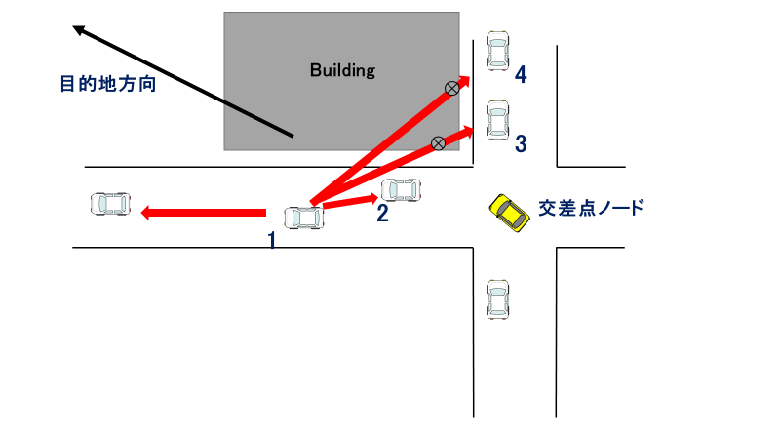

Slide 9
D
３
S
２
１
S

Slide 10
D
３
S
２
１
S

Slide 17

Building Area
Two-way street
300 m
300 m

Slide 18
Building Area
Two-way street
300 m
300 m

Slide 19
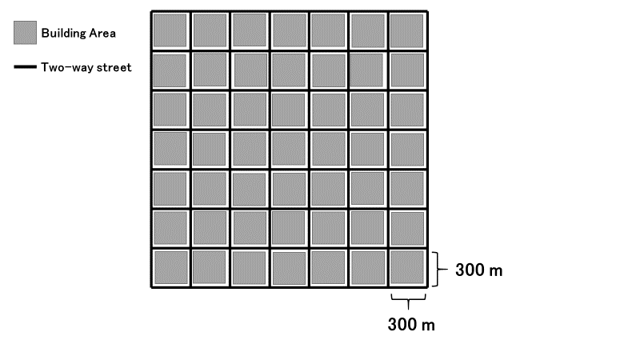
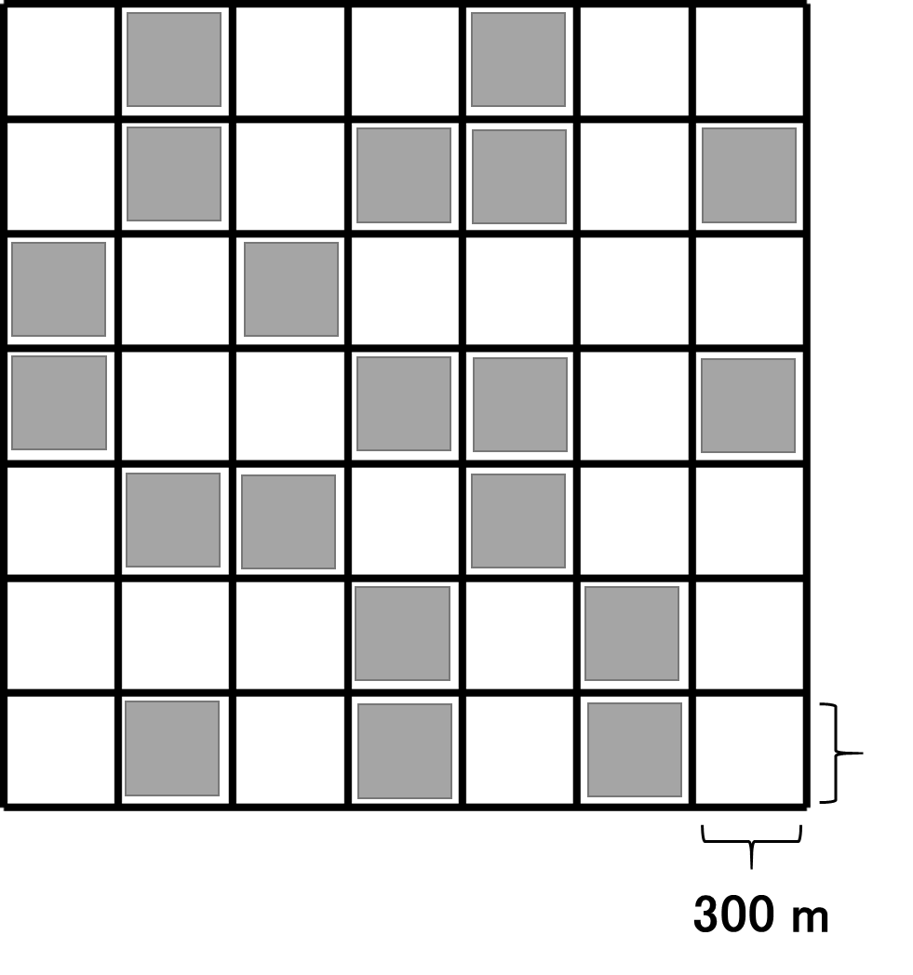

Slide 20
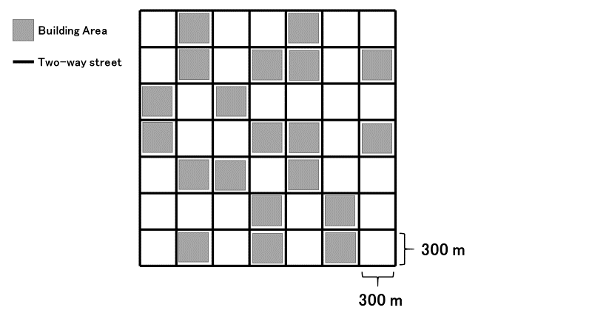

Slide 21
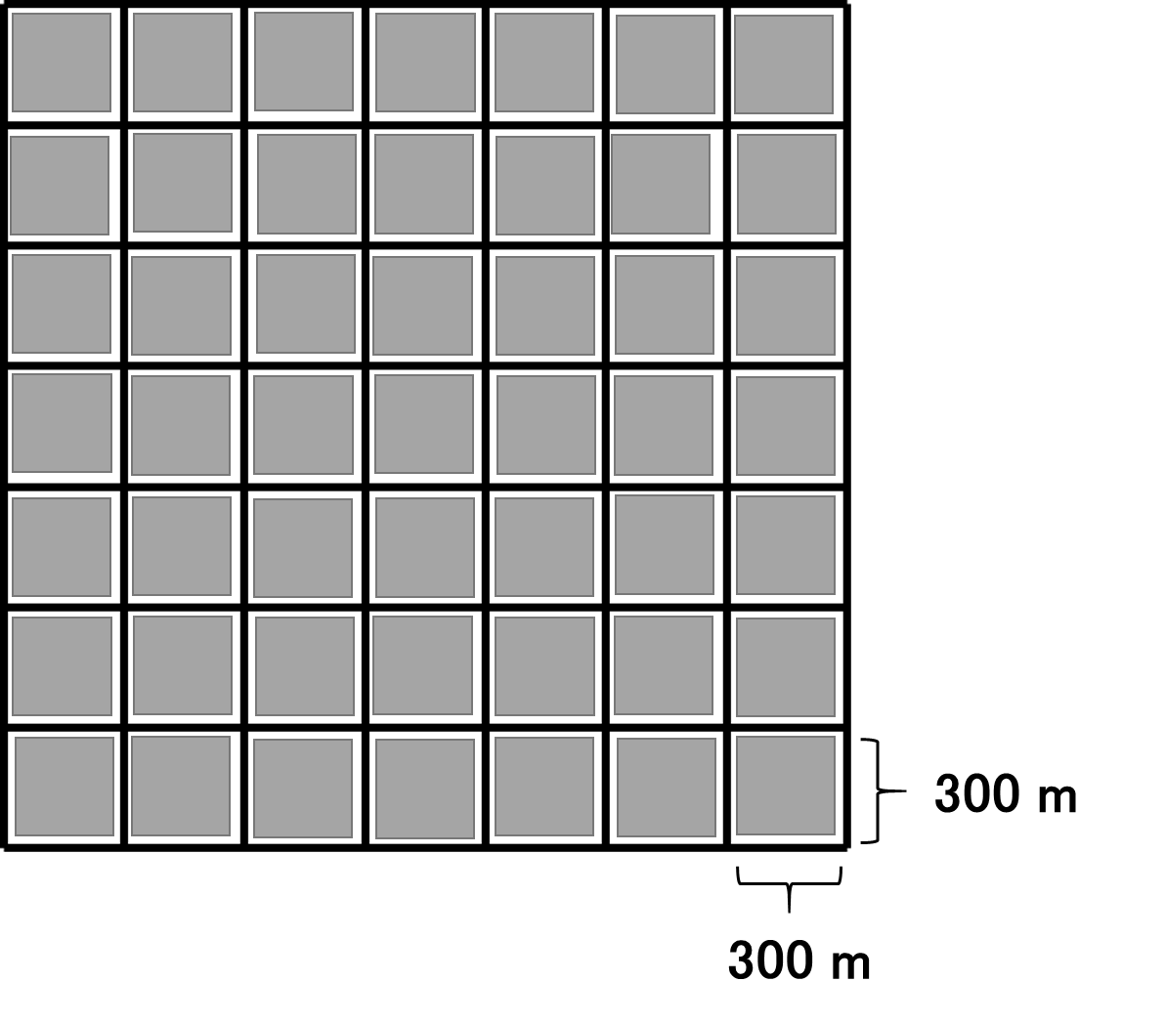
Building Area
Two-way street

Slide 22
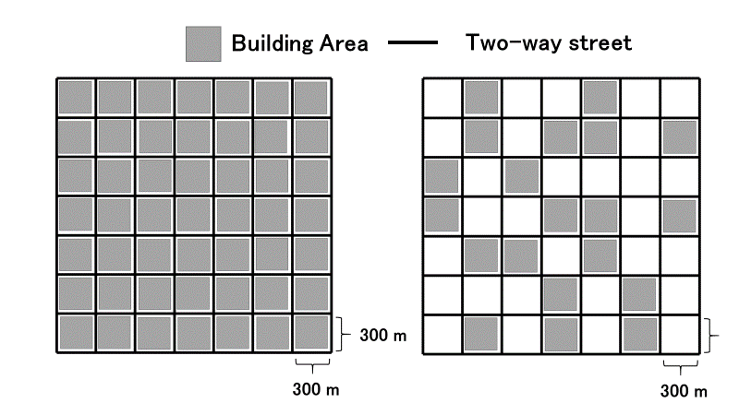

Slide 23
Building
Gray-Zone

Slide 24
宛先ノード
道路の中心座標
θ
交差点車両
Building
送信車両

Slide 25

$$SourceId$$ | $$DstId$$ | $$DstXpos$$ | $$DstYpos$$ | $$ID_{1}$$ | $$ID_{2}$$ | $$ID_{i}$$ | ... | $$ID_{N}$$ | $$Data$$
header
Data packet format
$$ID$$ | $$X$$ | $$Y$$ | $$v$$ | $$a$$ | $$θ$$
Hello packet format

Slide 26


Destination Node
Building
Building
Closest road segment
$$r_{1}\left(t\right)$$
$$r_{2}\left(t\right)$$
Intersection area
Transmitting Node
Road center coordinates

Slide 27



Destination Node
Building
Building
$$r_{1}\left(t\right)$$
Road center coordinates
Closest road segment
$$r_{2}\left(t\right)$$
$$θ_{I}$$
Transmitting Node
Intersection area

Slide 28
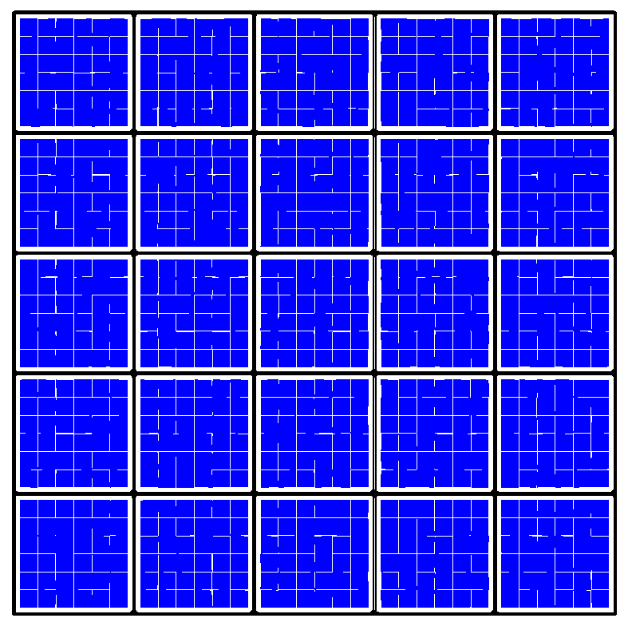
Destination area
Source area

Slide 29

Destination Node
Building
Building
$$θ_{I}$$
Intersection node
Transmitting Node

Slide 30

Destination Node
Building
Building
$$θ_{I}$$
Intersection node
Transmitting Node

Slide 31


Slide 32
Inefficient route
no shadowing
shadowing
efficient route
Destination Node
Building
Building
Building
③
③
①
②
Send Node
Building

Slide 33
Destination Node
Destination Node
Building
Building
C
×
×
D
A
A
Building
Building
B
B
(a) unreachable case in LSGO
(b) reachable case

Slide 34
Intersection-based routing
Other routing schemes
Building
Building
Destination Node
Building

Slide 40
Destination direction
Building
Building
1
2
3
Intersection node
4

Slide 41
Building
Building
Destination direction
1
2
3
Intersection node
4

Slide 42
(a) simulation scenario
(b) packet delivery ratio
(c) overhead

