Slide 1
1 hop
N1
2 hop
Ns
N2
Nd
・・・
Nn

Slide 2










Cancel rebroadcast
$$N_{2}$$
$$N_{2}$$
×
priority2
relay time:0.04s
$$N_{s}$$
priority1
$$N_{1}$$
$$N_{d}$$
$$N_{s}$$
$$N_{1}$$
$$N_{d}$$
relay time:0s
priority3
・・・
$$N_{n}$$
×
$$N_{n}$$
×
relay time:0.12s
Cancel rebroadcast

Slide 3

$$N_{2}$$
再ブロードキャストキャンセル
中継タイマー: 0.04s
$$N_{2}$$
×
$$N_{s}$$
$$N_{1}$$
$$N_{d}$$
中継タイマー: 0s
・・・
$$N_{s}$$
$$N_{1}$$
$$N_{d}$$
$$N_{n}$$
中継タイマー: 0.12s
×
$$N_{n}$$
×
再ブロードキャストキャンセル

Slide 4


$$N_{2}$$
再ブロードキャストキャンセル
$$N_{2}$$
×
中継タイマー: 0.04s
$$N_{s}$$
$$N_{1}$$
$$N_{d}$$
$$N_{s}$$
$$N_{1}$$
$$N_{d}$$
中継タイマー: 0s
・・・
$$N_{n}$$
中継タイマー: 0.12s
×
$$N_{n}$$
×
再ブロードキャストキャンセル

Slide 5


RCS1
$$N_{s}$$
$$N_{d}$$
RCS4
RCS3
RCS2

Slide 6




$$N_{s}$$
$$N_{d}$$
Gegraphic Route
Opportunistic Route
Opportunistic Relay
Wireless Link
$$N_{s}$$
Source Node
$$N_{d}$$
Destination Node

Slide 7
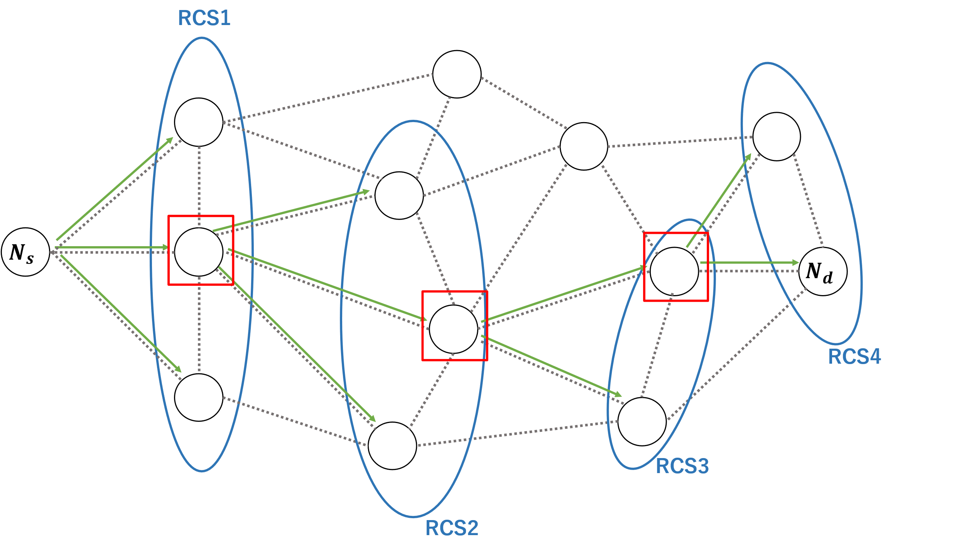
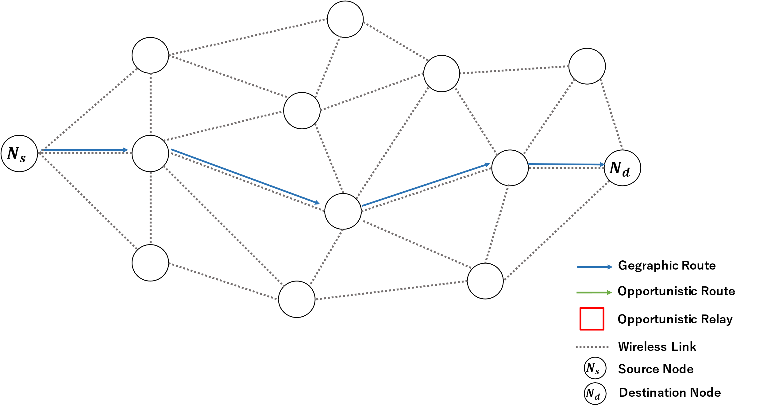

Slide 8
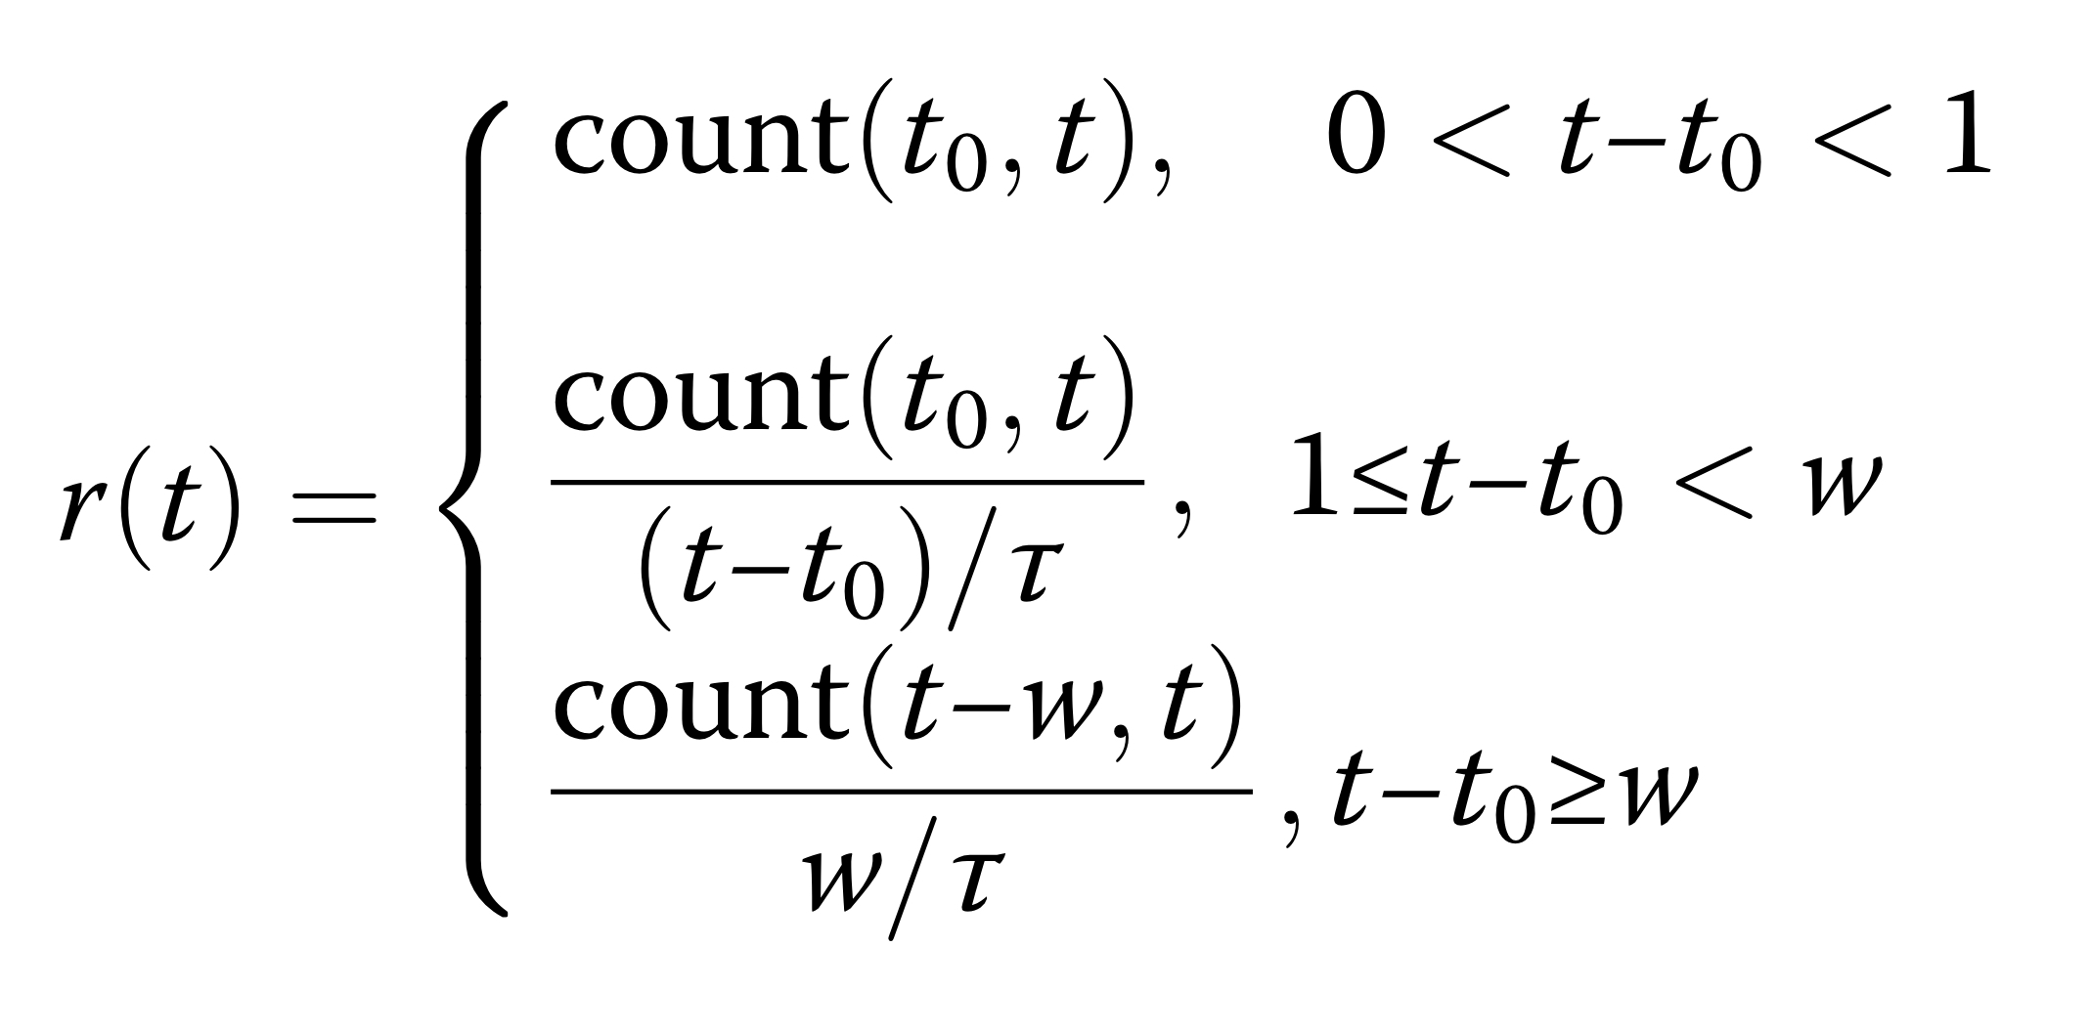

Slide 9
N1
D1d
Dsd
Ns
Nd
D2d
N2
・・・
Nn

Slide 10
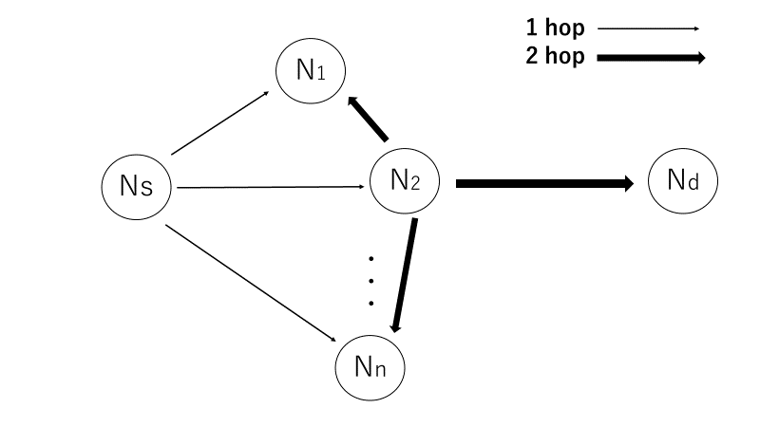
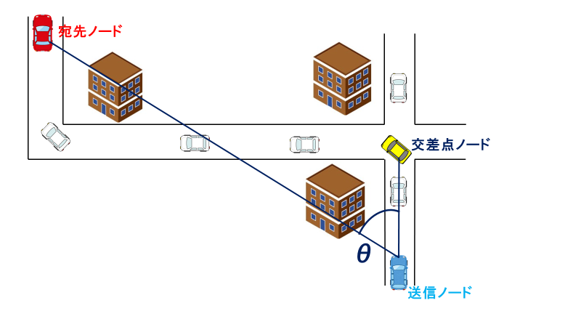

Slide 11


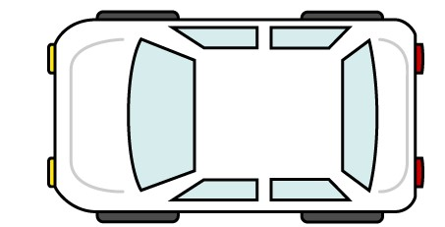


宛先ノード
交差点ノード
θ
送信ノード

Slide 12
Building
4
目的地方向
3
2
交差点ノード
1

Slide 13
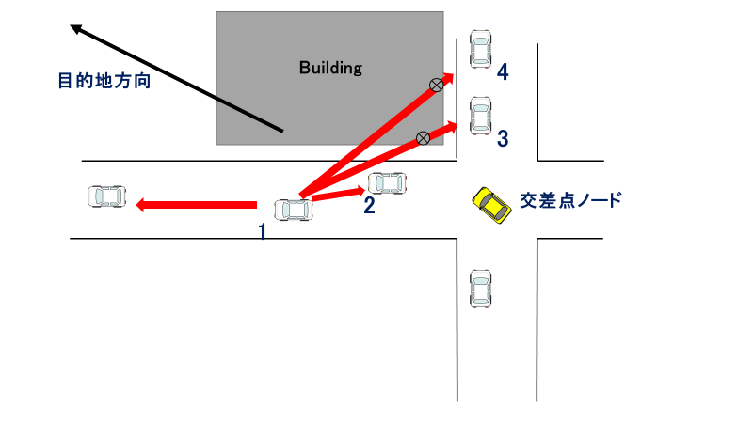

Slide 14
D
３
S
２
１
S

Slide 15
D
３
S
２
１
S

Slide 22

Building Area
Two-way street
300 m
300 m

Slide 23
Building Area
Two-way street
300 m
300 m

Slide 24
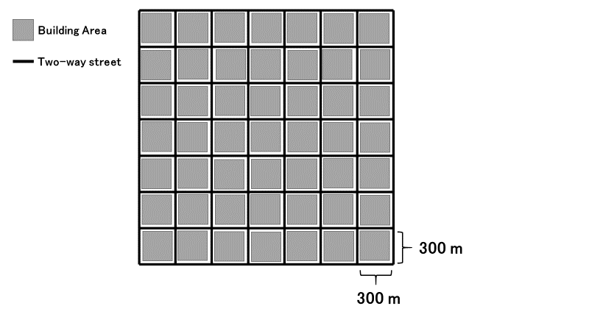
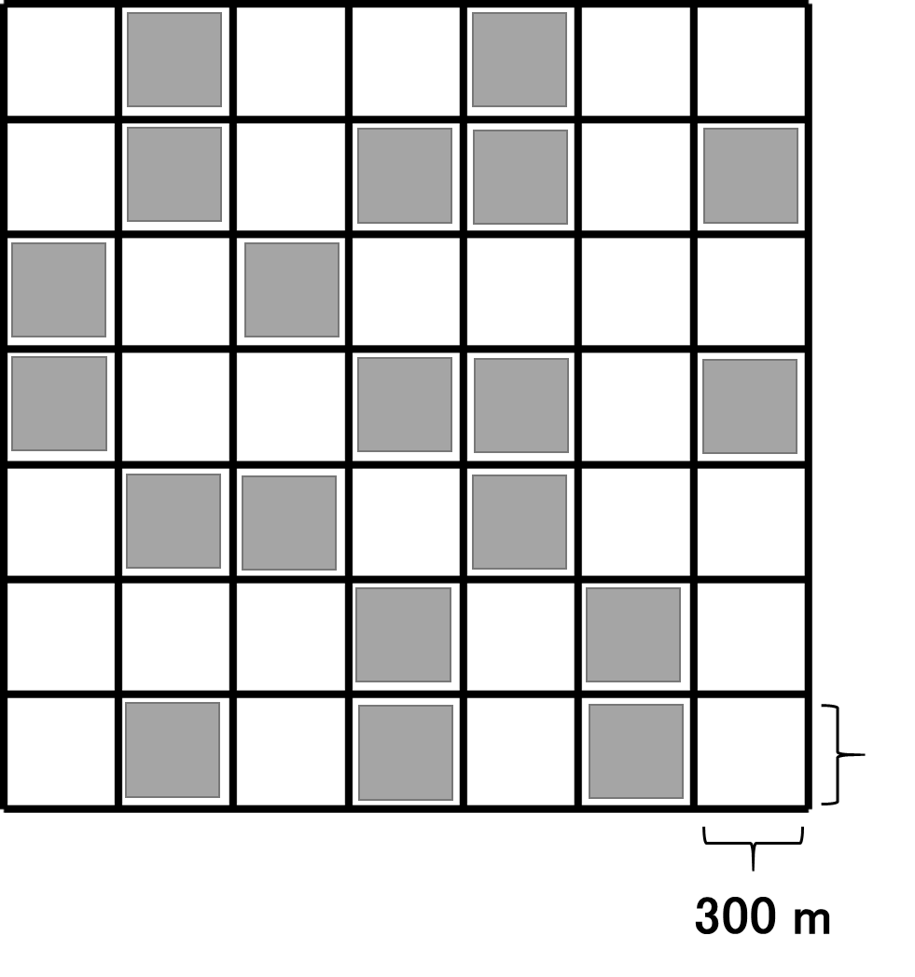

Slide 25
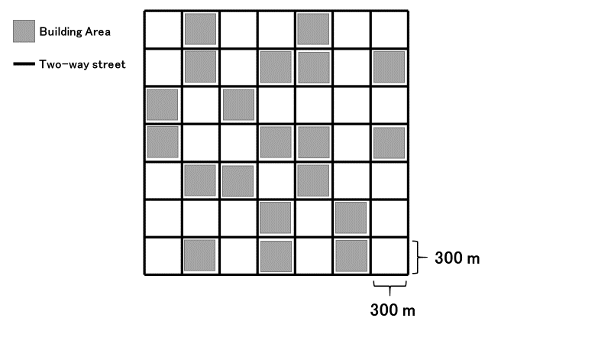

Slide 26
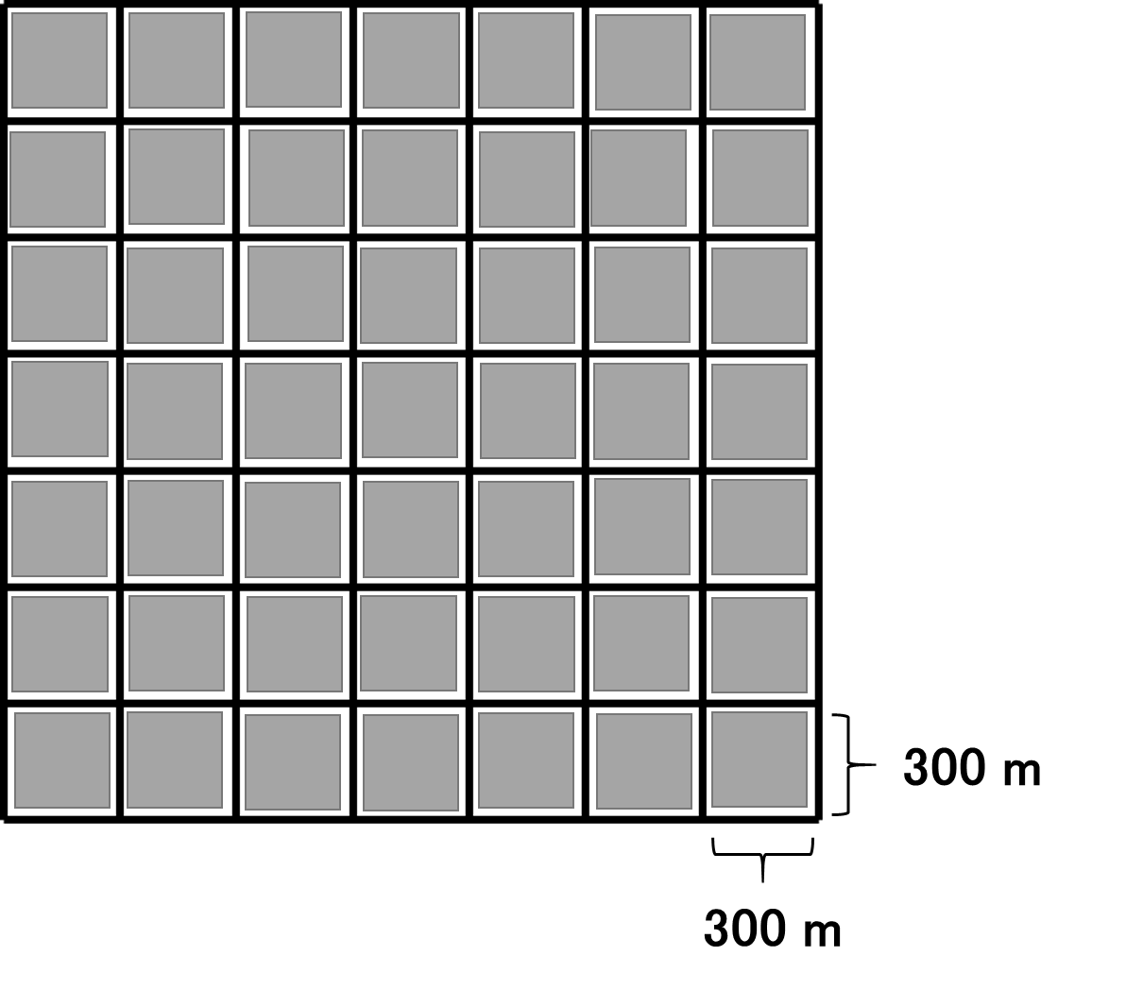
Building Area
Two-way street

Slide 27
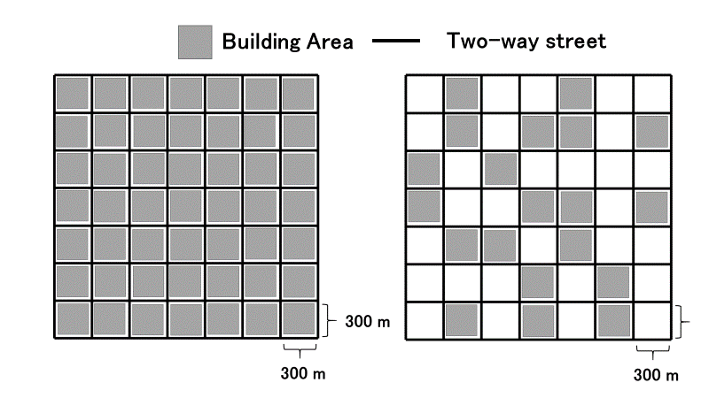

Slide 28
Building
Gray-Zone

Slide 29
宛先ノード
道路の中心座標
θ
交差点車両
Building
送信車両

Slide 30

$$SourceId$$ | $$DstId$$ | $$DstXpos$$ | $$DstYpos$$ | $$ID_{1}$$ | $$ID_{2}$$ | $$ID_{i}$$ | ... | $$ID_{N}$$ | $$Data$$
header
Data packet format
$$ID$$ | $$X$$ | $$Y$$ | $$v$$ | $$a$$ | $$θ$$
Hello packet format

Slide 31


Destination Node
Building
Building
Closest road segment
$$r_{1}\left(t\right)$$
$$r_{2}\left(t\right)$$
Intersection area
Transmitting Node
Road center coordinates

Slide 32
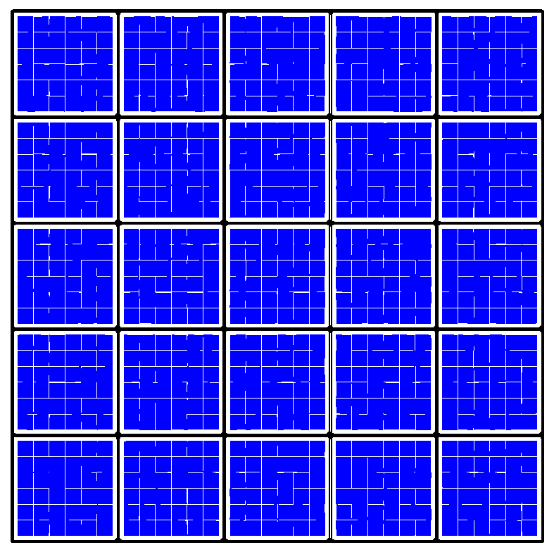
Destination area
Source area

Slide 33

Destination Node
Building
Building
$$θ_{I}$$
Intersection node
Transmitting Node

Slide 34


Slide 35
Inefficient route
no shadowing
shadowing
efficient route
Destination Node
Building
Building
Building
③
③
①
②
Send Node
Building

Slide 36
Destination Node
Destination Node
Building
Building
C
×
×
D
A
A
Building
Building
B
B
(a) unreachable case in LSGO
(b) reachable case

Slide 37
Intersection-based routing
Other routing schemes
Building
Building
Destination Node
Building

Slide 44
Destination direction
Building
Building
1
2
3
Intersection node
4

Slide 45
(a) simulation scenario
(b) packet delivery ratio
(c) overhead

Slide 46


Destination Node
Building
Building
Closest road segment
$$r_{1}\left(t\right)$$
$$r_{2}\left(t\right)$$
Transmitting Node
Intersection area
Road center coordinates

Slide 47



D
D
minanle2
sdangle
R2
$$r_{1}\left(t\right)$$
minanle1
snangle2
R1
$$r_{2}\left(t\right)$$
$$θ_{I}$$
snangle1
S
Transmitting node
Destination
LSN
Destination
Intersection node
Road center coordinates
PLSN
Relay candidate node
Closest road segment
Road segment
Transmitting node
(a)The closest road segment
(b)Minimum angle method

Slide 48

D
D
minanle2
sdangle
R2
$$r_{1}\left(t\right)$$
minanle1
snangle2
R1
$$r_{2}\left(t\right)$$
$$θ_{i}$$
snangle1
Transmitting node
Destination
LSN
Destination
Intersection node
Road center coordinates
PLSN
Relay candidate node
Closest road segment
Road segment
Transmitting node
(a)The closest road segment
(b)Minimum angle method

Slide 49
D
D
minanle2
sdangle
R2
$$r_{1}\left(t\right)$$
minanle1
snangle2
R1
$$r_{2}\left(t\right)$$
$$θ_{i}$$
snangle1
Transmitting node
Destination
LSN
Destination
Intersection node
Road center coordinates
PLSN
Relay candidate node
Closest road segment
Road segment
Transmitting node
(a)The closest road segment
(b)Minimum angle method

Slide 50
D
S
Local optimum
problem 発生

Slide 51



Recovery 成功
$N_{1}$より宛先に近い
$$N_{2}$$
D
S
$$N_{1}$$
Local optimum
problem 発生
Greedy Route
Recovery Route

Slide 52
z
u
D
y
D
w
x
x
S
Transmission range
Perimeter forwarding
Right-hand rule

Slide 53


同一の道路内ではGreedy fowarding
$$C_{2}$$
D
S
$$C_{1}$$
Local optimum
problem 発生
右手の法則で転送する道路を選択
Greedy Route
Recovery Route

Slide 54














$$Z$$
$$Z$$
$$D$$
$$D$$
$$Y$$
×
×
$$X$$
$$Y$$
$$X$$
$$S$$
$$V$$
$$W$$
$$S$$
$$V$$
$$W$$
Local optimum problem
or
Local shadowing problem
(a)
(b)
Reachable Route
Unreachable Route
D
Destination Node

Slide 55











$$A$$
$$O$$
$$B$$
Geocast Region
$$P$$
$$Q$$
×
$$X$$
$$Z$$
$$W$$
$$Y$$
Forwarding Region
$$S$$
$$C$$
Network Space

Slide 56






Geocast Region
Center Coordinates
$$Dist_{w}$$
$$Dist_{x}$$
$$Dist_{y}$$
$$W$$
$$Dist_{s}$$
$$X$$
×
$$S$$
$$Y$$
Network Space

Slide 57

D
minanleB
B
A
minanleA
S
$$C_{1}$$
最小角度法を用いて中継ノードを決定
同一の道路内ではGreedy fowarding
交差点ノードが存在する場合のルート
交差点ノードが存在しない場合のルート

Slide 58
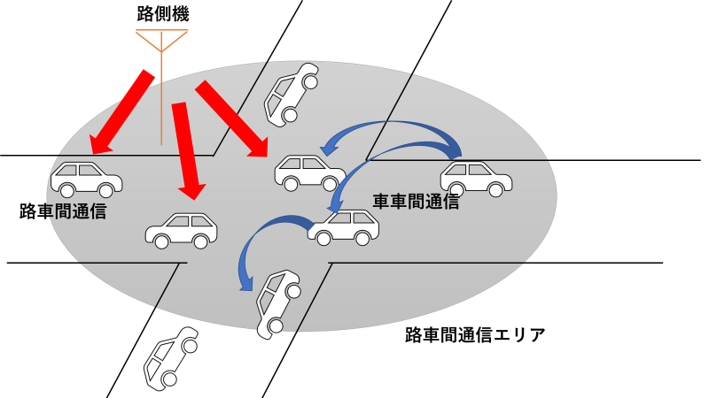

Slide 59
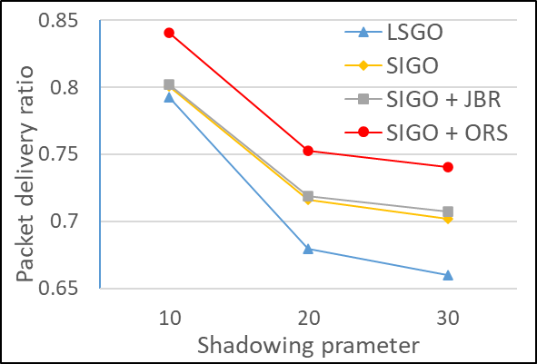
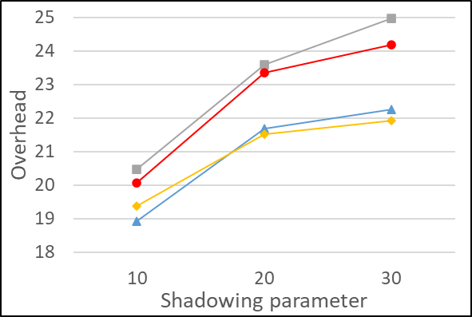
(a) simulation scenario
(b) packet delivery ratio
(c) overhead

Slide 60
(a) simulation scenario
(b) packet delivery ratio
(c) overhead

Slide 61
D
minanle2
sdangle
R2
minanle1
snangle2
R1
snangle1
S
Local source node
Destination
Previous local source node
Relay candidate node
(b)Minimum angle method

Slide 62
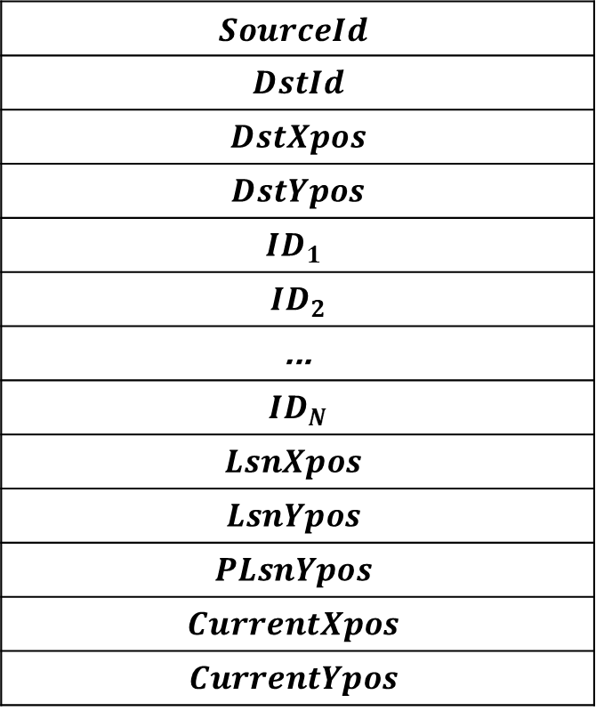
$$SourceId$$
$$DstId$$
$$DstXpos$$
$$DstYpos$$
$$ID_{1}$$
$$ID_{2}$$
$$\text{...}$$
$$ID_{N}$$
$$LsnXpos$$
$$LsnYpos$$
$$PLsnYpos$$
$$CurrentXpos$$
$$CurrentYpos$$

