Slide 1
An approach for deciding what to learn in software development
Janis Lesinskis
www.lesinskis.com
https://github.com/shuttle1987

Slide 2
Why this talk exists
A colleague recently asked me “What should I learn next”? I've been asked this question across multiple industries now.
The aim of this talk is to give you a concrete framework to help you prioritize what to learn.
But first, what happened when I asked this same question, or how I ended up working with a sports psychologist...

Slide 3

The state of my learning at the time

Slide 4
What I learned from working with a sports psychologist
“Amateurs train until they can get it right. Professionals train until they can't get it wrong.”
Being able to perform in pressure situations is different to non-pressure situations.
Train your core skills to the point where you can do them without needing to think as deeply. Getting a level of mastery lets you move on to learning the next skill.

Slide 5
What I learned from working with a sports psychologist
Skills/techniques can depend on having some mastery of other skills/techniques.
Being aware of what you know and how well you know it is very important for your learning. In many sports a coach helps by giving this guidance and keeping track of your progress.
If you consistently neglect weaker areas you end up not being able to progress. This is because skills and knowledge build on each other.

Slide 6
States of knowledge
Knowledge | Aware | Unaware
Known | Light-blue | Purple
Unknown | Orange | Red
Skills that are Unknowns and skills you need but are unaware of make estimation of effort substantially harder.

Slide 7
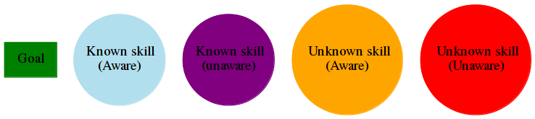

Slide 8
What I learned from working with a sports psychologist
The psychology of learning applies just the same in the IT industry.

Slide 9
Knowledge hierarchies within a project
In the IT industry we will have to complete many projects in our careers. How do we go about figuring out what we need to learn in order to complete a specific project?
Key concept: Each project has a set of skill/knowledge dependencies.
Even the simplest projects, like photocopying documents for a meeting...

Slide 10
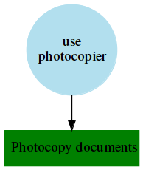
Photocopying

Slide 11
Knowledge dependencies in a real professional project
TreeViz was a single page web app that allowed users to edit tree based information directly in their browser. (Imagine something that lets you graphically edit trees, a bit like editing the diagrams in this talk)
What knowledge dependencies existed to make this project goal a reality?

Slide 12
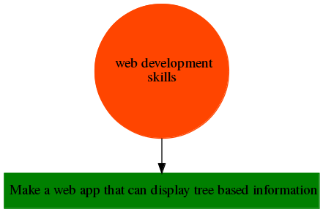
Too broad

Slide 13
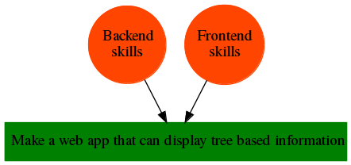
Better, but still too broad

Slide 14
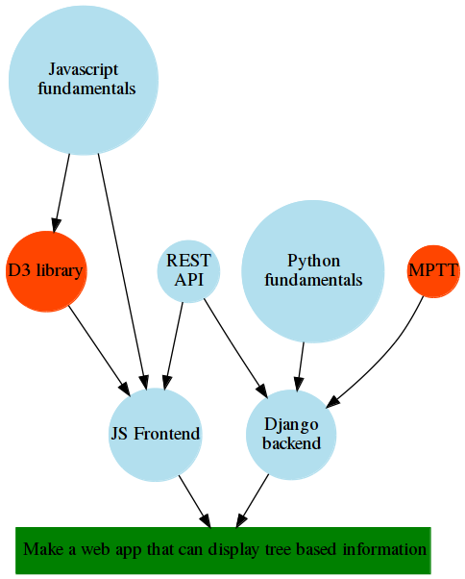
Knowledge towards end of project

Slide 15
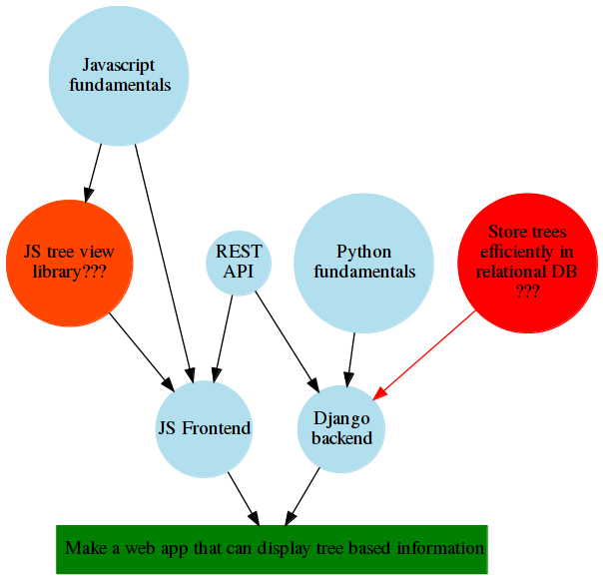
Knowledge at beginning of project

Slide 16
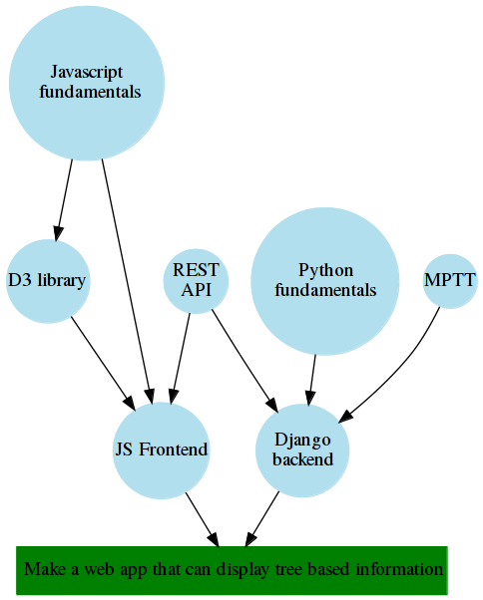
Knowledge at project completion

Slide 17
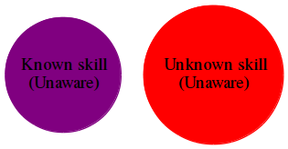
States of knowledge
In most of the diagrams I made that describe my own understanding these are missing:
Why is this?

Slide 18
Prioritize based on your industry
Each industry has a core set of somewhat similar “projects” that will come up regularly.
Map out your skills and how they connect with each other and with the project goals for the projects you will likely be involved in.

Slide 19
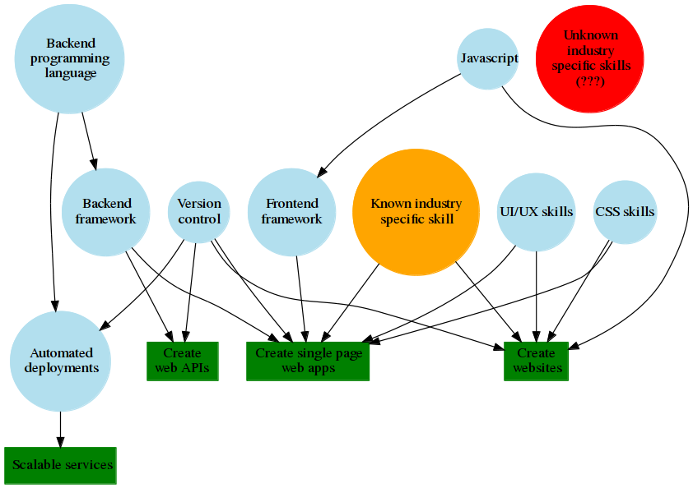

Slide 20
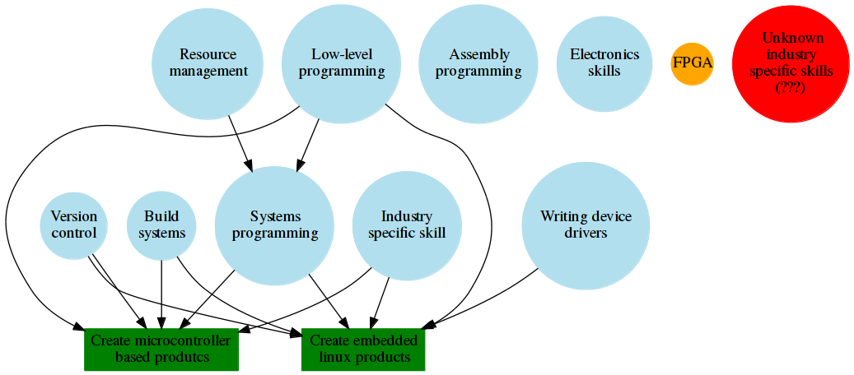

Slide 21
Turn the arrows around
Look for the most highly connected and depended on skills. (Example: version control)
Find out which non-technical skills are most important for you to know about to enable you to be effective in your specific area of work.

Slide 22
Personal projects
These concepts apply to your personal projects as well.
You can make a personal project map where your personal projects are the goals. This lets you see which skills are most important prerequisites for your projects.

Slide 23
Some questions to consider
What do you want to know more about?
Who do you know who can help fill in the gaps in your knowledge?

Slide 24
Questions?

