Slide 1

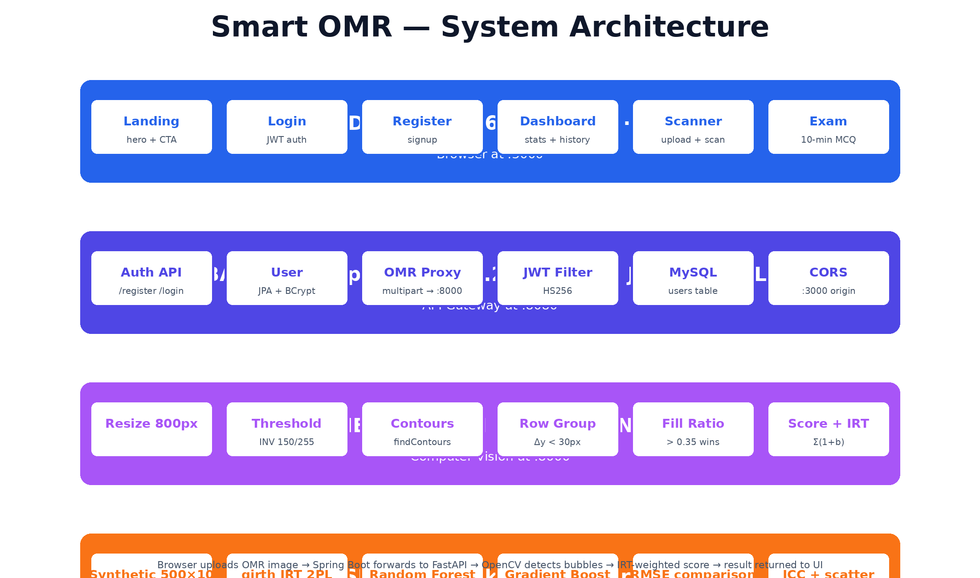
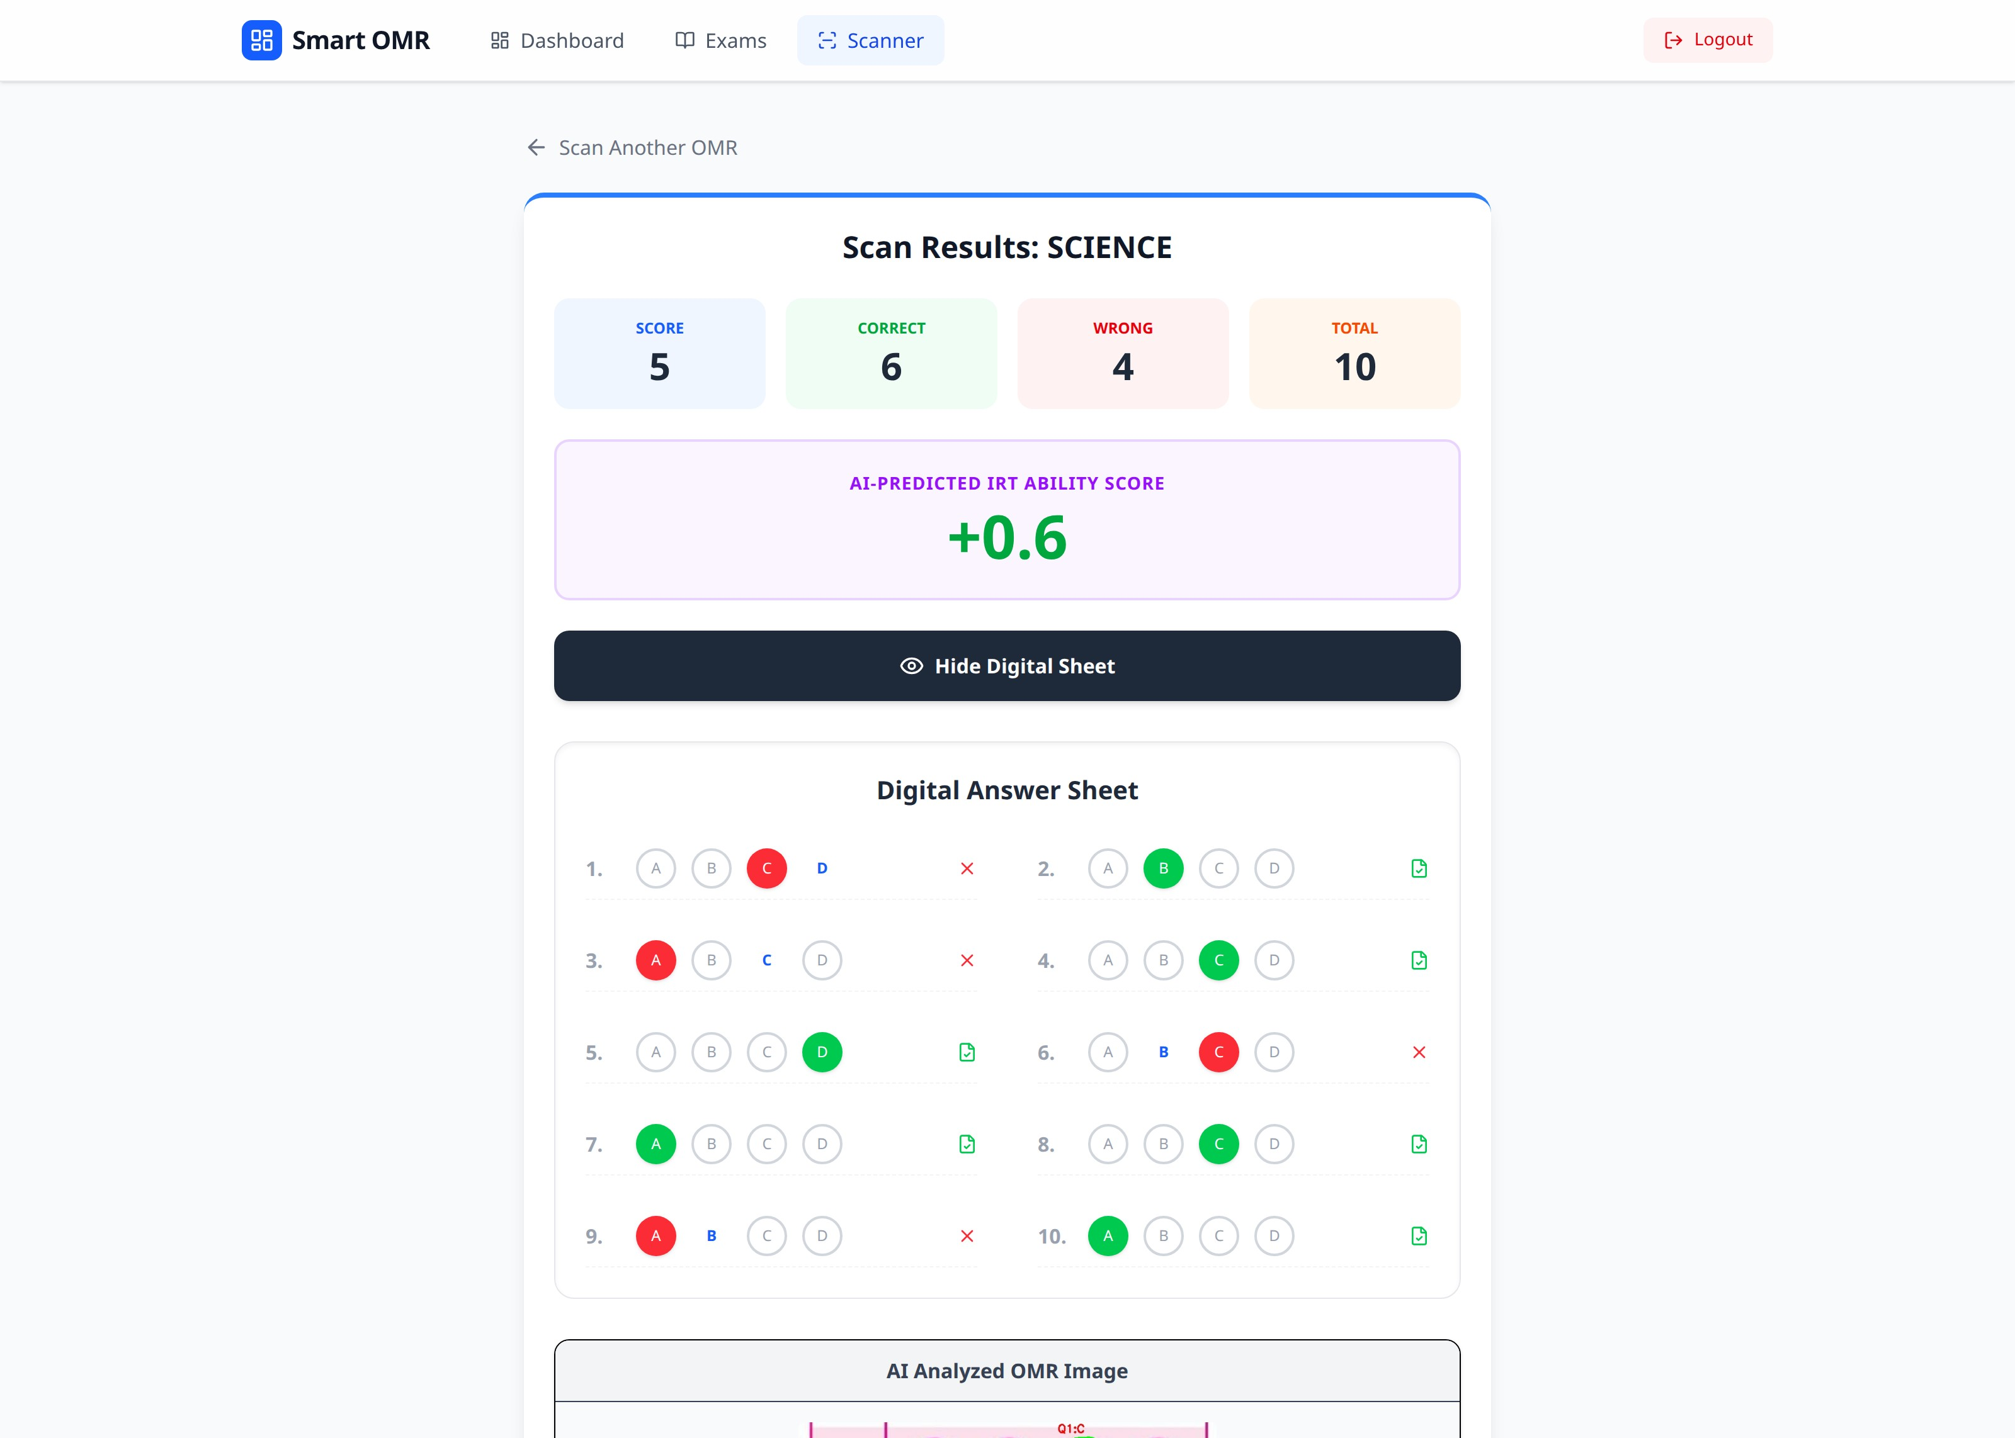
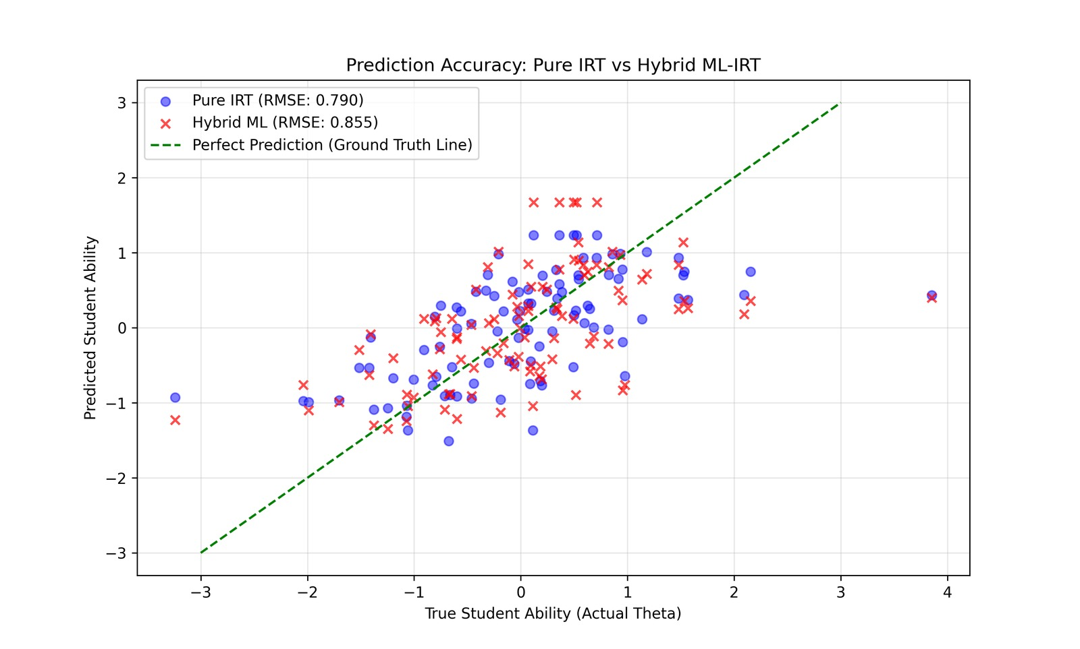
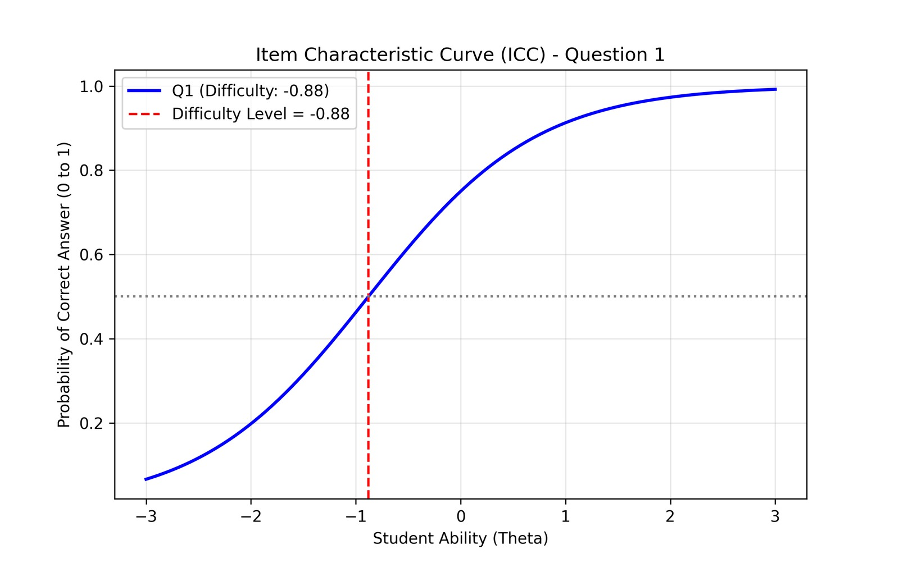
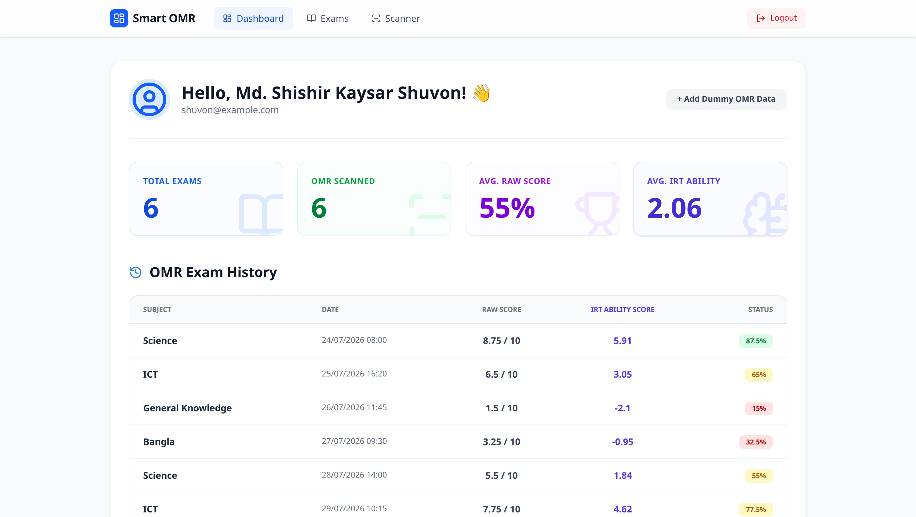

SMART OMR
An End-to-End Computer-Vision + Item-Response-Theory Pipeline for Automated MCQ Grading and Ability Estimation
Md. Shishir Kaysar Shuvon · Supervisor: Professor Dr. Ziaur Rahman
COMPUTER VISION
IRT
FASTAPI
SPRING BOOT
NEXT.JS
01 ABSTRACT
02 OBJECTIVES
Smart OMR is an intelligent, automated Optical Mark Recognition examination system that scans a photographed answer sheet, detects filled bubbles using classical computer vision, grades responses instantly, and reports both a raw score and an Item Response Theory (IRT)-weighted ability score. The full-stack implementation separates the web interface, secure API, and image-analysis service for modular deployment.
01
AUTOMATE Convert uploaded OMR images into detected A–D responses.
02
ASSESS Go beyond raw marks using question difficulty and IRT ability.
03
COMPARE Evaluate pure IRT against Random Forest and Gradient Boosting.
03 SYSTEM ARCHITECTURE
04 LIVE SCANNER OUTPUT
Browser → Spring Boot → FastAPI/OpenCV → IRT-weighted result
Live Science scan · science.jpeg · 10 MCQs · IRT ability · digital answers
05 COMPUTER-VISION PIPELINE
06 IRT + ML EXPERIMENT
1
Resize + gray
2
Gaussian blur
3
INV threshold
• Synthetic dataset: 500 students × 10 questions
• Responses generated with the 3-Parameter Logistic IRT model
• Pure IRT baseline: 2PL fitted by Marginal Maximum Likelihood
• Hybrid models: Random Forest and tuned Gradient Boosting
• Evaluation: RMSE against the known true latent ability θ
800 px width
5×5 kernel
150 / 255
4
Find contours
5
Group rows
6
Fill ratio
bubble heuristics
Δy < 30 px
> 0.35 wins
IRT weighted ability = Σ (correctᵢ ? 1 + difficultyᵢ : 0)
IRT 2PL
Random Forest
Gradient Boosting
07 QUANTITATIVE RESULTS
08 RESEARCH VISUALS
MODEL
RMSE ↓
Pure IRT 2PL
0.7900
Gradient Boosting
0.8006
Random Forest
0.8546
IRT vs hybrid model predictions
KEY FINDING
Pure IRT achieved the lowest RMSE. Hybrid ML did not outperform the mathematical baseline on this small synthetic dataset.
Item Characteristic Curve (Q1)
09 WEB DASHBOARD
10 LIMITATIONS & FUTURE WORK
CURRENT LIMITATIONS
NEXT STEPS
• Synthetic research data; no real classroom validation yet
• Hard-coded answer key and question-difficulty vector
• Contour heuristics assume aligned rectangular sheets
• No skew/perspective correction or multi-page support
• History is stored in browser localStorage
• Deep-learning detector (YOLO/UNet)
• Real student dataset and IRT calibration
• Subject-specific answer keys and difficulty vectors
• QR student IDs and multi-page sheets
• Cloud persistence, PDF/CSV export, Docker deployment
Live dashboard: raw score, OMR count, IRT ability, and history
CONCLUSION
Smart OMR demonstrates a modular, end-to-end grading workflow that connects computer-vision bubble detection with psychometric ability estimation. The study’s most credible result is that pure IRT remains a strong baseline—even when compared with modern ensemble regressors.
REFERENCES / IMPLEMENTATION
SCAN FOR SOURCE
OpenCV contour analysis · FastAPI · Spring Boot · Next.js · girth twopl_mml · scikit-learn RandomForestRegressor & GradientBoostingRegressor Source: https://github.com/shuv-on/smart-omr-scanner
SMART OMR · Computer Vision + Item Response Theory + Modern Web Technologies

