Slide 1
Pneumonia Detection from Chest X-ray Images using Fine Tuned InceptionV3
Problem Statement
Classify chest X-rays as Pneumonia or Normal/Healthy.
Medical datasets are often imbalanced and require careful handling.
Methodology
Resize the Input to minimum spatial requirement for InceptionV3 Model. As original input size is 28x28.
Use pretrained InceptionV3 (ImageNet weights) as feature extractor.
Apply Transfer Learning + Fine-Tuning.
Mitigate class imbalance using class weights and data augmentation.
Prevent overfitting using Data Augmentation and Dropout Layer
Evaluate performance using AUC, Precision, and Sensitivity.

Slide 2
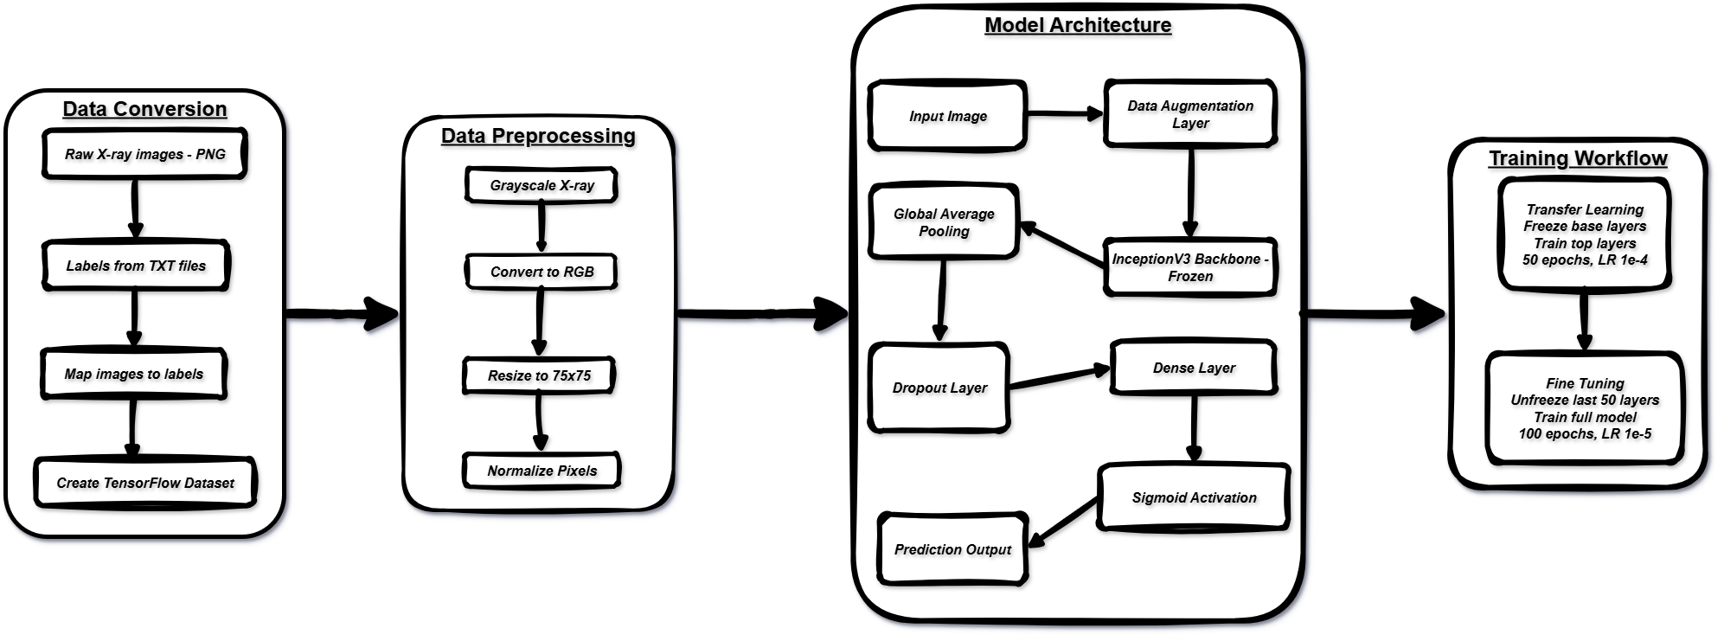
Model Architecture & Workflow:
Here’s below are the main components of InceptionV3 Implementation consisting 4 steps which are further followed by evaluation and testing of the model:
STEP 3
Defining the Model Architecture
STEP 1
Converting raw npz file into raw images and labels.
STEP 4
2 Phase Training i.e. Transfer Learning and Fine Tuning
STEP 2
Preprocessing the data and resizing it to minimum spatial required size for the model

Slide 3
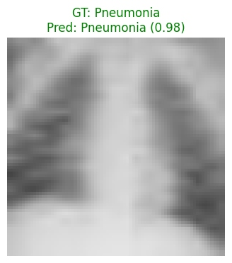
Results & Insights:
Training Insights:
Model Phase | Epochs | Set | AUC | Precision | Recall | Loss | Binary Accuracy
Transfer Learning | 50 | Training | ~ 0.8991 | ~ 0.9927 | ~ 0.7859 | ~ 0.3089 | ~ 0.8009
 |  | Validation | ~ 0.8583 | ~ 0.9914 | ~ 0.6675 | ~ 0.4201 | ~ 0.7441
Fine Tuning | 100 | Training | ~ 0.9695 | ~ 0.9991 | ~ 0.941 | ~ 0.1027 | ~ 0.9445
 |  | Validation | ~ 0.9551 | ~ 0.9967 | ~ 0.9657 | ~ 0.1432 | ~ 0.9258
Test Performance:
Metric | Value | Interpretation
Loss | 0.3411 | Overall model error on unseen data
Binary Accuracy | 88.30% | % of correct predictions
AUC | 0.8895 | Ability to distinguish between Normal & Pneumonia
Precision | 89.14% | % of predicted Pneumonia cases that were correct
Recall | 92.56% | % of actual Pneumonia cases correctly identified
Fig. Testing the InceptionV3 model on unseen data
The model was able to detect most pneumonia cases correctly (recall 92.56%), which is very important in healthcare. It also made very few wrong predictions (precision 89.14%) and could clearly tell the difference between normal and pneumonia cases (AUC 0.8895). Overall, the model performs well and can be helpful for real-life pneumonia detection.
Class Imbalance Handling:
To handle the problem of having more images of one class than the other, two methods were used:
Class weights helped the model give equal importance to both "Normal" and "Pneumonia" cases.
Data augmentation created more variety in the training images, especially for the minority class.
These steps helped the model learn fairly and improved its ability to detect pneumonia correctly without being biased.

