Slide 1


Department of Computer Sc. & Engineering
Chandigarh College of Engineering & Technology (CCET -Degree Wing)
(A Govt. College under Chandigarh UT Administration, Chandigarh)
Sector-26, Chandigarh - 160019
PROJECT-II: Real-Time Sign Language Detection Application
Submitted To
Dr. Sarabjeet Singh
Submitted By
Abhishek Pant (CO18305)
Kanish Chauhan (CO18330)
Shuvam Roy (CO18349)
8th Semester CSE

Slide 2

Department of Computer Science & Engineering
Chandigarh College of Engineering & Technology (CCET -Degree Wing)
(A Govt. College under Chandigarh UT Administration, Chandigarh) ,Sector-26, Chandigarh - 160019
ABSTRACT
Sign language recognition is a problem that has been addressed in research for years. However, we are still far from finding a complete solution available in our society. Lack of datasets along with variance in sign language with locality has resulted in restrained efforts in such hand sign gesture detection. Our project aims at taking the basic step in bridging the communication gap between normal people and deaf and dumb people using a simple and effective deep learning vision based model to recognize sign languages in real time.
Effective extension of this project may not only make the deaf and dumb people communicate faster and easier with the outer world, but also provide a boost in developing autonomous systems for understanding and aiding them.

Slide 3
Department of Computer Science & Engineering
Chandigarh College of Engineering & Technology (CCET -Degree Wing)
(A Govt. College under Chandigarh UT Administration, Chandigarh) ,Sector-26, Chandigarh - 160019
NEED FOR THE PROPOSED SYSTEM
No Major datasets for signs used by deaf and dumb people.
Different people use different signs, hence a standard model or application will not suffice to cater all use cases.
Optimization of deep learning model as most systems use excess memory, GPU and hence accommodation in an existing software like Zoom or Google Meet is a problem.
Limitations In Existing System:
🕐 High initial setup cost and less practical feasibility
🕐 User requires adequate knowledge of technology to use the hardware system
🕐 Considerable E-waste due to large number of sensors used.

Slide 4
Department of Computer Science & Engineering
Chandigarh College of Engineering & Technology (CCET -Degree Wing)
(A Govt. College under Chandigarh UT Administration, Chandigarh) ,Sector-26, Chandigarh - 160019
ADVANTAGES OF THE PROPOSED SYSTEM
Cheaper and more appealing with less setup cost
User gains design autonomy. They are allowed to train their own images based on their requirements.
It does not require high proficiency of the user in terms of hardware installation and updations.
As a representative ML approach, artificial neural networks enable to handle a huge amount of data with the assistance of cutting-edge computer vision technologies.

Slide 5
Department of Computer Science & Engineering
Chandigarh College of Engineering & Technology (CCET -Degree Wing)
(A Govt. College under Chandigarh UT Administration, Chandigarh) ,Sector-26, Chandigarh - 160019
LITERATURE SURVEY
Static Sign Language Recognition Using Deep Learning
A system was developed that will serve as a learning tool for starters in sign language that involves hand detection. This system is based on a skin-color modeling technique, i.e., explicit skin-color space thresholding.
Disadvantage: Involves converting RGB to Binary image files. Leads to extra overhead memory and processing.
Research on the Hand Gesture Recognition Based on Deep Learning
The long-term recurrent convolution network is used to classify the video sequences of hand gestures. In the standard long-term recurrent convolution network-based action classifier, multiple frames sampled from the video sequence are given as an input to the network, to perform classification. To extract the representative frames, we propose to use novel tiled image patterns and tiled binary pattern within a semantic segmentation-based deep learning framework, the deconvolution neural network.
Disadvantage: Tiling of data frames provides static detection boxes and is not suitable for detecting large sized real time images.

Slide 6
Department of Computer Science & Engineering
Chandigarh College of Engineering & Technology (CCET -Degree Wing)
(A Govt. College under Chandigarh UT Administration, Chandigarh) ,Sector-26, Chandigarh - 160019
MAIN OBJECTIVE
The objective of this project is to create a sign language detector that does real time sign language detection and train itself continuously based on user images.
The main objectives of this project are:
To create a dataset by live capturing images of sign language and perform Data processing and augmentation on
To perform live detection of hand signs in real time that can detect deaf and dumb signs for hello, thank you etc.
Extend the working of the trained CNN Model to creation of automatic sign language translators in live video conferencing applications.

Slide 7
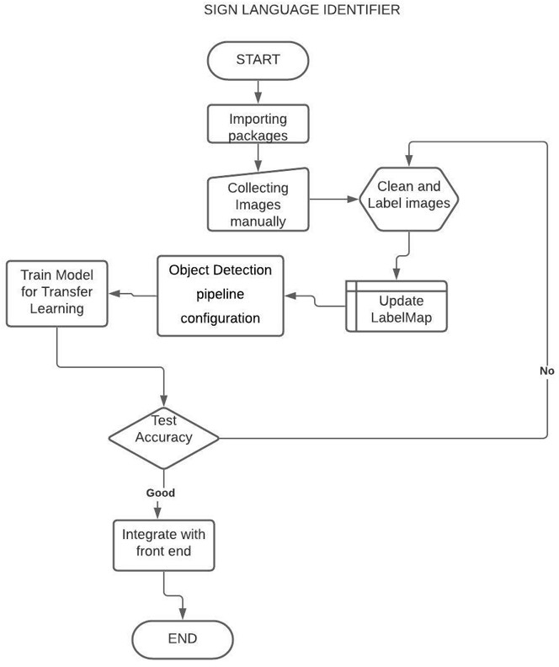
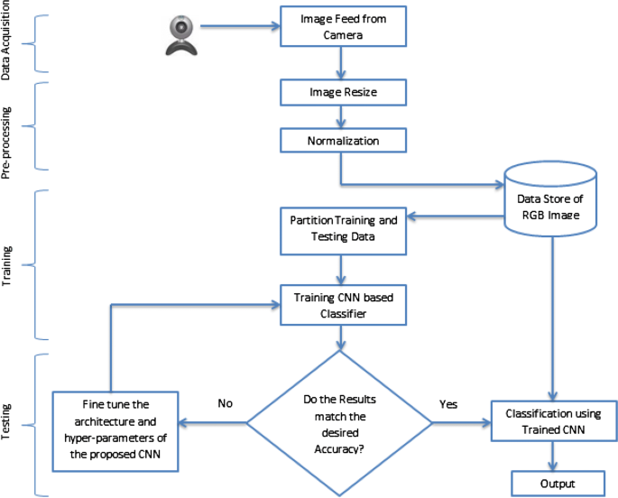
Department of Computer Science & Engineering
Chandigarh College of Engineering & Technology (CCET -Degree Wing)
(A Govt. College under Chandigarh UT Administration, Chandigarh) ,Sector-26, Chandigarh - 160019
ARCHITECTURE - WORKFLOW PROCESS

Slide 8

Department of Computer Science & Engineering
Chandigarh College of Engineering & Technology (CCET -Degree Wing)
(A Govt. College under Chandigarh UT Administration, Chandigarh) ,Sector-26, Chandigarh - 160019
SYSTEM REQUIREMENTS
The project is done on Windows 7(64-bit RAM). Python version 3.7 is used to implement the code. Object detection API and tensorflow is pre installed. Microsoft Visual C++ Redistributable for Visual Studio 2015, 2017 and 2019 is needed for installation of Object detection API. Mobilenet-ssd model is used as Single-Shot multibox Detection (SSD) network intended to perform object detection.
A GPU setup is required to train the images using cudart to achieve better accuracy. GPU support requires a CUDA®-enabled card in Windows and Ubuntu systems. Tensorflow GPU has the following requisites:

Slide 9
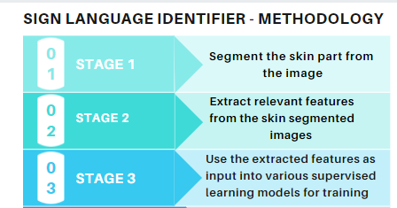
Department of Computer Science & Engineering
Chandigarh College of Engineering & Technology (CCET -Degree Wing)
(A Govt. College under Chandigarh UT Administration, Chandigarh) ,Sector-26, Chandigarh - 160019
FUNCTIONAL DESCRIPTION
The first stage is to segment the skin part from the image, as the remaining part can be regarded as noise.
The second stage is to extract relevant features from the skin segmented images which can prove significant for the next stage i.e. learning and classification.
The third stage as mentioned above is to use the extracted features as input into various supervised learning models for training and then finally use the trained models for classification.
The research method extends to work on creating a system that allows user to train certain signs at any time as per user requirement.

Slide 10
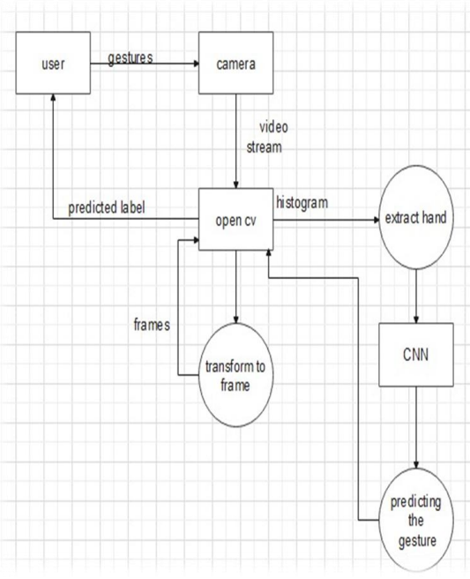
Department of Computer Science & Engineering
Chandigarh College of Engineering & Technology (CCET -Degree Wing)
(A Govt. College under Chandigarh UT Administration, Chandigarh) ,Sector-26, Chandigarh - 160019
MODULES USED:
Convolutional neural networks have been employed to recognize sign language gestures. The image dataset used consists of dynamic sign language gestures captured on a system attached camera.
Preprocessing was performed on the images, which then served as the cleaned input. The results are obtained by retraining and testing this sign language gestures dataset on a convolutional neural network model.
1. Feeding Image from Camera
2. Image Resizing and Labelling
3. Normalization and Partition of datasets
4. Training CNN based classifier
5. Classification based output
Level 0 : Data Flow Diagram

Slide 11
Department of Computer Science & Engineering
Chandigarh College of Engineering & Technology (CCET -Degree Wing)
(A Govt. College under Chandigarh UT Administration, Chandigarh) ,Sector-26, Chandigarh - 160019
IMPLEMENTATION
STEP 1:
A separate sub-directory is created for the IMAGES_PATH where the collected images and their labels will be stored. The labels are initialised and live images are captured and collected using opencv and stored in the respective label folder.
STEP2:
DATA PRE- PROCESSING AND LABELLING.
Images are labelled graphically label the images and also remove the skin part and unwanted background from the image for training. The attributes and coordinates of the labelled image is stored in an XML file.

Slide 12
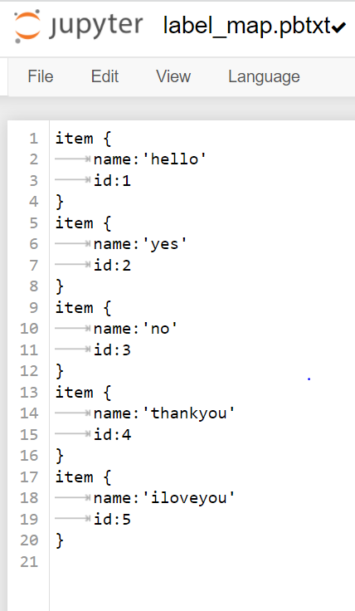
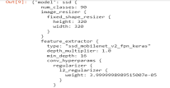
Department of Computer Science & Engineering
Chandigarh College of Engineering & Technology (CCET -Degree Wing)
(A Govt. College under Chandigarh UT Administration, Chandigarh) ,Sector-26, Chandigarh - 160019
IMPLEMENTATION
STEP 3: Tensorflow Object Detection pipeline configuration is setup. The labels are converted and saved in a pbtxt file that contains text graph definition in protobuf format.
STEP 4: The configurations are pipelined from the config file and trained using the SD Mobilenet model in Object Detection in python. 5000 train steps are used to train the model. Transfer Learning is used to train a deep learning model and load the trained model from checkpoint.

Slide 13
Department of Computer Science & Engineering
Chandigarh College of Engineering & Technology (CCET -Degree Wing)
(A Govt. College under Chandigarh UT Administration, Chandigarh) ,Sector-26, Chandigarh - 160019
LAPLACE MATRIX(contd.)
The smallest eigenvalue always :λ₁ = 0 for eigen vector (vector of all 1’s i.e. eigen vector of Laplacian matrix)v₁ = e = [1, 1, 1...1]^{T}
L*e = (D − A)*e = 0
Number of zero eigenvalues = number of connected components
In connected graph λ₂ ≠ 0 – determines algebraic connectivity of a graph (spectral graph), v₂ - Fiedler vector

Slide 14
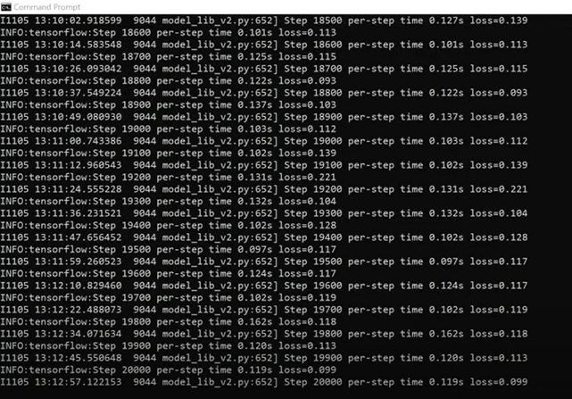
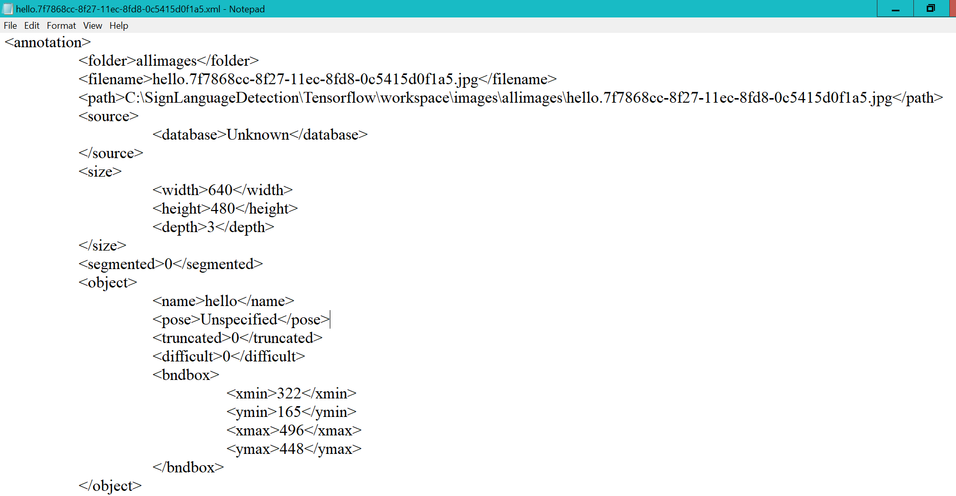
Department of Computer Science & Engineering
Chandigarh College of Engineering & Technology (CCET -Degree Wing)
(A Govt. College under Chandigarh UT Administration, Chandigarh) ,Sector-26, Chandigarh - 160019
FORM DESIGN
Training Dataset Form in Image Converted to XML File
Command Prompt

Slide 15
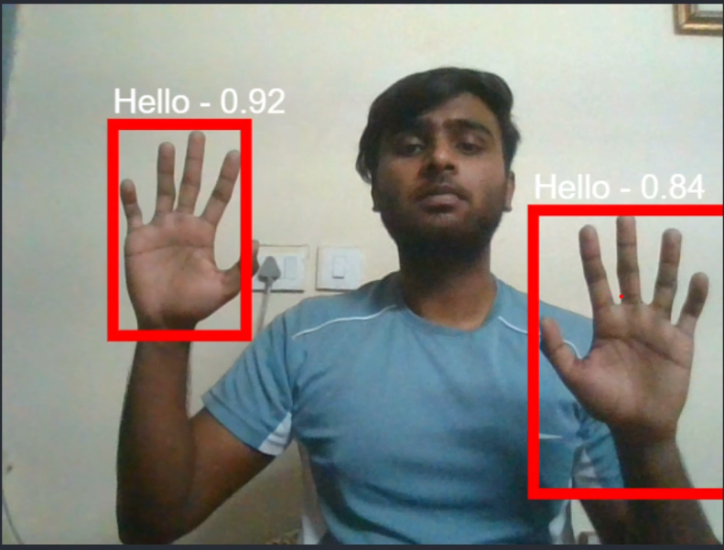
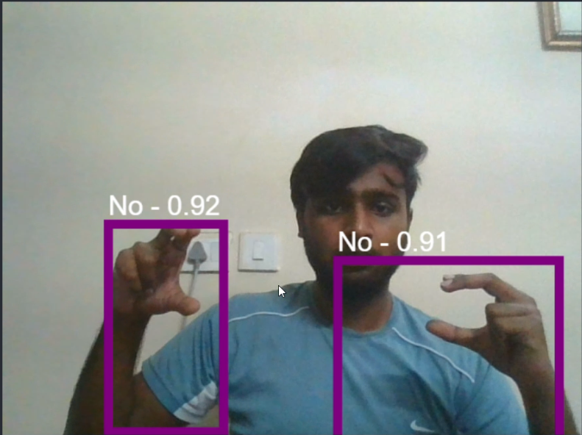
Department of Computer Science & Engineering
Chandigarh College of Engineering & Technology (CCET -Degree Wing)
(A Govt. College under Chandigarh UT Administration, Chandigarh) ,Sector-26, Chandigarh - 160019
TESTING
The model is successfully trained and run with no compilation errors. An average accuracy of 60-80% is achieved in the detection. The detection occurs within a proximity of 1-3 metre from the system camera.

Slide 16
Department of Computer Science & Engineering
Chandigarh College of Engineering & Technology (CCET -Degree Wing)
(A Govt. College under Chandigarh UT Administration, Chandigarh) ,Sector-26, Chandigarh - 160019
CONCLUSIONS
Pattern recognition and Gesture recognition are the developing fields of research. This can be very helpful for the deaf and dumb people in interacting and communicating with other people and also computer systems. It can also be used as a sign language translator for the deaf and dumb people. The need for Interpreter in government organizations or in the private sector insinuates the need and scope of the project.
The development of vision-based applications and touchless control on ubiquitous devices is increasing. As hand gesture recognition is at the core of sign language analysis a robust hand gesture recognition system should consider both spatial and temporal features.
In this study, we proposed an efficient deep convolutional neural networks approach for hand gesture recognition to detect sign language. The proposed approach employed transfer learning to beat the scarcity of a large labeled hand gesture dataset.

Slide 17
Department of Computer Science & Engineering
Chandigarh College of Engineering & Technology (CCET -Degree Wing)
(A Govt. College under Chandigarh UT Administration, Chandigarh) ,Sector-26, Chandigarh - 160019
FUTURE ENHANCEMENT
We can develop a model for ISL word and sentence level recognition. This will require creating a system that can detect changes with respect to the temporal space.
The model can also be programmed with teleconferencing software like Google Meet, Zoom as a functionality extension to enable deaf and dumb people to interact in the virtual medium using the sign detection model.
We can develop a complete product that will help the speech and hearing impaired people, and thereby reduce the communication gap.

Slide 18
Department of Computer Science & Engineering
Chandigarh College of Engineering & Technology (CCET -Degree Wing)
(A Govt. College under Chandigarh UT Administration, Chandigarh) ,Sector-26, Chandigarh - 160019
REFERENCES
https://www.researchgate.net/publication/ 282839736_Sign_Language_Converter
http://sersc.org/journals/index.php/IJAST/article/view/20937/10563
https://tensorflow-object-detection-api-tutorial.readthedocs.io/en/latest/
https://academic.oup.com/jdsde/article/11/4/421/411839
https://www.sciencedirect.com/science/article/pii/ S1877050918321331
https://www.ijert.org/sign-language-to-text-and-speech-translation-in-real-time-using-convolutional-neural-network
https://www.ripublication.com/ijaer18/ijaerv13n9_90.pdf
http://reports.ias.ac.in/report/19049/real-time-indian -sign-language-recognition

Slide 19
Department of Computer Science & Engineering
Chandigarh College of Engineering & Technology (CCET -Degree Wing)
(A Govt. College under Chandigarh UT Administration, Chandigarh) ,Sector-26, Chandigarh - 160019
THANK YOU

