Slide 1
The housing problem
SCENE 1 · THE FIRST CLUES
A team member searching for affordable rent noticed an entire apartment nearby, sitting on Airbnb with many open dates. That's where the investigation started.
$260
17,741
per night — the apartment that prompted the investigation
active Sydney listings in the dataset
Notes:
Point to the 17,741 figure when the student says "We analysed 17,741 active listings across Sydney."

Slide 2
The first clue fails
SCENE 1 · THE FIRST CLUES
1,029
1,027
listings with missing licence information
of those required stays of 90+ nights — probably long-term lets, not the short-stay pattern we were testing for
One red flag on its own told us nothing.

Slide 3

An open calendar doesn't mean a booking
SCENE 2 · WHEN THE OBVIOUS CLUES FAIL
Calendars open >180 days
5,763
Estimated occupancy >180 nights
1,792
Potential availability, yes — but not a confirmed booking.

Slide 4
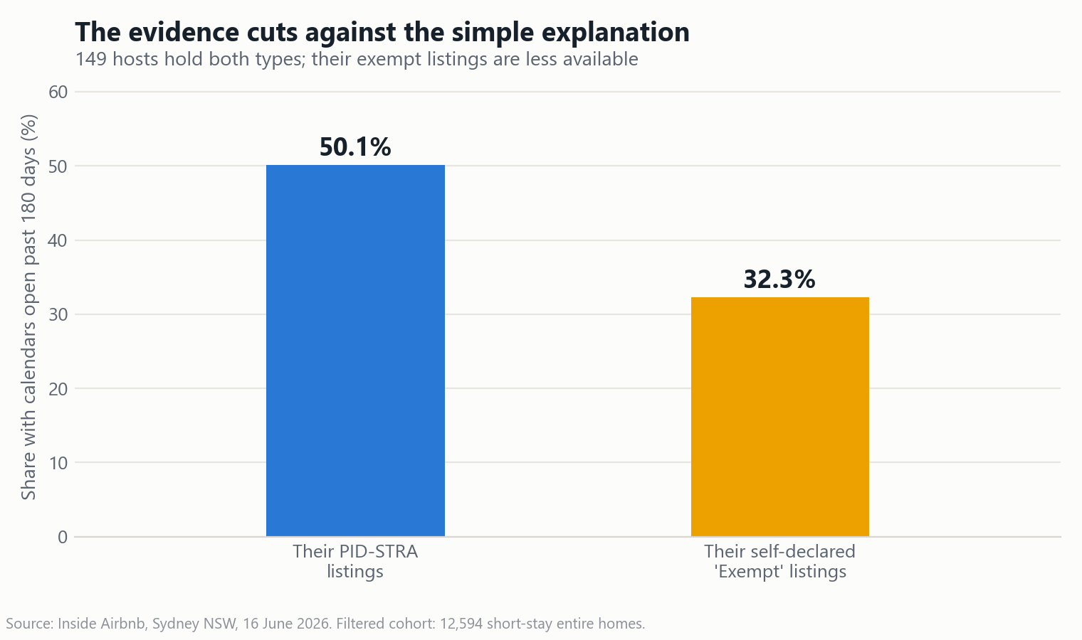
Exemption status isn't enough either
SCENE 2 · WHEN THE OBVIOUS CLUES FAIL
Exempt listings were actually less likely to be booked out — not more.

Slide 5

From 17,741 listings to 726 priority listings
SCENE 3 · THE AHA MOMENT
17,741
Starting dataset
Four screening conditions
Entire homes, stays under 21 nights · Self-declared exemption · Calendar open >180 days · Multiple listings per host
726
Priority listings linked to 201 hosts

Slide 6
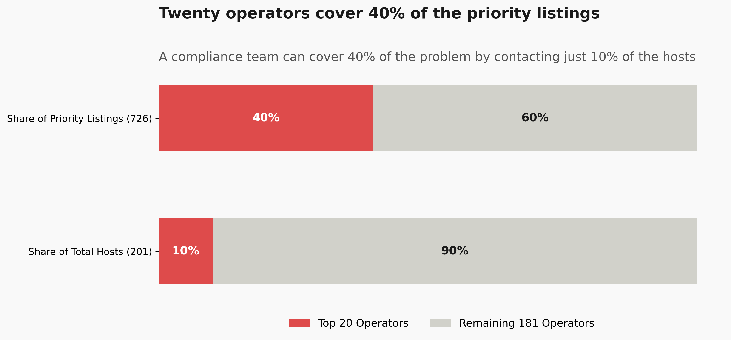
Twenty hosts, 289 listings
SCENE 3 · THE AHA MOMENT

Slide 7
Where should the council look first?
SCENE 4 · THE DASHBOARD AND DECISION
Total listings
Priority listings
Priority hosts
Top cluster
17,741
726
201
20 hosts
Filters
Priority host accounts, ranked
LGA
Host ID | Linked listings | LGA
HOST-8931 | 24 | Sydney
HOST-4512 | 19 | Randwick
HOST-1077 | 16 | Parramatta
Licence status
Availability
Host scale
Stylised mock-up — swap in your real dashboard screenshot before presenting.

Slide 8
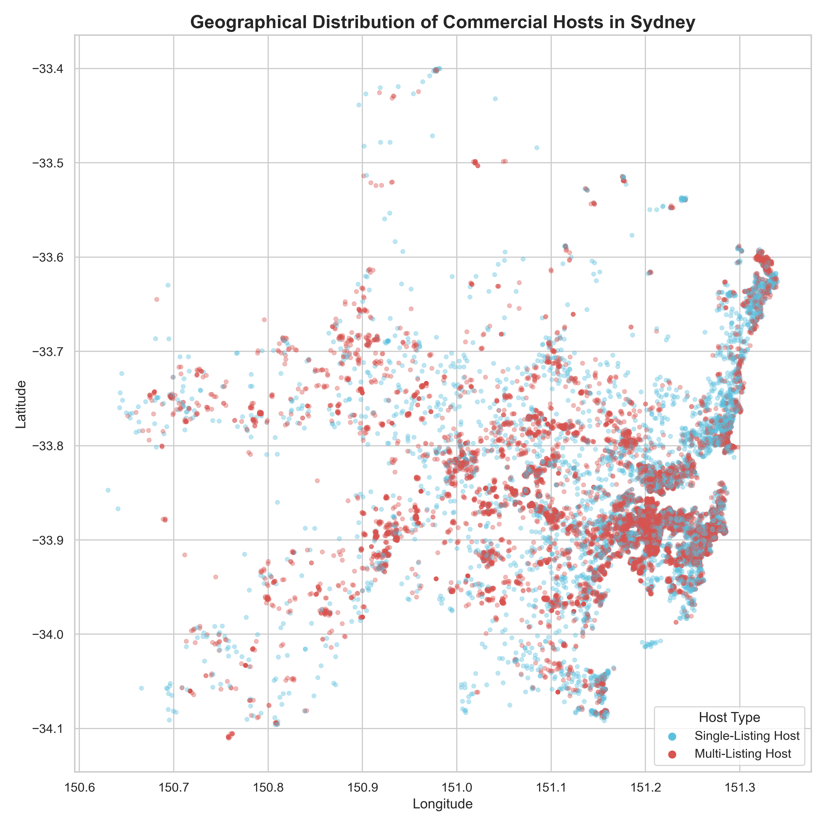
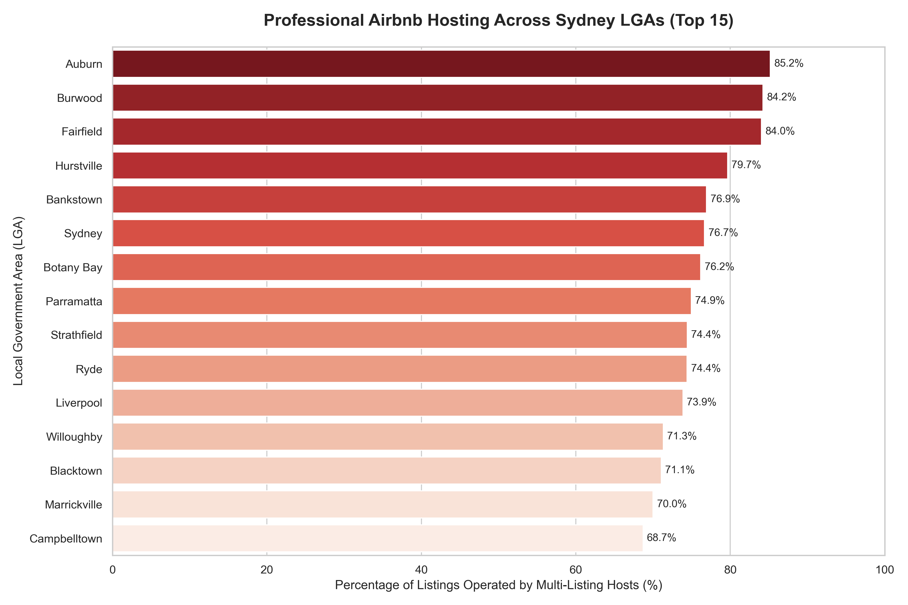
From citywide patterns to a local check
SCENE 4 · THE DASHBOARD AND DECISION

Slide 9
A practical starting point
SCENE 5 · FINAL TAKEAWAY
20
289
Verify
against official STRA records
Hosts to review first
Linked priority listings
Data doesn't decide who's guilty.
It helps us decide where to look first.

