Slide 1

HR Analytics – Employee Attrition
Shuvayan Das
6.5 out of 10 people remember what they see…
Notes:
This slide contains the editable pieces that were used to build infographic sample
Icons – Eye, PC

Slide 2
BUSINESS CASE
What is this about?
In this case study, we will explore a real life HR dataset of a company and try to answer three questions: What are the key drivers that is causing people to leave the company? Who is at high, medium or low risk of leaving? What are the thresholds that are important in an employee’s journey map?
Analysis
Data Preparation and Visualization - Generate insights as to the plausible causes of attrition. Feature Extraction – Finding the most important variables leading to attrition. Attrition Risk Model - Using machine learning to predict who is at low , medium or high risk of leaving. Survival Analysis – By ‘WHEN’ a certain percentage of the employees would have left.
Data Preparation and Visualization
Feature Extraction
Attrition Risk Model
Survival Analysis
22%

Slide 3
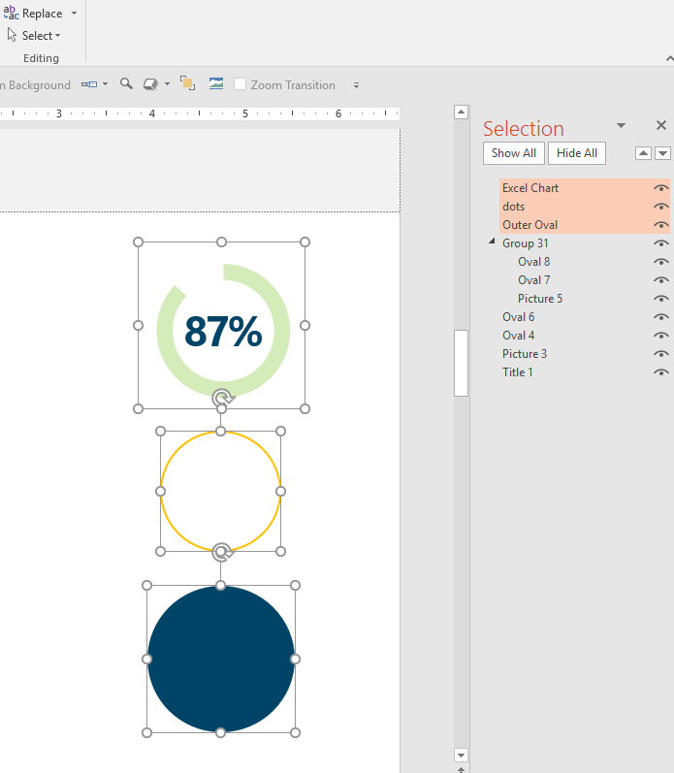
Data Description
Rehire | Terminated | Employee_code | Department | Job Level | Tenure | TimeLastPos | Has been promoted | Last Rating | Client work travel | Education | Gen -der | Marital Status | Annual Income | Year of Birth
FALSE | 1 | 140384 | Risk Management | Senior Analyst | 253 | 253 | No | 1.965571042 | High Travel | Bachelors Degree | F | Single | 1678 | 1963
FALSE | 1 | 120921 | Tax | Senior Analyst | 1384 | 118 | Yes | 1 | Medium Travel | Bachelors Degree | M | Married | 2144 | 1966
FALSE | 1 | 88512 | Audit | Staff I | 1188 | 482 | Yes | 2 | Medium Travel | M.Sc Analytics | M | Married | 584 | 1977
FALSE | 1 | 80636 | Financial Advisory | Lead Analyst | 1013 | 1013 | No | 2 | Medium Travel | MA | F | Married | 6205 | 1970
FALSE | 0 | 123543 | Sales | Lead Analyst | 1300 | 1132 | Yes | 2 | Medium Travel | MA | F | Married | 6986 | 1970
FALSE | 1 | 32530 | Tax | Lead Analyst | 1020 | 1020 | No | 3 | High Travel | Bachelors Degree | F | Single | 4494 | 1985
FALSE | 1 | 124815 | Finance | Staff I | 4352 | 1357 | Yes | 2 | High Travel | MSc | F | Divorced | 334 | 1987
FALSE | 1 | 76118 | Audit | Senior Analyst | 1025 | 306 | Yes | 2 | Medium Travel | Bcom | M | Married | 1817 | 1989
FALSE | 1 | 99950 | Financial Advisory | Staff II | 1761 | 894 | Yes | 2 | Medium Travel | Bcom | M | Married | 2289 | 1988
FALSE | 1 | 54216 | Audit | Staff I | 1566 | 384 | Yes | 2 | High Travel | MSc | F | Divorced | 355 | 1978
Understanding Data
Feature | Description
1.Rehire | If the employee left the organization at some point, but rejoined later
2.Terminated | Left the company
3.Employee_code | Unique employee number
4.Department | Name of the department the employee is/was working
5.Job Level | Job title
6.Tenure | Number of days in the company
7.TimeLastPos | Number of days since last promotion
8.Has been promoted | Whether the employee was promoted
9.LastRating | Performance Rating
10.Client work travel | How much travelling does the employee do for work
11.Education | Highest level of education
12.Gender | Male or Female
13.Marital Status | Married, divorce or single
14.Annual Income | Salary for the year
15.Year of Birth | Year the employee was born
Excel chart
dots
Outer Oval

Slide 4
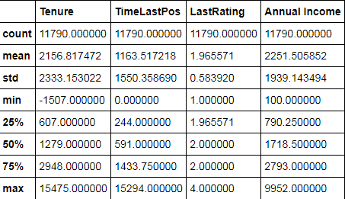
DATA PREPARATION .. 1
The data is more or less proper albeit some missing / wrong information:
There are 41 records which contain no department information – assigned ‘unknown’ category to Department in these records. There are 10 records where Tenure is negative:- Since it is only 0.08% of the sample I have removed them.
Observations from the summary shown
75% of the sample had been last promoted about 4 years earlier . The median rating is 2 and also 75% of the sample have their rating as 2. The median Tenure is about 3.5 years and the average Tenure is 5.9 years.
Inference
Promotions are low in the company. Most of the employees are having performance issues. There are many people who are in the Tenure bucket of 0-5 years who are leaving.
7.5 out of 10 promoted in the last 4 years
75%
75% of the sample have their rating as 2.

Slide 5
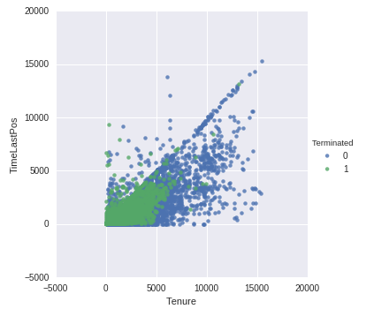
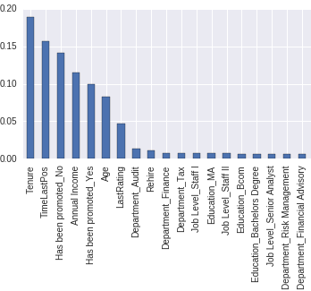
DATA PREPARATION .. 2
PLOT 1:
There are a large number of people leaving where both the Tenure and TimeLastPos are very low or zero. At some places the TimeLastPos is less than the Tenure which is clearly absurd. There is high correlation between Tenure and Days since last promotion.(77%).
ANALYSIS: There are a total to 1288 records where either the Tenure is less than Days since last promotion or TimeLastPos is 0. Also in all these records where TimeLastPos = 0 the field ‘Has been promoted’ contains the value ‘Yes’ which is clearly a contradiction. Removing 1288 records will result in a loss of more than 10% of the sample.
SOLUTION (PLOT 2):
We will find out how important the variable TimeLastPos is for predicting Attrition by using feature importance algorithm. RESULT: Though it is the second most important variable it is also highly correlated with Tenure. Hence for modeling attrition we will use not use TimeLastPos to avoid multi-collinearity.
5

Slide 6
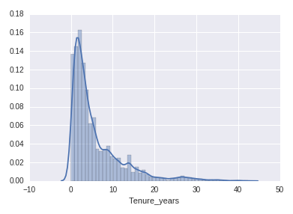
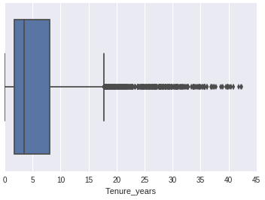
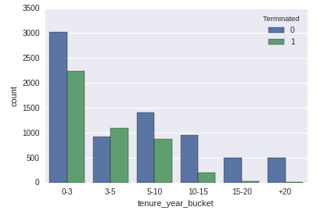
VISUALIZATION
INSIGHTS:
The distribution is right skewed with many people who have been in the company for a long time (15 + years.) If we take a look at the Attrition by Tenure buckets we can see that most of the people are leaving in the 0-3 to 5-10 years range. The 3-5 bracket has the most attrition.
HYPOTHESIS:
Most employees leave in the 0-5 years range as they might be looking for : better salary , better role . Trial and error time which leads to job shopping. Performance during these years might also be the cause for leaving as it takes time to understand the business and how one can contribute meaningfully. People who have been in the company for a long time ( > 5-7 years) are more settled and much less inclined to leave.
6

Slide 7
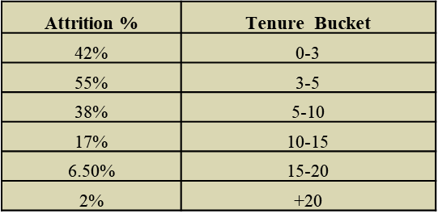
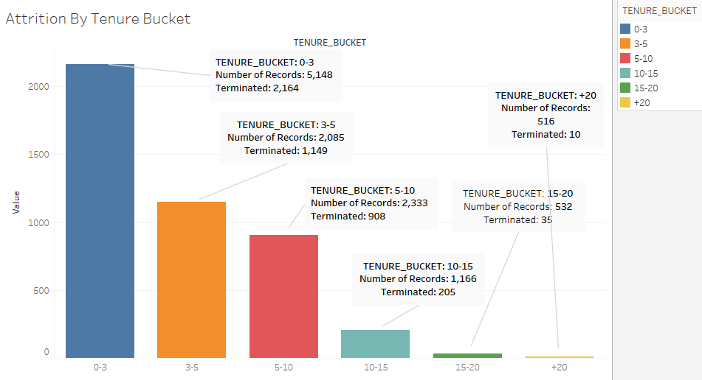
VISUALIZATION: Attrition by Tenure Bucket - Figures
Attrition in percentages
Insights:
The maximum attrition is in the 3-5 years Tenure bracket followed by 0-3 years. There is a gradual decrease in attrition levels as the Tenure years increase. This conforms with our earlier hypothesis that as the Tenure increases chances of leaving decrease
7

Slide 8
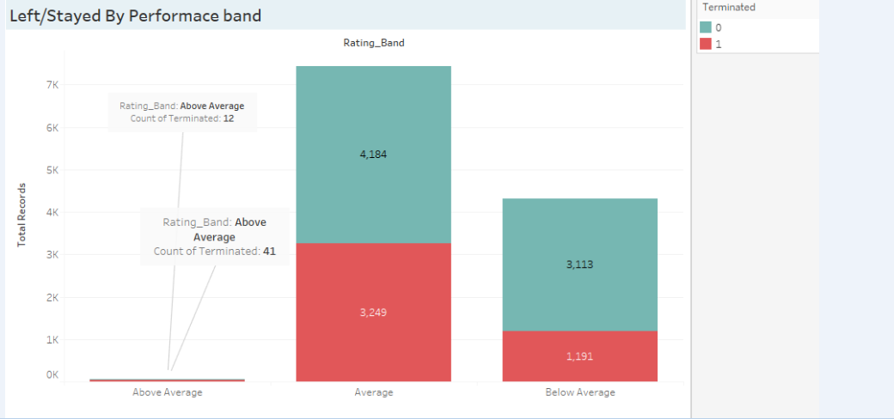
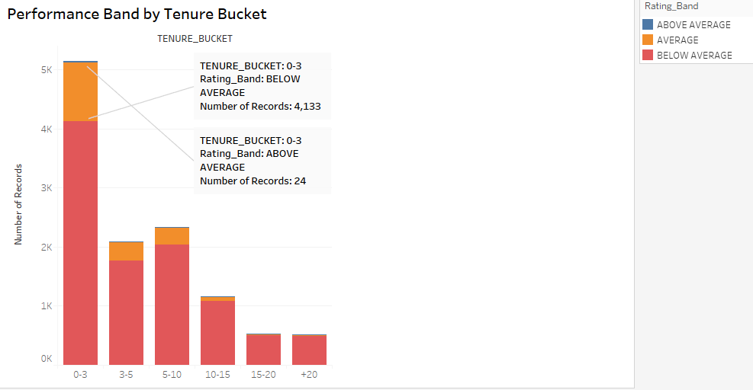
VISUALIZATION: Performance Issues
How are employees performing across Tenure Brackets:
Insights: Most of the employees are performing below average (Last Rating < 2) across all the Tenure Brackets. 43 % of the employees in the Average Rating Band( Last Rating:2 – 3) have left the organization. 28% of the below average performers have left. Overall these visuals suggest performance issues in the company. Is this because of Departmental problems or job misfit or Burnout?
Course of Action
Metrics like Number of Projects , Average working hours would be helpful in garnering more information.
8

Slide 9
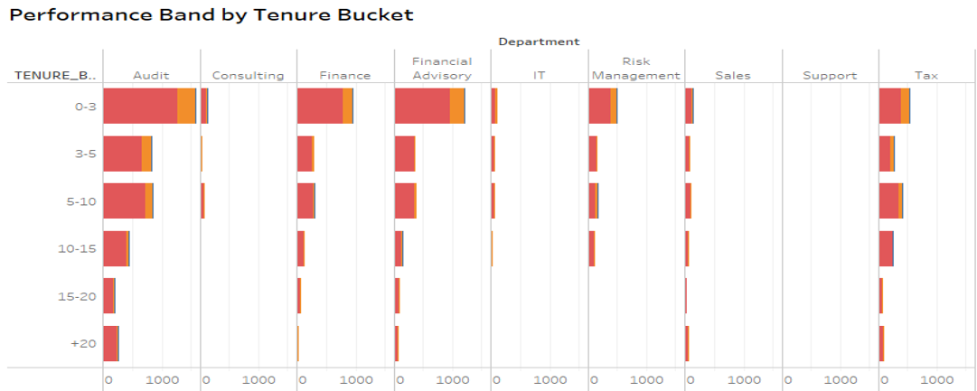
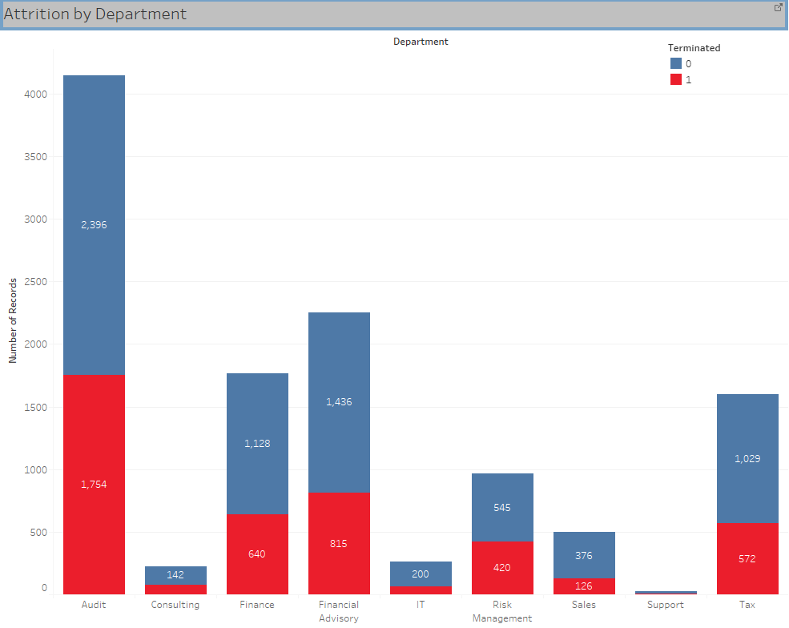
VISUALISATION : Departmental Problems?
The departments which get highlighted
Audit Finance and Financial Advisory Tax
Insights:
The attrition rates in these departments is the highest. Audit (43%) , Finance (36%) , Financial Advisory (36%) and Tax(35%) The performance of employees in these departments is mostly below average.
9

Slide 10
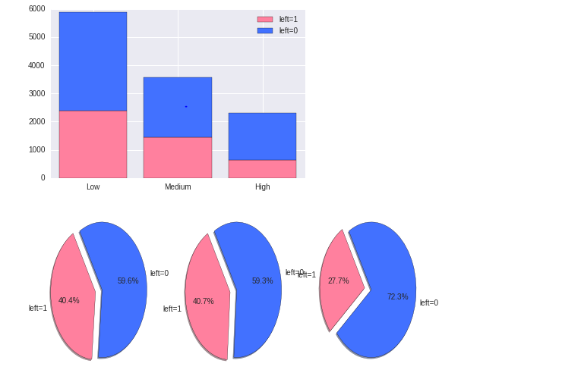
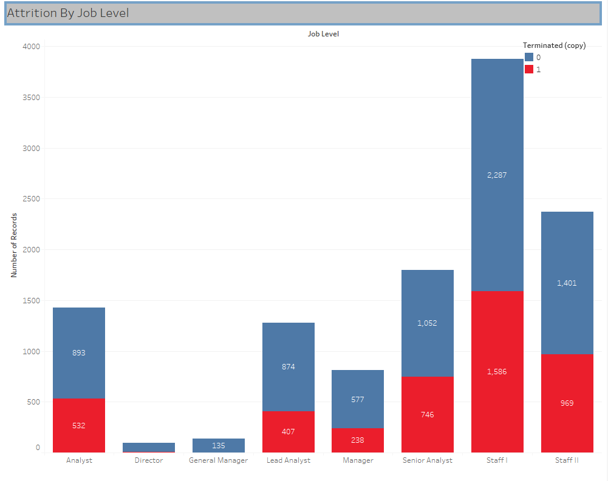
Visualization : Job Level / Salary Issues ?
Low Salary
There are a lot of people leaving in the Low(<= 1715 Annual Income) to Medium salary (1715 – 3000 Annual Income) bracket. The Staff I Level has the maximum attrition levels among all the Job Levels.
Insights:
40.4% and 40.7% of the employees in the Low – Medium Salary Bracket have left. Staff I , Staff II Job Levels have attrition Levels of about 41%. The Senior Analyst Job Level has the highest attrition rate of about 42% . The attrition level across all Analysts job level is around 38%.
Course of Action:
Are the employees at various Job Levels not satisfied : A metric like satisfaction indicator which can be captured from internal employee surveys would help in capturing the sentiment of the workforce.
10

Slide 11
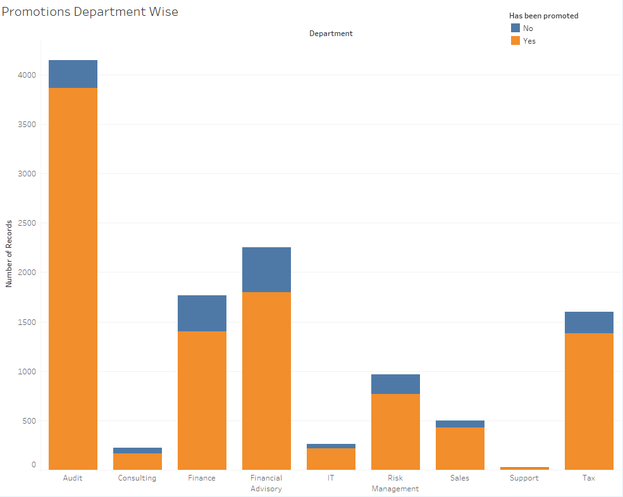
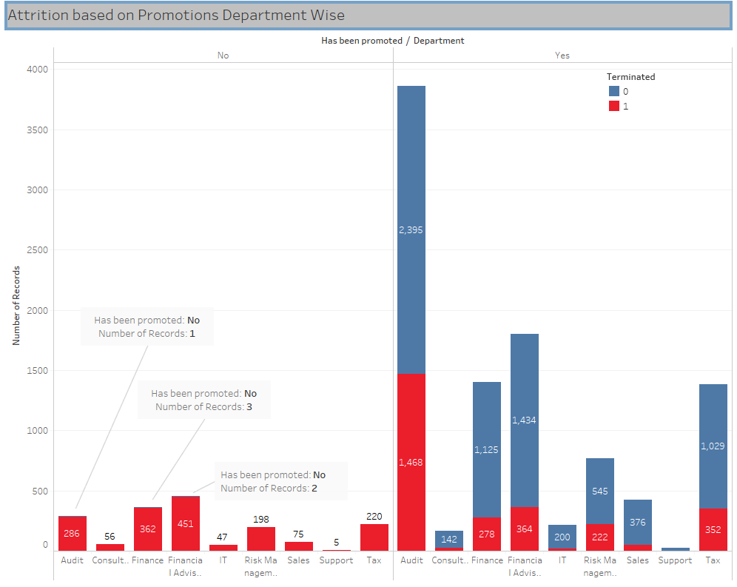
Visualization : Promotions
Promotions?
Overall the Promotions are quite high across the company at about 85%. But people who have not been promoted are also leaving quite heavily.
Insights:
In the Audit Department 286 people out of 287 who have not been given promotion have left. In Finance 362 out of 365 who had not been promoted have left. In Financial Advisory 451 out of 453 people who had not been promoted have left. Given that there are a large number of average – below average performers in the company and we have already seen some departments like Audit, Finance etc. have high attrition. It can be hypothesized that these low performers have not been given promotions, but that is not a reason for leaving. It may be that they have been overworked but still were not promoted.
Course of Action:
Are the employees at various Job Levels not satisfied : A metric like satisfaction indicator which can be captured from internal employee surveys would help in capturing the sentiment of the workforce.
11

Slide 12
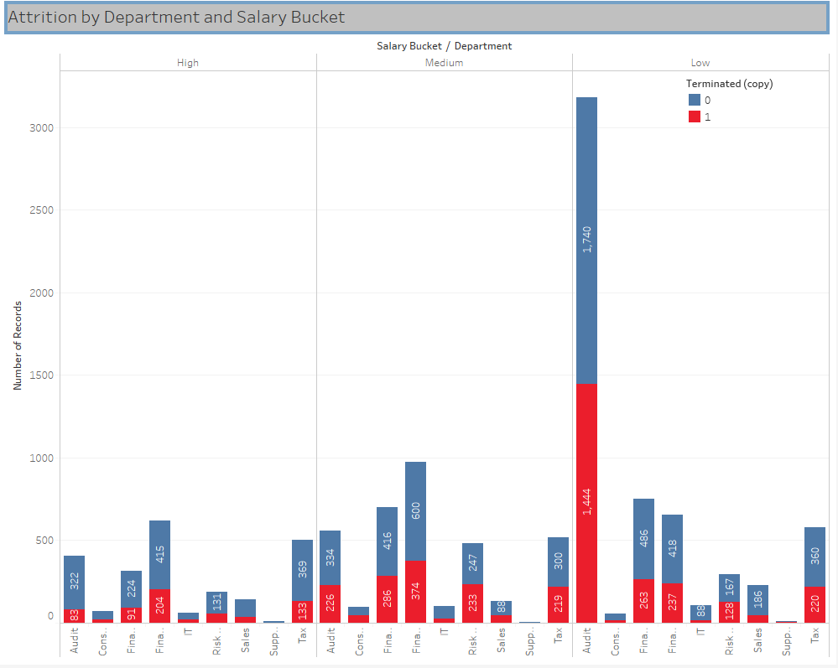
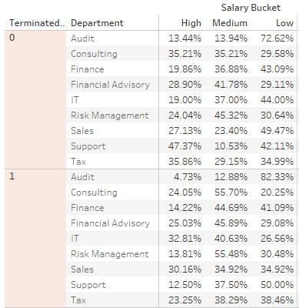
Visualization : Attrition across salary levels and departments
Salary levels & Departments
The attrition levels across the low and medium salary band are the maximum. The Audit ,Finance , Financial Advisory and Tax are the departments which have the most people in the Low , Medium Salary bracket.
Insights:
83 % of the employees in the Low salary bucket of Audit Department have left. 55% of the employees in the Medium salary bucket of Consulting have left. The visualizations suggest that Tenure , Promotions , Department and Salary are the most important factors which influence leaving or staying decisions.
12

Slide 13
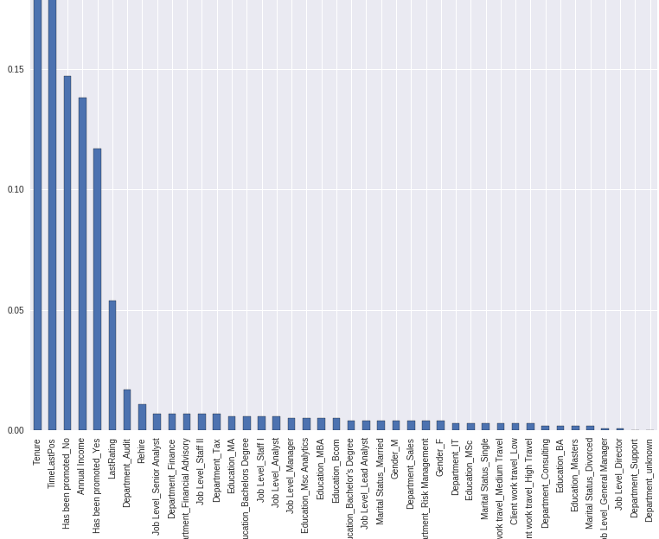
Feature Extraction
Feature Extraction
This plot shows the features ranked in descending order of their importance based on how each variable improves the information gain of the model. We can see that Tenure, TimeLastPos, Promotions , Salary and Department come out to be the most important ones as we had hypothesized earlier from the visualizations. TimeLastPos is highly correlated with Tenure and also this variable seemed to contain some spurious information we are not going to use it in our modelling phase. We have created categories across variables like Tenure and Salary because dividing continuous variables into buckets makes it easier to capture information which exists in silos. Ex. A difference of 1-100 dollars will not affect the probability of attrition as much as 1000 dollars which makes an employee lie in another salary band altogether. Also, when employees choose to leave due to Salary issues they are looking at far more than a few units increase in Salary.
13

Slide 14
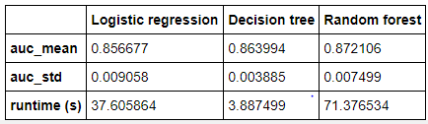
Attrition Risk Model
Model Consideration
I have considered three models: Logistic Regression : A generalized linear model which works well for binary classification problems and when the data is linearly separable. Decision Trees : Used when the data is non-linear and business rules are needed which can be integrated into IT systems. Can capture complex relationships between the variables. Random Forests : An ensemble of Decision Trees which helps in removing bias and variance. Based on the AUC metric of the three models I have chosen the one with the lowest AUC as that signifies a model with lowest variance which is one of the considerations while solving binary classification problems.
The decision tree has lowest Standard Deviation for the AUC metric and also it has the lowest run time , which is an important factor when running in production.
14

Slide 15
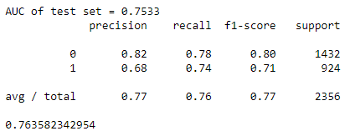
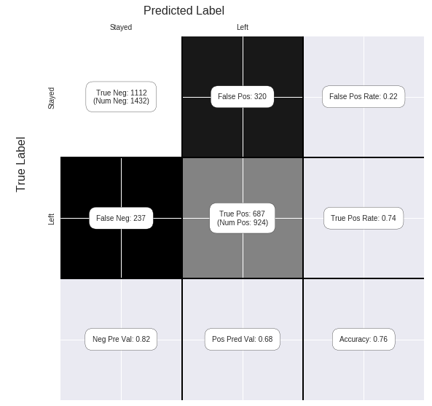
Attrition Risk Model │ Model Evaluation (Decision Tree)
Metrics
Accuracy : 76%. AUC score : 75%. Precision : 68%. Recall : 74% F1-Score : 0.71
15

Slide 16
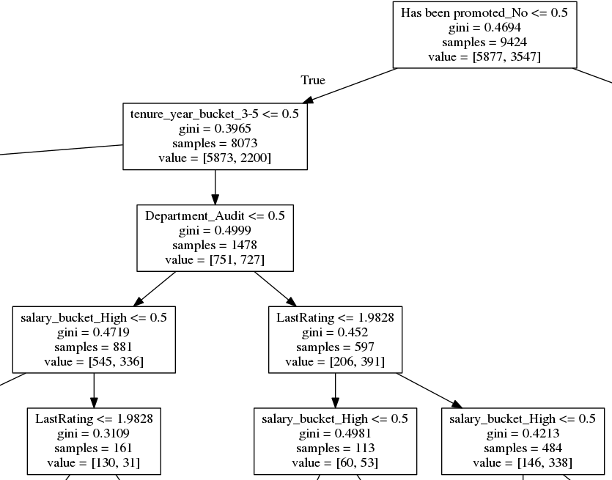
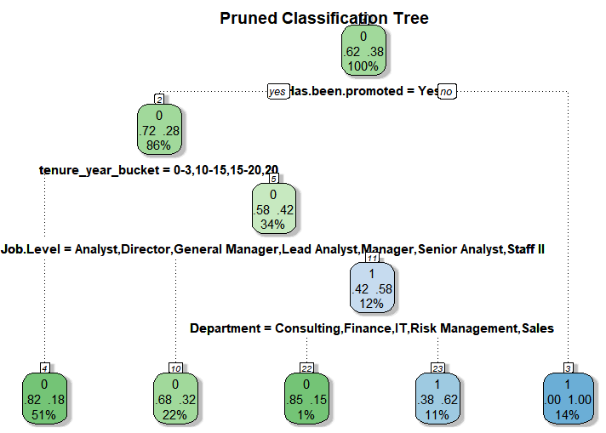
Attrition Risk Model │ Model Interpretation (Decision Tree)
Model Interpretations
Decision Trees generate rules and a tree structure can be visualized from those rules as shown in the adjoining figures. These rules can be converted to if-else statements which can easily be integrated into the business systems for implementation purposes.
Interpretation
When has_been_promoted is No and Tenure year bucket is ‘3-5’ years and Department is Audit then the probability of an employee leaving is about 49%. Further down, if has_been_promoted is No and Tenure year bucket is 3-5 years and Department is Audit and salary_bucket is High then probability of leaving is 38%. The pruned tree ( to avoid overfitting) shows that probability of his leaving is 28% and further down if his job level is amongst Analyst, Director, General Manager, Lead Analyst, Manager , Senior Analyst and Staff II his probability of leaving is only 18%.
16

Slide 17
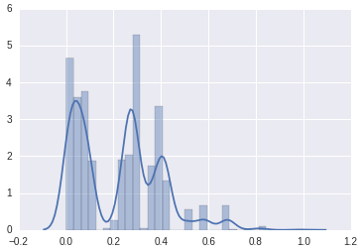
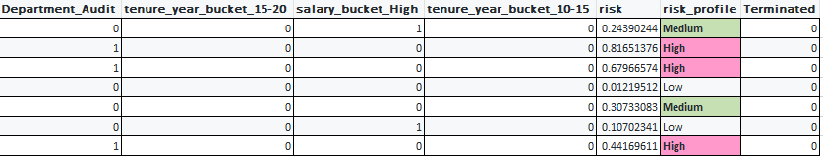
Attrition Risk Model │ Defining the Risk Profile
Risk Profile
Using the rules generated by the Decision Tree we can define the risk profile of the employees who have not left based on their attributes and assigning a cutoff probability for each risk bracket. Based on the histogram of predicted probabilities, the risk profile is defined as: Predicted Probability >= 0.0 and Predicted Probability < 0.20 : risk_profile = 'Low’ Predicted Probability >= 0.20 and Predicted Probability < 0.40:risk_profile = 'Medium’ Predicted Probability >= 0.40:risk_profile = 'High'
17

Slide 18
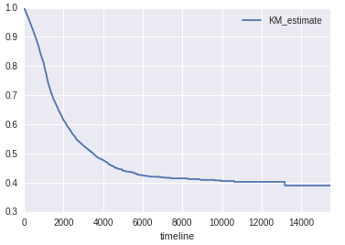
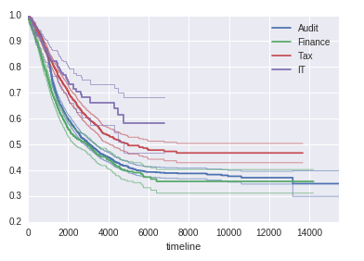
Survival Analysis
Survival Analysis
The survival function shows that after about 4 years about 30% of the sample would have left. The department wise breakup demonstrates that across the departments Audit, Finance, Tax the attrition rates are almost similar while in IT it is very low. The sharpest decline is in the range of 0-6 years as is evident from the drop in the survival function in this range. This shows that it is in the initial years of an employee that he is most likely to leave because of external or internal factors. But once the threshold of 6-7 years is crossed the chances of an employee leaving reduce.
18

Slide 19
CONCLUSION
Analysis
Promotions, Tenure , Department and Performance Rating as major causes of employees leaving. Certain departments like Audit have high percentage of low performers and also people who have left. From the data it is evident that Performance is a major issue in the company. Further data to suggest if performance issues are due to role misfit or some other factor like working concurrently on too many projects is not available.
Recommendations
Internal survey to capture the sentiment of the workforce. Define more variables to be captured : WorkHours , NumberOfPromotions , AverageRating etc. as applicable. Integrate exit interview data with current data cuts if applicable.
19

