Slide 1
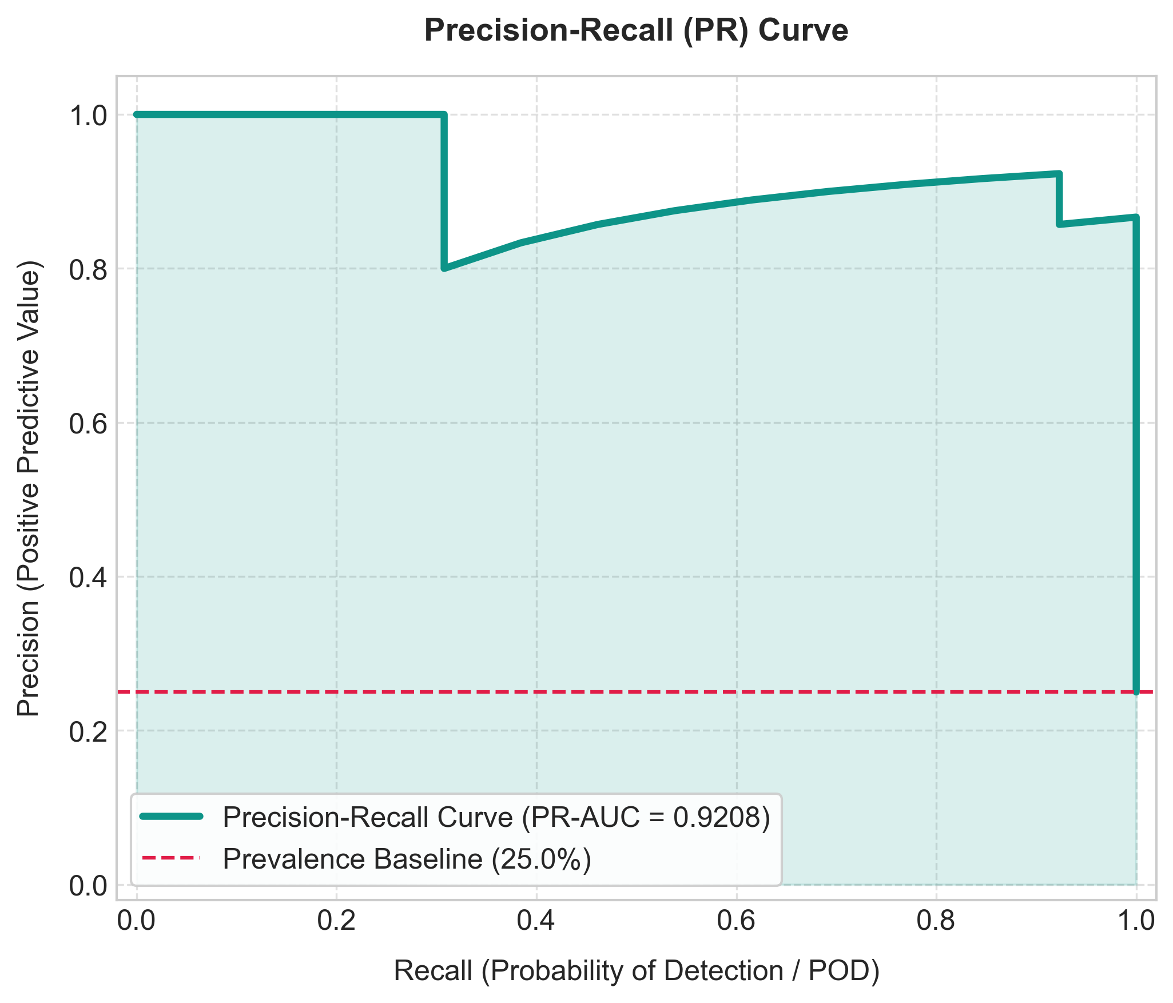
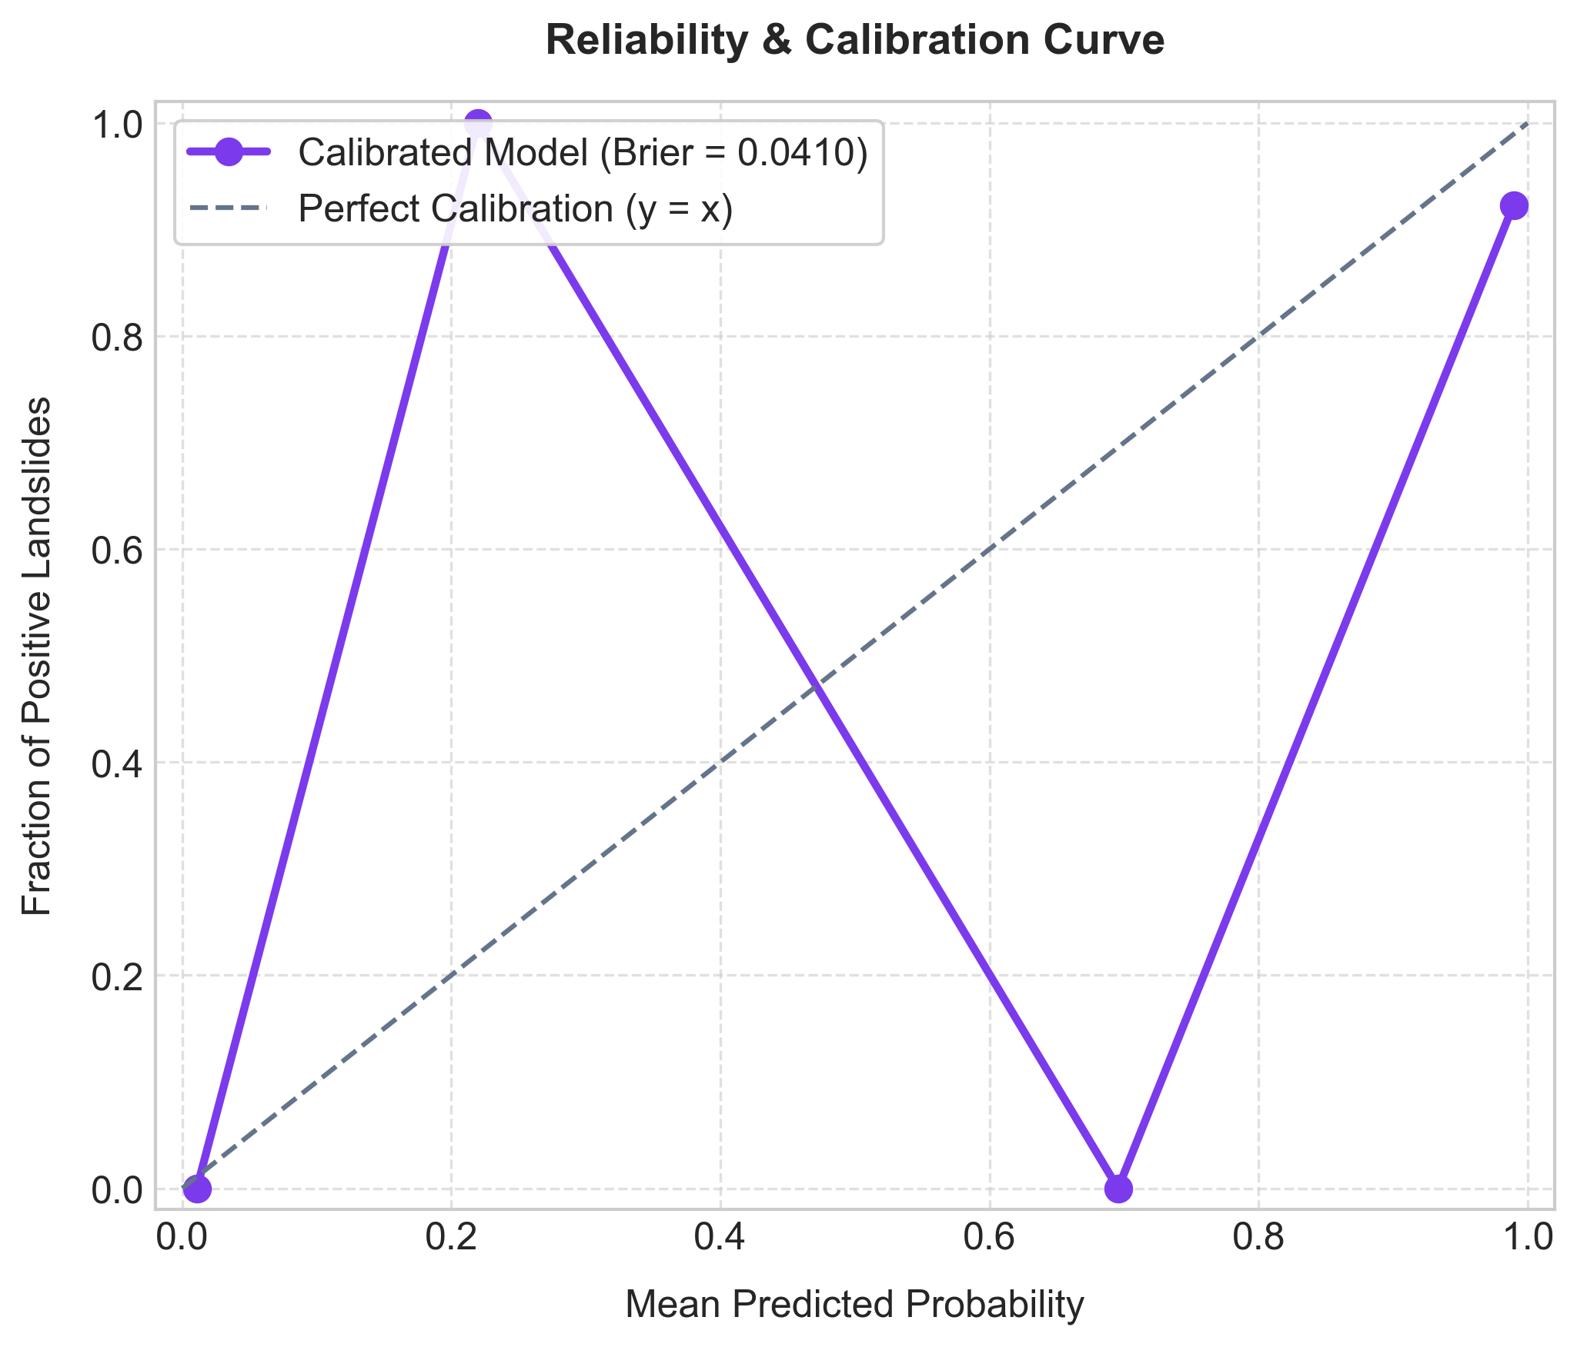
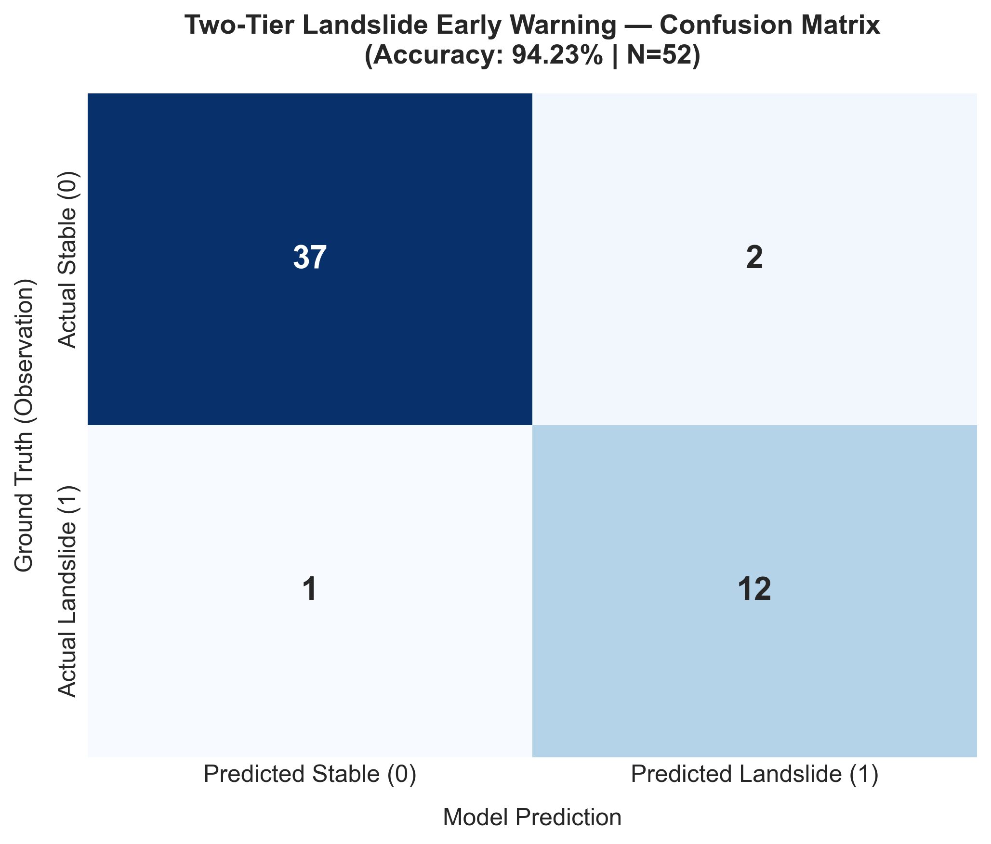
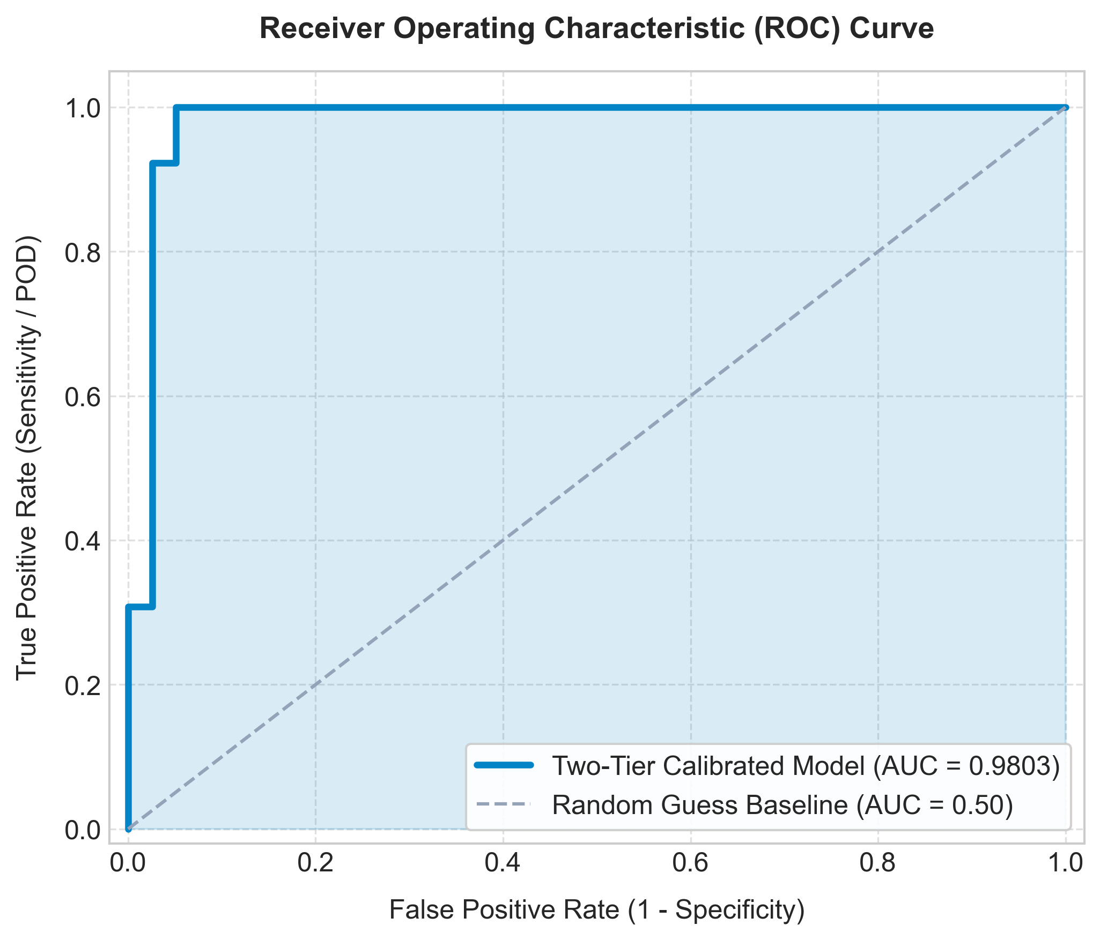
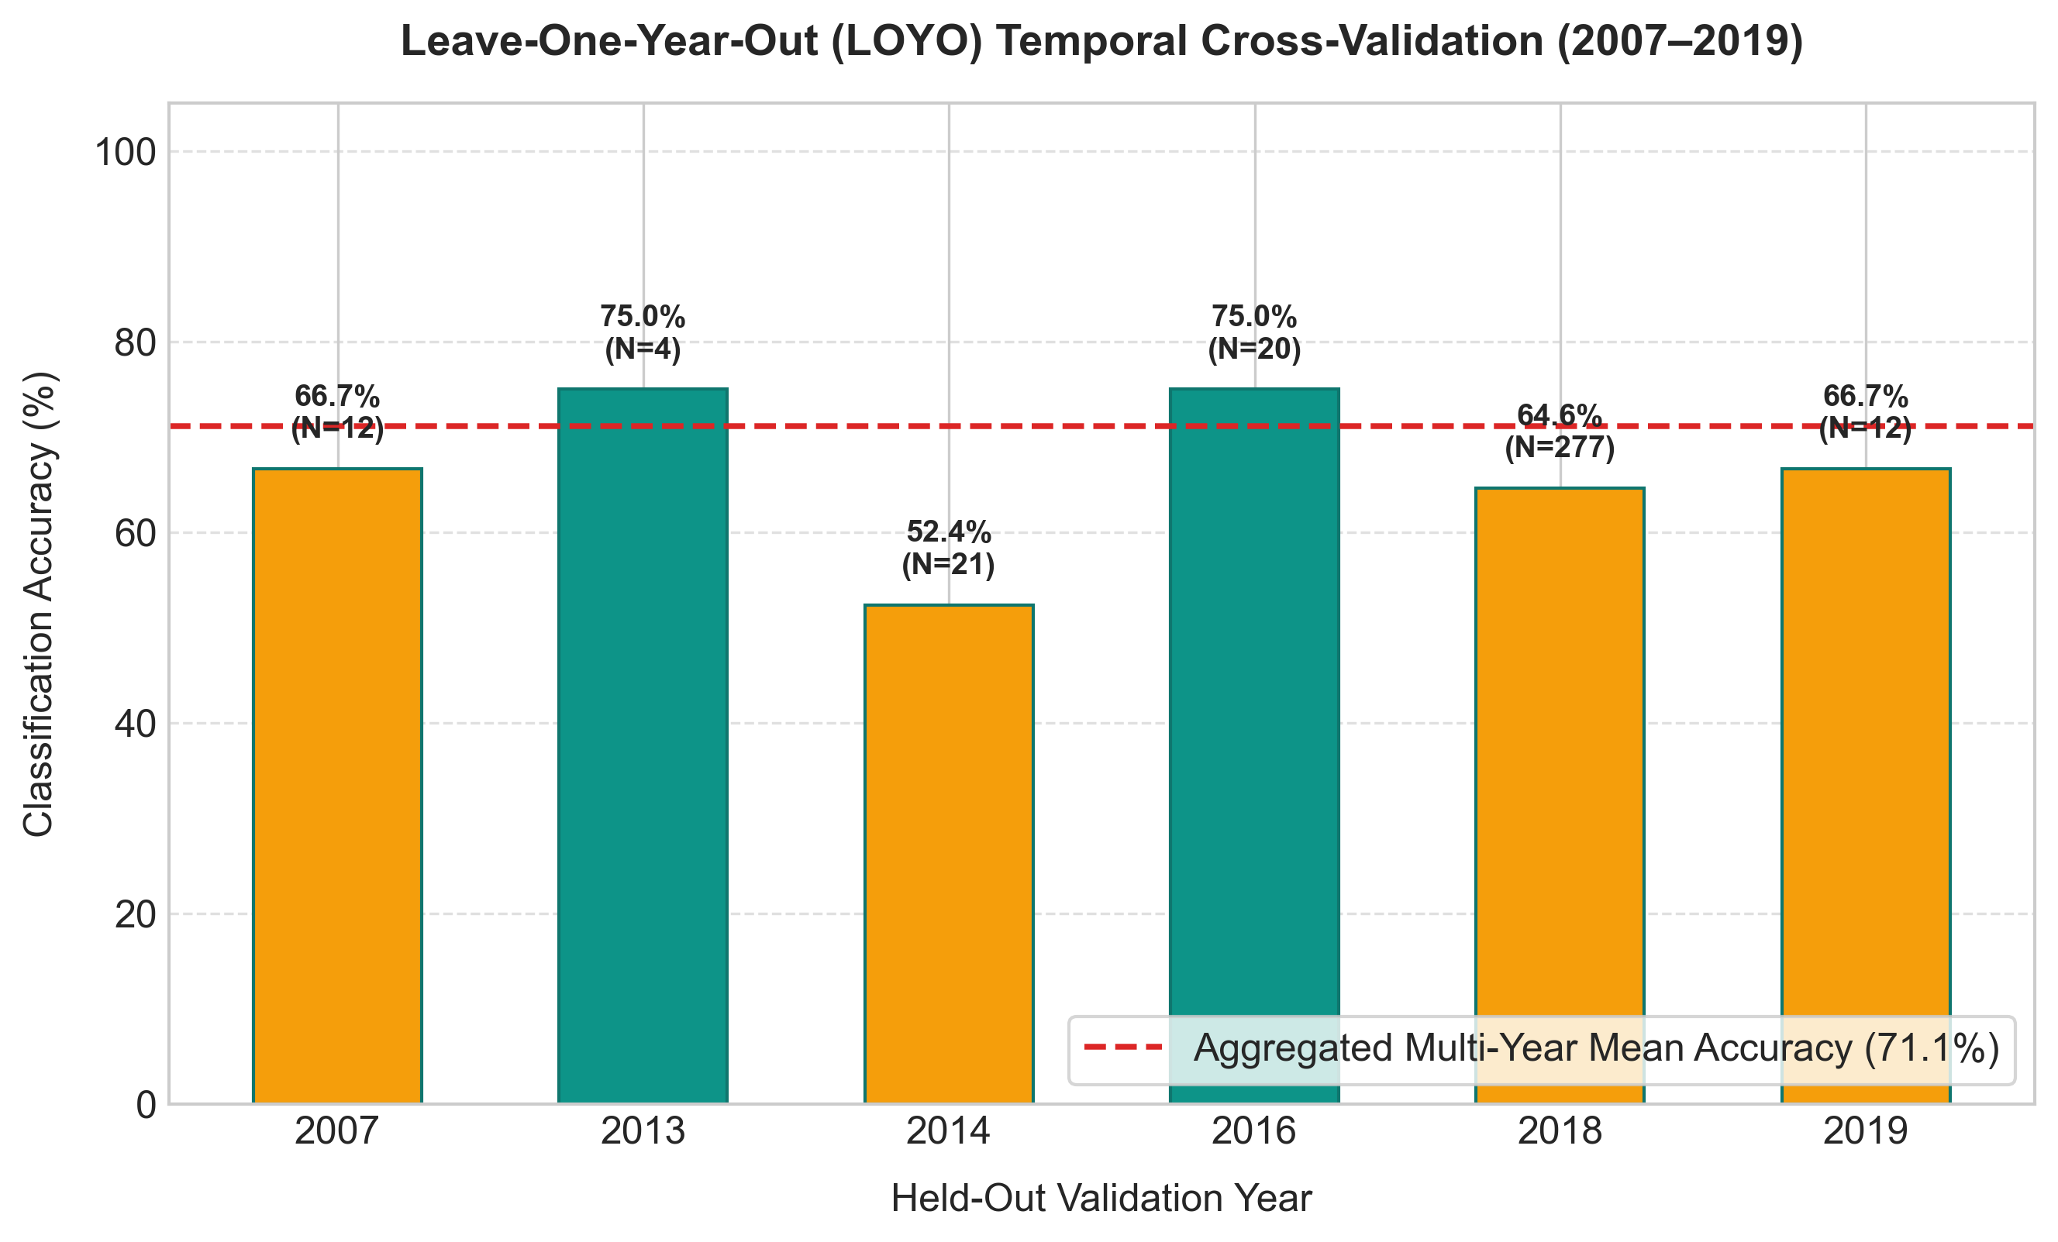
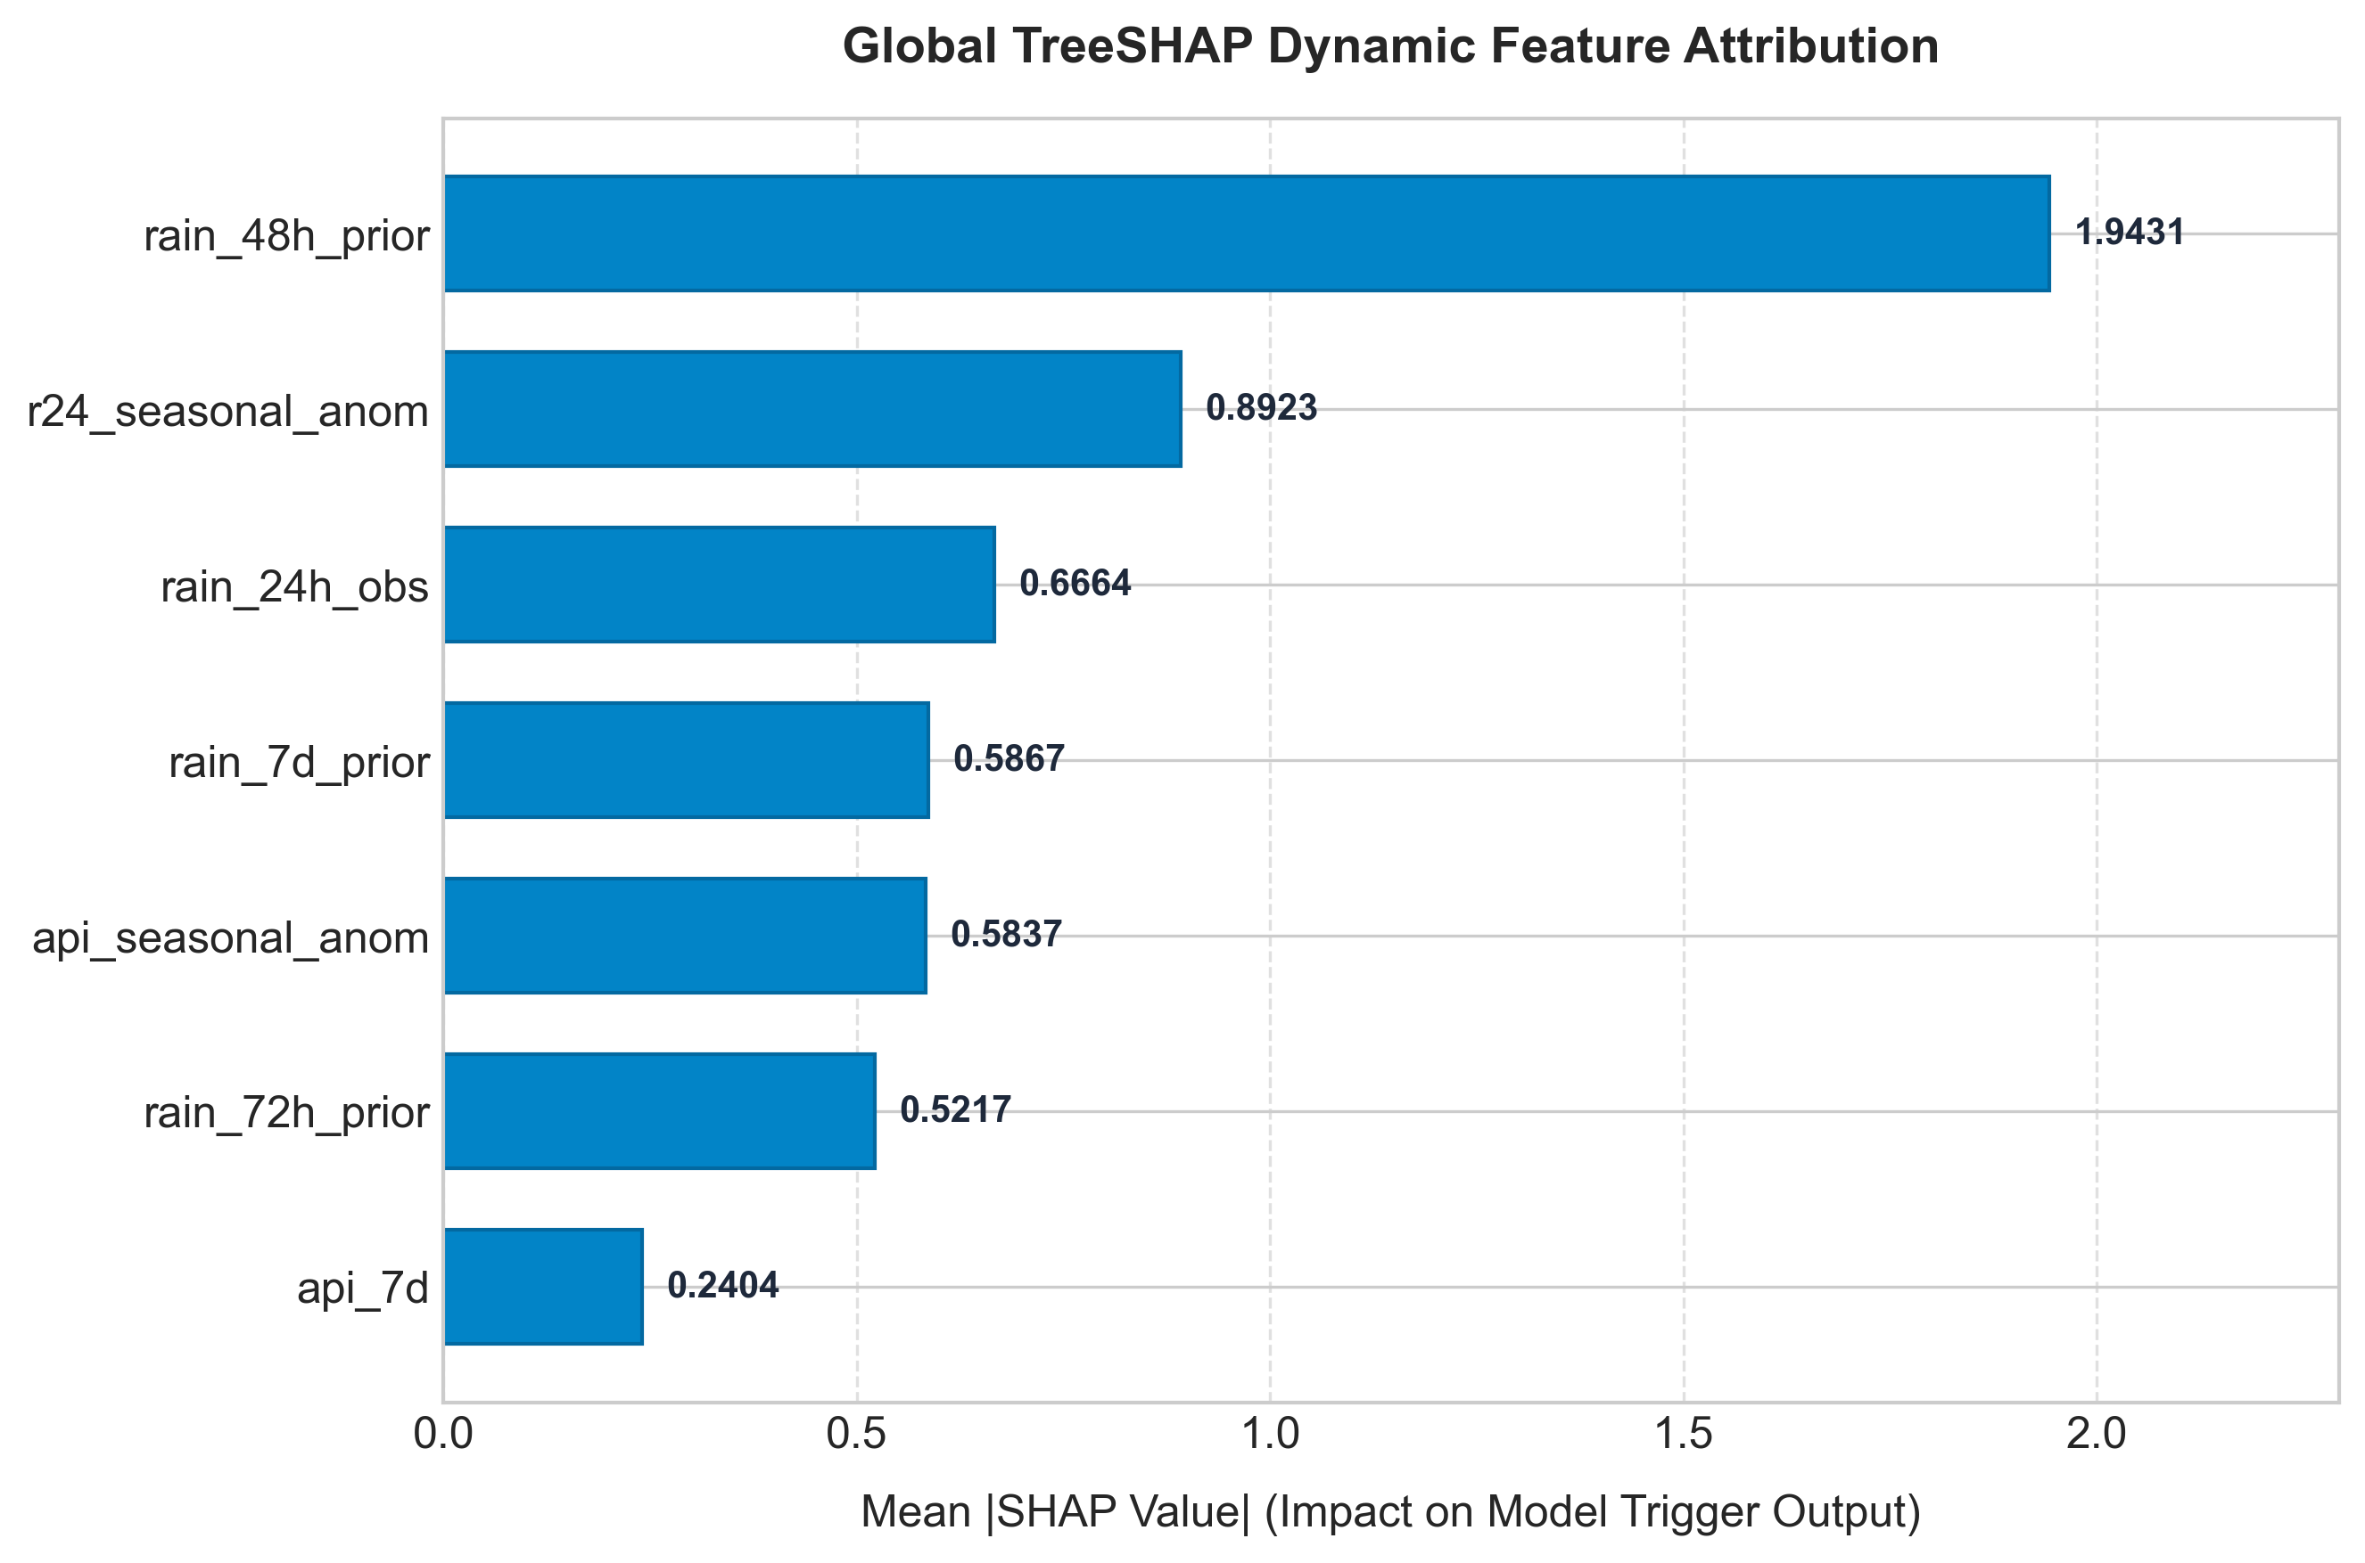
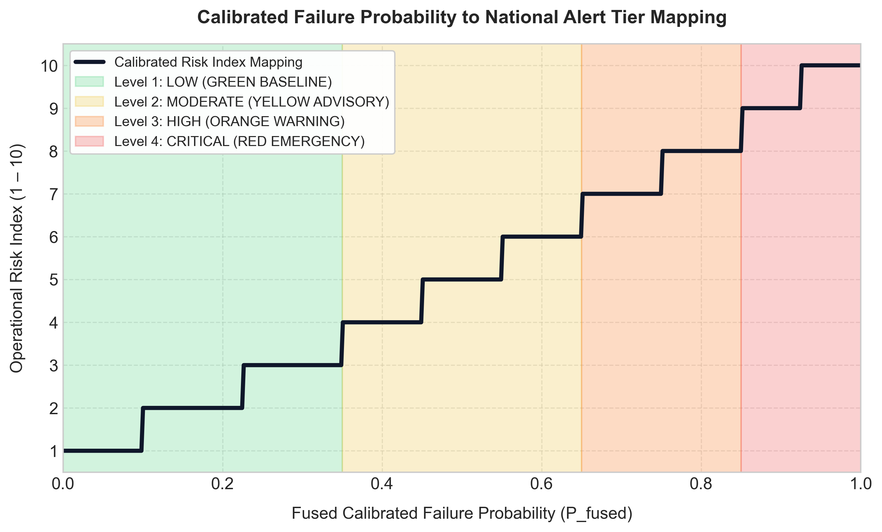
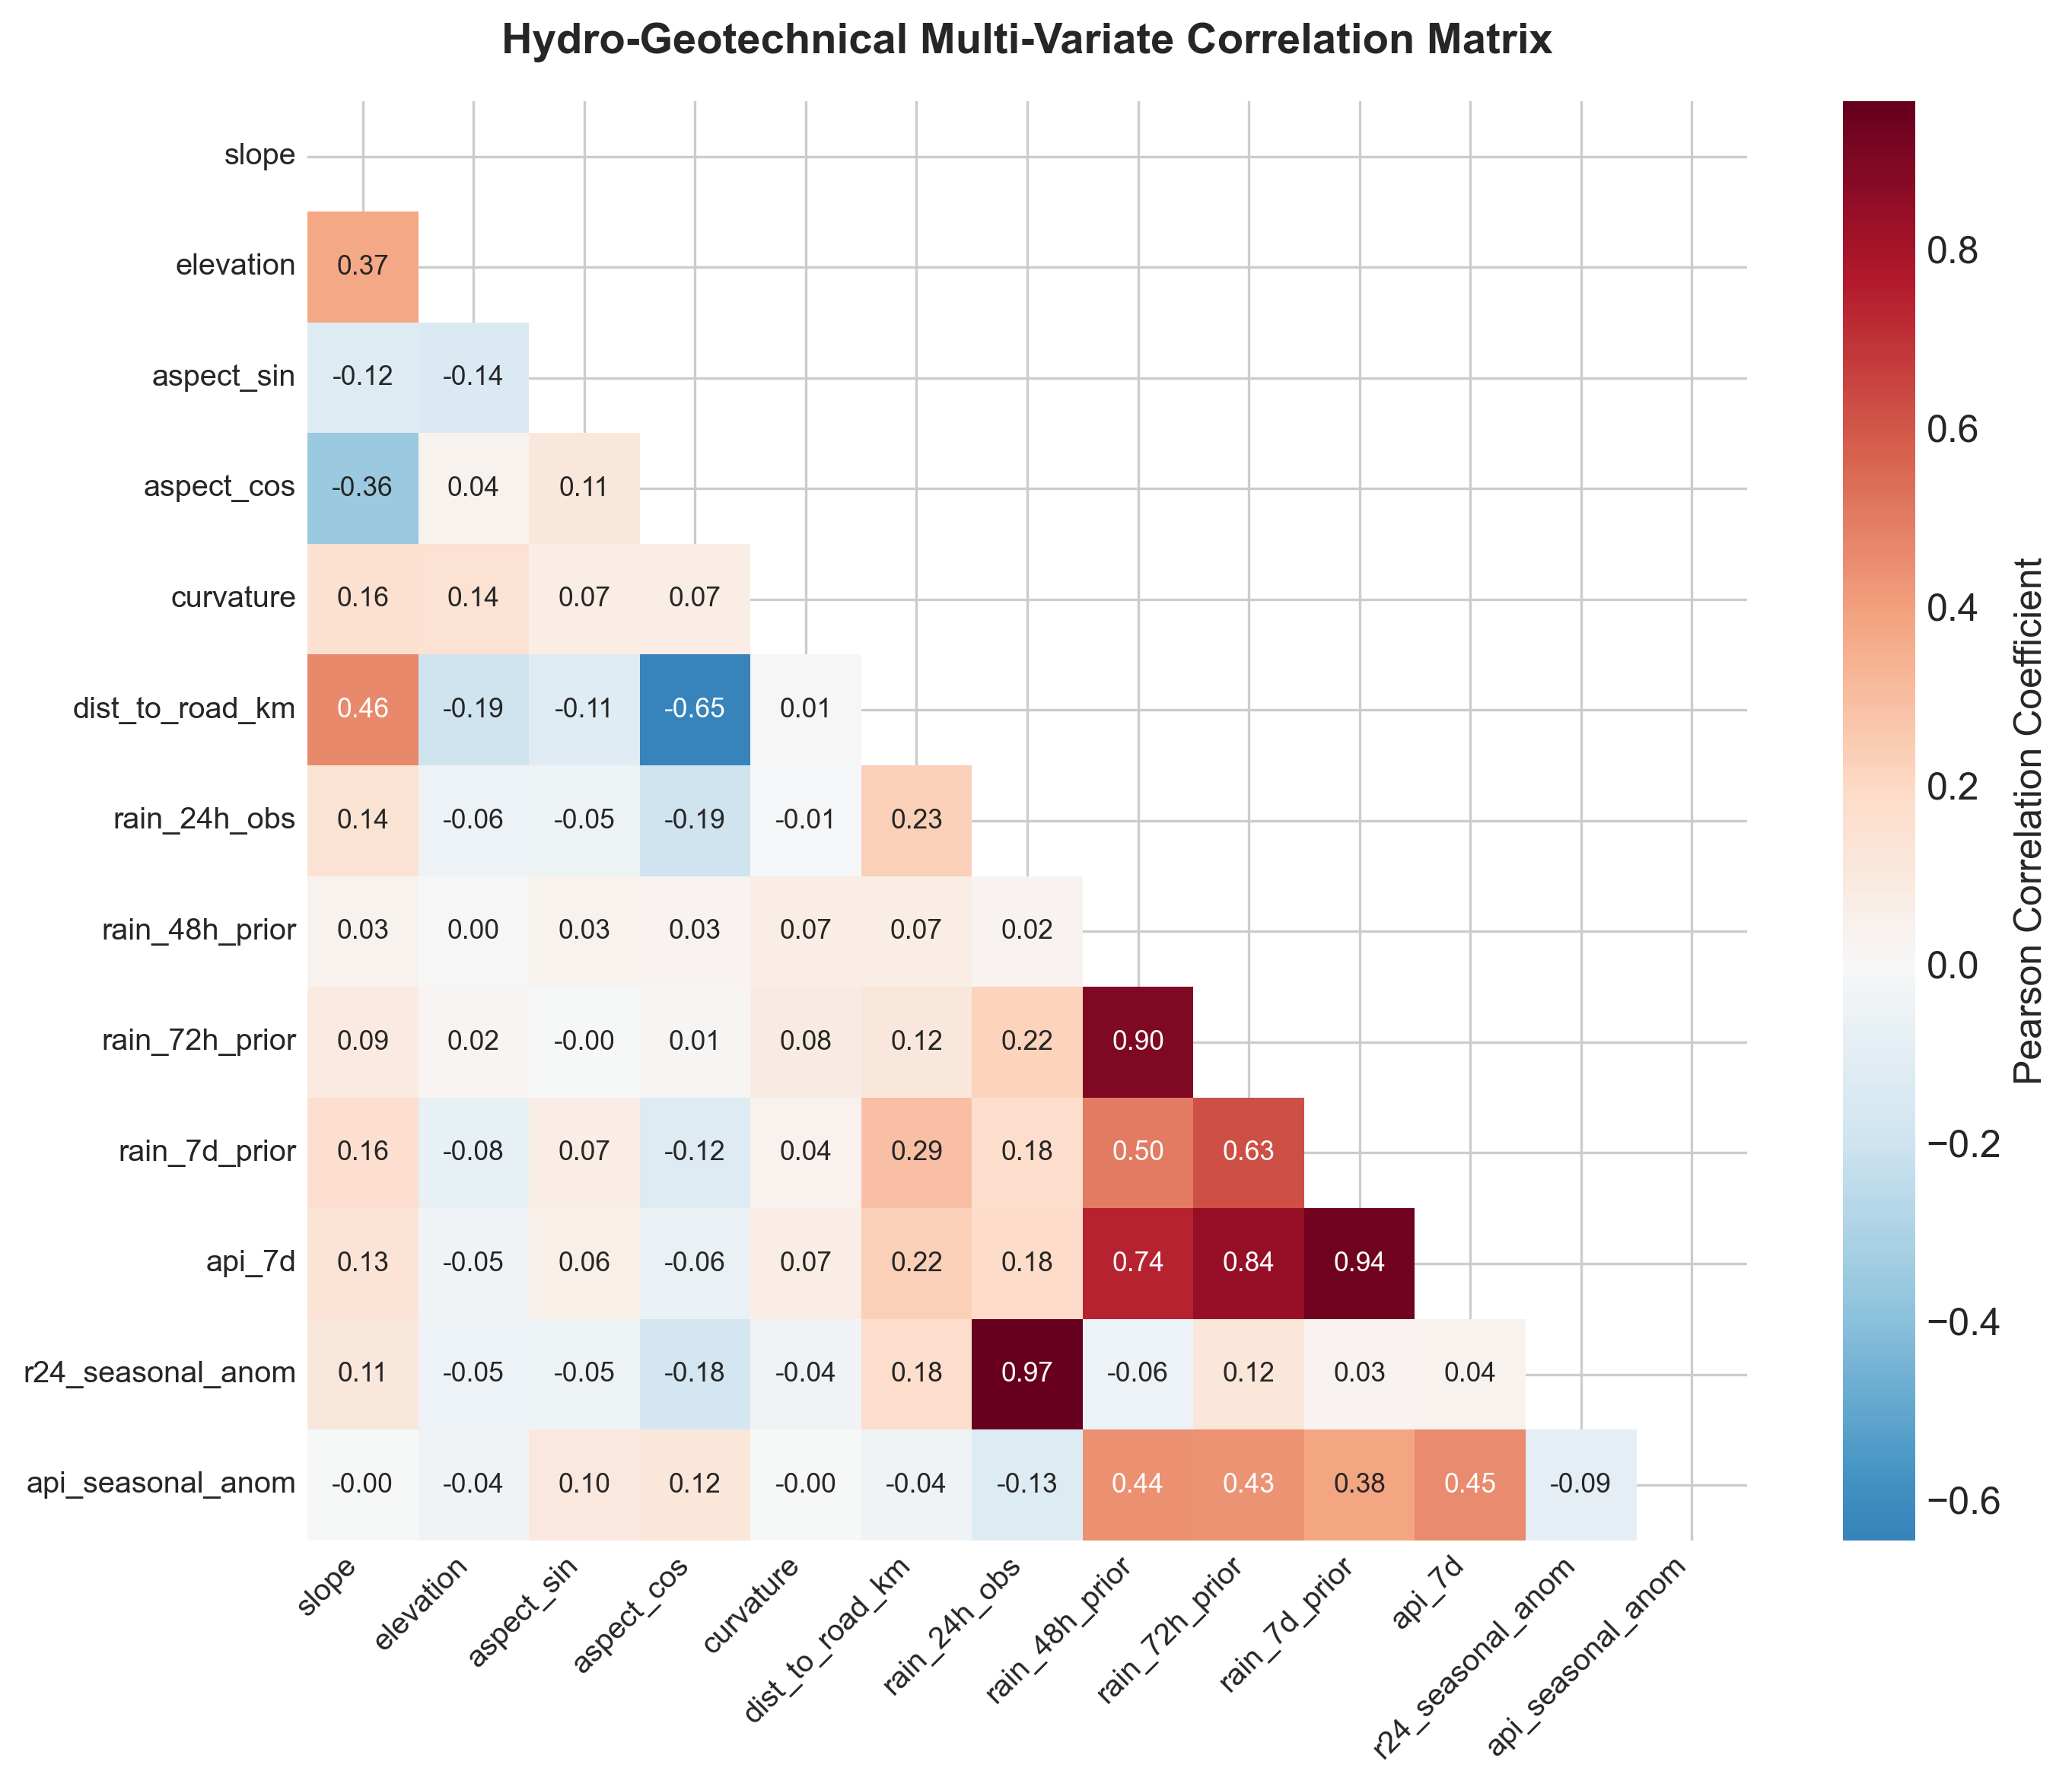
AI-Driven Two-Tier Landslide Early Warning & Disaster Resilience Grid for North-East India (NER)
XGBoost Two-Tier Stacking | Meta-Calibrator Fusion | Real-Time IoT Telemetry | InSAR Ground Deformation | Dijkstra Evacuation Routing | OASIS CAP v1.2 Multi-Lingual Alert
Dr. R. Rajmohan | Disaster Management Research Group, SRM Institute of Science & Technology | Coord: 20-30N, 88-98E | NH-10, NH-27, NH-29, NH-44
Artificial Intelligence
Geotechnical Eng.
Satellite Remote Sensing
Disaster Risk Reduction
Study Context & Problem Statement
Performance Metrics Dashboard
Global TreeSHAP Dynamic Feature Attribution
North-East India reports >200 monsoon fatalities annually from landslides across 8 national highways. Existing threshold systems lack spatial specificity and probabilistic calibration.
MINDMELD decouples static terrain susceptibility S(x) from dynamic hydro-geotechnical triggers T(x,t) via a two-tier XGBoost stacking architecture with a meta-calibrator fusion engine, producing calibrated P_fused mapped to 4 NDMA operational alert tiers.
Holdout Test | Spatial Block OOF | LOYO Temporal
Trigger Model - Mean |SHAP Value| ranking
Test Partition (N=52)
rain_48h_prior
1.8878 (34.7%)
Accuracy
Precision
POD/Recall
ROC-AUC
PR-AUC
Brier
r24_seasonal_anom
0.8781 (16.1%)
94.23%
85.71%
92.31%
0.9803
0.9208
0.0410
rain_24h_obs
0.7105 (13.1%)
Spatial Block OOF (N=346)
rain_7d_prior
0.6528 (12.0%)
Accuracy
Precision
POD/Recall
ROC-AUC
PR-AUC
Brier
Bounding Box
8 NE States
Dataset
IoT Nodes
85.84%
75.95%
66.67%
0.8816
0.8177
0.0991
api_seasonal_anom
0.5773 (10.6%)
20N-30N
88E-98E
Assam+7 states
1152 events
2007-2019
40-node grid
LOYO Temporal (N=346, 2007-2019)
rain_72h_prior
0.4913 (9.0%)
Accuracy
Precision
POD/Recall
ROC-AUC
PR-AUC
Brier
api_7d
0.2419 (4.5%)
Two-Tier XGBoost Stacking Architecture
71.10%
41.67%
27.78%
0.5925
0.3870
0.2176
TIER 1 - Static Susceptibility S(x)
Confusion Matrix - Test Partition (theta=0.35, N=52)
Precision-Recall & Calibration Reliability Curves
Inputs: slope, elevation, aspect_sin, aspect_cos, curvature, dist_to_road_km
XGBoost: n_est=180, max_depth=6, eta=0.30, lambda=1.0, seed=42
Output: P_susc in [0,1] | Logit: zeta_1 = ln[P/(1-P)]
Pred 0
Pred 1
TIER 2 - Dynamic Trigger T(x,t)
Act 0
37
2
Inputs: rain_24h, rain_48h_prior, rain_72h, rain_7d, API_7d,
r24_seasonal_anom, api_seasonal_anom
XGBoost: n_est=100, max_depth=6, eta=0.30, base_score=0.26
Output: P_trig in [0,1] | Logit: zeta_2 = ln[P/(1-P)]
Act 1
1
12
TP=12
TN=37
FP=2
FN=1
META-CALIBRATOR - LR Fusion Engine
Z = [zeta_1, zeta_2]^T | LR: L2 penalty, C=1.0, lbfgs
P_fused = sigma(w0 + w1*zeta_1 + w2*zeta_2) | Threshold theta=0.35
R_k = f(P_fused) -> NDMA {GREEN | YELLOW | ORANGE | RED}
Geotechnical Physics - Infinite Slope Factor of Safety
Fig 3. PR Curve (AUC=0.9208)
Fig 4. Reliability (Brier=0.0410)
Terzaghi Effective Stress
Leave-One-Year-Out Temporal Validation (2007-2019)
sigma_prime = (gamma_s*z - gamma_w*h_w)*cos^2(beta)
Year
N
Acc%
Prec%
POD%
FAR%
AUC
Mohr-Coulomb Shear Strength
2007
12
66.67
0.00
0.00
100.0
0.222
tau_f = c_prime + sigma_prime * tan(phi_prime)
2013
4
75.00
0.00
0.00
0.00
1.000
Infinite Slope FS
2014
21
52.38
0.00
0.00
100.0
0.378
FS = [c_prime + (gamma_s*z - gamma_w*h_w)*cos^2(beta)*tan(phi_prime)] / [gamma_s*z*sin(beta)*cos(beta)]
Fig 1. Confusion Matrix Heatmap (Test N=52, theta=0.35)
2016
20
75.00
0.00
0.00
0.00
0.400
Critical Rainfall Depth h_w*
2018
277
64.62
23.53
16.90
76.47
0.564
h_w* = z - [c_prime/(gamma_w*cos^2(beta)*tan(phi_prime))] + [z*tan(beta)/tan(phi_prime)]
2019
12
66.67
33.33
33.33
66.67
0.296
Richards PDE (Transient Seepage)
d(theta)/dt = d/dz[K(h)*(dh/dz + 1)] - S(z,t)
MEAN
346
71.10
41.67
27.78
58.33
0.593
Antecedent Precip Index
API_t = SUM[k=0..n] P_(t-k) * exp(-k/tau) [tau=7-day decay]
Seasonal Anomaly
Anom_t = (P_t - mu_clim(doy)) / sigma_clim(doy)
TreeSHAP Global Dynamic Feature Attribution
Fig 2. ROC Curve (AUC=0.9803) - Two-Tier Calibrated Model
Fig 5. LOYO Multi-Year Accuracy Bar (Mean=71.10%)
Real-Time System Components
Sentinel-1A InSAR
40-Node IoT Grid
C-Band SAR | LOS ~1-3 mm
Interferogramme unwrapping
Piezometers + MEMS IPI
AsyncIO FastAPI @ 5-min poll
Fig 6. Global TreeSHAP - rain_48h_prior dominates (34.70%)
Dijkstra EV-Router
CAP v1.2 Alerts
Calibrated Risk to NDMA Alert Tier Mapping
NetworkX multigraph G=(V,E,W)
C_risk = 100*P^2 + 10*P + 1
OASIS XML/JSON + Haversine
8-language SMS broadcast engine
Fig 7. P_fused -> R_k (1-10) -> NDMA {Green|Yellow|Orange|Red} theta=0.35
Hydro-Geotechnical Feature Correlation Matrix
AI-Driven Two-Tier Landslide EWS | Dr. R. Rajmohan | SRM Institute of Science & Technology
Dataset: N=1,152 events (2007-2019) | Python 3.14 + XGBoost + scikit-learn + FastAPI | 2026
Fig 8. Pearson Correlation - Static + Dynamic Feature Matrix (13 vars)

