Slide 1

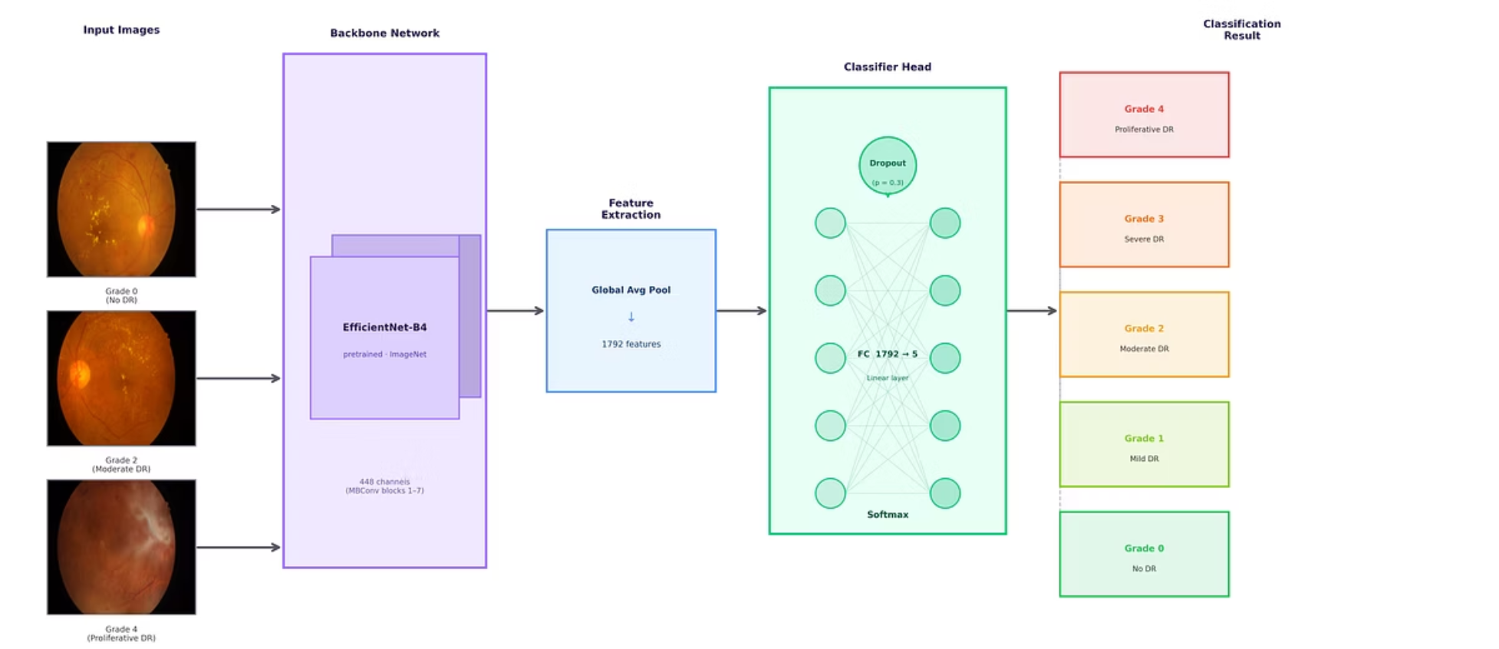
METHODOLOGY
Dataset & Model Architecture
Dataset
Model Architecture
EyePACS: 35,126 retinal images
Dataset Imbalance: put weight on Grade 4
Dataset Distribution: 75% Training, 15% Validation, 15% Testing
Backbone: EfficientNet-B4 (ImageNet transfer learning)
Global Average Pooling → 1,792 features
Dropout (p=0.3) → Fully Connected (1,792 → 5)
Training: Adam + weighted cross-entropy
10 epochs with cosine learning rate scheduler

