Slide 1
What is MapReduce?
MapReduce is a framework using which we can write applications to process huge amounts of data, in parallel, on large clusters of commodity hardware in a reliable manner.
MapReduce is a processing technique and a program model for distributed computing based on java.
The MapReduce algorithm contains two important tasks, namely Map and Reduce.
Map takes a set of data and converts it into another set of data, where individual elements are broken down into tuples (key/value pairs).
Secondly, reduce task, which takes the output from a map as an input and combines those data tuples into a smaller set of tuples. As the sequence of the name MapReduce implies, the reduce task is always performed after the map job.

Slide 2
What is MapReduce?
The major advantage of MapReduce is that it is easy to scale data processing over multiple computing nodes.
Under the MapReduce model, the data processing primitives are called mappers and reducers.
Decomposing a data processing application into mappers and reducers is sometimes nontrivial. But, once we write an application in the MapReduce form, scaling the application to run over hundreds, thousands, or even tens of thousands of machines in a cluster is merely a configuration change.
This simple scalability is what has attracted many programmers to use the MapReduce model.

Slide 3
What is MapReduce?
MapReduce program executes in three stages, namely map stage, shuffle stage, and reduce stage.
Map stage: The map or mapper’s job is to process the input data. Generally the input data is in the form of file or directory and is stored in the Hadoop file system (HDFS). The input file is passed to the mapper function line by line. The mapper processes the data and creates several small chunks of data.
Reduce stage: This stage is the combination of the Shuffle stage and the Reduce stage. The Reducer’s job is to process the data that comes from the mapper. After processing, it produces a new set of output, which will be stored in the HDFS.

Slide 4
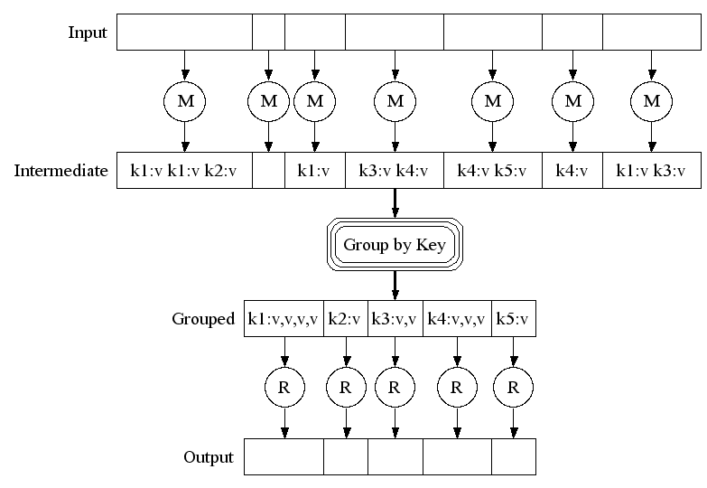
The MapReduce Framework

Slide 5
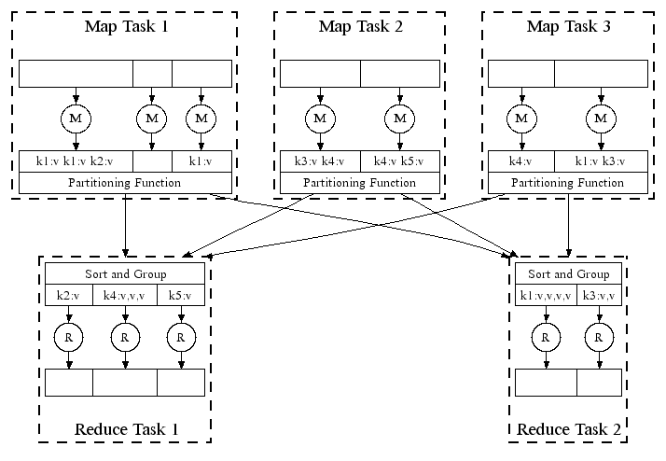
Automatic Parallel Execution
Handles failures automatically, e.g., restarts tasks if a node fails; runs multiples copies of the same task to avoid a slow task slowing down the whole job

Slide 6
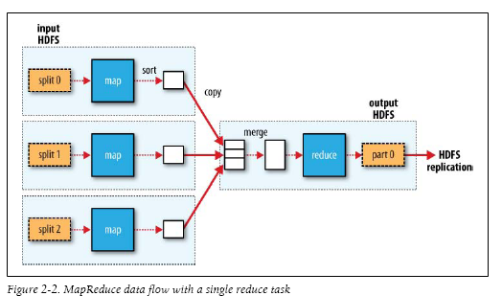
MapReduce in Hadoop (1)

Slide 7
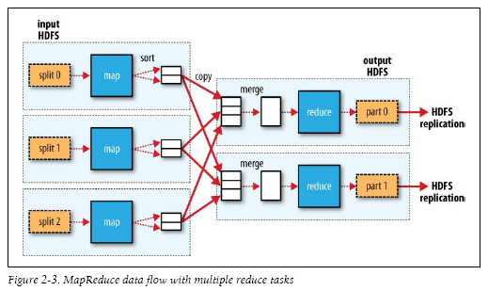
MapReduce in Hadoop (2)

Slide 8
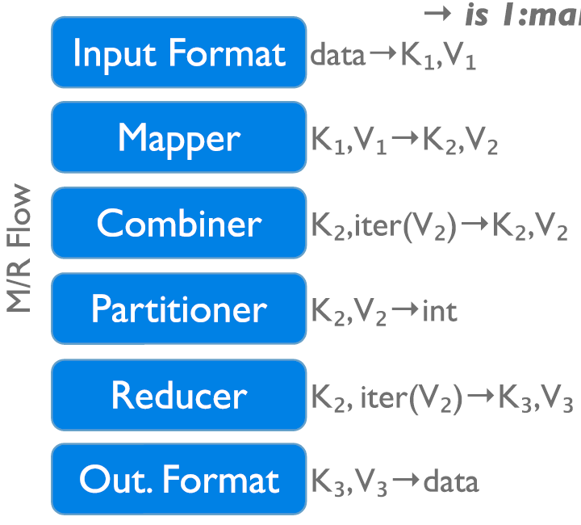
Data Flow in a MapReduce
→ 1:many
InputFormat
Map function
Partitioner
Sorting & Merging
Combiner
Shuffling
Merging
Reduce function
OutputFormat

Slide 9
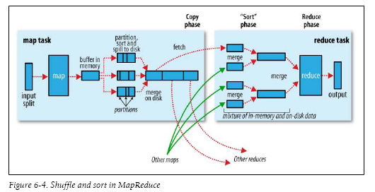
Data Flow in a MapReduce

Slide 10
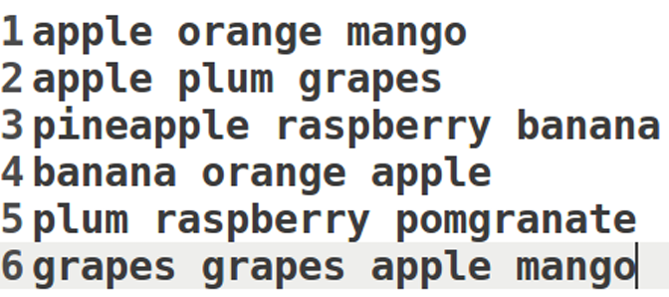
Write a program using Hadoop that counts number of occurrences of words in a file.

Slide 11
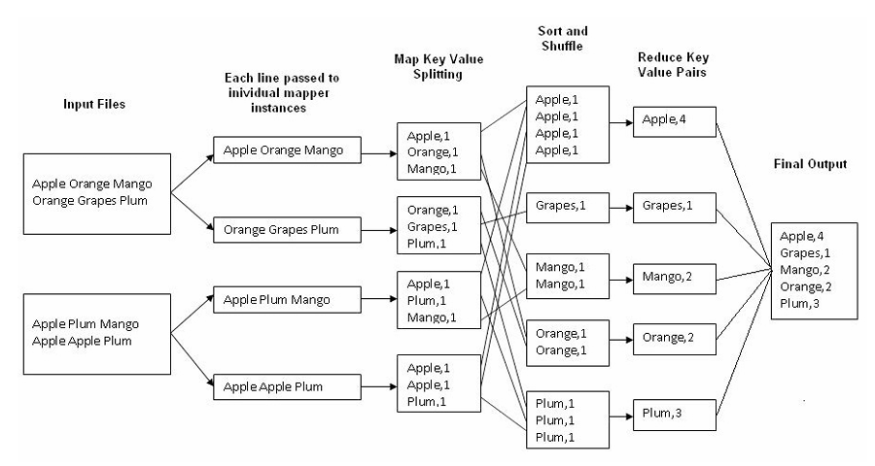
The MapReduce Framework for Word Count

Slide 12
Terminology
Mapper - Mapper maps the input key/value pairs to a set of intermediate key/value pair.
NamedNode - Node that manages the Hadoop Distributed File System (HDFS).
DataNode - Node where data is presented in advance before any processing takes place.
MasterNode - Node where JobTracker runs and which accepts job requests from clients.
SlaveNode - Node where Map and Reduce program runs.
JobTracker - Schedules jobs and tracks the assign jobs to Task tracker.
Task Tracker - Tracks the task and reports status to JobTracker.
Job - A program is an execution of a Mapper and Reducer across a dataset.
Task - An execution of a Mapper or a Reducer on a slice of data.

Slide 13
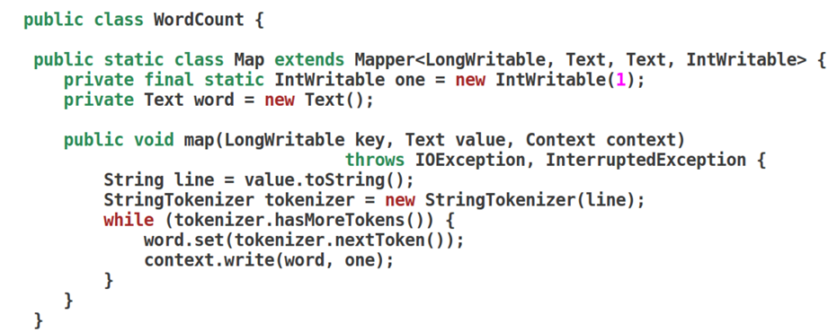
Mapper

Slide 14
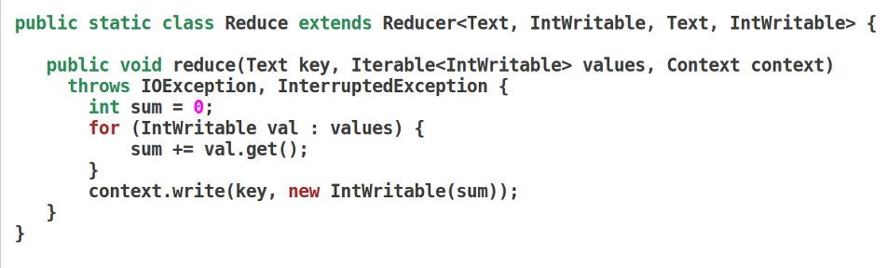
Reducer

Slide 15
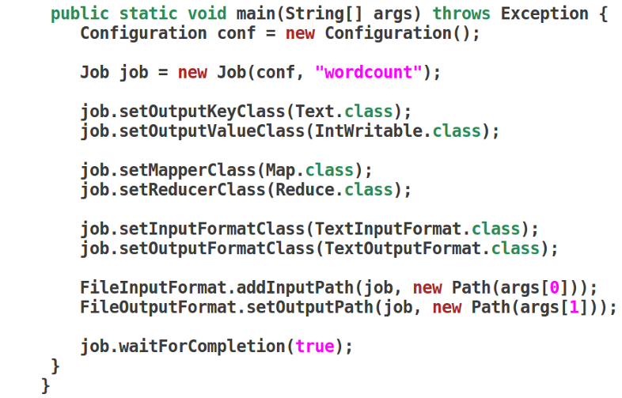
Reducer

Slide 16
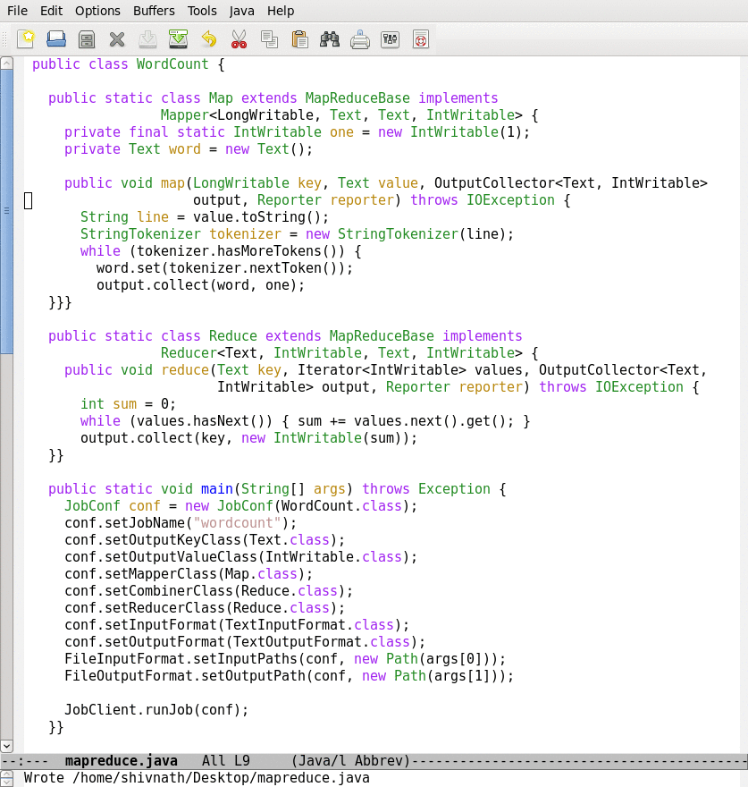
Lifecycle of a MapReduce Job
Map function
Reduce function
Run this program as a
MapReduce job

Slide 17
Compilation and Execution
• Let us assume we are in the home directory of a Hadoop user (e.g. /home/StudentName).
• Follow the steps given below to compile and execute the above program.
• Step 1
– The following command is to create a directory to store the compiled java classes.
– $ mkdir word

Slide 18
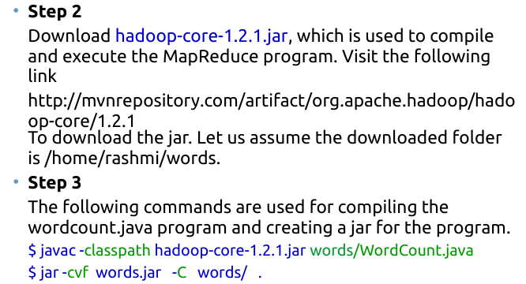
Compilation and Execution

Slide 19
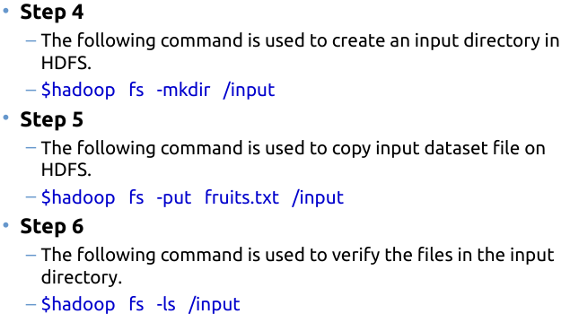
Compilation and Execution

Slide 20
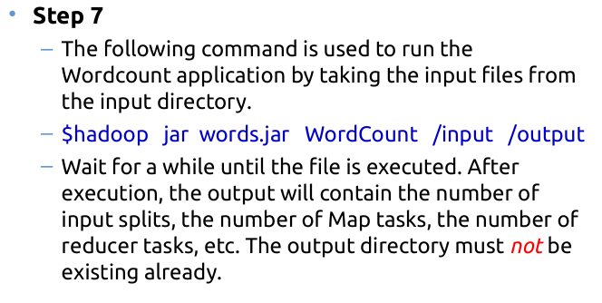
Compilation and Execution

Slide 21
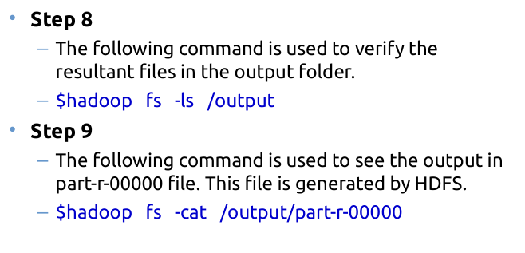
Compilation and Execution

Slide 22
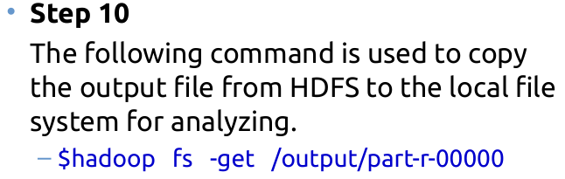
Compilation and Execution

Slide 23
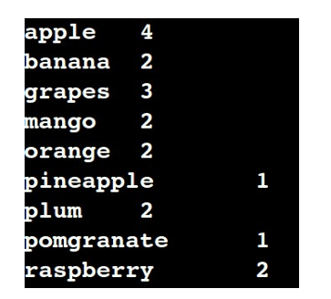
Output

