Slide 1


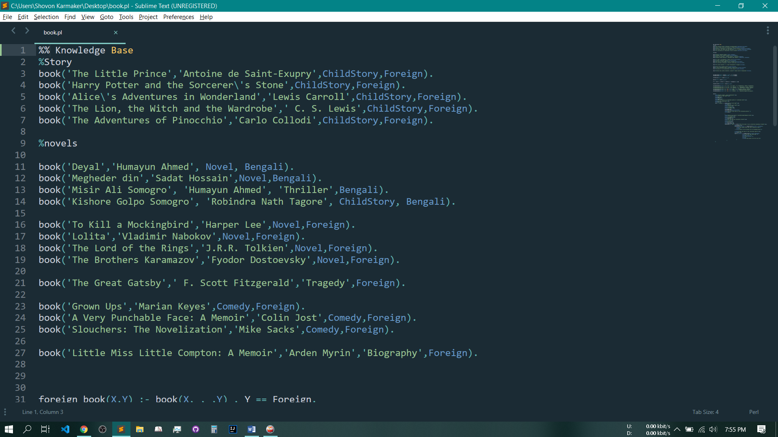
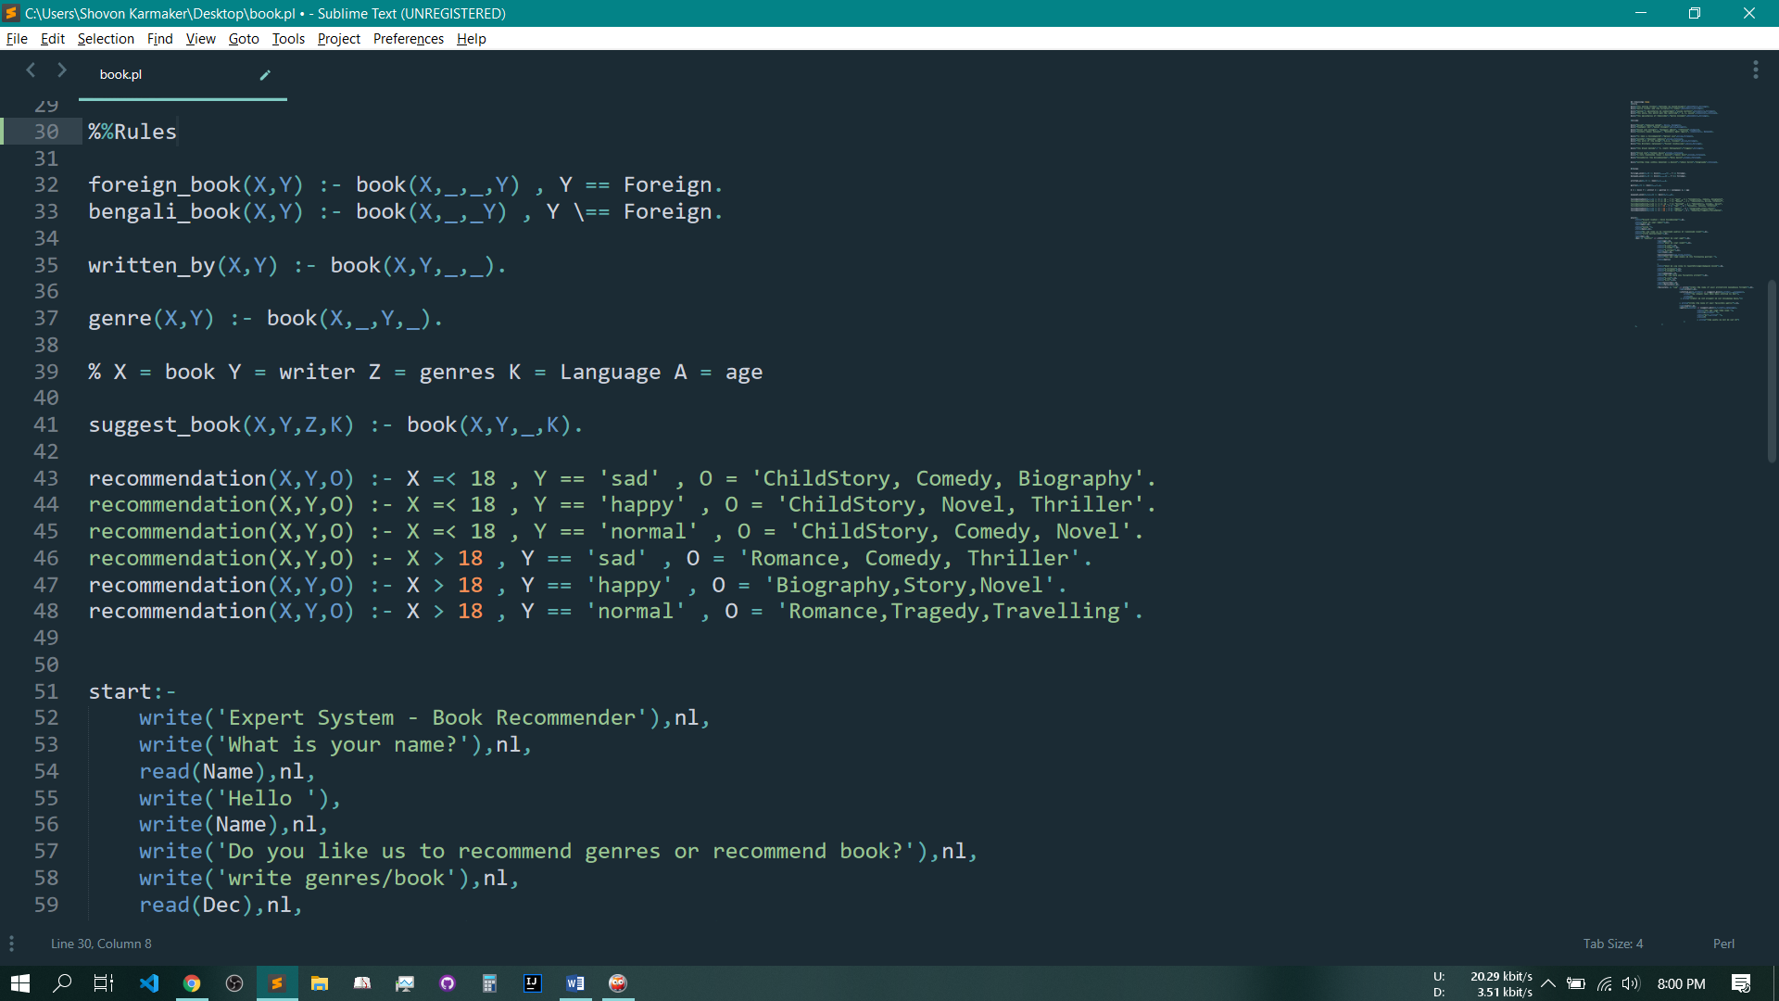
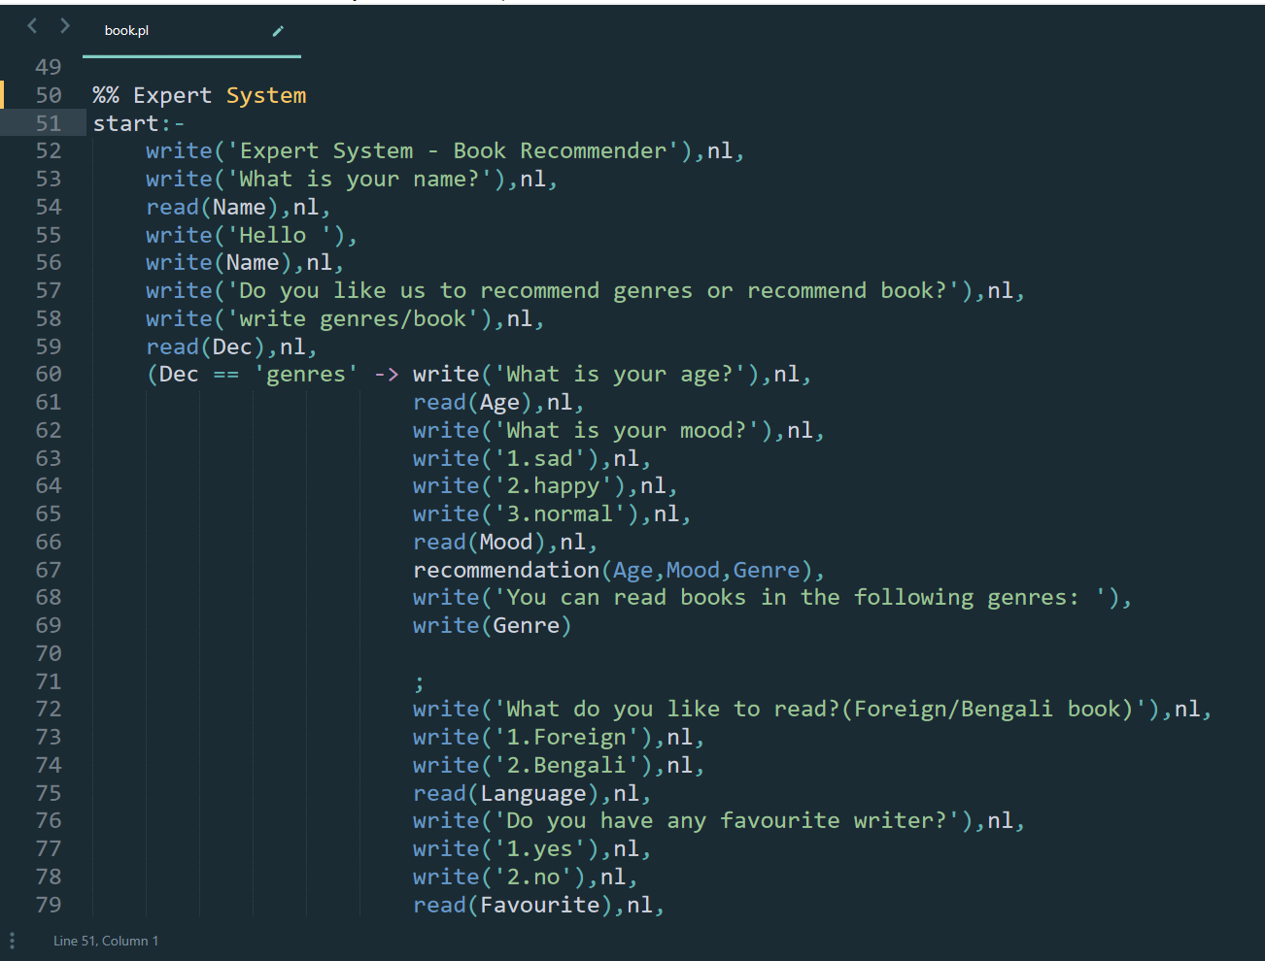



Book Recommendation System
Shovon Karmaker
University of Chittagong
Introduction
Design
Methodology
In our current world, we have lots of kinds of recommendation system like food, cloth, etc.
Every system utilizes the user data and generates proper response.
In order to process such huge amount of data we need expert systems which can learn from user behavior. Now-a-days AI is everywhere.
So to familiarize ourselves to the state of the art of AI we used logical programming language like prolog to develop our project.
In this part, the system recommends book based on the language of the book and the writer’s name of the book.
If the writer’s name is not in the knowledge base then the system shows that the name is not in the knowledge base.
There is another part in this system. This part recommends book based on the language and genre of the book.
The system is divided into three parts.
Knowledge Base
Rules
Expert System
Knowledge Base: It contains facts about the system.
Rules: It contains the conditional rules of the system.
Expert System: It is the main interactive system that interact with the user
Design
Figure 4 : Code of the system
The Book Recommendation System is designed into two parts. In one part, the system recommend genres based on the age and mood of the user.
If a user is below 18 years the expert system will suggest Child Story to him.
Another part of our system is to recommend books to the user. The system can recommend books using genres or the book’s writer.
Figure 4 : Code of the system
Figure 2 : Snapshot of the system
Figure 5 : Code of the system
Conclusions
The objective of this project is to build an expert system that can recommend books depending on small number of factors.
In future, we may build a robust system depending on a large number of factors.
Figure 1 : Snapshot of the system
Figure 3 : Snapshot of the system

