Slide 1

Predicting Injury Severity in New York City Car Accidents: An Analysis of Factors Impacting Crash Severity Using Machine Learning by Md Mahamudul Hasan Khan CISC 602 Narasimhaswamy Banavara, Ph.D. May 09, 2023

Slide 2
Introduction
The problem of car accidents in New York City
The importance of predicting injury severity
The goal of the study: Identifying key factors and using machine learning to predict accident severity

Slide 3
Dataset and Preprocessing
Data source: New York City traffic accident data
Steps taken in preprocessing the data:
Data cleansing
Transformation
Feature engineering

Slide 4
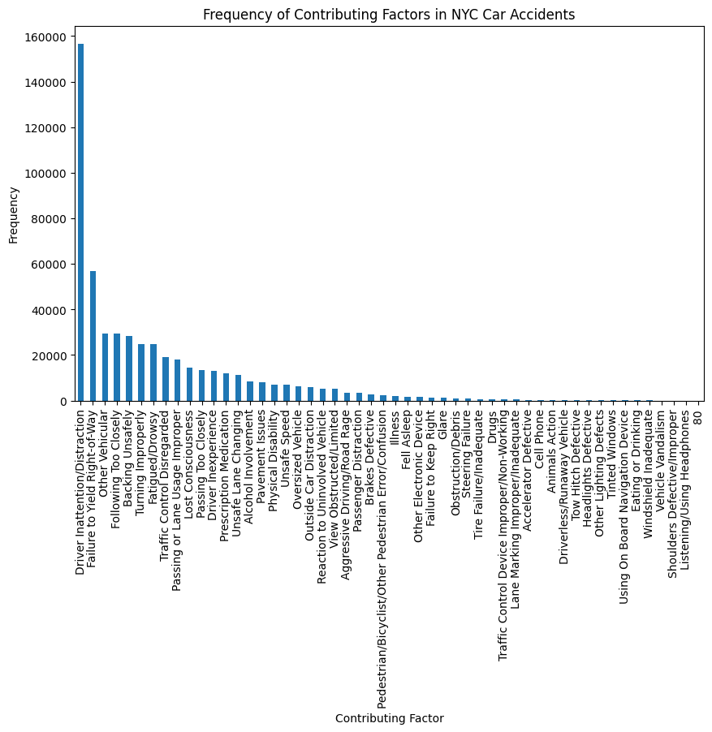
Frequency of Contributing Factors in NYC Car Accidents

Slide 5
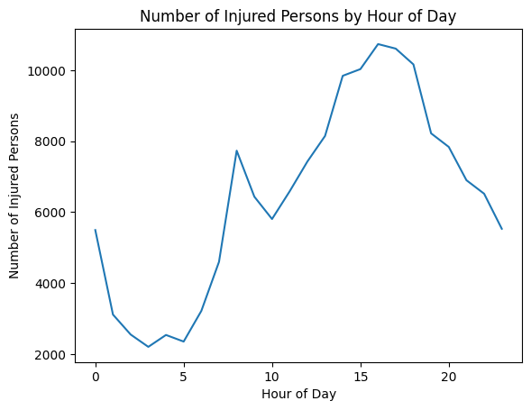
EDA - Number of Injured Persons by Hour of Day

Slide 6
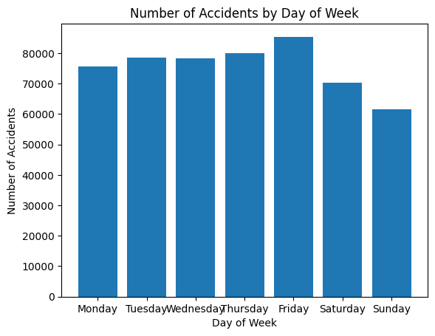
EDA - Number of Accidents by Day of Week

Slide 7
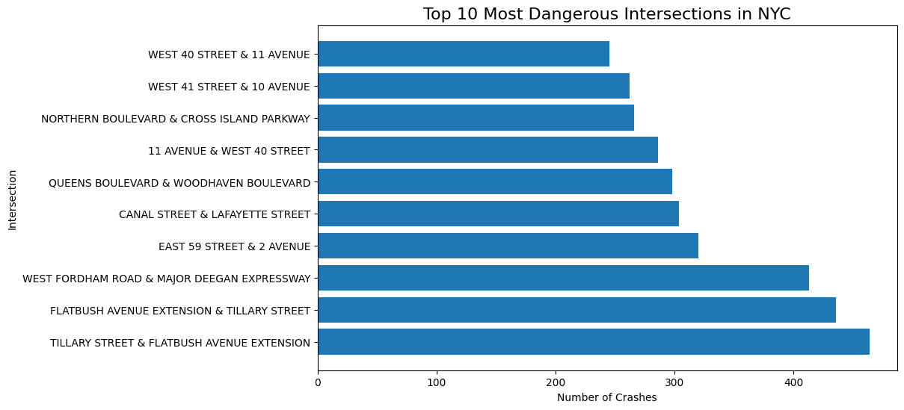
EDA - Top 10 Most Dangerous Intersections in NYC

Slide 8
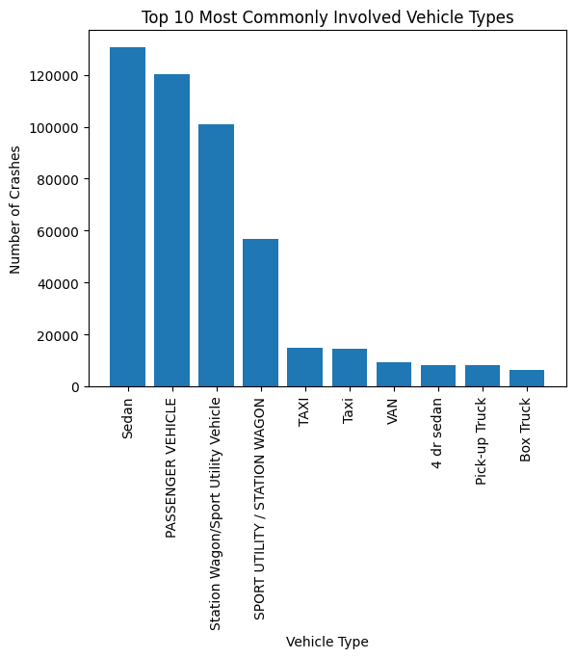
EDA - Top 10 Most Commonly Involved Vehicle Types

Slide 9
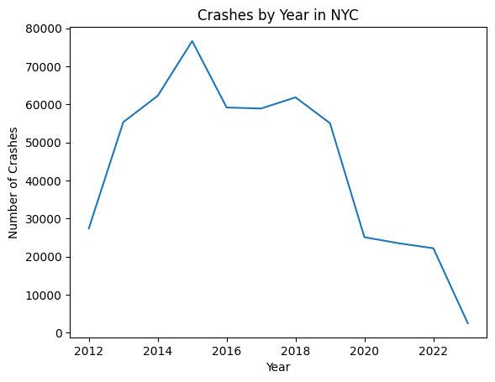
EDA - Crashes by Year in NYC

Slide 10
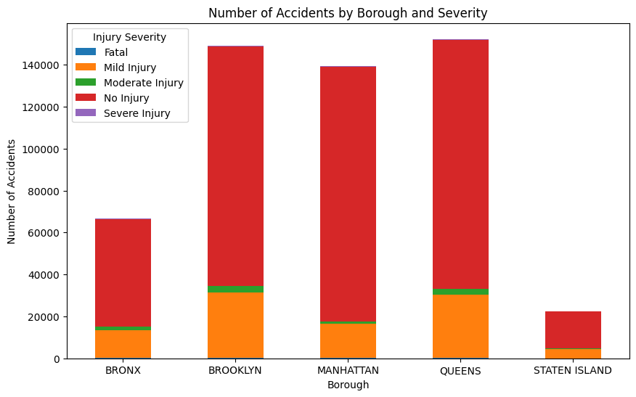
EDA - Number of Accidents by Borough and Severity

Slide 11
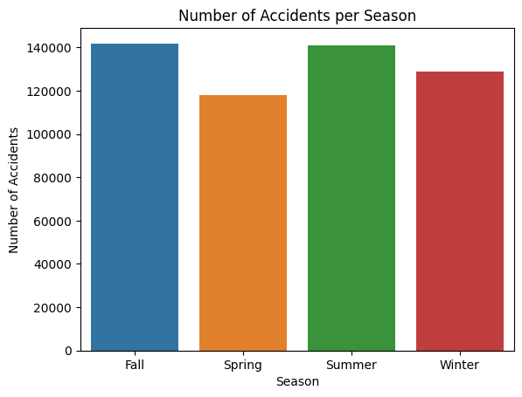
EDA - Number of Accidents In every Season

Slide 12
Machine Learning Models
Four machine learning models used:
Decision Tree Classifier
Random Forest Classifier
Logistic Regression
Multilayer Perceptron (MLP) Classifier

Slide 13
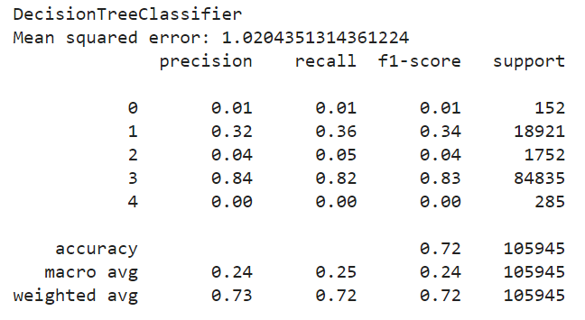
Model Comparison Decision Tree classifier

Slide 14
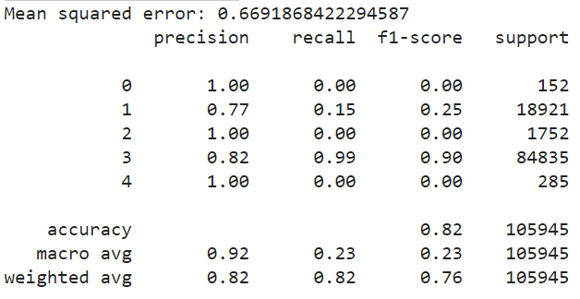
Model Comparison Random Forest Classifier

Slide 15
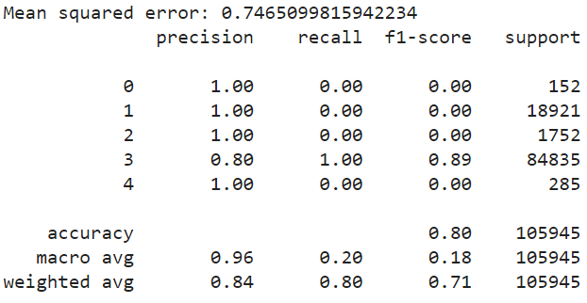
Model Comparison Logistic Regression

Slide 16
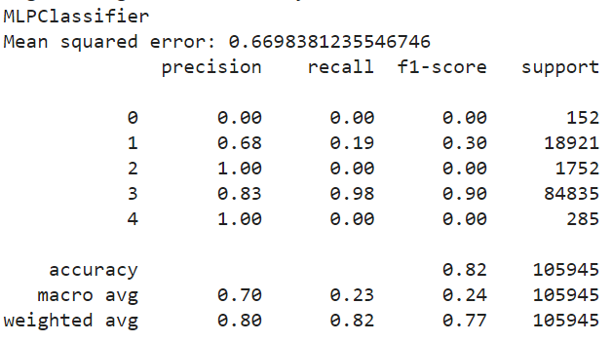
Model Comparison MLP Classifier

Slide 17
Conclusion
The main findings of the study
The MLP Classifier is the most suitable model for predicting accident severity using the given dataset

Slide 18
Possible Solutions
Potential solutions to address traffic congestion and reduce accident rates in New York City:
Promoting remote work policies
Staggering the start times of schools and businesses
Encouraging and supporting the adoption of autonomous vehicles

Slide 19
Future Work
Possible avenues for future research:
Examining road accident data from various countries
Incorporating more detailed information about drivers and their vehicles
Investigating psychological aspects of drivers and their influence on driving behaviors

Slide 20

Questions

